Slide 1
Lesson 86
oa, ow, oe /ō/

Slide 2
Notes:
ufliteracy.org

Slide 4
Lesson 86
oa, ow, oe /ō/

Slide 6
Notes:
See UFLI Foundations lesson plan Step 1 for phonemic awareness activity.

Slide 8
Notes:
See UFLI Foundations lesson plan Step 2 for student phoneme responses.

Slide 9
ee

Slide 10
ea

Slide 11
ey

Slide 12
ai

Slide 13
ay

Slide 14
ir

Slide 15
ur

Slide 16
er

Slide 17
or

Slide 18
ore

Slide 19
ar

Slide 20
y

Slide 21
dge

Slide 22
g

Slide 23
tch

Slide 24
ch

Slide 25
a

Slide 26
i

Slide 27
o

Slide 28
e

Slide 29
u

Slide 31
Notes:
See UFLI Foundations lesson plan Step 3 for auditory drill activity.

Slide 32
Notes:
No slides needed for auditory drill.

Slide 34
Notes:
See UFLI Foundations lesson plan Step 4 for blending drill word chain and grid.
Visit ufliteracy.org to access the Blending Board app.

Slide 36
Notes:
See UFLI Foundations lesson plan Step 5 for recommended teacher language and activities to introduce the new concept.

Slide 37
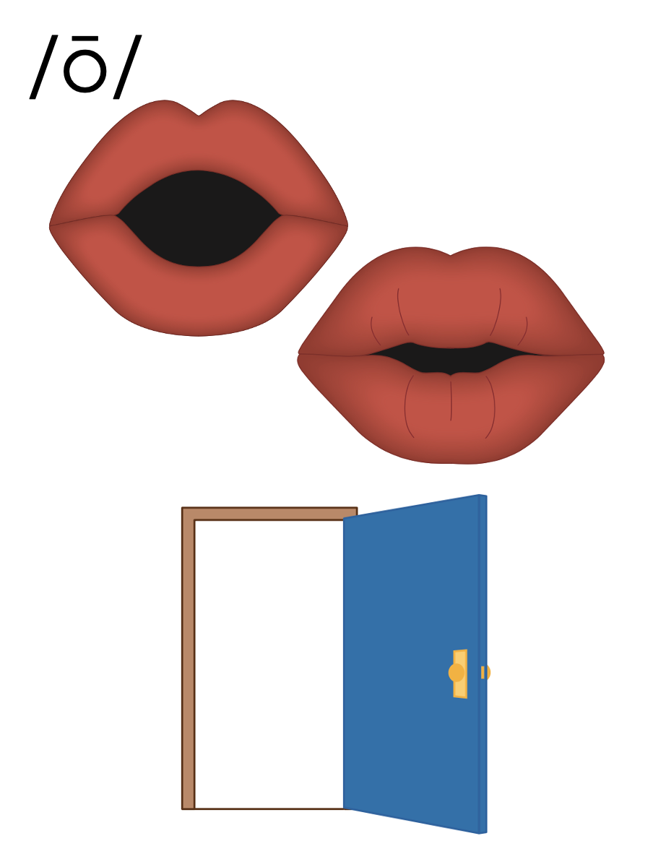

Slide 38
o_e
b
o
n
e

Slide 39
o
Open Syllable
cozy

Slide 40
Vowel Team
2 or more letters that work together to make 1 sound.

Slide 41
oa

Slide 42
boat
road
oa

Slide 43
oat
oak
oa

Slide 44
ow

Slide 45
show
grow
ow

Slide 46
bowl
flown
ow

Slide 47
oe

Slide 48
toe
oe

Slide 49
o_e
o
oa
ow
oe

Slide 50
Notes:
Handwriting paper for letter formation practice. Use as needed.
See UFLI Foundations manual for more information about letter formation.

Slide 51
road
grow
toe
window

Slide 52
boat
toad
coast
coach
low
show

Slide 53
own
grown
foe
yellow

Slide 54
Notes:
See UFLI Foundations lesson plan Step 5 for words to spell.
Handwriting paper to model spelling.

Slide 55
Notes:
See UFLI Foundations lesson plan Step 5 for words to spell.
Handwriting paper for guided spelling practice.

Slide 57
Insert brief reinforcement activity and/or transition to next part of reading block.

Slide 58
Lesson 86
oa, ow, oe /ō/

Slide 60
New Concept Review
Notes:
See UFLI Foundations lesson plan Step 5 for recommended teacher language and activities to review the new concept.

Slide 61
Vowel Team
2 or more letters that work together to make 1 sound.

Slide 62
oa

Slide 63
boat
road
oa

Slide 64
oat
oak
oa

Slide 65
ow

Slide 66
show
grow
ow

Slide 67
bowl
flown
ow

Slide 68
oe

Slide 69
toe
oe

Slide 70
o_e
o
oa
ow
oe

Slide 71
road
grow
yellow
toe

Slide 73
Notes:
See UFLI Foundations lesson plan Step 6 for word work activity.
Visit ufliteracy.org to access the Word Work Mat apps.

Slide 75
Notes:
See UFLI Foundations lesson plan Step 7 for irregular word activities.
The white rectangle under each word may be used in editing mode. Cover the heart and square icons then reveal them one at a time during instruction.

Slide 76
Notes:
See UFLI Foundations manual for more information about reviewing irregular words.

Slide 77
today
Notes:
Lesson 84+
O represents the /ū/ sound or the /ə/ sound depending on stress and dialect.
The white rectangle under the word may be used in editing mode. Cover the heart and square icons then reveal them one at a time during instruction.

Slide 78
very
Notes:
Lesson 84+
ER represents the /air/ sound.
The white rectangle under the word may be used in editing mode. Cover the heart and square icons then reveal them one at a time during instruction.

Slide 79
above
Notes:
Lesson 85+
A represents the /ə/ or the /ŭ/ sound, depending on stress.
O represents the /ŭ/ sound.
The final E is silent but does not follow the long vowel VCe pattern. In this case, the silent E is there because English words do not end in V.
The white rectangle under the word may be used in editing mode. Cover the heart and square icons then reveal them one at a time during instruction.

Slide 80
among
Notes:
Lesson 85+
A represents the /ə/ or the /ŭ/ sound, depending on stress.
O represents the /ŭ/ sound.
The white rectangle under the word may be used in editing mode. Cover the heart and square icons then reveal them one at a time during instruction.

Slide 81
Notes:
Handwriting paper for irregular word spelling practice. Use as needed.
See UFLI Foundations manual for more information about reviewing irregular words.

Slide 82
Teach
Notes:
The orange star indicates these are new irregular words that need to be introduced.
See UFLI Foundations manual for more information about teaching irregular words.

Slide 83
again
Notes:
Lesson 86+
The first A represents the /ə/ or the /ŭ/ sound, depending on stress.
AI represents the /ĕ/ or /ĭ/ sound, depending on dialect.
In some dialects, the AI in again is pronounced /ā/. In this case, this part of the word would not be irregular.
The white rectangle under the word may be used in editing mode. Cover the heart and square icons then reveal them one at a time during instruction.

Slide 84
against
Notes:
Lesson 86+
The first A represents the /ə/ or the /ŭ/ sound, depending on stress.
AI represents the /ĕ/ or /ĭ/ sound, depending on dialect.
In some dialects, the AI in against is pronounced /ā/. In this case, this part of the word would not be irregular.
The white rectangle under the word may be used in editing mode. Cover the heart and square icons then reveal them one at a time during instruction.

Slide 85
Notes:
Handwriting paper for irregular word spelling practice. Use as needed.
See UFLI Foundations manual for more information about teaching irregular words.

Slide 87
Notes:
See UFLI Foundations lesson plan Step 8 for connected text activities.

Slide 88
He will row the boat to the coast again.

Slide 89
Take your coat with you, it is very cold today.

Slide 90
The coach asks Joe to play a game against Tom.

Slide 91
Notes:
See UFLI Foundations lesson plan Step 8 for sentences to write.

Slide 92
Notes:
The UFLI Foundations decodable text is provided here. See UFLI Foundations decodable text guide for additional text options.

Slide 93
A Trip to the Coast
Harvey owns a big yellow boat. Every summer, he takes the boat on a trip to the coast. This time, he wants to bring his friends, Layla and Joe, with him. There is just one problem, Layla can not swim! Layla must be able to swim if she wants to go on the boat.

Slide 94
Layla started swim lessons to grow her skills. She even got a swim coach to teach her. She started slow, but Joe helped her get better. After four weeks of lessons, Layla could swim! Now she could paddle, kick, and float all by herself.

Slide 95
Layla showed Harvey her skills. Harvey was thrilled! The next day, Harvey and Layla and Joe set sail to the coast.

Slide 97
Insert brief reinforcement activity and/or transition to next part of reading block.

