Slide 1
Lesson 85
ee, ea, ey /ē/

Slide 2
Notes:
ufliteracy.org

Slide 4
Lesson 85
ee, ea, ey /ē/

Slide 6
Notes:
See UFLI Foundations lesson plan Step 1 for phonemic awareness activity.

Slide 8
Notes:
See UFLI Foundations lesson plan Step 2 for student phoneme responses.

Slide 9
ai

Slide 10
ay

Slide 11
ir

Slide 12
ur

Slide 13
er

Slide 14
or

Slide 15
ore

Slide 16
ar

Slide 17
y

Slide 18
dge

Slide 19
g

Slide 20
tch

Slide 21
ch

Slide 22
c

Slide 23
a

Slide 24
i

Slide 25
o

Slide 26
e

Slide 27
u

Slide 29
Notes:
See UFLI Foundations lesson plan Step 3 for auditory drill activity.

Slide 30
Notes:
No slides needed for auditory drill.

Slide 32
Notes:
See UFLI Foundations lesson plan Step 4 for blending drill word chain and grid.
Visit ufliteracy.org to access the Blending Board app.

Slide 34
Notes:
See UFLI Foundations lesson plan Step 5 for recommended teacher language and activities to introduce the new concept.

Slide 35
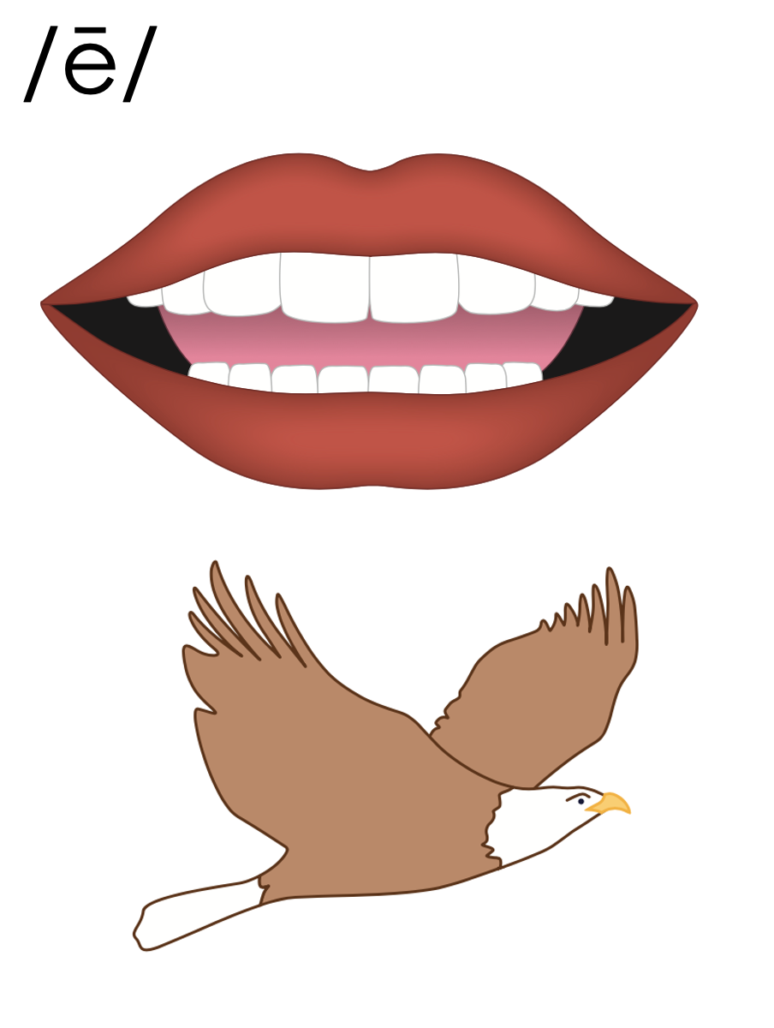

Slide 36
e_e
th
e
m
e

Slide 37
e
Open Syllable
began

Slide 38
y
y
1st syllable
2nd syllable
puppy

Slide 39
Vowel Team
2 or more letters that work together to make 1 sound.

Slide 40
ee

Slide 41
need
feet
ee

Slide 42
see
tree
ee

Slide 43
eel
ee

Slide 44
ea

Slide 45
mean
team
ea

Slide 46
eat
each
ea

Slide 47
tea
flea
ea

Slide 48
ey

Slide 49
money
turkey
ey
1st syllable
2nd syllable

Slide 50
e_e
e
y
ee
ea
ey

Slide 51
Notes:
Handwriting paper for letter formation practice. Use as needed.
See UFLI Foundations manual for more information about letter formation.

Slide 52
keep
heat
monkey

Slide 53
seem
need
tree
sleep
three
eat

Slide 54
sea
each
read
leave
clean
turkey

Slide 55
hockey

Slide 56
Notes:
See UFLI Foundations lesson plan Step 5 for words to spell.
Handwriting paper to model spelling.

Slide 57
Notes:
See UFLI Foundations lesson plan Step 5 for words to spell.
Handwriting paper for guided spelling practice.

Slide 59
Insert brief reinforcement activity and/or transition to next part of reading block.

Slide 60
Lesson 85
ee, ea, ey /ē/

Slide 62
New Concept Review
Notes:
See UFLI Foundations lesson plan Step 5 for recommended teacher language and activities to review the new concept.

Slide 63
Vowel Team
2 or more letters that work together to make 1 sound.

Slide 64
ee

Slide 65
need
feet
ee

Slide 66
see
tree
ee

Slide 67
eel
ee

Slide 68
ea

Slide 69
mean
team
ea

Slide 70
eat
each
ea

Slide 71
tea
flea
ea

Slide 72
ey

Slide 73
money
turkey
ey
1st syllable
2nd syllable

Slide 74
e_e
e
y
ee
ea
ey

Slide 75
need
green
each
monkey

Slide 77
Notes:
See UFLI Foundations lesson plan Step 6 for word work activity.
Visit ufliteracy.org to access the Word Work Mat apps.

Slide 79
Notes:
See UFLI Foundations lesson plan Step 7 for irregular word activities.
The white rectangle under each word may be used in editing mode. Cover the heart and square icons then reveal them one at a time during instruction.

Slide 80
Notes:
See UFLI Foundations manual for more information about reviewing irregular words.

Slide 81
father
Notes:
Lessons 83-93
*Temporarily irregular
A represents the /ŏ/ sound. This is a low-frequency concept that has not been introduced yet.
The white rectangle under the word may be used in editing mode. Cover the heart and square icons then reveal them one at a time during instruction.

Slide 82
water
Notes:
Lessons 83-93
*Temporarily irregular
A represents the /ŏ/ sound. This is a low-frequency concept that has not been introduced yet.
In some dialects, A represents the /ŭ/ sound. In this case water would be a permanently irregular word.
T may be pronounced /d/ depending on dialect.
The white rectangle under the word may be used in editing mode. Cover the heart and square icons then reveal them one at a time during instruction.

Slide 83
today
Notes:
Lesson 84+
O represents the /ū/ sound or the /ə/ sound depending on stress and dialect.
The white rectangle under the word may be used in editing mode. Cover the heart and square icons then reveal them one at a time during instruction.

Slide 84
very
Notes:
Lesson 84+
ER represents the /air/ sound.
The white rectangle under the word may be used in editing mode. Cover the heart and square icons then reveal them one at a time during instruction.

Slide 85
Notes:
Handwriting paper for irregular word spelling practice. Use as needed.
See UFLI Foundations manual for more information about reviewing irregular words.

Slide 86
Teach
Notes:
The orange star indicates these are new irregular words that need to be introduced.
See UFLI Foundations manual for more information about teaching irregular words.

Slide 87
above
Notes:
Lesson 85+
A represents the /ə/ or the /ŭ/ sound, depending on stress.
O represents the /ŭ/ sound.
The final E is silent but does not follow the long vowel VCe pattern. In this case, the silent E is there because English words do not end in V.
The white rectangle under the word may be used in editing mode. Cover the heart and square icons then reveal them one at a time during instruction.

Slide 88
among
Notes:
Lesson 85+
A represents the /ə/ or the /ŭ/ sound, depending on stress.
O represents the /ŭ/ sound.
The white rectangle under the word may be used in editing mode. Cover the heart and square icons then reveal them one at a time during instruction.

Slide 89
Notes:
Handwriting paper for irregular word spelling practice. Use as needed.
See UFLI Foundations manual for more information about teaching irregular words.

Slide 91
Notes:
See UFLI Foundations lesson plan Step 8 for connected text activities.

Slide 92
Can I please eat kidney beans with rice?

Slide 93
They put the green beans above the apples.

Slide 94
The queen was hidden among the forty bees in her hive.

Slide 95
Notes:
See UFLI Foundations lesson plan Step 8 for sentences to write.

Slide 96
Notes:
The UFLI Foundations decodable text is provided here. See UFLI Foundations decodable text guide for additional text options.

Slide 97
Deep in the Green Forest
Once upon a time, there was a fox who lived in a valley. She spent her days deep in the green forest. Each day, she would wake up from her sleep and greet the forest animals. She would say hello to the animals in the trees above her. She would also say hello to the animals who rested by the stream.

Slide 98
One morning, the peace of the forest was broken by a horrid scream! The fox looked up to see where the scream came from. She saw a fallen tree. She peeked in and came upon a monkey. The monkey was stuck in the fallen tree. “Can you please help me get free?” pleaded the monkey. “I will try my best,” the fox said.

Slide 99
The fox pushed very hard and in the end the monkey was freed! “Thank you so much,” the monkey said as he leaped into another tree. As the fox walked back to the valley, she beamed with pride for helping the monkey.

Slide 101
Insert brief reinforcement activity and/or transition to next part of reading block.

