Slide 1
Lesson 84
ai, ay/ā/

Slide 2
Notes:
ufliteracy.org

Slide 4
Lesson 84
ai, ay/ā/

Slide 6
Notes:
See UFLI Foundations lesson plan Step 1 for phonemic awareness activity.

Slide 8
Notes:
See UFLI Foundations lesson plan Step 2 for student phoneme responses.

Slide 9
ir

Slide 10
ur

Slide 11
er

Slide 12
or

Slide 13
ore

Slide 14
ar

Slide 15
y

Slide 16
dge

Slide 17
g

Slide 18
tch

Slide 19
ch

Slide 20
c

Slide 21
a

Slide 22
i

Slide 23
o

Slide 24
e

Slide 25
u

Slide 26
nk

Slide 27
ng

Slide 29
Notes:
See UFLI Foundations lesson plan Step 3 for auditory drill activity.

Slide 30
Notes:
No slides needed for auditory drill.

Slide 32
Notes:
See UFLI Foundations lesson plan Step 4 for blending drill word chain and grid.
Visit ufliteracy.org to access the Blending Board app.

Slide 34
Notes:
See UFLI Foundations lesson plan Step 5 for recommended teacher language and activities to introduce the new concept.

Slide 35
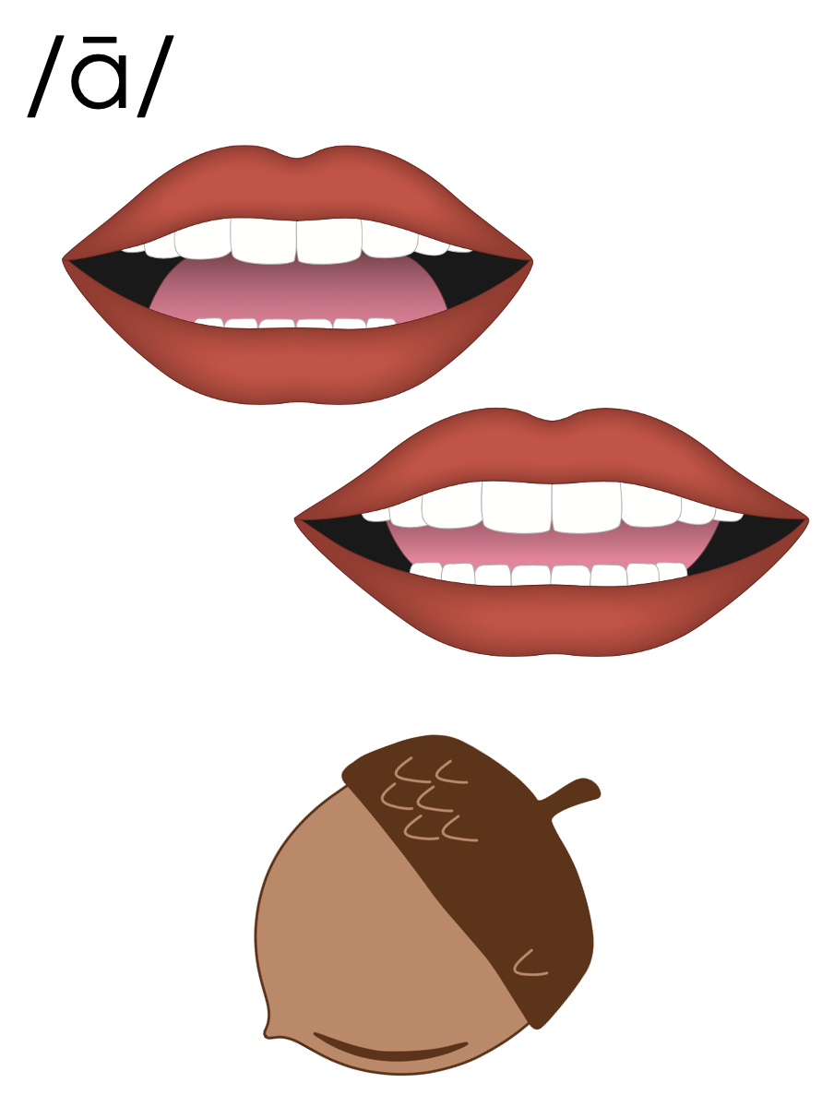

Slide 36
a_e
c
a
k
e

Slide 37
a
Open Syllable
baby

Slide 38
Vowel Team
2 or more letters that work together to make 1 sound.

Slide 39
ai

Slide 40
bait
mail
ai

Slide 41
aim
aid
ai

Slide 42
ay

Slide 43
may
say
ay

Slide 44
a_e
a
ai
ay

Slide 45
Notes:
Handwriting paper for letter formation practice. Use as needed.
See UFLI Foundations manual for more information about letter formation.

Slide 46
rain
say
away

Slide 47
wait
main
paint
plain
way
may

Slide 48
gray
play
saying
Sunday

Slide 49
Notes:
See UFLI Foundations lesson plan Step 5 for words to spell.
Handwriting paper to model spelling.

Slide 50
Notes:
See UFLI Foundations lesson plan Step 5 for words to spell.
Handwriting paper for guided spelling practice.

Slide 52
Insert brief reinforcement activity and/or transition to next part of reading block.

Slide 53
Lesson 84
ai, ay/ā/

Slide 55
New Concept Review
Notes:
See UFLI Foundations lesson plan Step 5 for recommended teacher language and activities to review the new concept.

Slide 56
Vowel Team
2 or more letters that work together to make 1 sound.

Slide 57
ai

Slide 58
bait
mail
ai

Slide 59
aim
aid
ai

Slide 60
ay

Slide 61
may
say
ay

Slide 62
a_e
a
ai
ay

Slide 63
wait
paint
say
away

Slide 65
Notes:
See UFLI Foundations lesson plan Step 6 for word work activity.
Visit ufliteracy.org to access the Word Work Mat apps.

Slide 67
Notes:
See UFLI Foundations lesson plan Step 7 for irregular word activities.
The white rectangle under each word may be used in editing mode. Cover the heart and square icons then reveal them one at a time during instruction.

Slide 68
Notes:
See UFLI Foundations manual for more information about reviewing irregular words.

Slide 69
mother
Notes:
Lesson 81+
O represents the /ŭ/ sound.
The white rectangle under the word may be used in editing mode. Cover the heart and square icons then reveal them one at a time during instruction.

Slide 70
brother
Notes:
Lesson 81+
O represents the /ŭ/ sound.
The white rectangle under the word may be used in editing mode. Cover the heart and square icons then reveal them one at a time during instruction.

Slide 71
father
Notes:
Lessons 83-93
*Temporarily irregular
A represents the /ŏ/ sound. This is a low-frequency concept that has not been introduced yet.
The white rectangle under the word may be used in editing mode. Cover the heart and square icons then reveal them one at a time during instruction.

Slide 72
water
Notes:
Lessons 83-93
*Temporarily irregular
A represents the /ŏ/ sound. This is a low-frequency concept that has not been introduced yet.
In some dialects, A represents the /ŭ/ sound. In this case water would be a permanently irregular word.
T may be pronounced /d/ depending on dialect.
The white rectangle under the word may be used in editing mode. Cover the heart and square icons then reveal them one at a time during instruction.

Slide 73
Notes:
Handwriting paper for irregular word spelling practice. Use as needed.
See UFLI Foundations manual for more information about reviewing irregular words.

Slide 74
Teach
Notes:
The orange star indicates these are new irregular words that need to be introduced.
See UFLI Foundations manual for more information about teaching irregular words.

Slide 75
today
Notes:
Lesson 84+
O represents the /ū/ sound or the /ə/ sound depending on stress and dialect.
The white rectangle under the word may be used in editing mode. Cover the heart and square icons then reveal them one at a time during instruction.

Slide 76
very
Notes:
Lesson 84+
ER represents the /air/ sound.
The white rectangle under the word may be used in editing mode. Cover the heart and square icons then reveal them one at a time during instruction.

Slide 77
Notes:
Handwriting paper for irregular word spelling practice. Use as needed.
See UFLI Foundations manual for more information about teaching irregular words.

Slide 79
Notes:
See UFLI Foundations lesson plan Step 8 for connected text activities.

Slide 80
Their friend will stay here today.

Slide 81
We will wait at the main gate today.

Slide 82
Can you water the plants if it doesn’t rain?

Slide 83
Notes:
See UFLI Foundations lesson plan Step 8 for sentences to write.

Slide 84
Notes:
The UFLI Foundations decodable text is provided here. See UFLI Foundations decodable text guide for additional text options.

Slide 85
Sunday Fun
On Sundays, Gail visits her brother at his farm. Gail loves to go to the farm because there is so much to do. She starts the day in the garden. If it did not rain, she sprays the plants with water.

Slide 86
Then, Gail and her brother walk on the trail from the garden to the pond. As they walk, Gail hunts for snail shells. When she finds shells, she tucks them in her pocket. She will paint them when she gets home.

Slide 87
At the pond, her brother likes to fish. He strings bait onto his fishing pole and waits for a bite. While they wait, Gail plays in the mud and clay.
At the end of the day, they walk back up the trail to go home. As they walk, they see the sun set and the day fade away.

Slide 89
Insert brief reinforcement activity and/or transition to next part of reading block.

