Slide 1
Lesson 83
R-Controlled Vowels
Review

Slide 2
Notes:
ufliteracy.org

Slide 4
Lesson 83
R-Controlled Vowels Review

Slide 6
Notes:
See UFLI Foundations lesson plan Step 1 for phonemic awareness activity.

Slide 8
Notes:
See UFLI Foundations lesson plan Step 2 for student phoneme responses.

Slide 9
ir

Slide 10
ur

Slide 11
er

Slide 12
or

Slide 13
ore

Slide 14
ar

Slide 15
y

Slide 16
dge

Slide 17
g

Slide 18
tch

Slide 19
ch

Slide 20
c

Slide 21
a

Slide 22
i

Slide 23
o

Slide 24
e

Slide 25
u

Slide 26
nk

Slide 27
ng

Slide 29
Notes:
See UFLI Foundations lesson plan Step 3 for auditory drill activity.

Slide 30
Notes:
No slides needed for auditory drill.

Slide 32
Notes:
See UFLI Foundations lesson plan Step 4 for blending drill word chain and grid.
Visit ufliteracy.org to access the Blending Board app.

Slide 34
Notes:
See UFLI Foundations lesson plan Step 5 for recommended teacher language and activities to introduce the new concept.

Slide 35
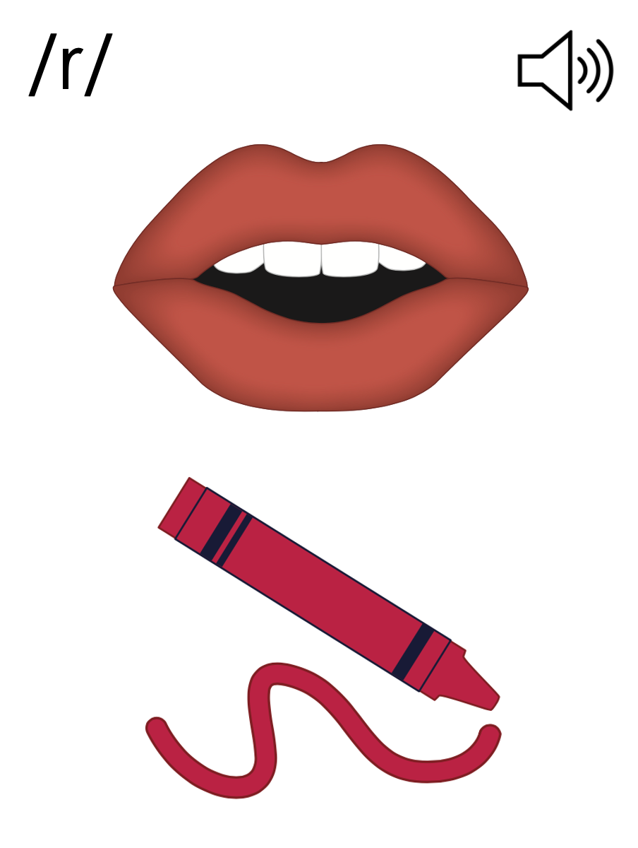

Slide 36
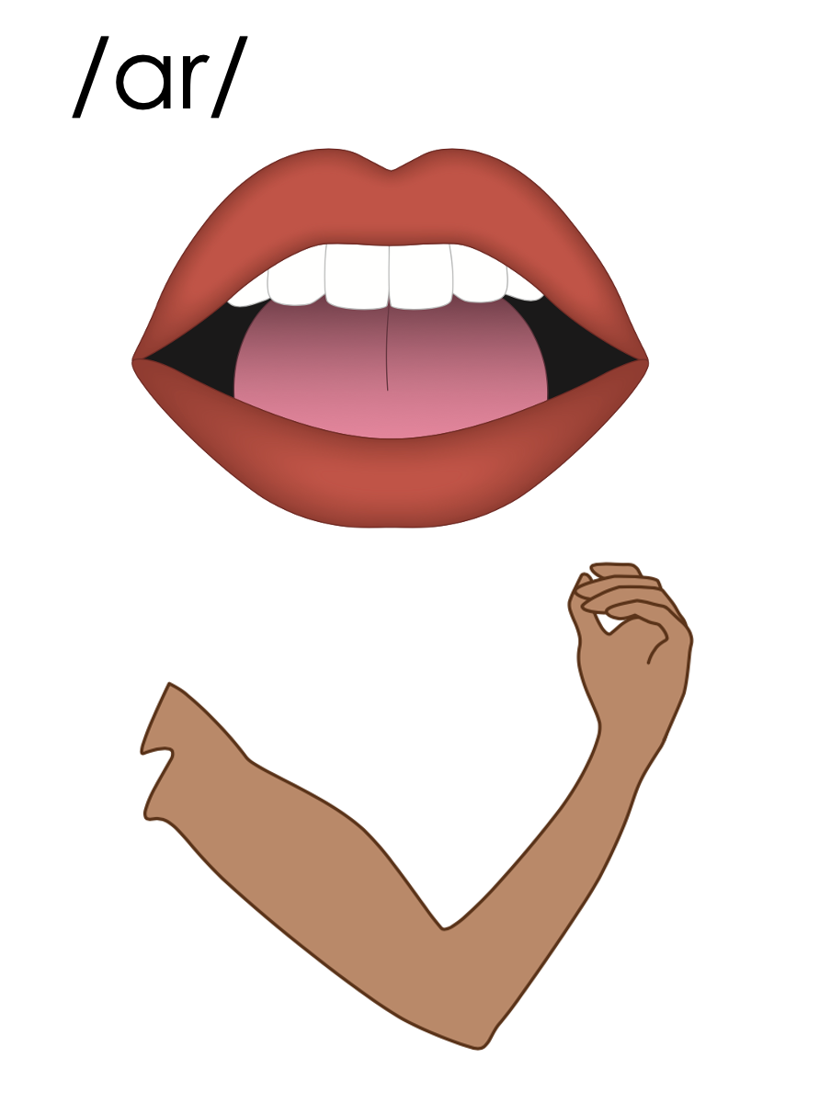
ar
park
far
arm

Slide 37
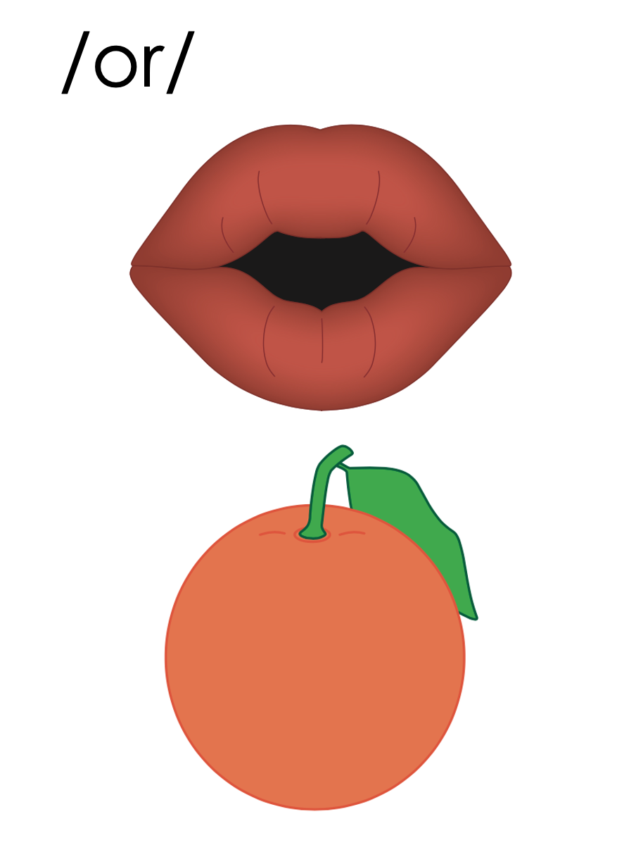

Slide 38
or
cord

Slide 39
ore
store

Slide 40
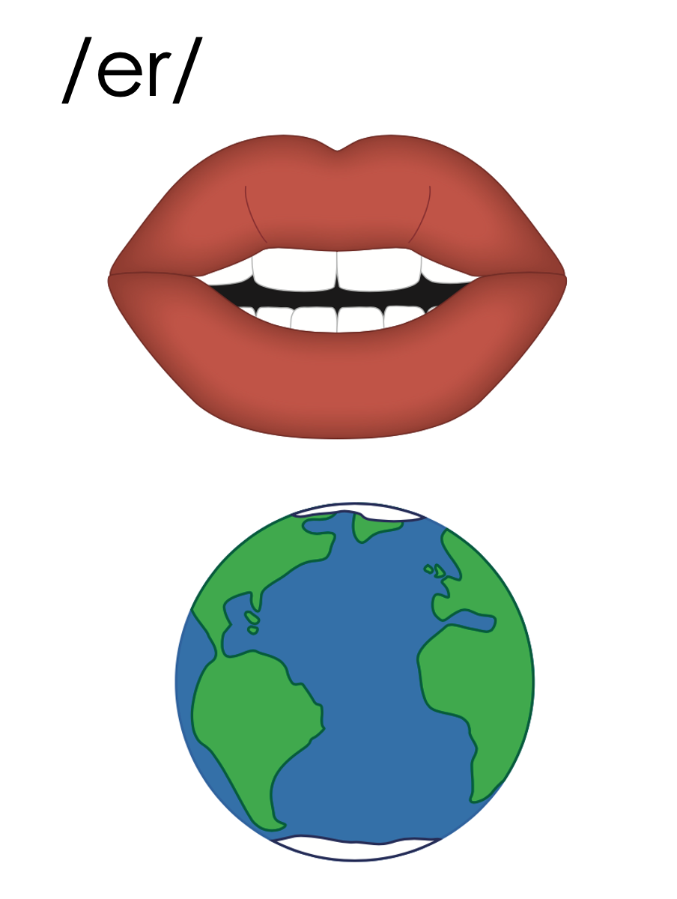
er
fern
ir
bird
ur
turn
work
w
or
world

Slide 41
ar
or
er
ore
ir
ur
or

Slide 42
Notes:
Handwriting paper for letter formation practice. Use as needed.
See UFLI Foundations manual for more information about letter formation.

Slide 43
starter

Slide 44
sharp
part
first
large
fern
perk

Slide 45
short
fork
third
merge
world
work

Slide 46
worthy
number
better
starter
sorter
dirty

Slide 47
Notes:
See UFLI Foundations lesson plan Step 5 for words to spell.
Handwriting paper to model spelling.

Slide 48
Notes:
See UFLI Foundations lesson plan Step 5 for words to spell.
Handwriting paper for guided spelling practice.

Slide 50
Insert brief reinforcement activity and/or transition to next part of reading block.

Slide 51
Lesson 83
R-Controlled Vowels Review

Slide 53
New Concept Review
Notes:
See UFLI Foundations lesson plan Step 5 for recommended teacher language and activities to review the new concept.

Slide 54
ar
park
far
arm

Slide 56
or
cord

Slide 57
ore
store

Slide 58
er
fern
ir
bird
ur
turn
work
w
or
world

Slide 59
ar
or
er
ore
ir
ur
or

Slide 60
start
work
bird

Slide 61
number
return

Slide 63
Notes:
See UFLI Foundations lesson plan Step 6 for word work activity.
Visit ufliteracy.org to access the Word Work Mat apps.

Slide 65
Notes:
See UFLI Foundations lesson plan Step 7 for irregular word activities.
The white rectangle under each word may be used in editing mode. Cover the heart and square icons then reveal them one at a time during instruction.

Slide 66
Notes:
See UFLI Foundations manual for more information about reviewing irregular words.

Slide 67
other
Notes:
Lesson 80+
O represents the /ŭ/ sound.
The white rectangle under the word may be used in editing mode. Cover the heart and square icons then reveal them one at a time during instruction.

Slide 68
another
Notes:
Lesson 80+
A represents the /ə/ sound or the /ŭ/ sound, depending on stress.
O represents the /ŭ/ sound.
The white rectangle under the word may be used in editing mode. Cover the heart and square icons then reveal them one at a time during instruction.

Slide 69
mother
Notes:
Lesson 81+
O represents the /ŭ/ sound.
The white rectangle under the word may be used in editing mode. Cover the heart and square icons then reveal them one at a time during instruction.

Slide 70
brother
Notes:
Lesson 81+
O represents the /ŭ/ sound.
The white rectangle under the word may be used in editing mode. Cover the heart and square icons then reveal them one at a time during instruction.

Slide 71
Notes:
Handwriting paper for irregular word spelling practice. Use as needed.
See UFLI Foundations manual for more information about reviewing irregular words.

Slide 72
Teach
Notes:
The orange star indicates these are new irregular words that need to be introduced.
See UFLI Foundations manual for more information about teaching irregular words.

Slide 73
father
Notes:
Lessons 83-93
*Temporarily irregular
A represents the /ŏ/ sound. This is a low-frequency concept that has not been introduced yet.
The white rectangle under the word may be used in editing mode. Cover the heart and square icons then reveal them one at a time during instruction.

Slide 74
water
Notes:
Lessons 83-93
*Temporarily irregular
A represents the /ŏ/ sound. This is a low-frequency concept that has not been introduced yet.
In some dialects, A represents the /ŭ/ sound. In this case water would be a permanently irregular word.
T may be pronounced /d/ depending on dialect.
The white rectangle under the word may be used in editing mode. Cover the heart and square icons then reveal them one at a time during instruction.

Slide 75
Notes:
Handwriting paper for irregular word spelling practice. Use as needed.
See UFLI Foundations manual for more information about teaching irregular words.

Slide 77
Notes:
See UFLI Foundations lesson plan Step 8 for connected text activities.

Slide 78
The shark started to swim to shore!

Slide 79
I got another star for doing my work.

Slide 80
My father was the first farmer in this part of the state.

Slide 81
Notes:
See UFLI Foundations lesson plan Step 8 for sentences to write.

Slide 82
Notes:
The UFLI Foundations decodable text is provided here. See UFLI Foundations decodable text guide for additional text options.

Slide 83
Fishing at the Port
Travis and his father wanted to go fishing at the port. They drove to the tackle store to pick up some items. They had to get some fishing line and a jar of worms.

Slide 84
Travis found the jar of worms under a large rack of fishing poles. His father found the fishing line. He picked the extra sturdy line so they could catch big fish. They gave the clerk a credit card for their items.

Slide 85
Travis and his father left the tackle store, got in the car, and drove north to the water. This would be their third trip to the port. Last time, they went home with five fish. This time, they hope to catch more.

Slide 87
Insert brief reinforcement activity and/or transition to next part of reading block.

