Slide 1
Lesson 82
Spelling /er/:
er, ir, ur, w + or

Slide 2
Notes:
ufliteracy.org

Slide 4
Lesson 82
Spelling /er/: er, ir, ur, w + or

Slide 6
Notes:
See UFLI Foundations lesson plan Step 1 for phonemic awareness activity.

Slide 8
Notes:
See UFLI Foundations lesson plan Step 2 for student phoneme responses.

Slide 9
or

Slide 10
ore

Slide 11
ar

Slide 12
y

Slide 13
dge

Slide 14
g

Slide 15
tch

Slide 16
ch

Slide 17
c

Slide 18
a

Slide 19
i

Slide 20
o

Slide 21
e

Slide 22
u

Slide 23
nk

Slide 24
ng

Slide 25
th

Slide 27
Notes:
See UFLI Foundations lesson plan Step 3 for auditory drill activity.

Slide 28
Notes:
No slides needed for auditory drill.

Slide 30
Notes:
See UFLI Foundations lesson plan Step 4 for blending drill word chain and grid.
Visit ufliteracy.org to access the Blending Board app.

Slide 32
Notes:
See UFLI Foundations lesson plan Step 5 for recommended teacher language and activities to introduce the new concept.

Slide 33
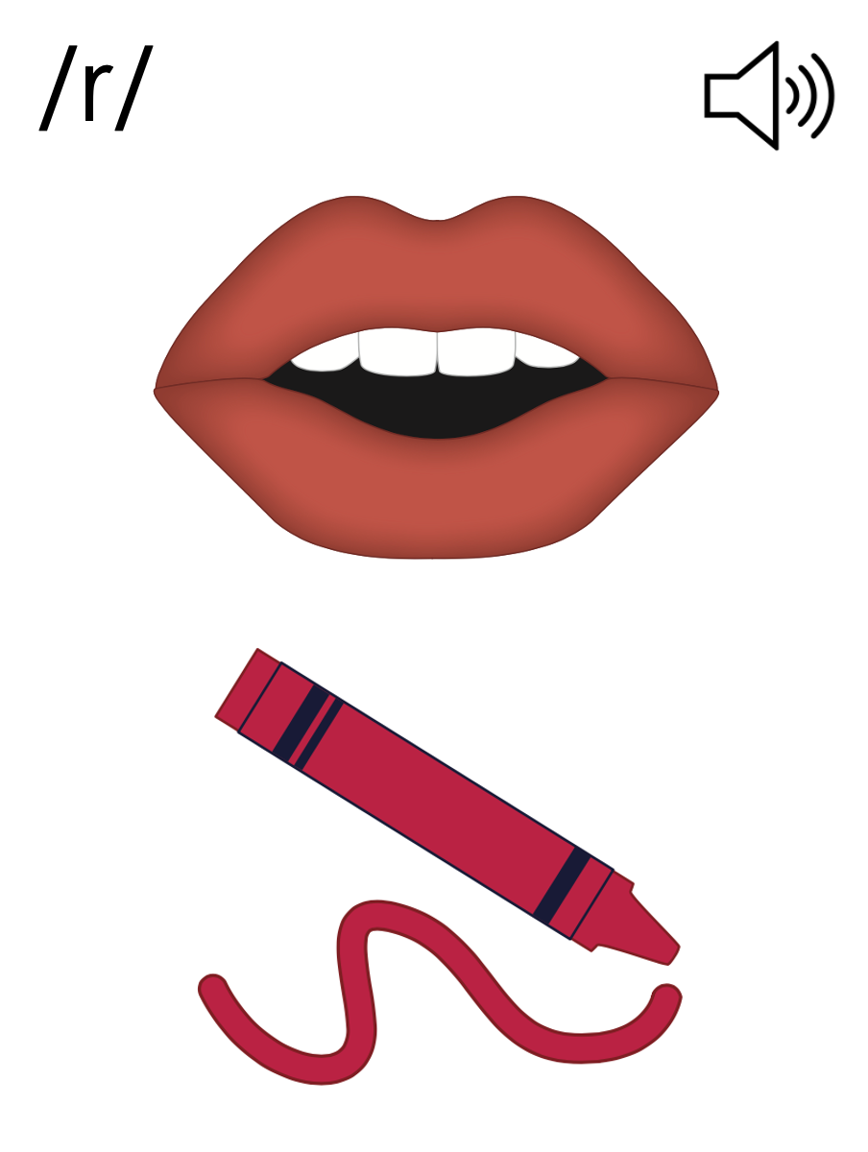

Slide 34
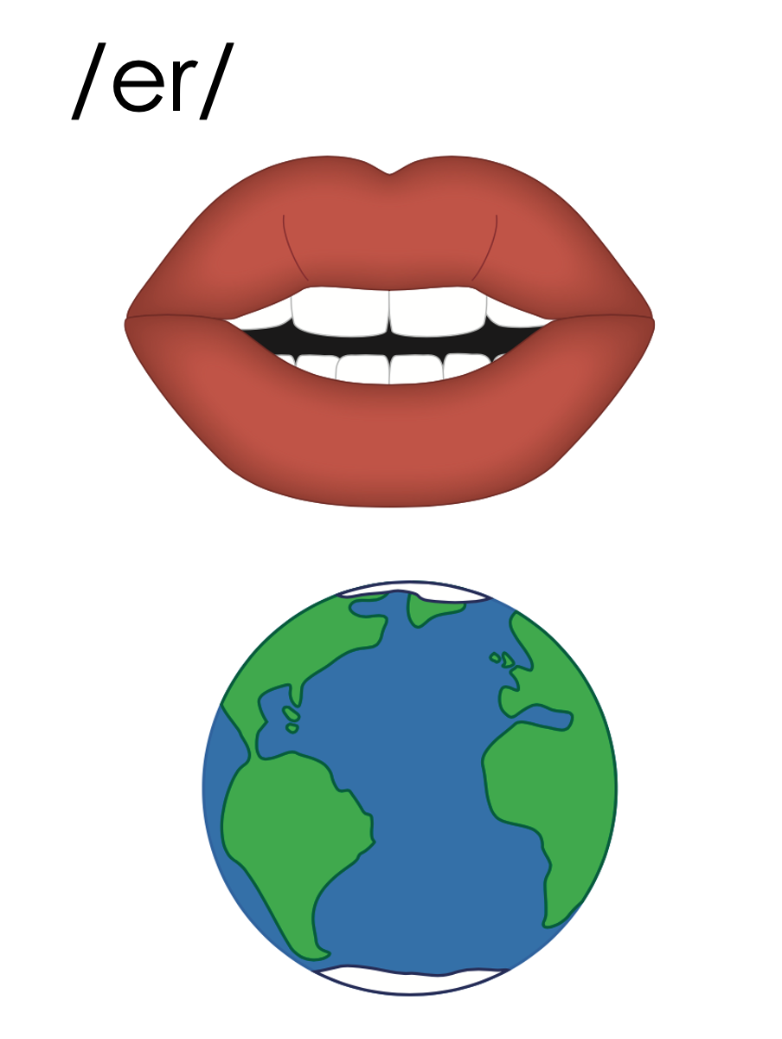
er

Slide 35
verb
fern
er

Slide 36
her
per
er

Slide 37
ir

Slide 38
girl
bird
ir

Slide 39
sir
stir
ir

Slide 40
ur

Slide 41
turn
hurt
ur

Slide 42
urn
urge
ur

Slide 43
fur
blur
ur

Slide 44
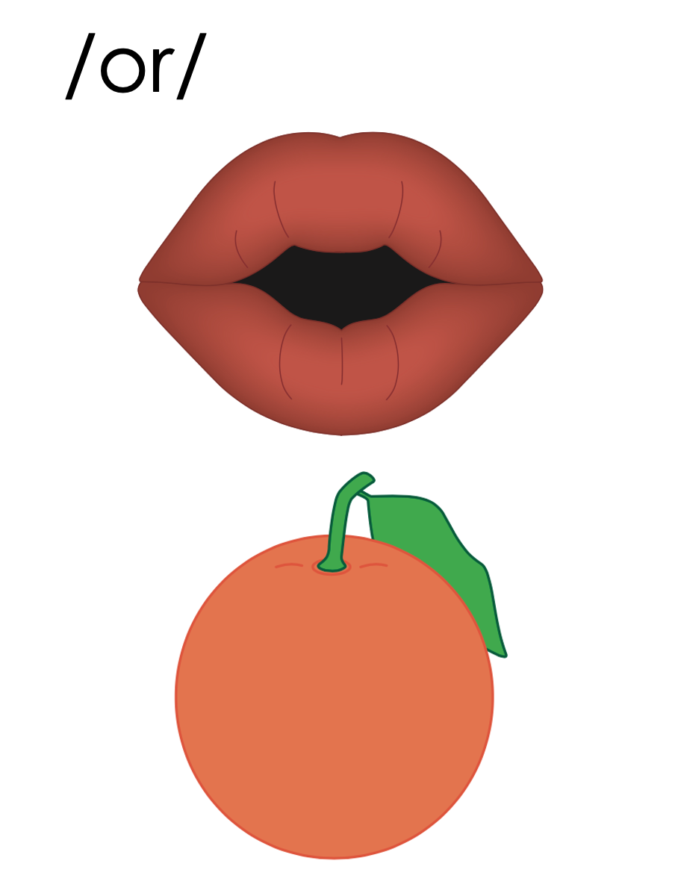
or

Slide 45
or
w

Slide 46
work
word
w
or

Slide 47
or
w

Slide 48
er
ir
ur
or

Slide 49
Notes:
Handwriting paper for letter formation practice. Use as needed.
See UFLI Foundations manual for more information about letter formation.

Slide 50
her
third
hurt
work

Slide 51
girl
first
after
over
turn
blur

Slide 52
word
world
paper
worker

Slide 53
Notes:
See UFLI Foundations lesson plan Step 5 for words to spell.
Handwriting paper to model spelling.

Slide 54
Notes:
See UFLI Foundations lesson plan Step 5 for words to spell.
Handwriting paper for guided spelling practice.

Slide 56
Insert brief reinforcement activity and/or transition to next part of reading block.

Slide 57
Lesson 82
Spelling /er/: er, ir, ur, w + or

Slide 59
New Concept Review
Notes:
See UFLI Foundations lesson plan Step 5 for recommended teacher language and activities to review the new concept.

Slide 61
er

Slide 62
verb
fern
er

Slide 63
her
per
er

Slide 64
ir

Slide 65
girl
bird
ir

Slide 66
sir
stir
ir

Slide 67
ur

Slide 68
turn
hurt
ur

Slide 69
urn
urge
ur

Slide 70
fur
blur
ur

Slide 71
or

Slide 72
or
w

Slide 73
work
word
w
or

Slide 74
or
w

Slide 75
er
ir
ur
or

Slide 76
never
third
word
hurt

Slide 78
Notes:
See UFLI Foundations lesson plan Step 6 for word work activity.
Visit ufliteracy.org to access the Word Work Mat apps.

Slide 80
Notes:
See UFLI Foundations lesson plan Step 7 for irregular word activities.
The white rectangle under each word may be used in editing mode. Cover the heart and square icons then reveal them one at a time during instruction.

Slide 81
Notes:
See UFLI Foundations manual for more information about reviewing irregular words.

Slide 82
other
Notes:
Lesson 80+
O represents the /ŭ/ sound.
The white rectangle under the word may be used in editing mode. Cover the heart and square icons then reveal them one at a time during instruction.

Slide 83
another
Notes:
Lesson 80+
A represents the /ə/ sound or the /ŭ/ sound, depending on stress.
O represents the /ŭ/ sound.
The white rectangle under the word may be used in editing mode. Cover the heart and square icons then reveal them one at a time during instruction.

Slide 84
mother
Notes:
Lesson 81+
O represents the /ŭ/ sound.
The white rectangle under the word may be used in editing mode. Cover the heart and square icons then reveal them one at a time during instruction.

Slide 85
brother
Notes:
Lesson 81+
O represents the /ŭ/ sound.
The white rectangle under the word may be used in editing mode. Cover the heart and square icons then reveal them one at a time during instruction.

Slide 86
Notes:
Handwriting paper for irregular word spelling practice. Use as needed.
See UFLI Foundations manual for more information about reviewing irregular words.

Slide 88
Notes:
See UFLI Foundations lesson plan Step 8 for connected text activities.

Slide 89
These worms live in the dirt.

Slide 90
Her baby brother just said his first words!

Slide 91
Bert and Kirk work well together because they are friends.

Slide 92
Notes:
See UFLI Foundations lesson plan Step 8 for sentences to write.

Slide 93
Notes:
The UFLI Foundations decodable text is provided here. See UFLI Foundations decodable text guide for additional text options.

Slide 94
The Worst Pet Ever
Morgan has wanted a pet for a long time. One morning, there was a small box on the table with her name on it. Inside the box, there was a bunch of dirt. Under the dirt was her new pet, a worm!

Slide 95
Morgan was sad. She thinks a worm is the worst pet in the world. She wanted a dog or cat or even a hamster, not a squirmy worm! What were her mom and dad thinking? This pet will not work. She started to cry.

Slide 96
Just then, mom and dad came in and said, “We got you! It was a joke! We are going to the pet shop!” Morgan was so happy. She wiped her face and gave mom and dad a hug. She was going to get the best pet ever!

Slide 98
Insert brief reinforcement activity and/or transition to next part of reading block.

