Slide 1
Lesson 78
or, ore /or/

Slide 2
Notes:
ufliteracy.org

Slide 4
Lesson 78
or, ore /or/

Slide 6
Notes:
See UFLI Foundations lesson plan Step 1 for phonemic awareness activity.

Slide 8
Notes:
See UFLI Foundations lesson plan Step 2 for student phoneme responses.

Slide 9
r

Slide 10
ar

Slide 11
y

Slide 12
dge

Slide 13
g

Slide 14
tch

Slide 15
ch

Slide 16
-ed

Slide 17
c

Slide 18
a

Slide 19
i

Slide 20
o

Slide 21
e

Slide 22
u

Slide 23
nk

Slide 24
ng

Slide 25
th

Slide 26
sh

Slide 27
ck

Slide 29
Notes:
See UFLI Foundations lesson plan Step 3 for auditory drill activity.

Slide 30
Notes:
No slides needed for auditory drill.

Slide 32
Notes:
See UFLI Foundations lesson plan Step 4 for blending drill word chain and grid.
Visit ufliteracy.org to access the Blending Board app.

Slide 34
Notes:
See UFLI Foundations lesson plan Step 5 for recommended teacher language and activities to introduce the new concept.

Slide 35
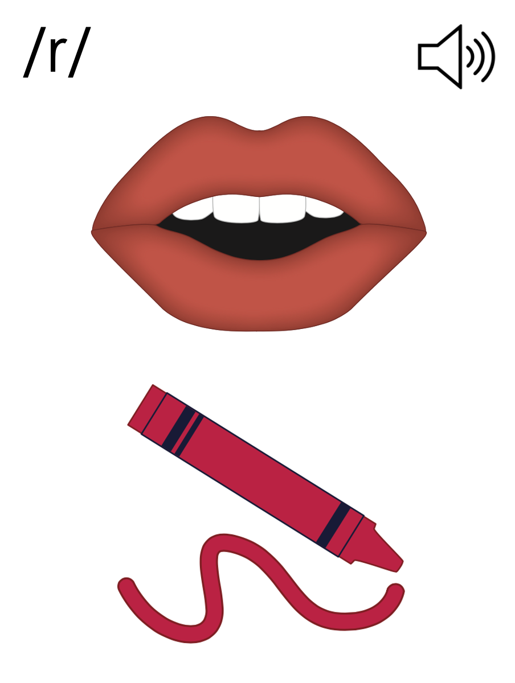

Slide 36
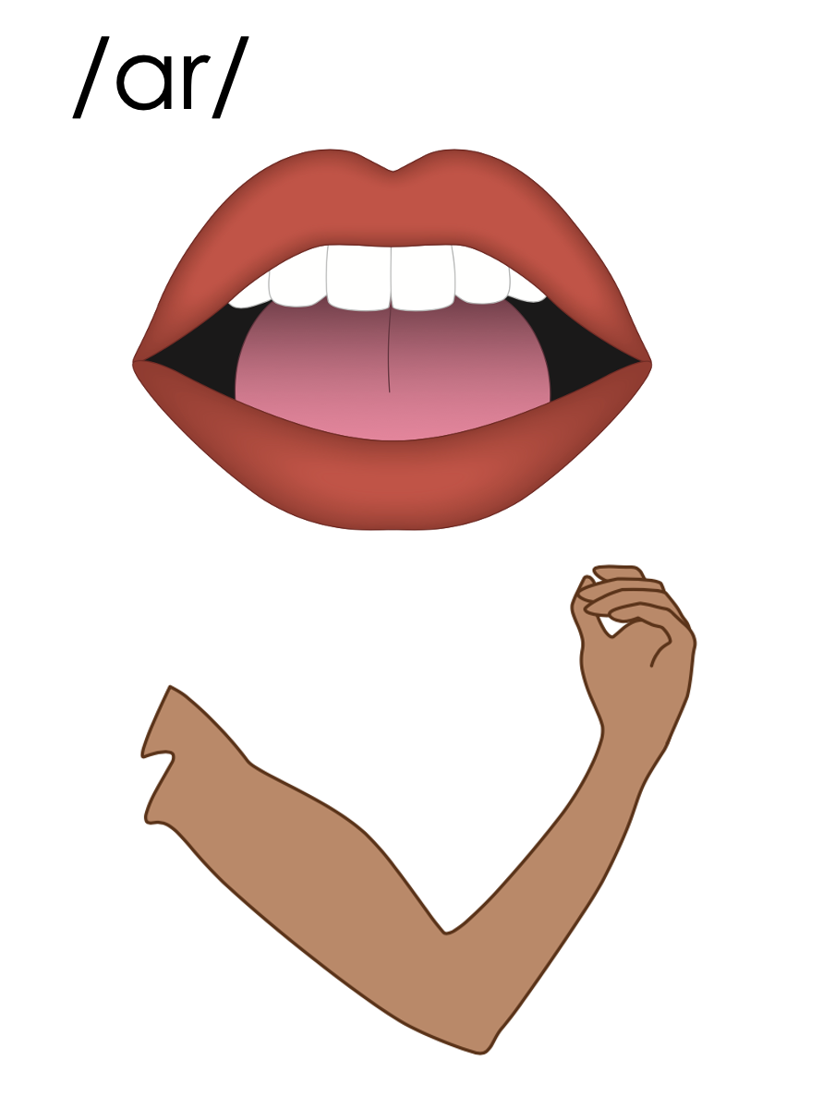
ar

Slide 37
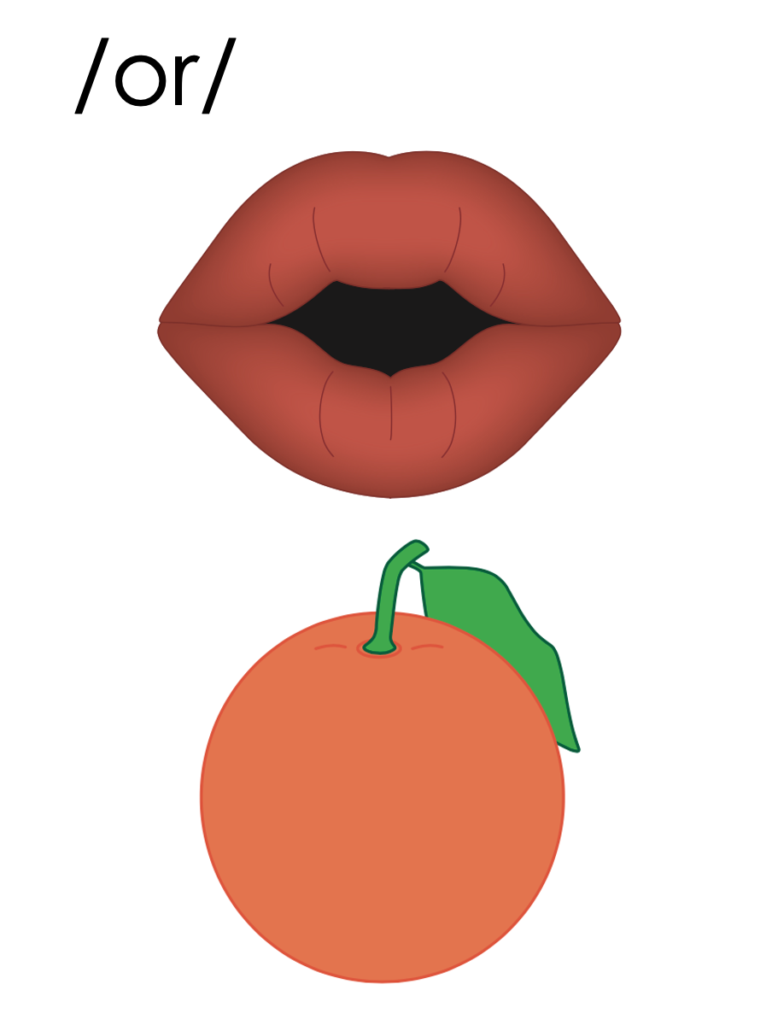
or

Slide 38
fork
corn
or

Slide 39
orb
or

Slide 40
for
or

Slide 41
more
store
ore

Slide 42
or
ore

Slide 43
Notes:
Handwriting paper for letter formation practice. Use as needed.
See UFLI Foundations manual for more information about letter formation.

Slide 44
sport
important

Slide 45
for
form
corn
north
more
force

Slide 46
story
morning
before

Slide 47
Notes:
See UFLI Foundations lesson plan Step 5 for words to spell.
Handwriting paper to model spelling.

Slide 48
Notes:
See UFLI Foundations lesson plan Step 5 for words to spell.
Handwriting paper for guided spelling practice.

Slide 50
Insert brief reinforcement activity and/or transition to next part of reading block.

Slide 51
Lesson 78
or, ore /or/

Slide 53
New Concept Review
Notes:
See UFLI Foundations lesson plan Step 5 for recommended teacher language and activities to review the new concept.

Slide 54
ar

Slide 55
or

Slide 56
fork
corn
or

Slide 57
orb
or

Slide 58
for
or

Slide 59
more
store
ore

Slide 60
or
ore

Slide 61
form
story
more
before

Slide 63
Notes:
See UFLI Foundations lesson plan Step 6 for word work activity.
Visit ufliteracy.org to access the Word Work Mat apps.

Slide 65
Notes:
See UFLI Foundations lesson plan Step 7 for irregular word activities.
The white rectangle under each word may be used in editing mode. Cover the heart and square icons then reveal them one at a time during instruction.

Slide 66
Notes:
See UFLI Foundations manual for more information about reviewing irregular words.

Slide 67
four
Notes:
Lesson 73+
OUR represents the /or/ sound.
The white rectangle under the word may be used in editing mode. Cover the heart and square icons then reveal them one at a time during instruction.

Slide 68
fourth
Notes:
Lesson 73+
OUR represents the /or/ sound.
The white rectangle under the word may be used in editing mode. Cover the heart and square icons then reveal them one at a time during instruction.

Slide 69
forty
Notes:
Lesson 74+
This spelling is not irregular, but it can be confusing once a student has learned to spell FOUR and FOURTH. FORTY is often misspelled FOURTY.
Also, T may be pronounced /d/ depending on dialect.
The white rectangle under the word may be used in editing mode. Cover the heart and square icons then reveal them one at a time during instruction.

Slide 70
people
Notes:
Lesson 75+
EO represents the /ē/ sound.
The white rectangle under the word may be used in editing mode. Cover the heart and square icons then reveal them one at a time during instruction.

Slide 71
pretty
Notes:
Lesson 77+
E represents the /ĭ/ sound.
TT may be pronounced /d/ depending on dialect.
The white rectangle under the word may be used in editing mode. Cover the heart and square icons then reveal them one at a time during instruction.

Slide 72
Notes:
Handwriting paper for irregular word spelling practice. Use as needed.
See UFLI Foundations manual for more information about reviewing irregular words.

Slide 73
Teach
Notes:
The orange star indicates these are new irregular words that need to be introduced.
See UFLI Foundations manual for more information about teaching irregular words.

Slide 74
nothing
Notes:
Lesson 78+
O represents the /ŭ/ sound.
The white rectangle under the word may be used in editing mode. Cover the heart and square icons then reveal them one at a time during instruction.

Slide 75
Notes:
Handwriting paper for irregular word spelling practice. Use as needed.
See UFLI Foundations manual for more information about teaching irregular words.

Slide 77
Notes:
See UFLI Foundations lesson plan Step 8 for connected text activities.

Slide 78
The bad storm tore up the shore!

Slide 79
I love to sit and do nothing on my porch.

Slide 80
We ate pork and corn for lunch.

Slide 81
Notes:
See UFLI Foundations lesson plan Step 8 for sentences to write.

Slide 82
Notes:
The UFLI Foundations decodable text is provided here. See UFLI Foundations decodable text guide for additional text options.

Slide 83
Marvel at the Shore
Cory and his horse, North, traveled to the shore. Cory held on to North’s mane as North galloped across the sand. They arrived at the shore before anyone else. There had been a storm at sunset, so this morning the shore was a marvel.

Slide 84
There were hundreds of starfish along the shoreline. The starfish got pulled to the shore in the storm. They were so pretty, but if they were left on the shore they would dry up. Cory jumped off North’s back.

Slide 85
He picked up starfish one by one and placed them back where they came from. Cory was happy he could transport the starfish back home.

Slide 87
Insert brief reinforcement activity and/or transition to next part of reading block.

