Slide 1

Lesson 68
Open/Closed

Slide 2
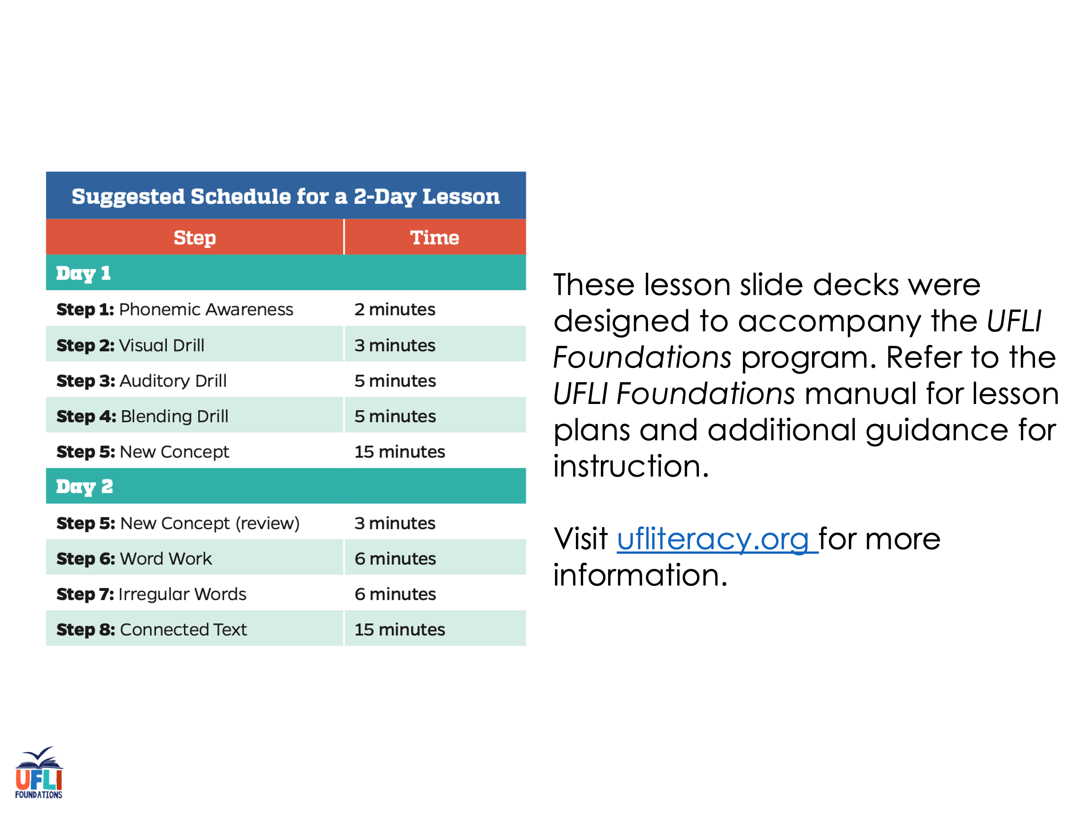
Notes:
ufliteracy.org

Slide 3
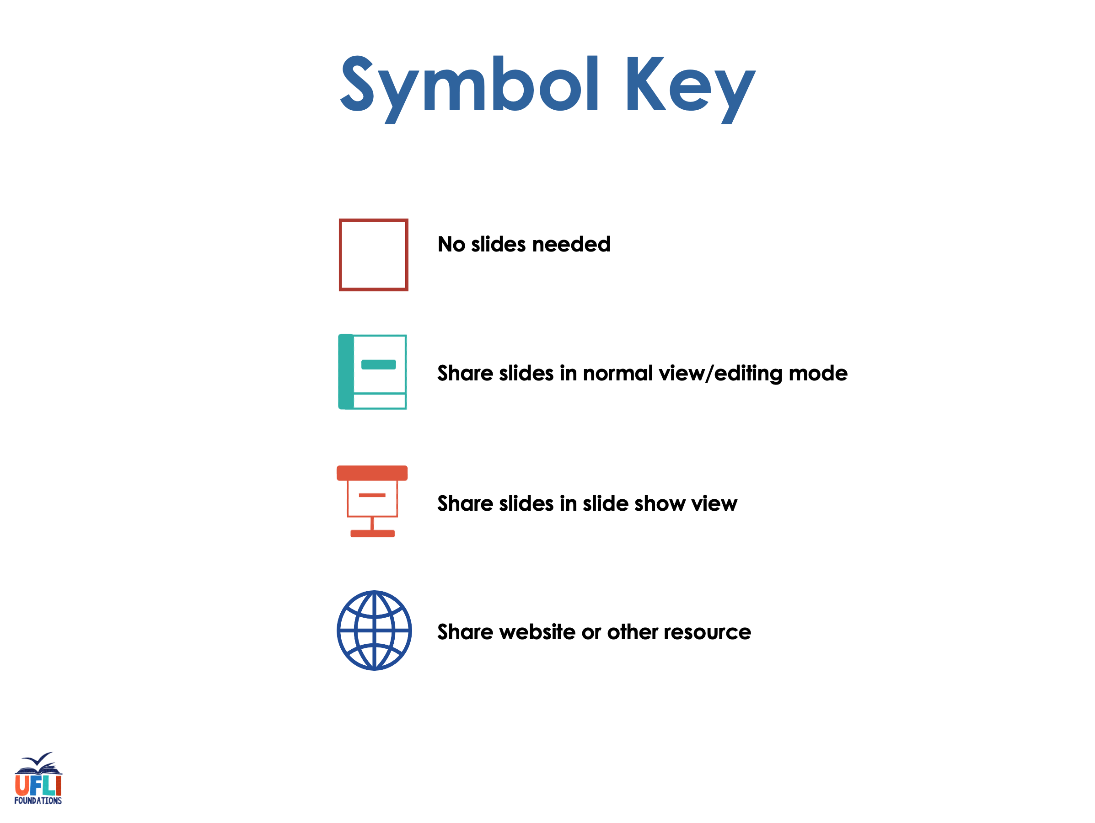

Slide 4

Lesson 68
Open/Closed

Slide 5
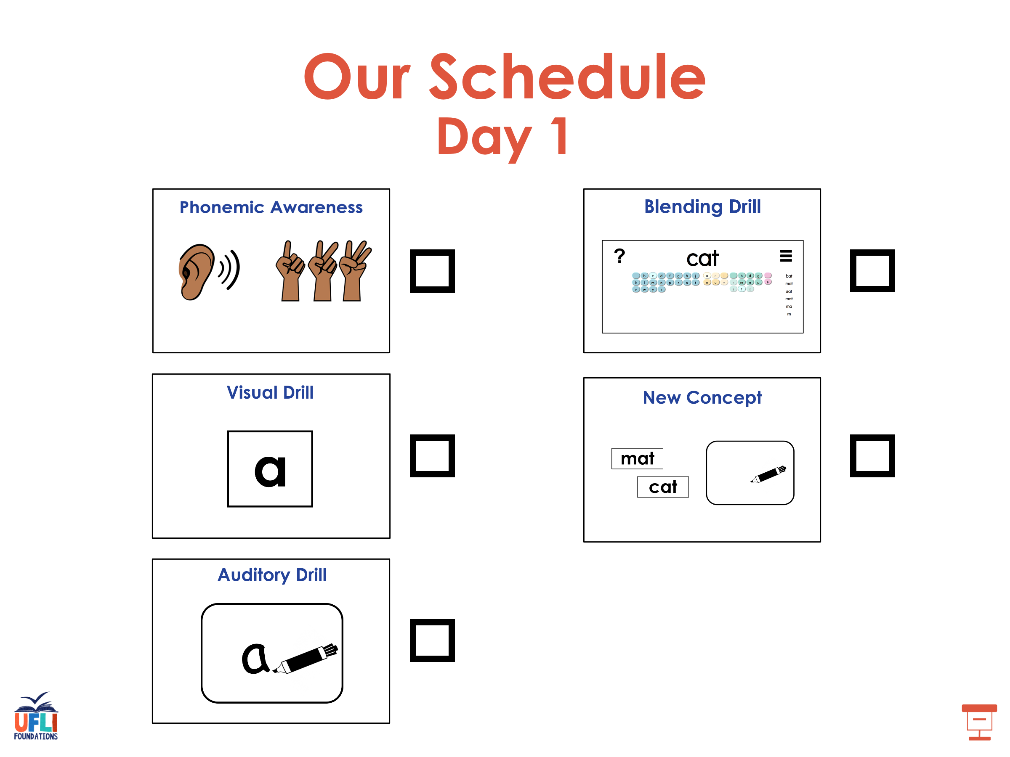

Slide 6
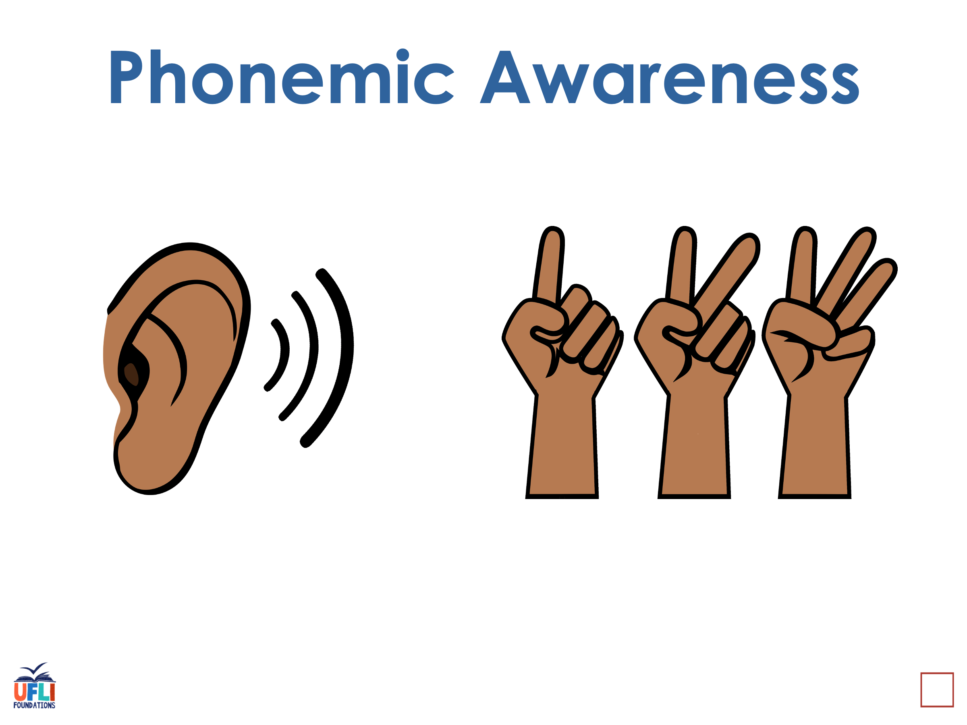
Notes:
See UFLI Foundations lesson plan Step 1 for phonemic awareness activity.

Slide 7
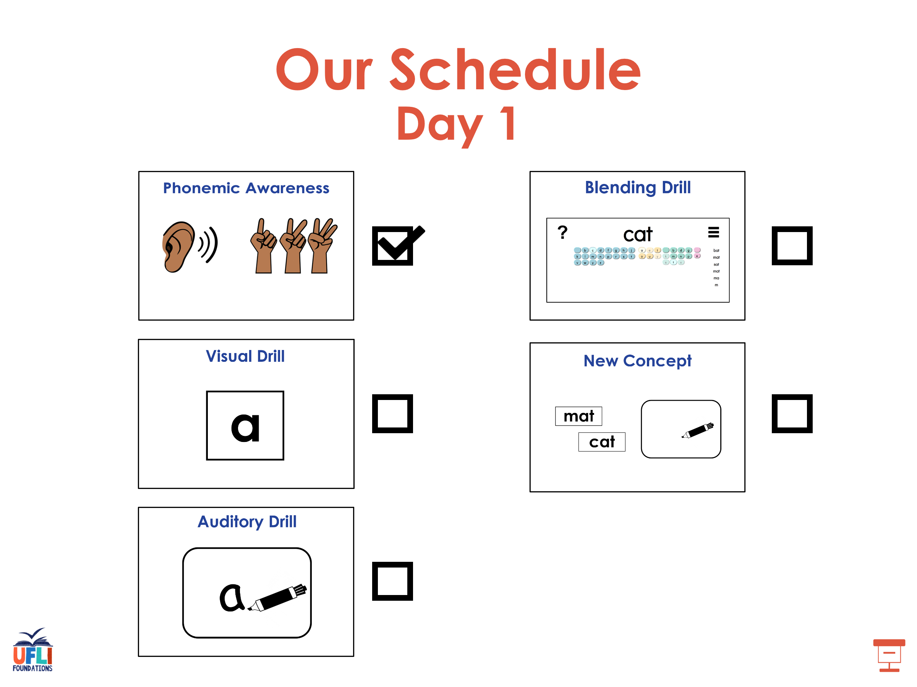

Slide 8
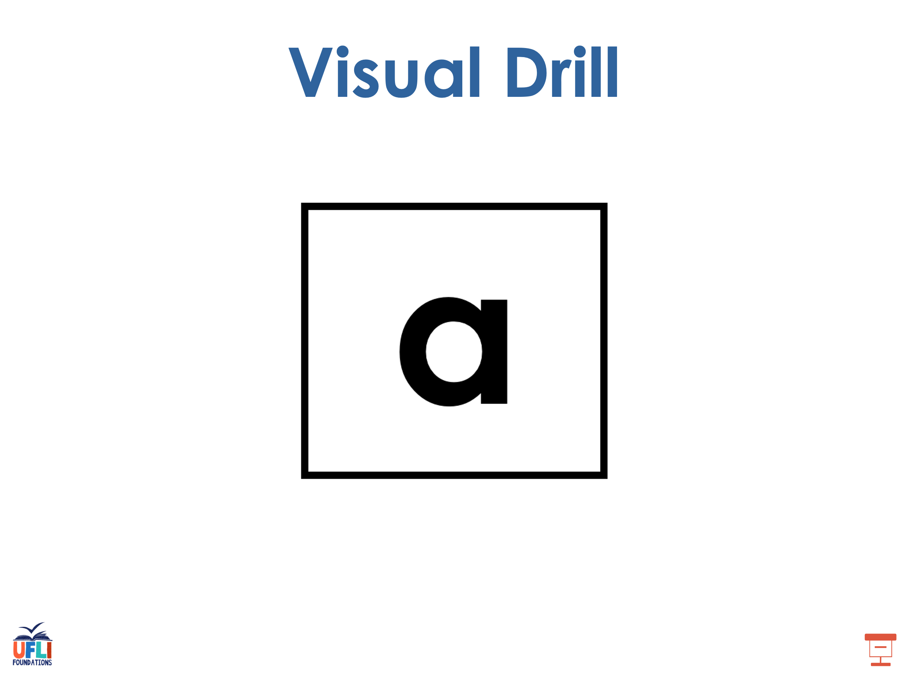
Notes:
See UFLI Foundations lesson plan Step 2 for student phoneme responses.

Slide 9
-ed

Slide 10
g

Slide 11
c

Slide 12
a

Slide 13
i

Slide 14
o

Slide 15
e

Slide 16
u

Slide 17
nk

Slide 18
ng

Slide 19
wh

Slide 20
ph

Slide 21
ch

Slide 22
th

Slide 23
sh

Slide 24
ck

Slide 25
s

Slide 26
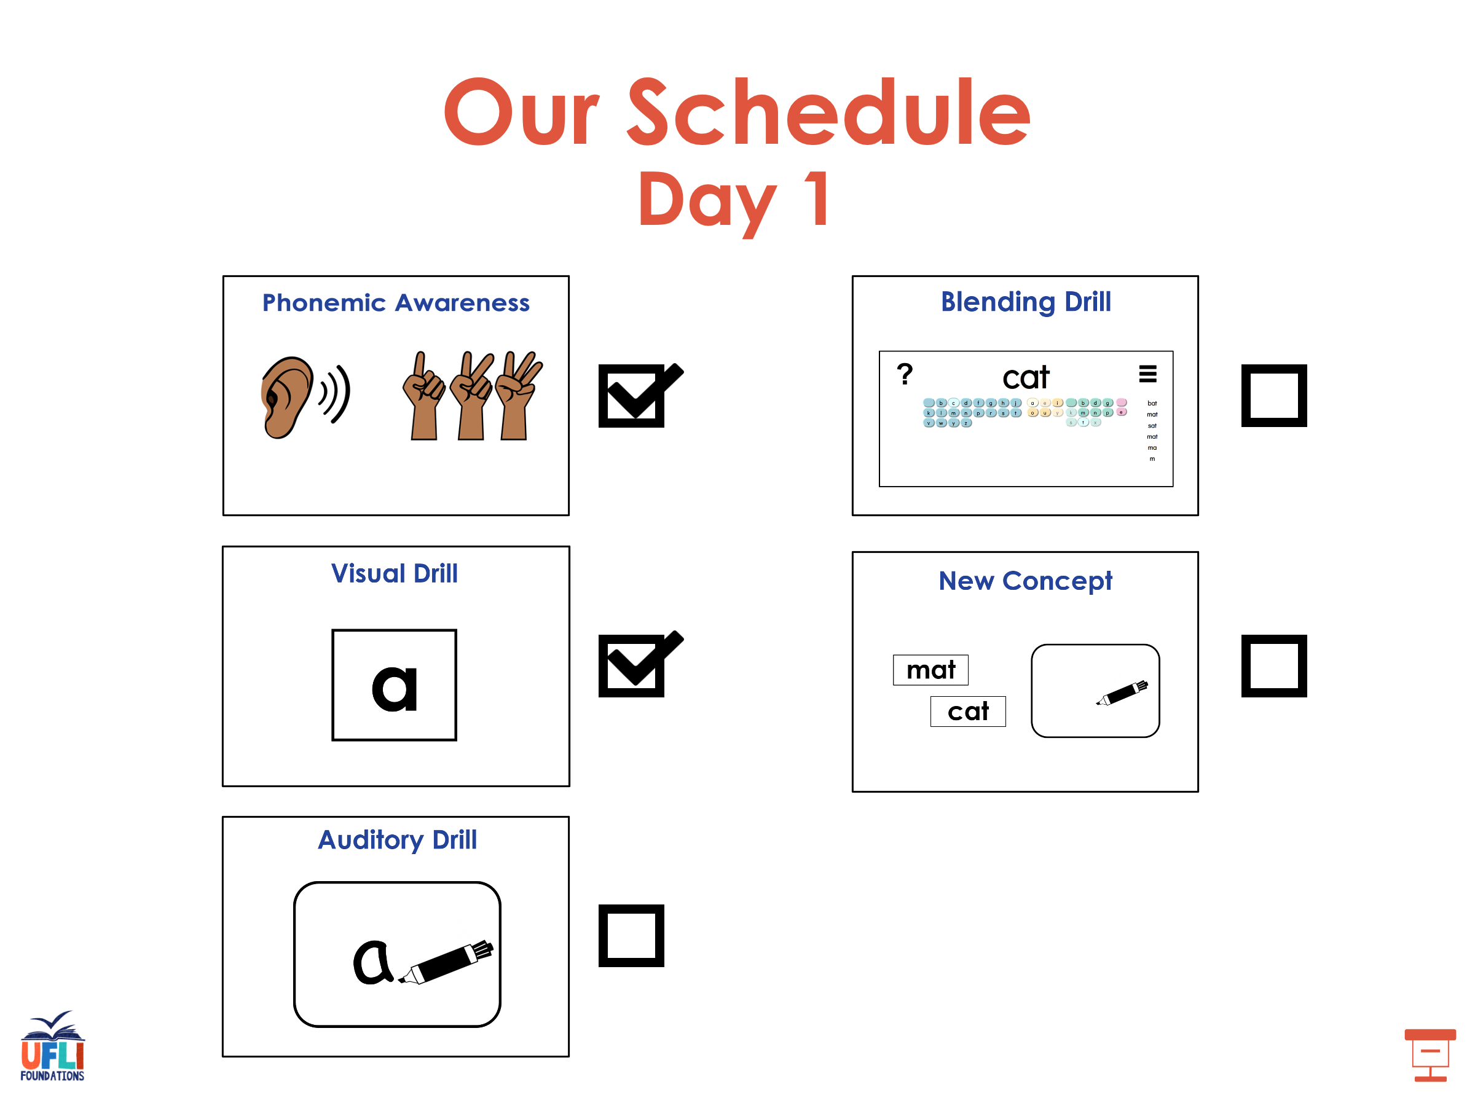

Slide 27
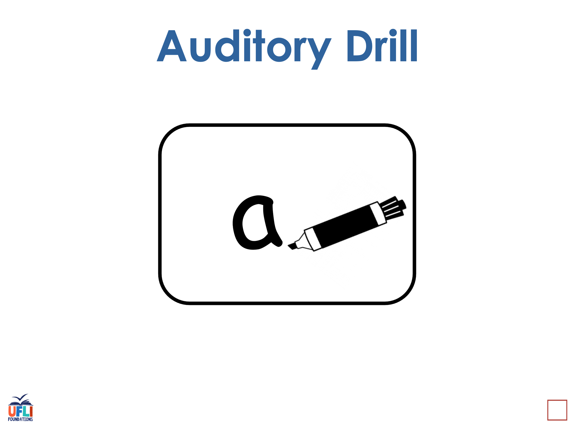
Notes:
See UFLI Foundations lesson plan Step 3 for auditory drill activity.

Slide 28
Notes:
No slides needed for auditory drill.

Slide 29
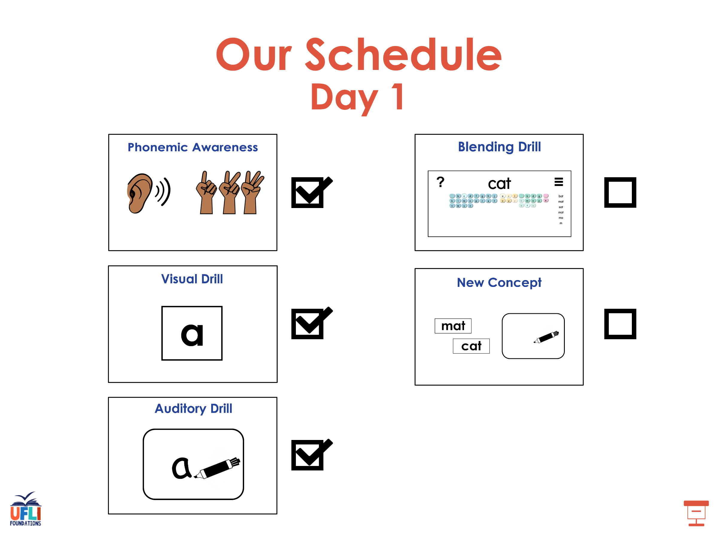

Slide 30
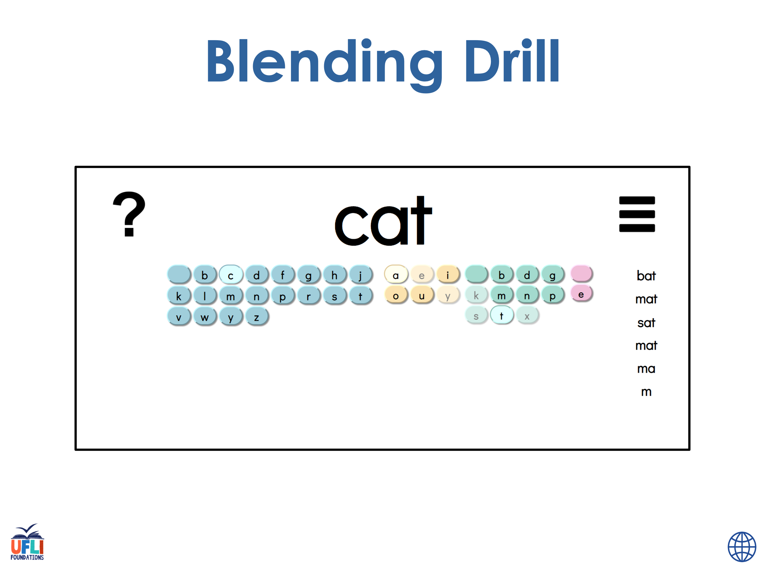
Notes:
See UFLI Foundations lesson plan Step 4 for blending drill word chain and grid.
Visit ufliteracy.org to access the Blending Board app.

Slide 31
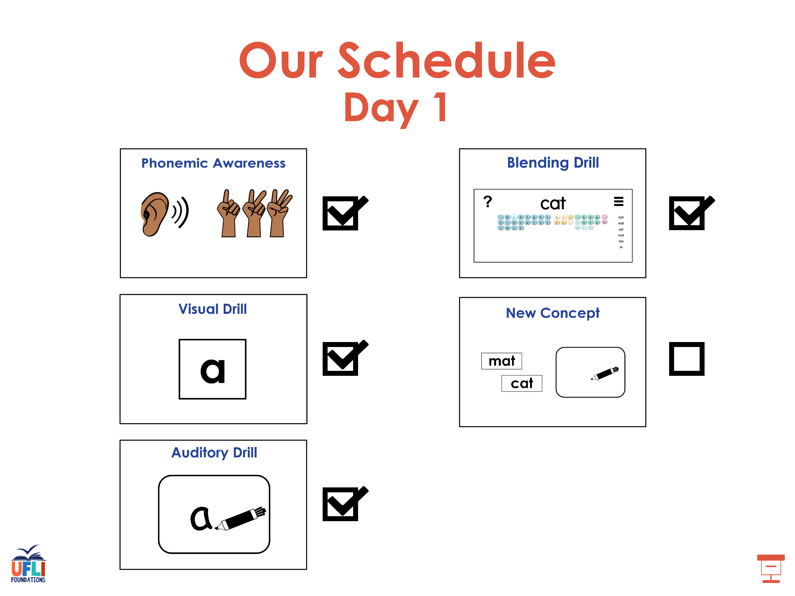

Slide 32
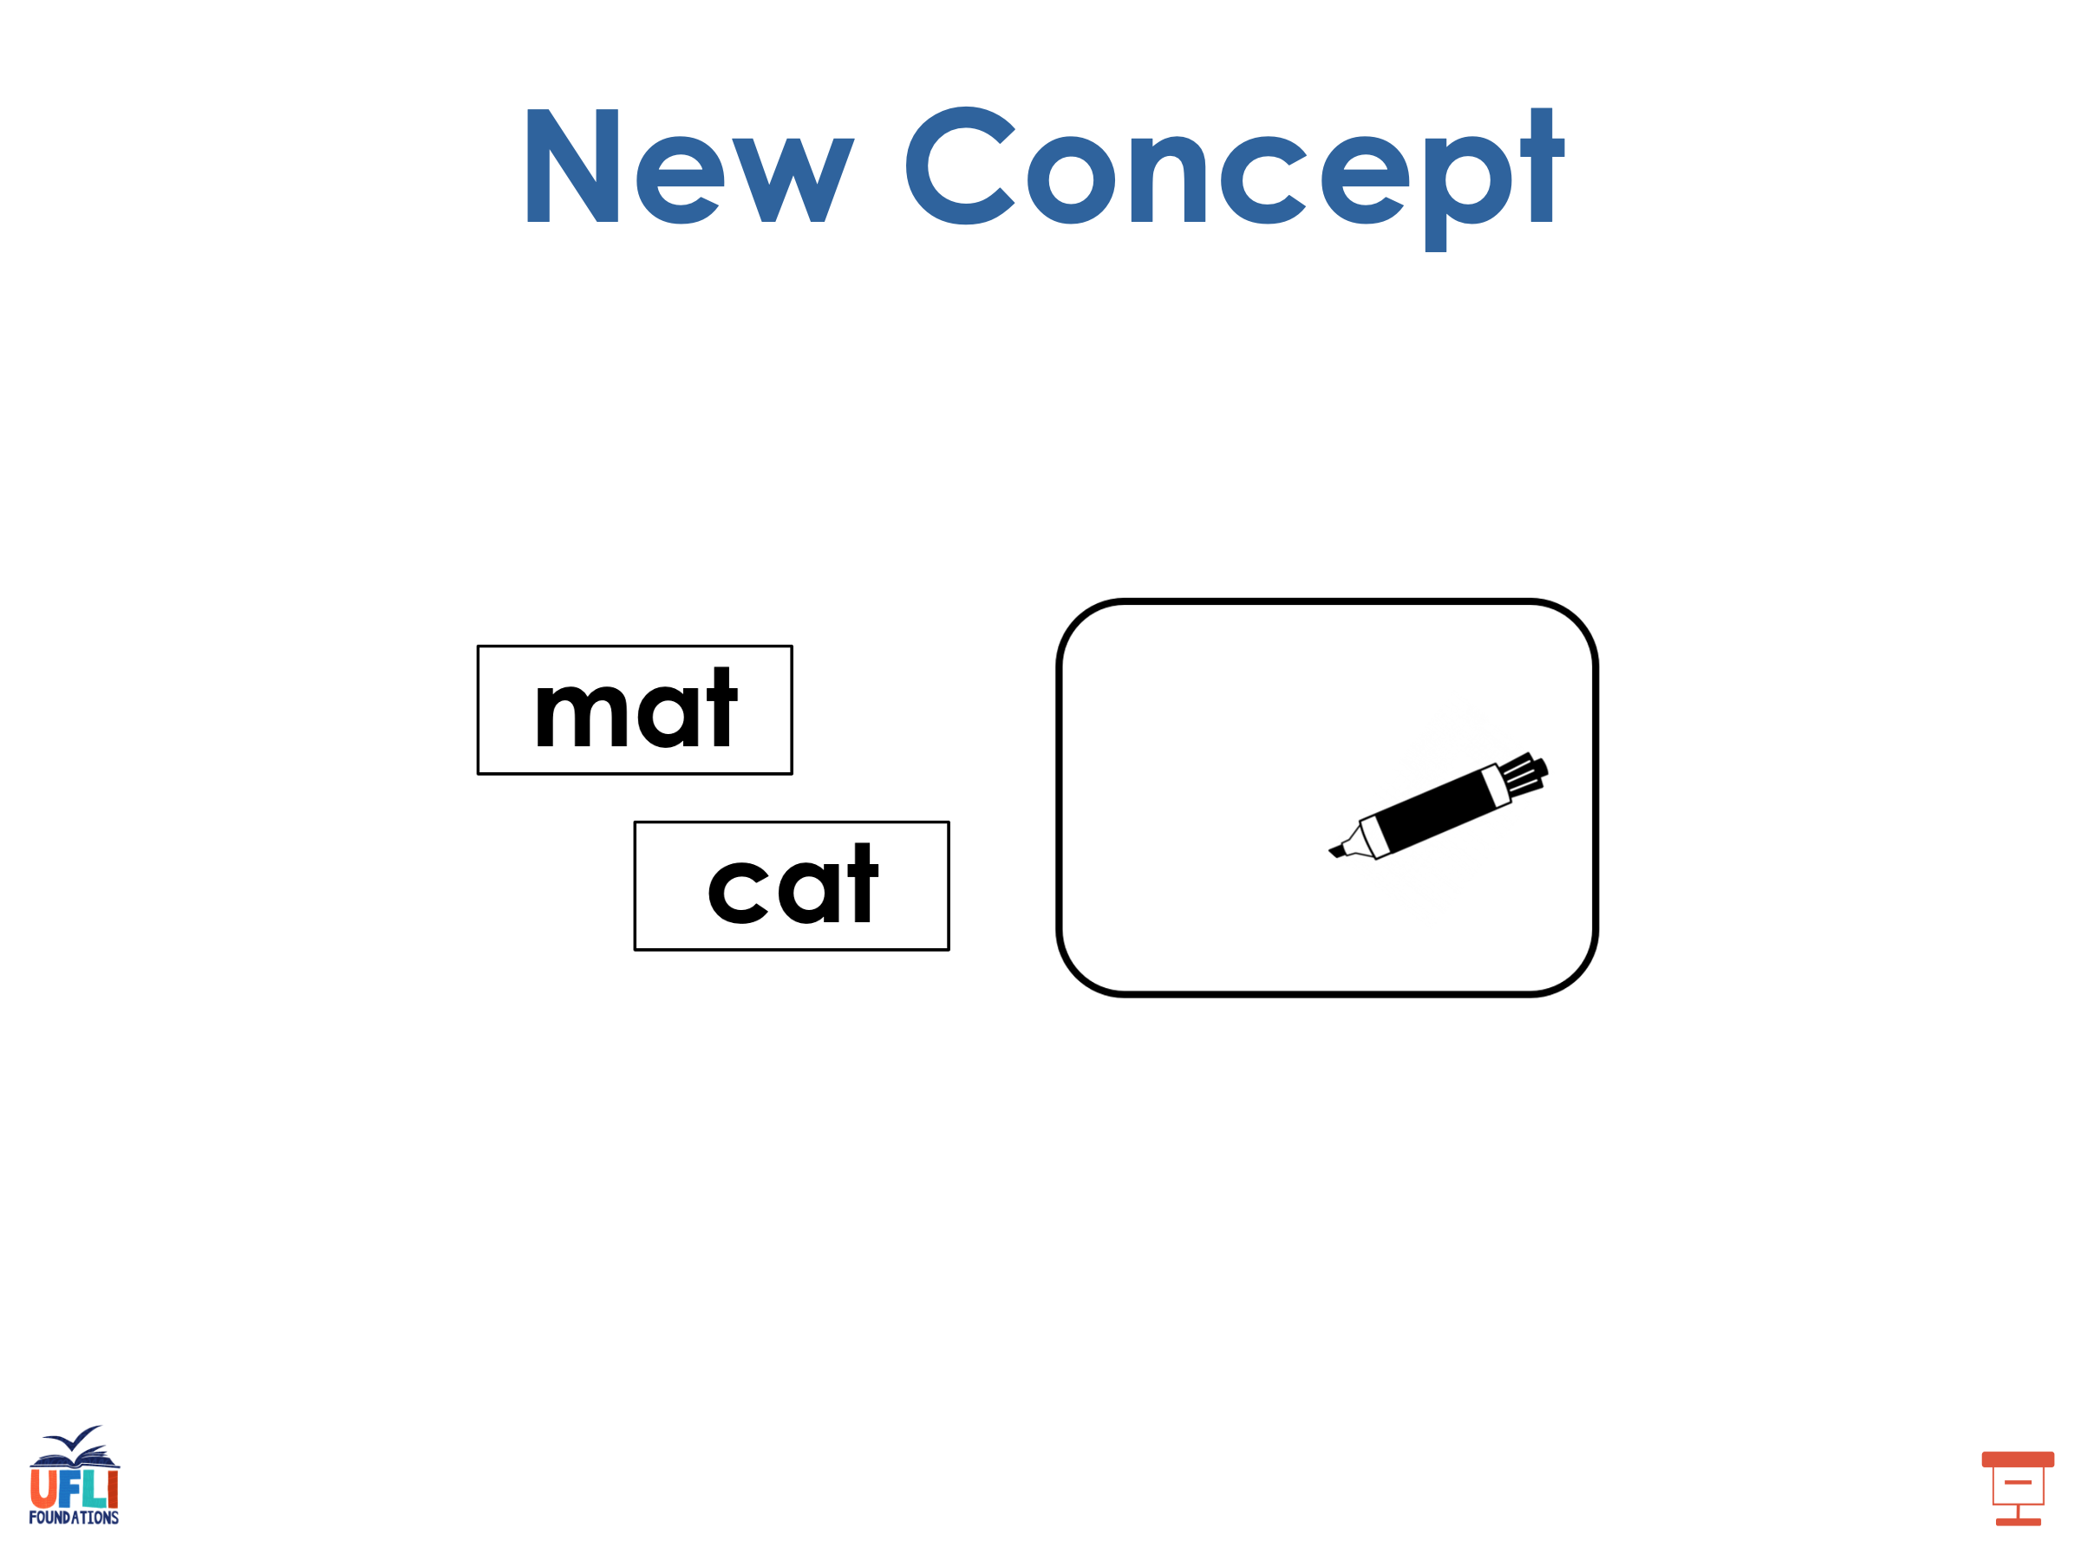
Notes:
See UFLI Foundations lesson plan Step 5 for recommended teacher language and activities to introduce the new concept.

Slide 33

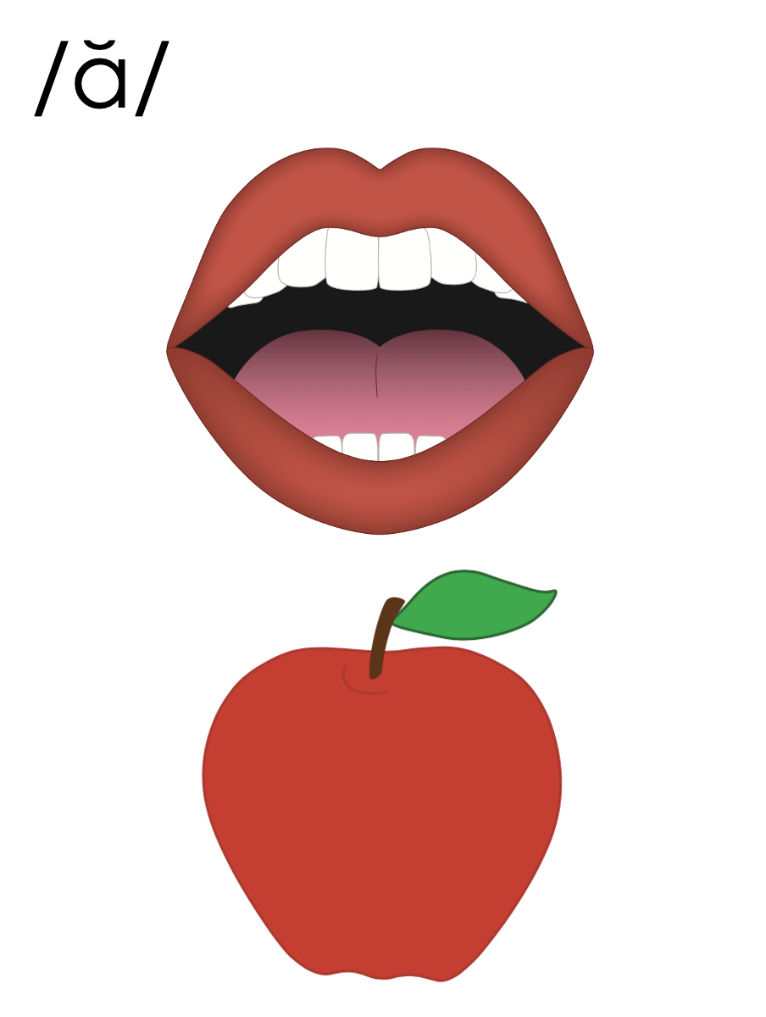
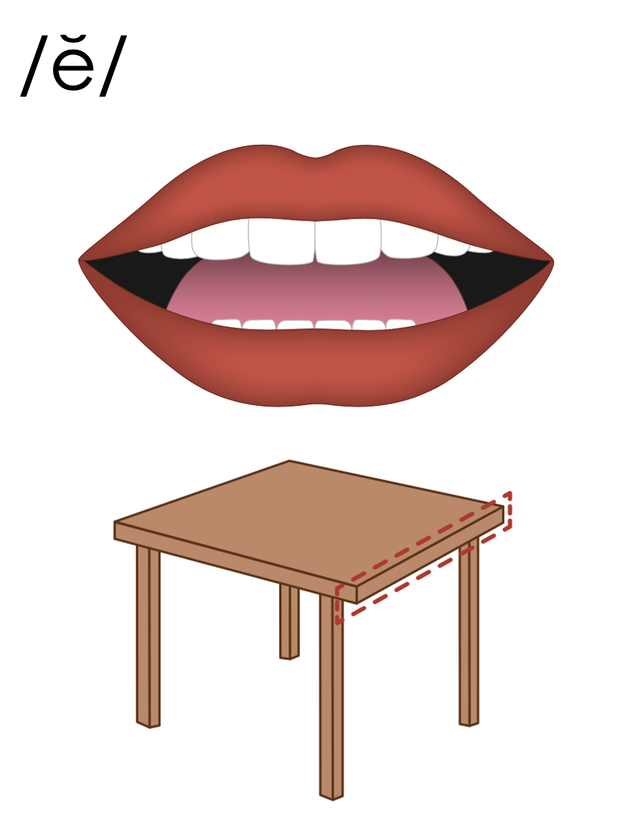
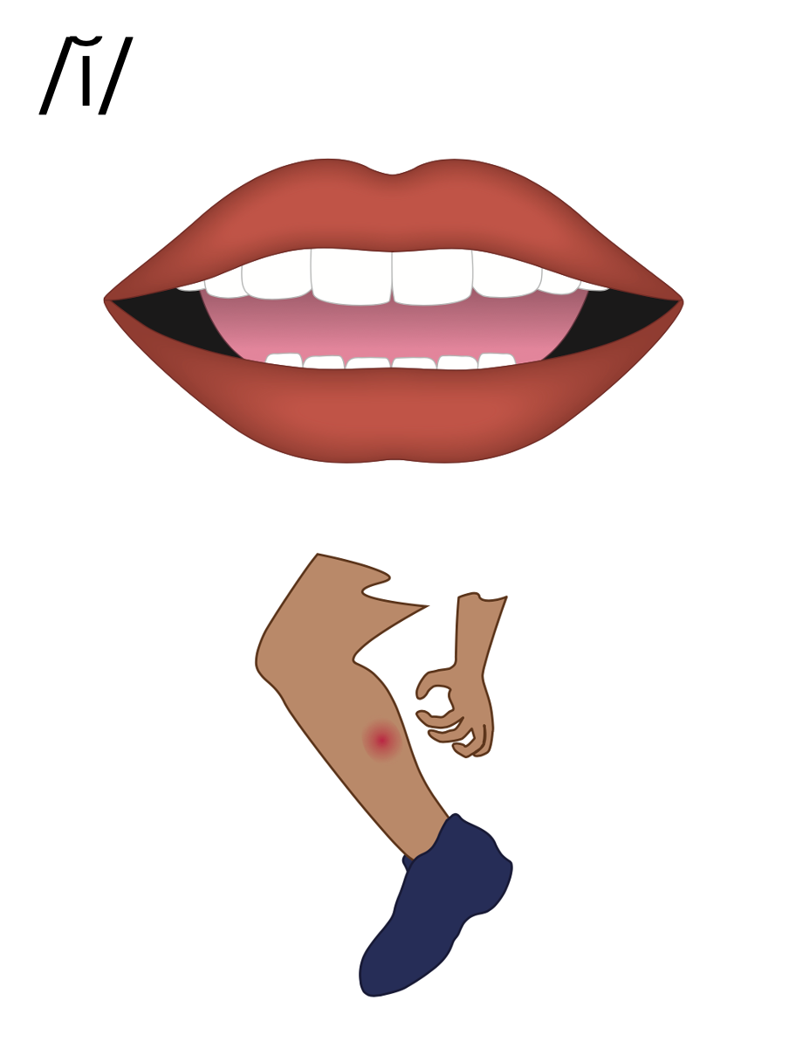
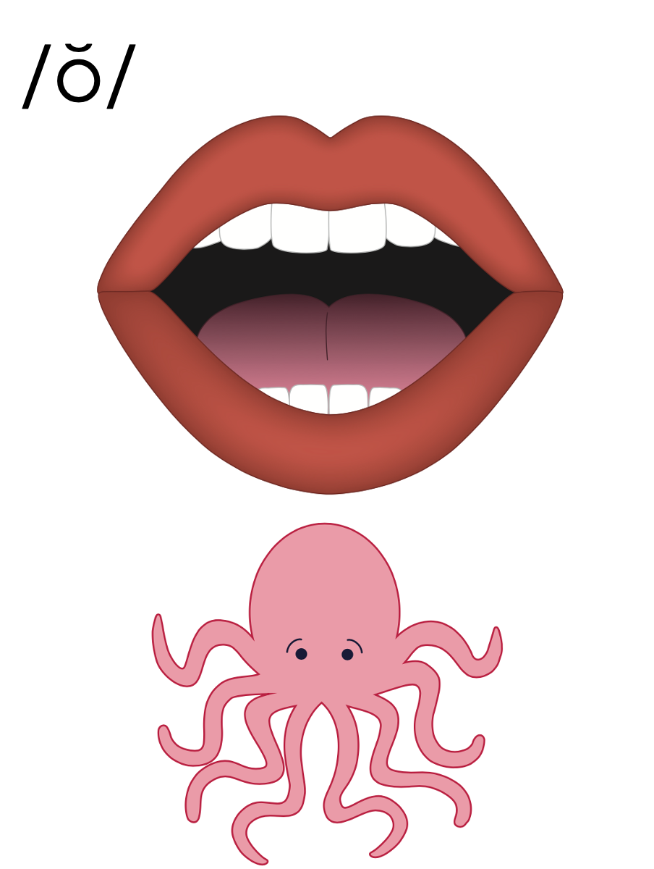
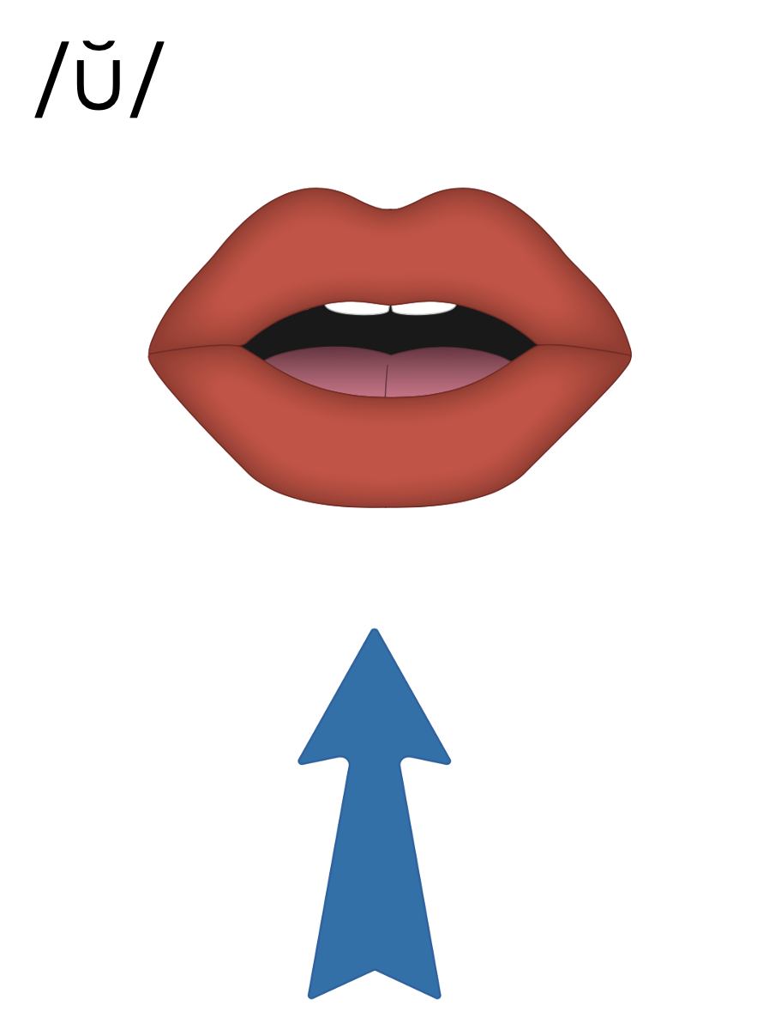
Closed Syllable
V
C

Slide 34
Closed Syllable
V
C
met

Slide 35

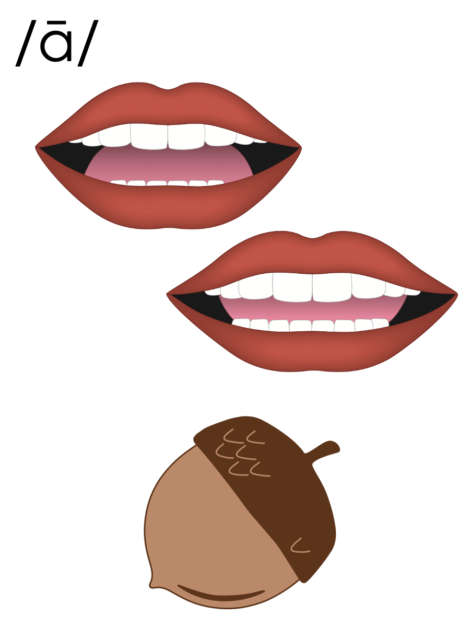
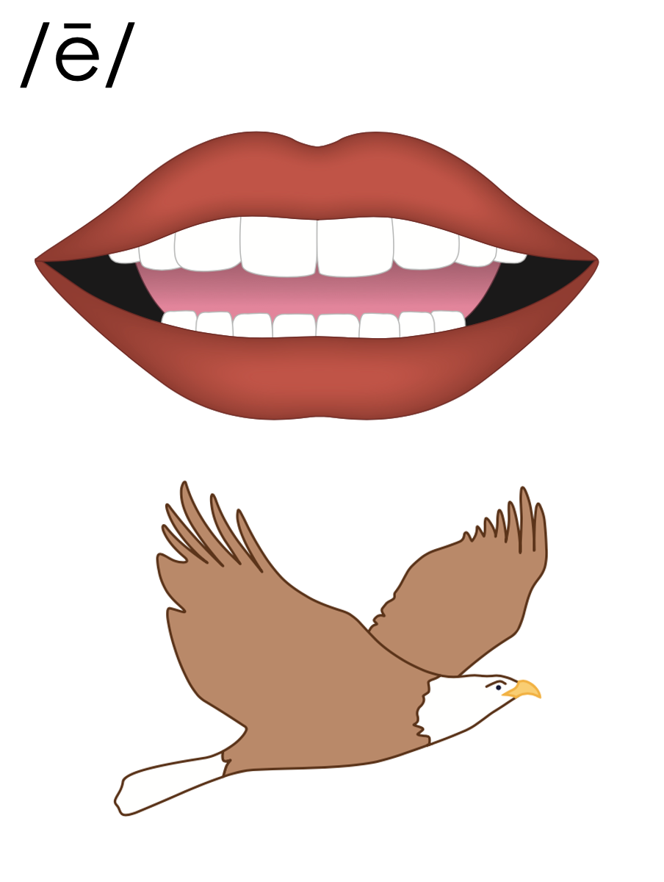
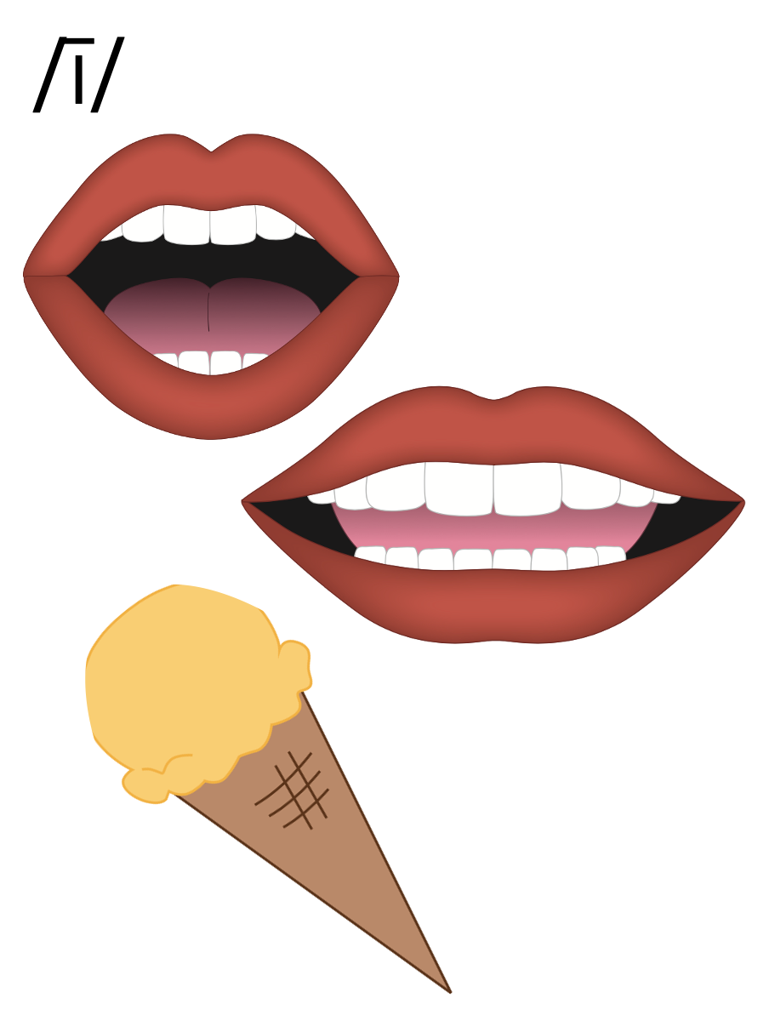
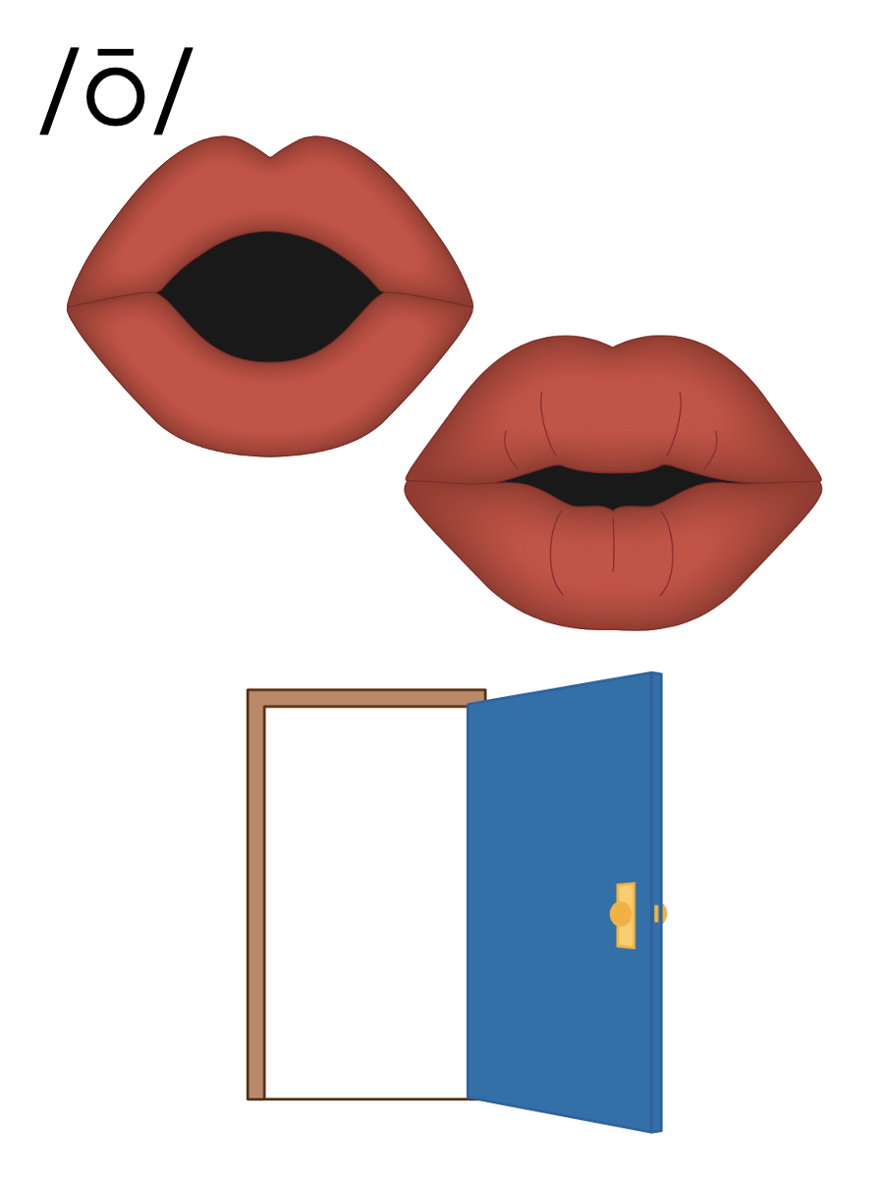
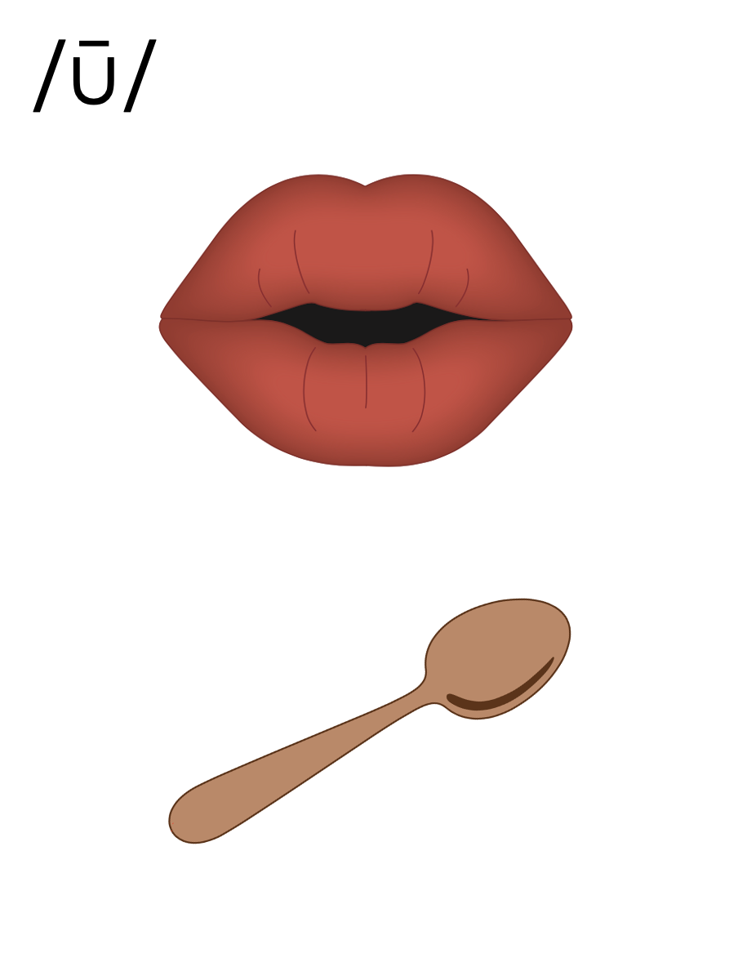
Open Syllable
V

Slide 36
Open Syllable
V
me

Slide 37
be
yond

Slide 38
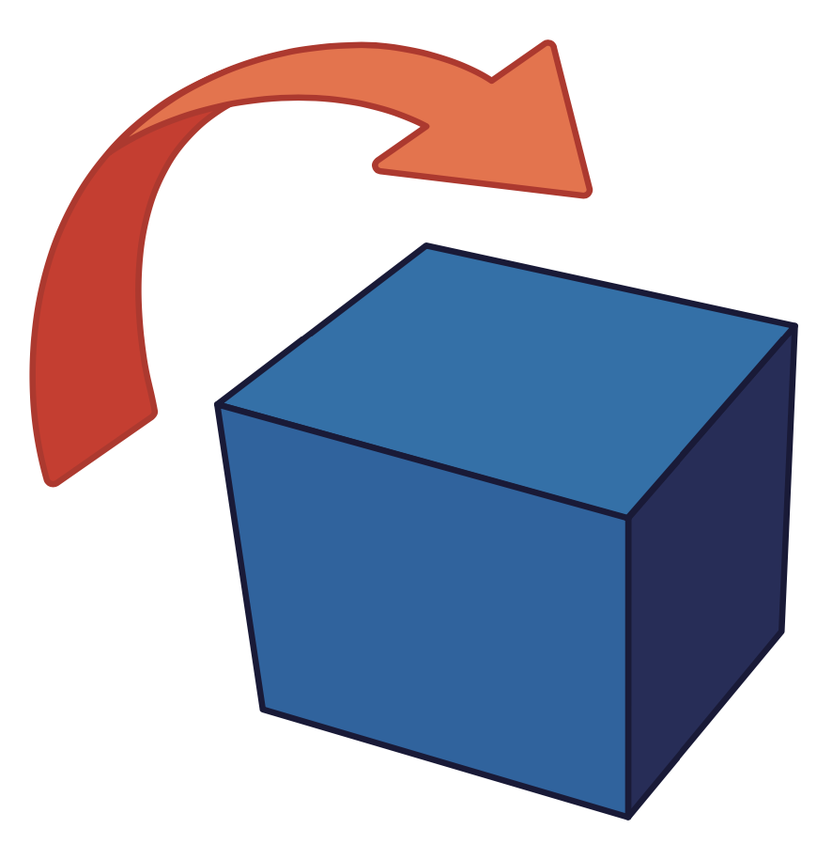
about

Slide 39
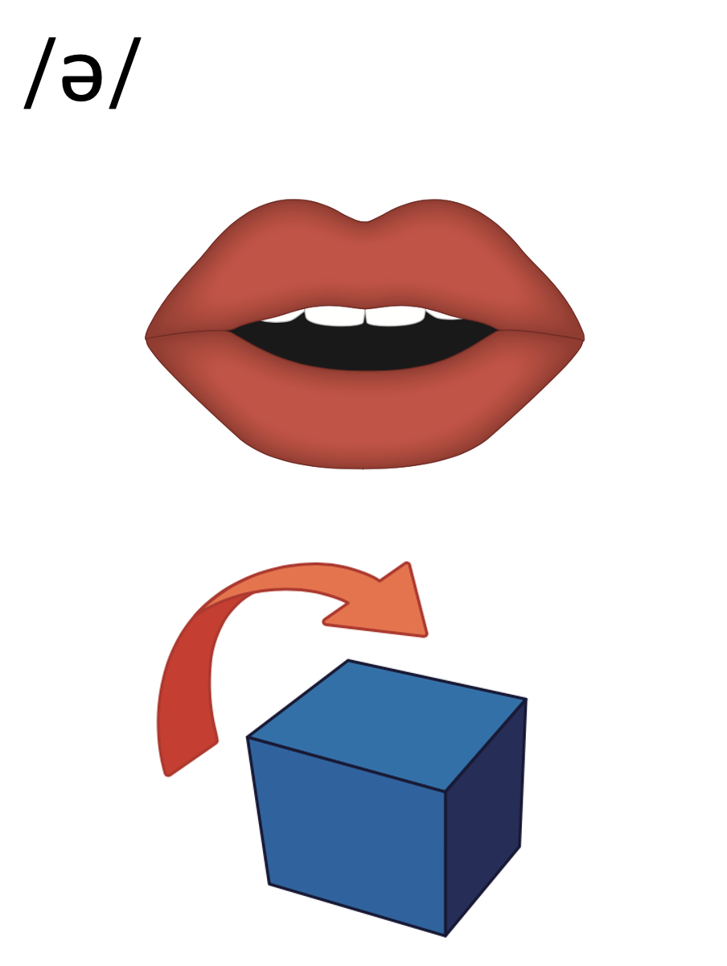
a
e
i
o
u
y

Slide 40
o-pen

Slide 41
bo-nus

Slide 42
hu-man

Slide 43
de-mand

Slide 44
den-im

Slide 45
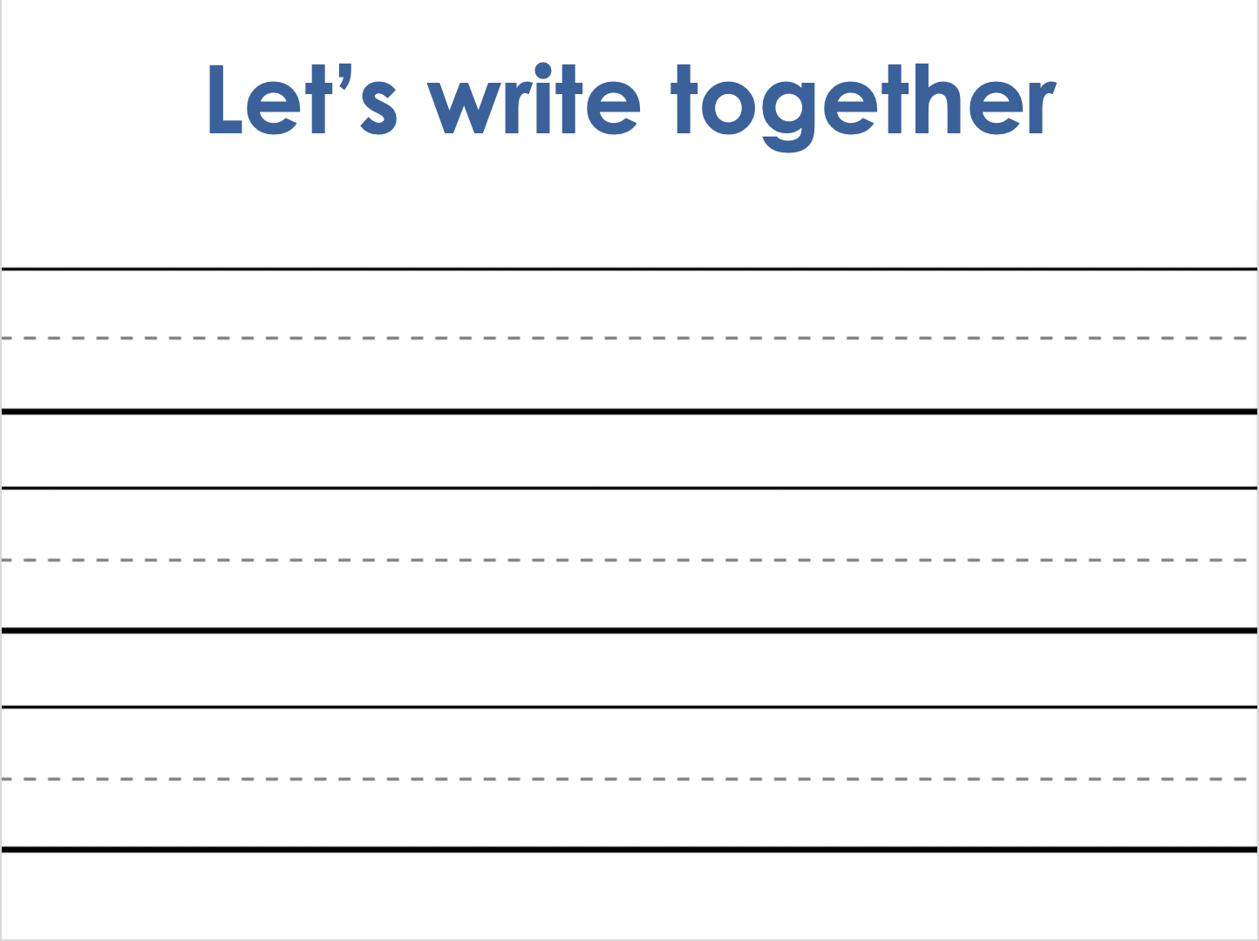
Notes:
Handwriting paper for letter formation practice. Use as needed.
See UFLI Foundations manual for more information about letter formation.

Slide 46
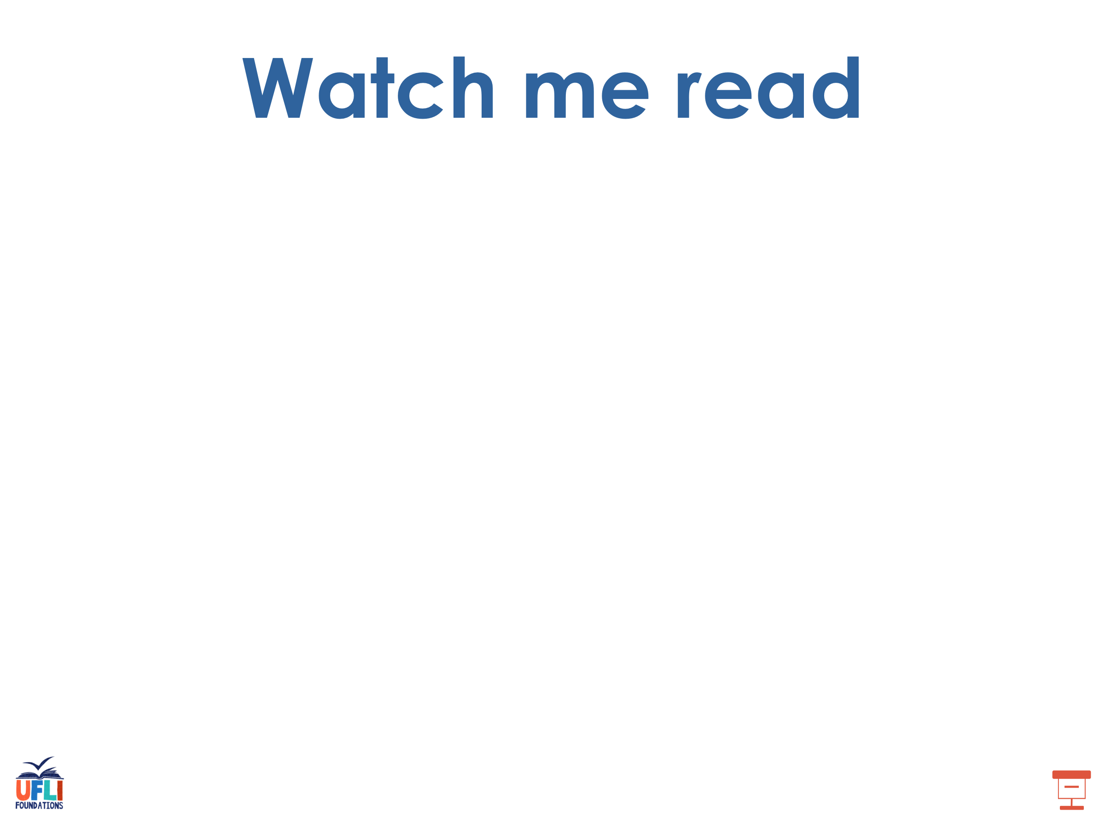
basic
frozen

Slide 47
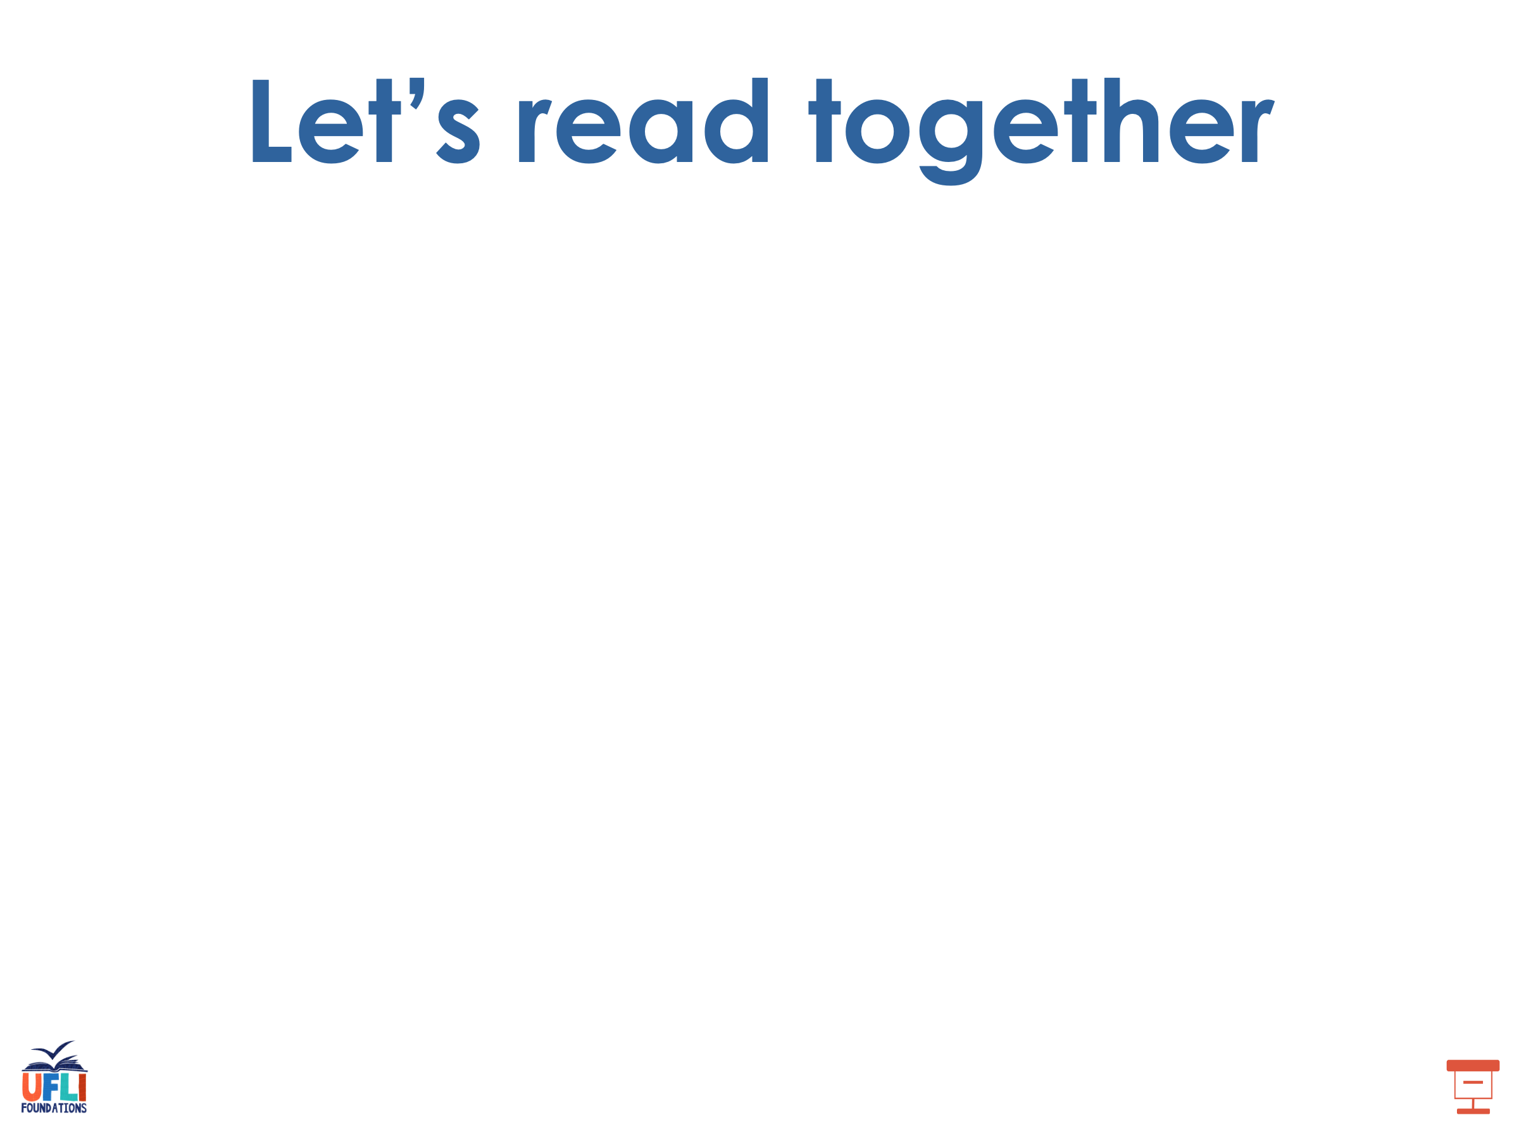
open
even
unit
virus
robot
begin

Slide 48
secret
humid
moment

Slide 49
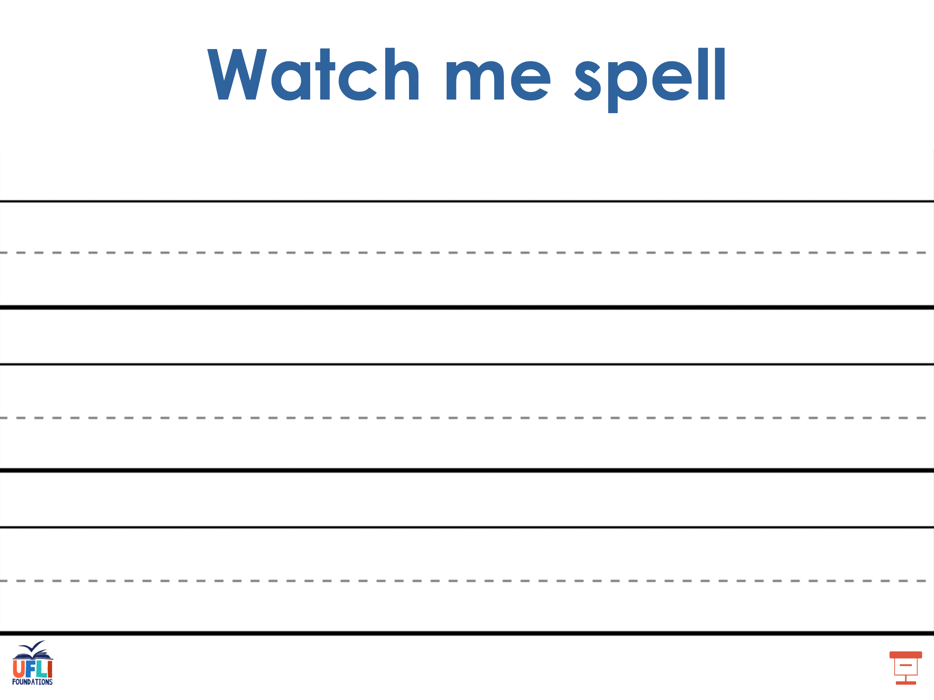
Notes:
See UFLI Foundations lesson plan Step 5 for words to spell.
Handwriting paper to model spelling.

Slide 50
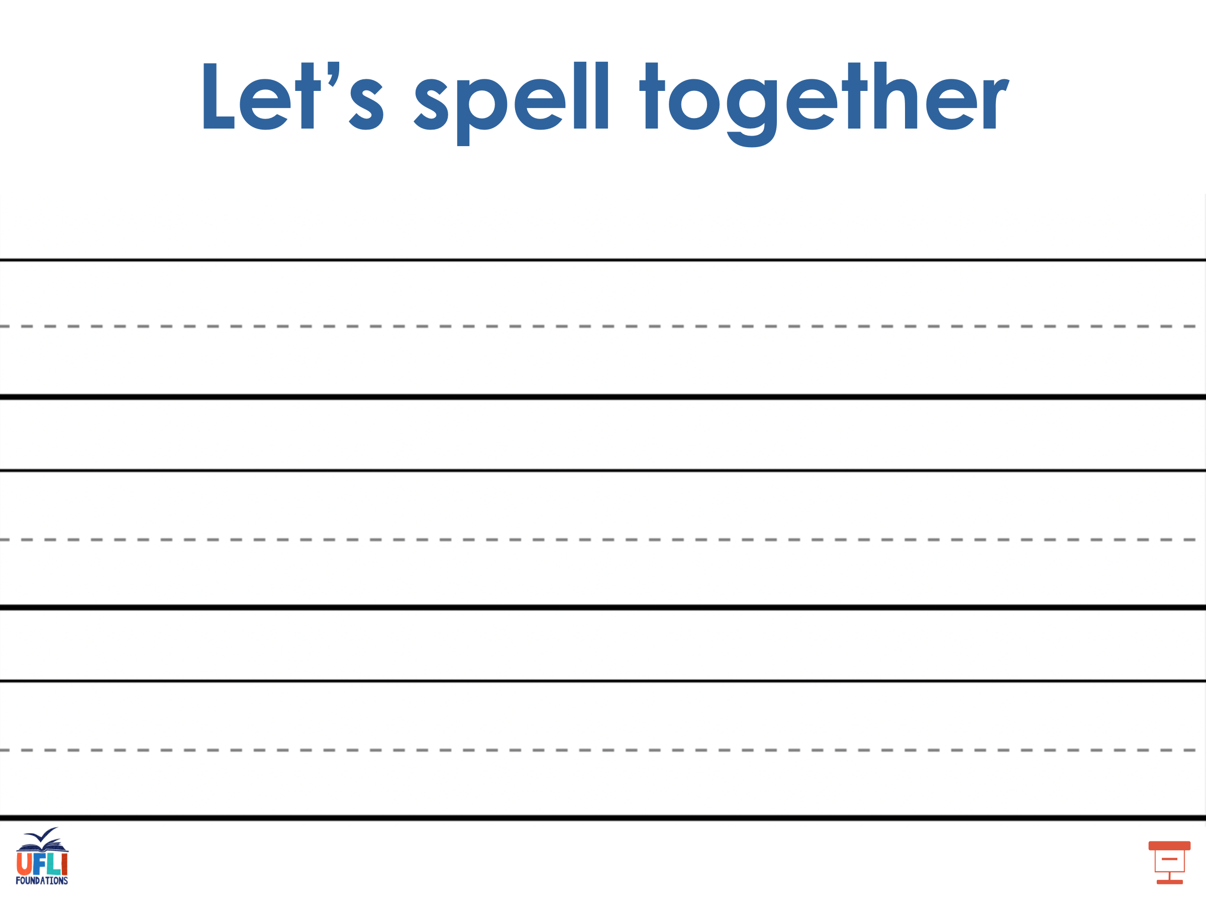
Notes:
See UFLI Foundations lesson plan Step 5 for words to spell.
Handwriting paper for guided spelling practice.

Slide 51
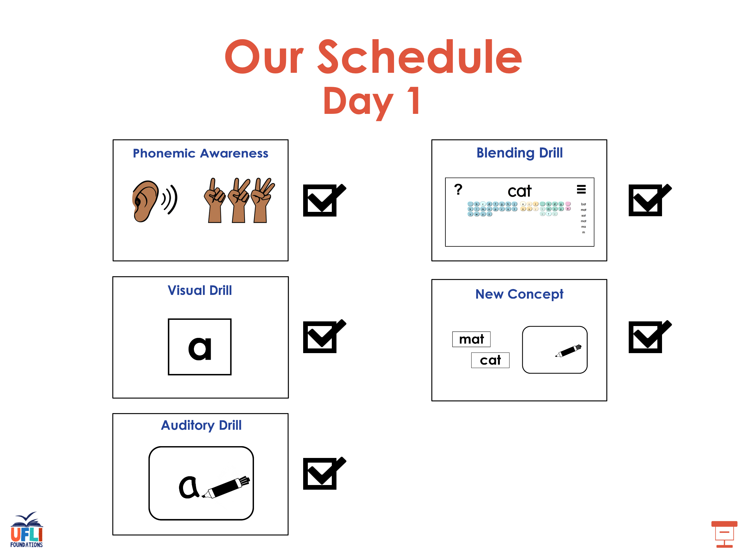

Slide 52

Insert brief reinforcement activity and/or transition to next part of reading block.

Slide 53
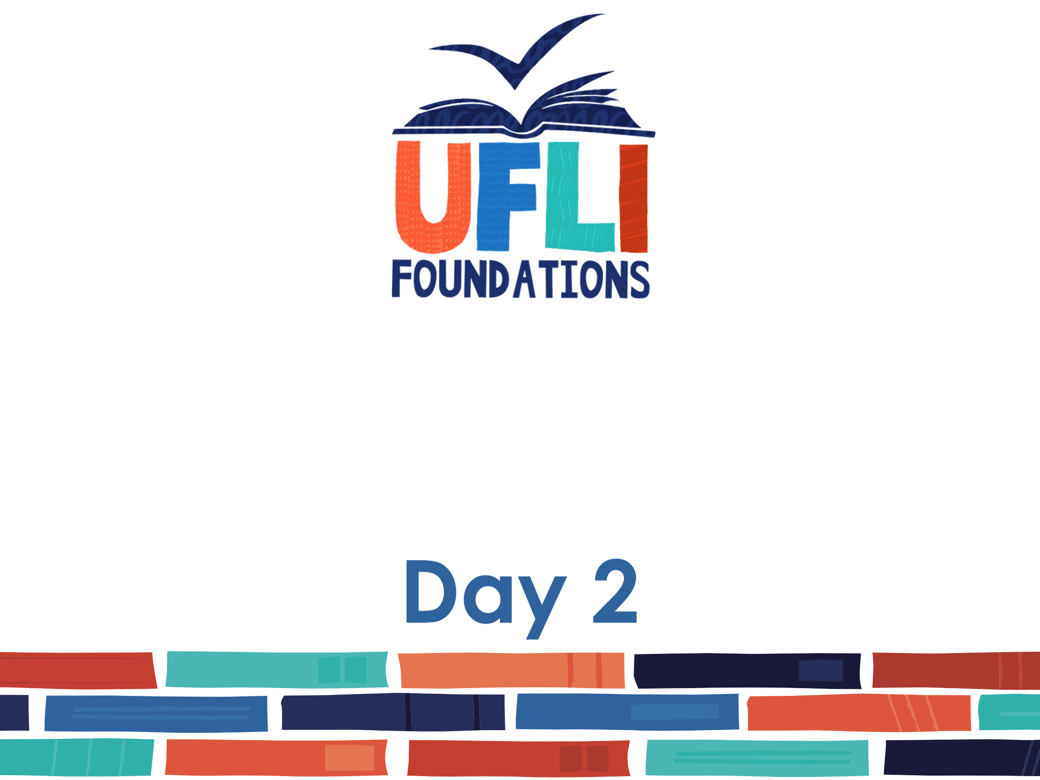
Lesson 68
Open/Closed

Slide 54
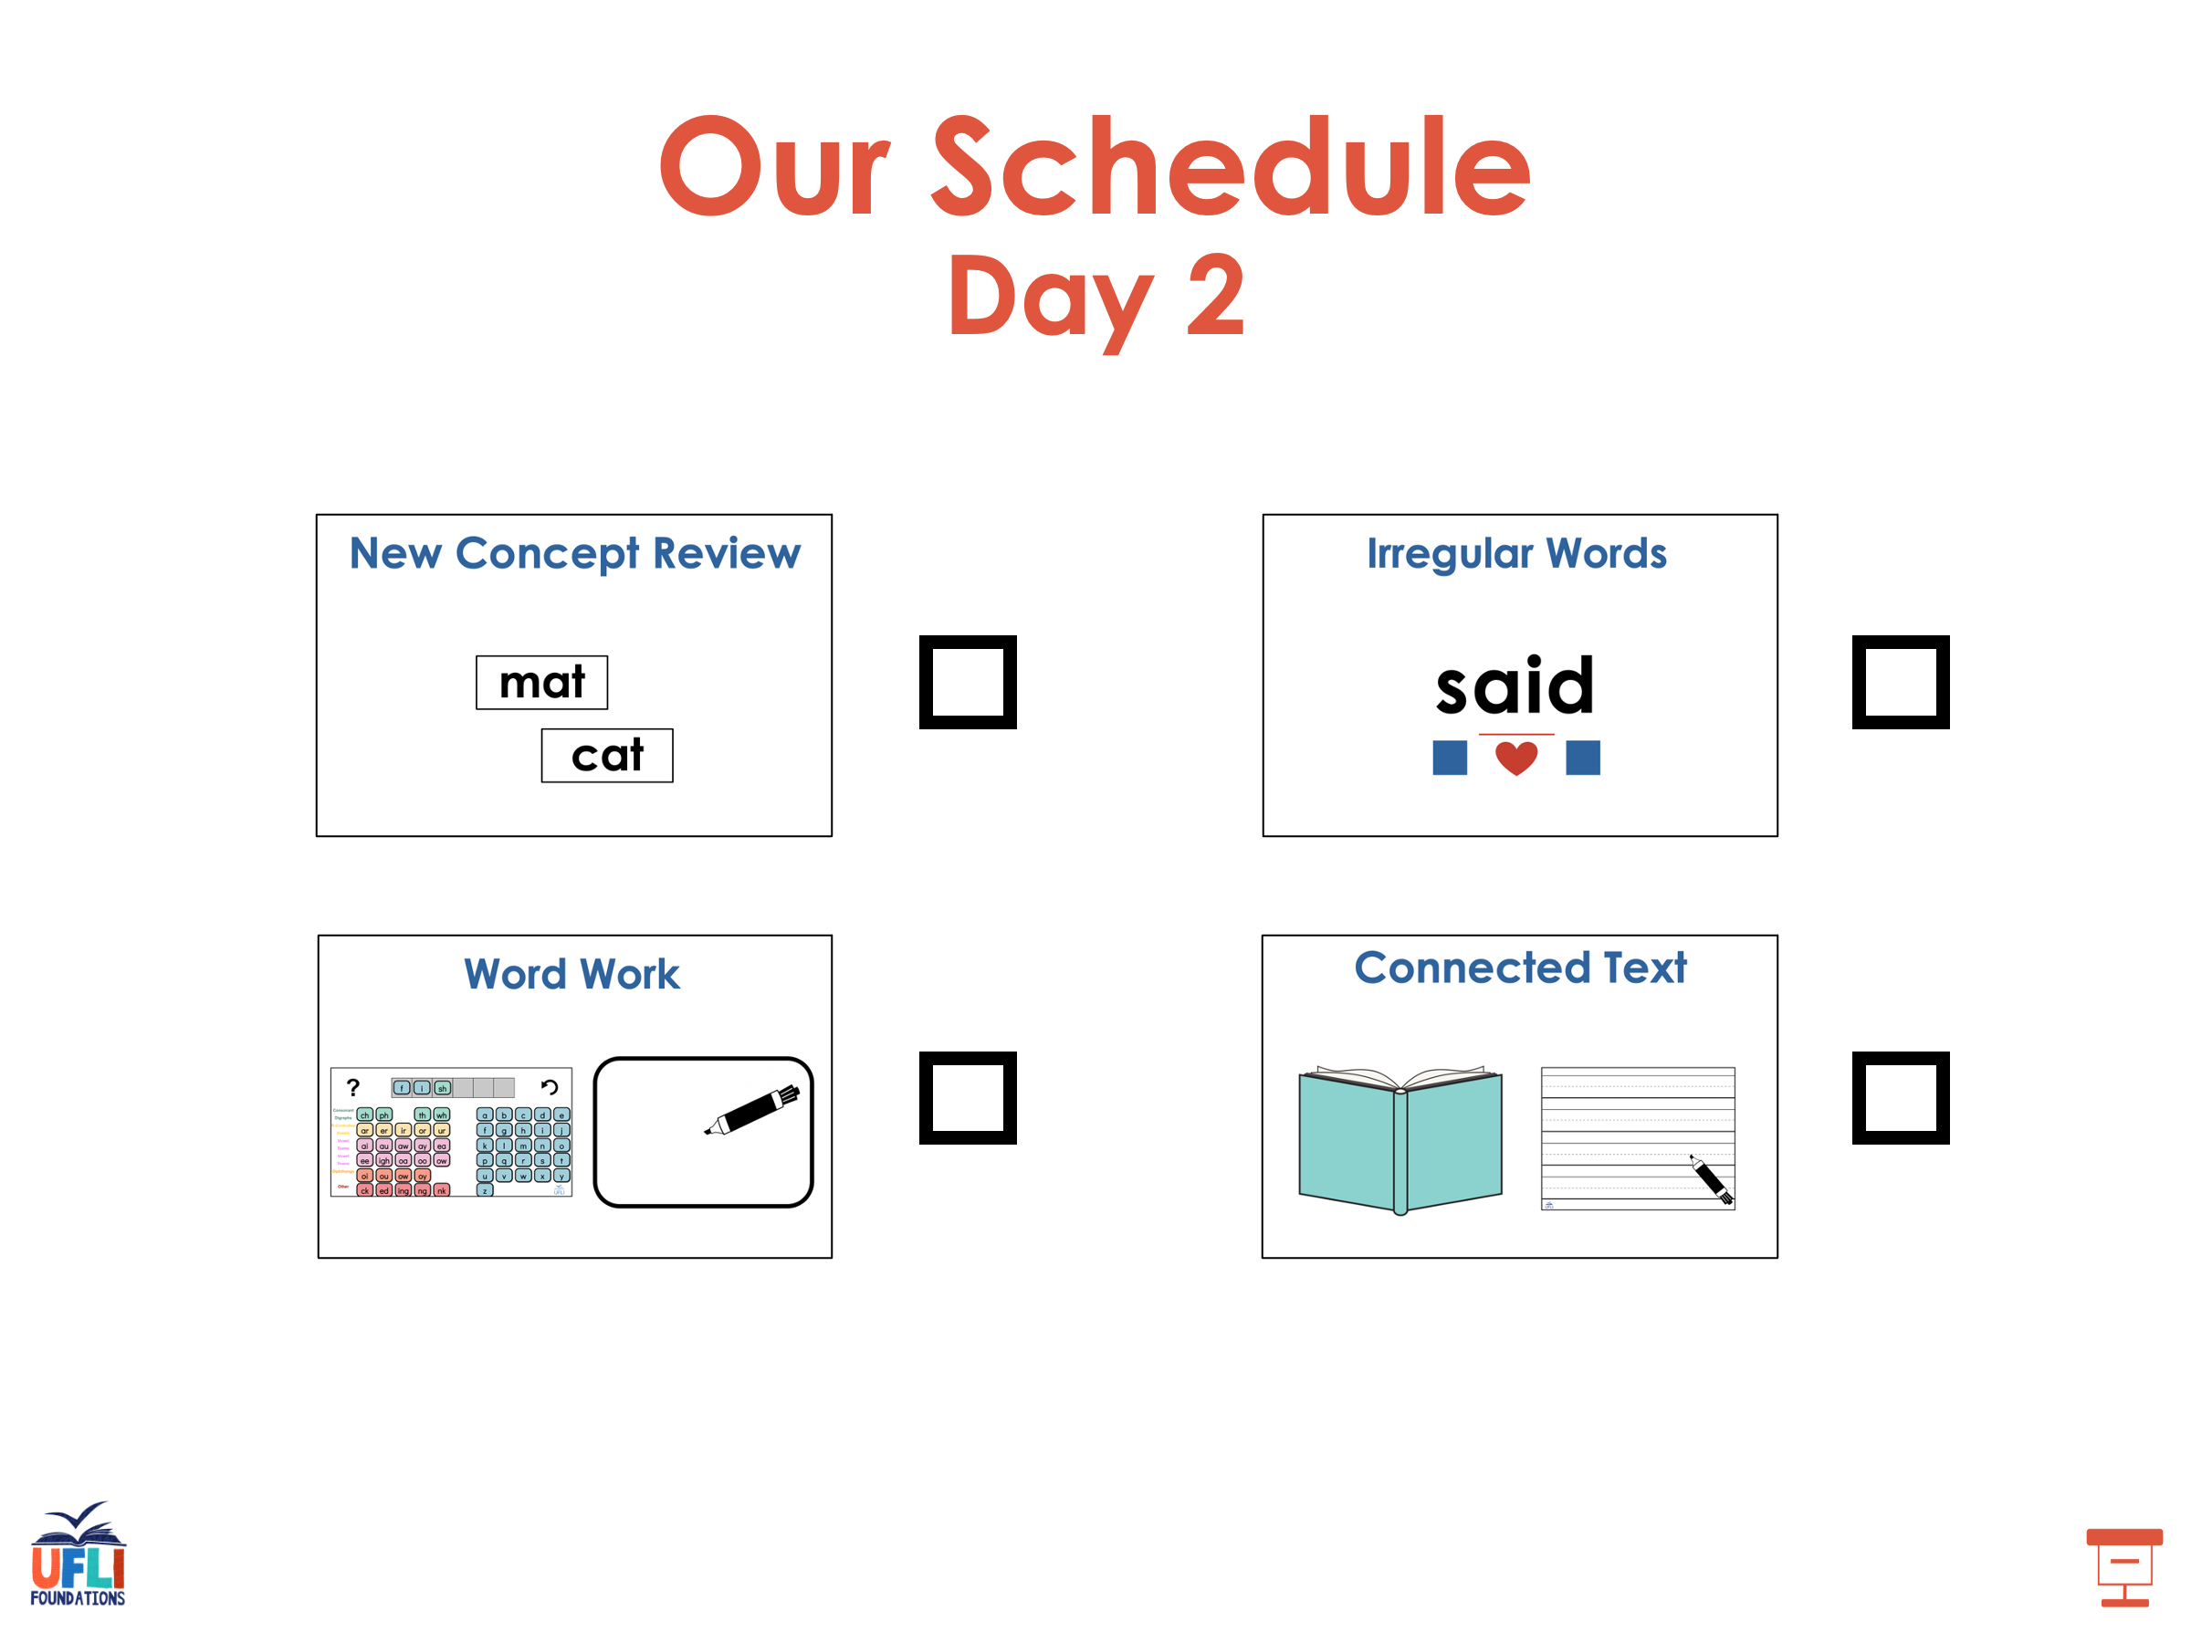

Slide 55
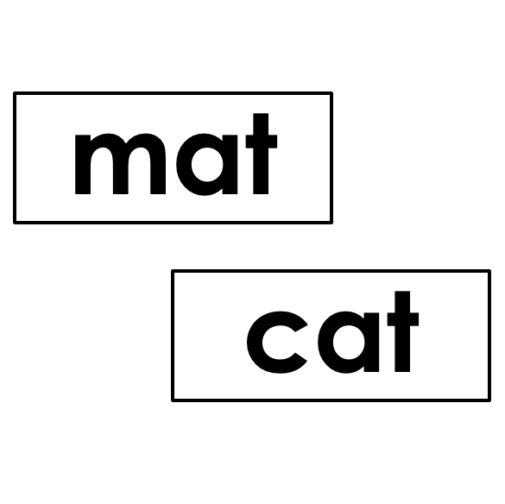


New Concept Review
Notes:
See UFLI Foundations lesson plan Step 5 for recommended teacher language and activities to review the new concept.

Slide 56
Closed Syllable
V
C

Slide 57
Closed Syllable
V
C
met

Slide 58
Open Syllable
V

Slide 59
Open Syllable
V
me

Slide 60
be
yond

Slide 61
about

Slide 62
a
e
i
o
u
y

Slide 63
bo-nus

Slide 64
hu-man

Slide 65
den-im

Slide 66
began
even
open
begin

Slide 67
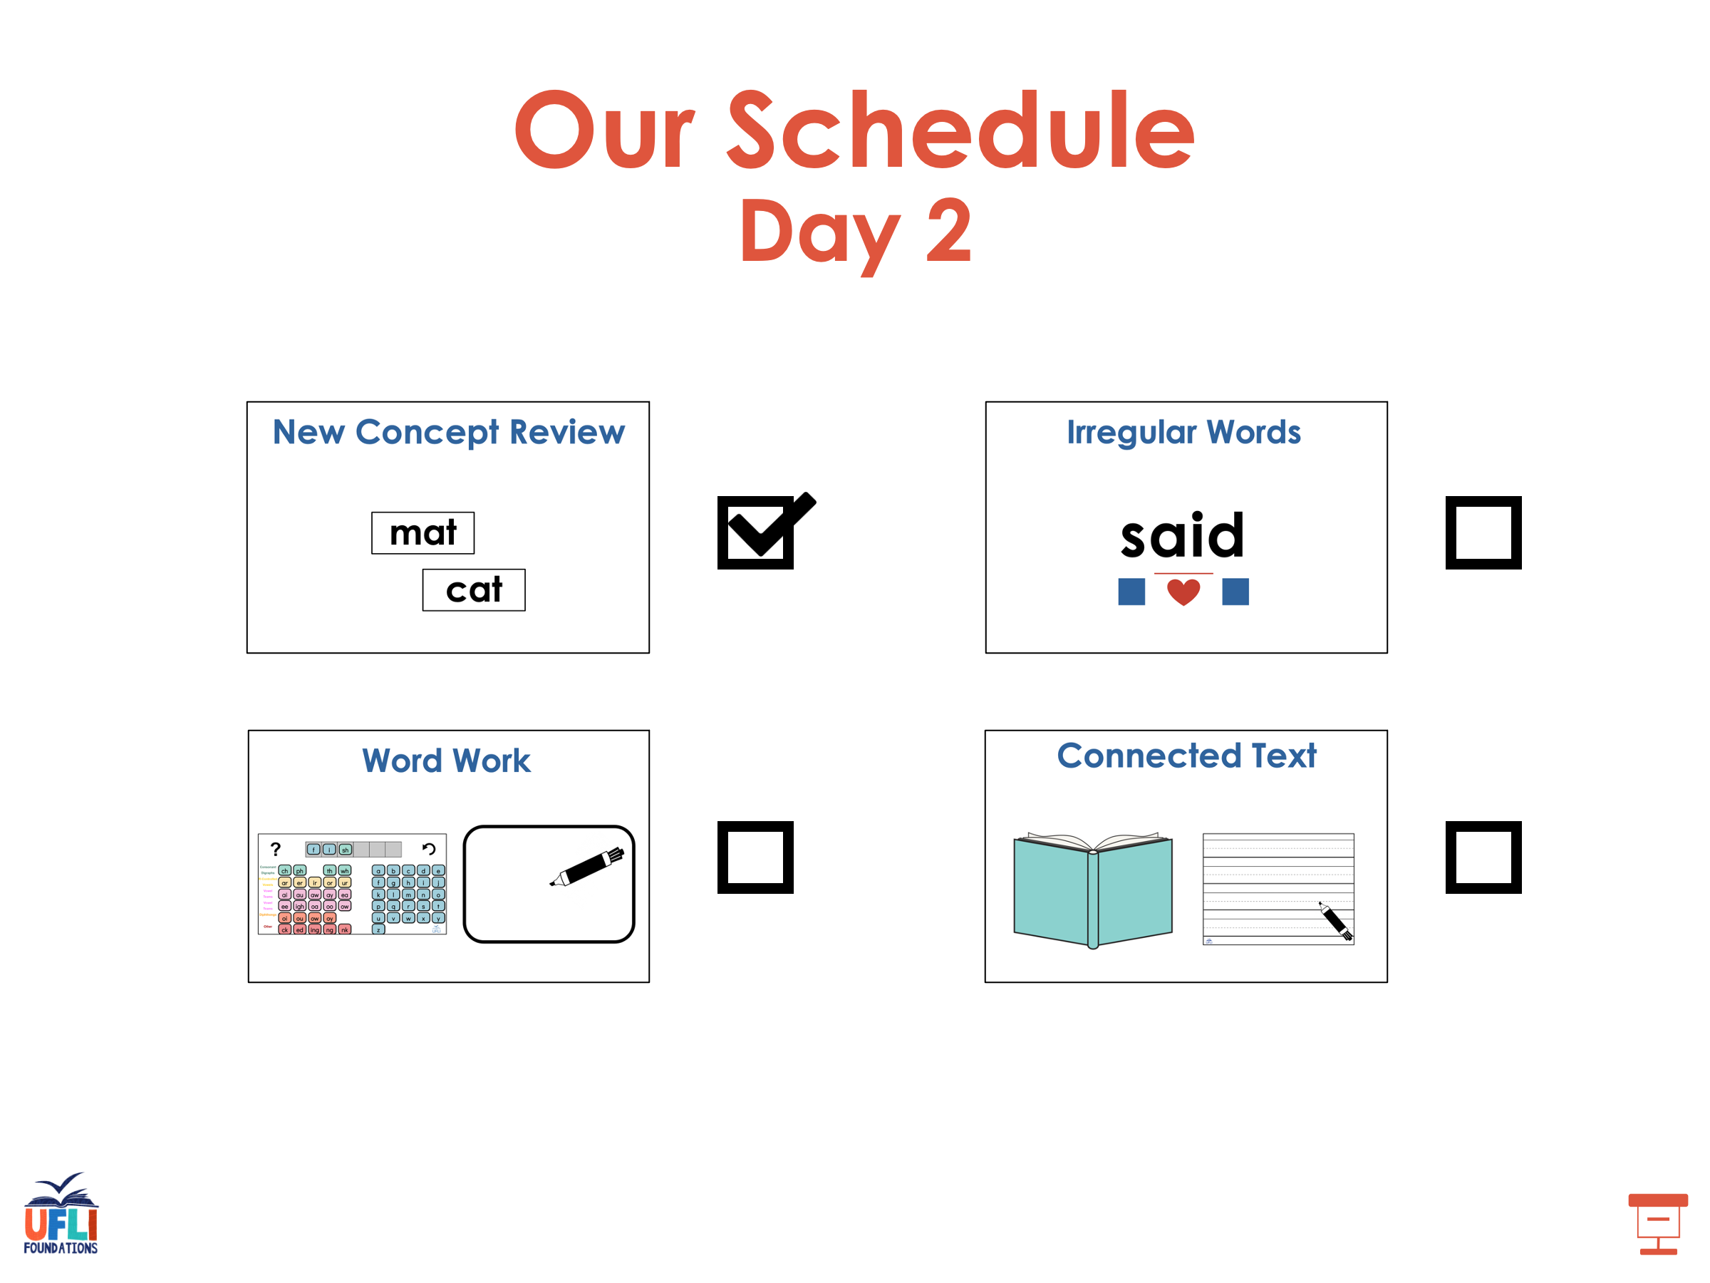

Slide 68
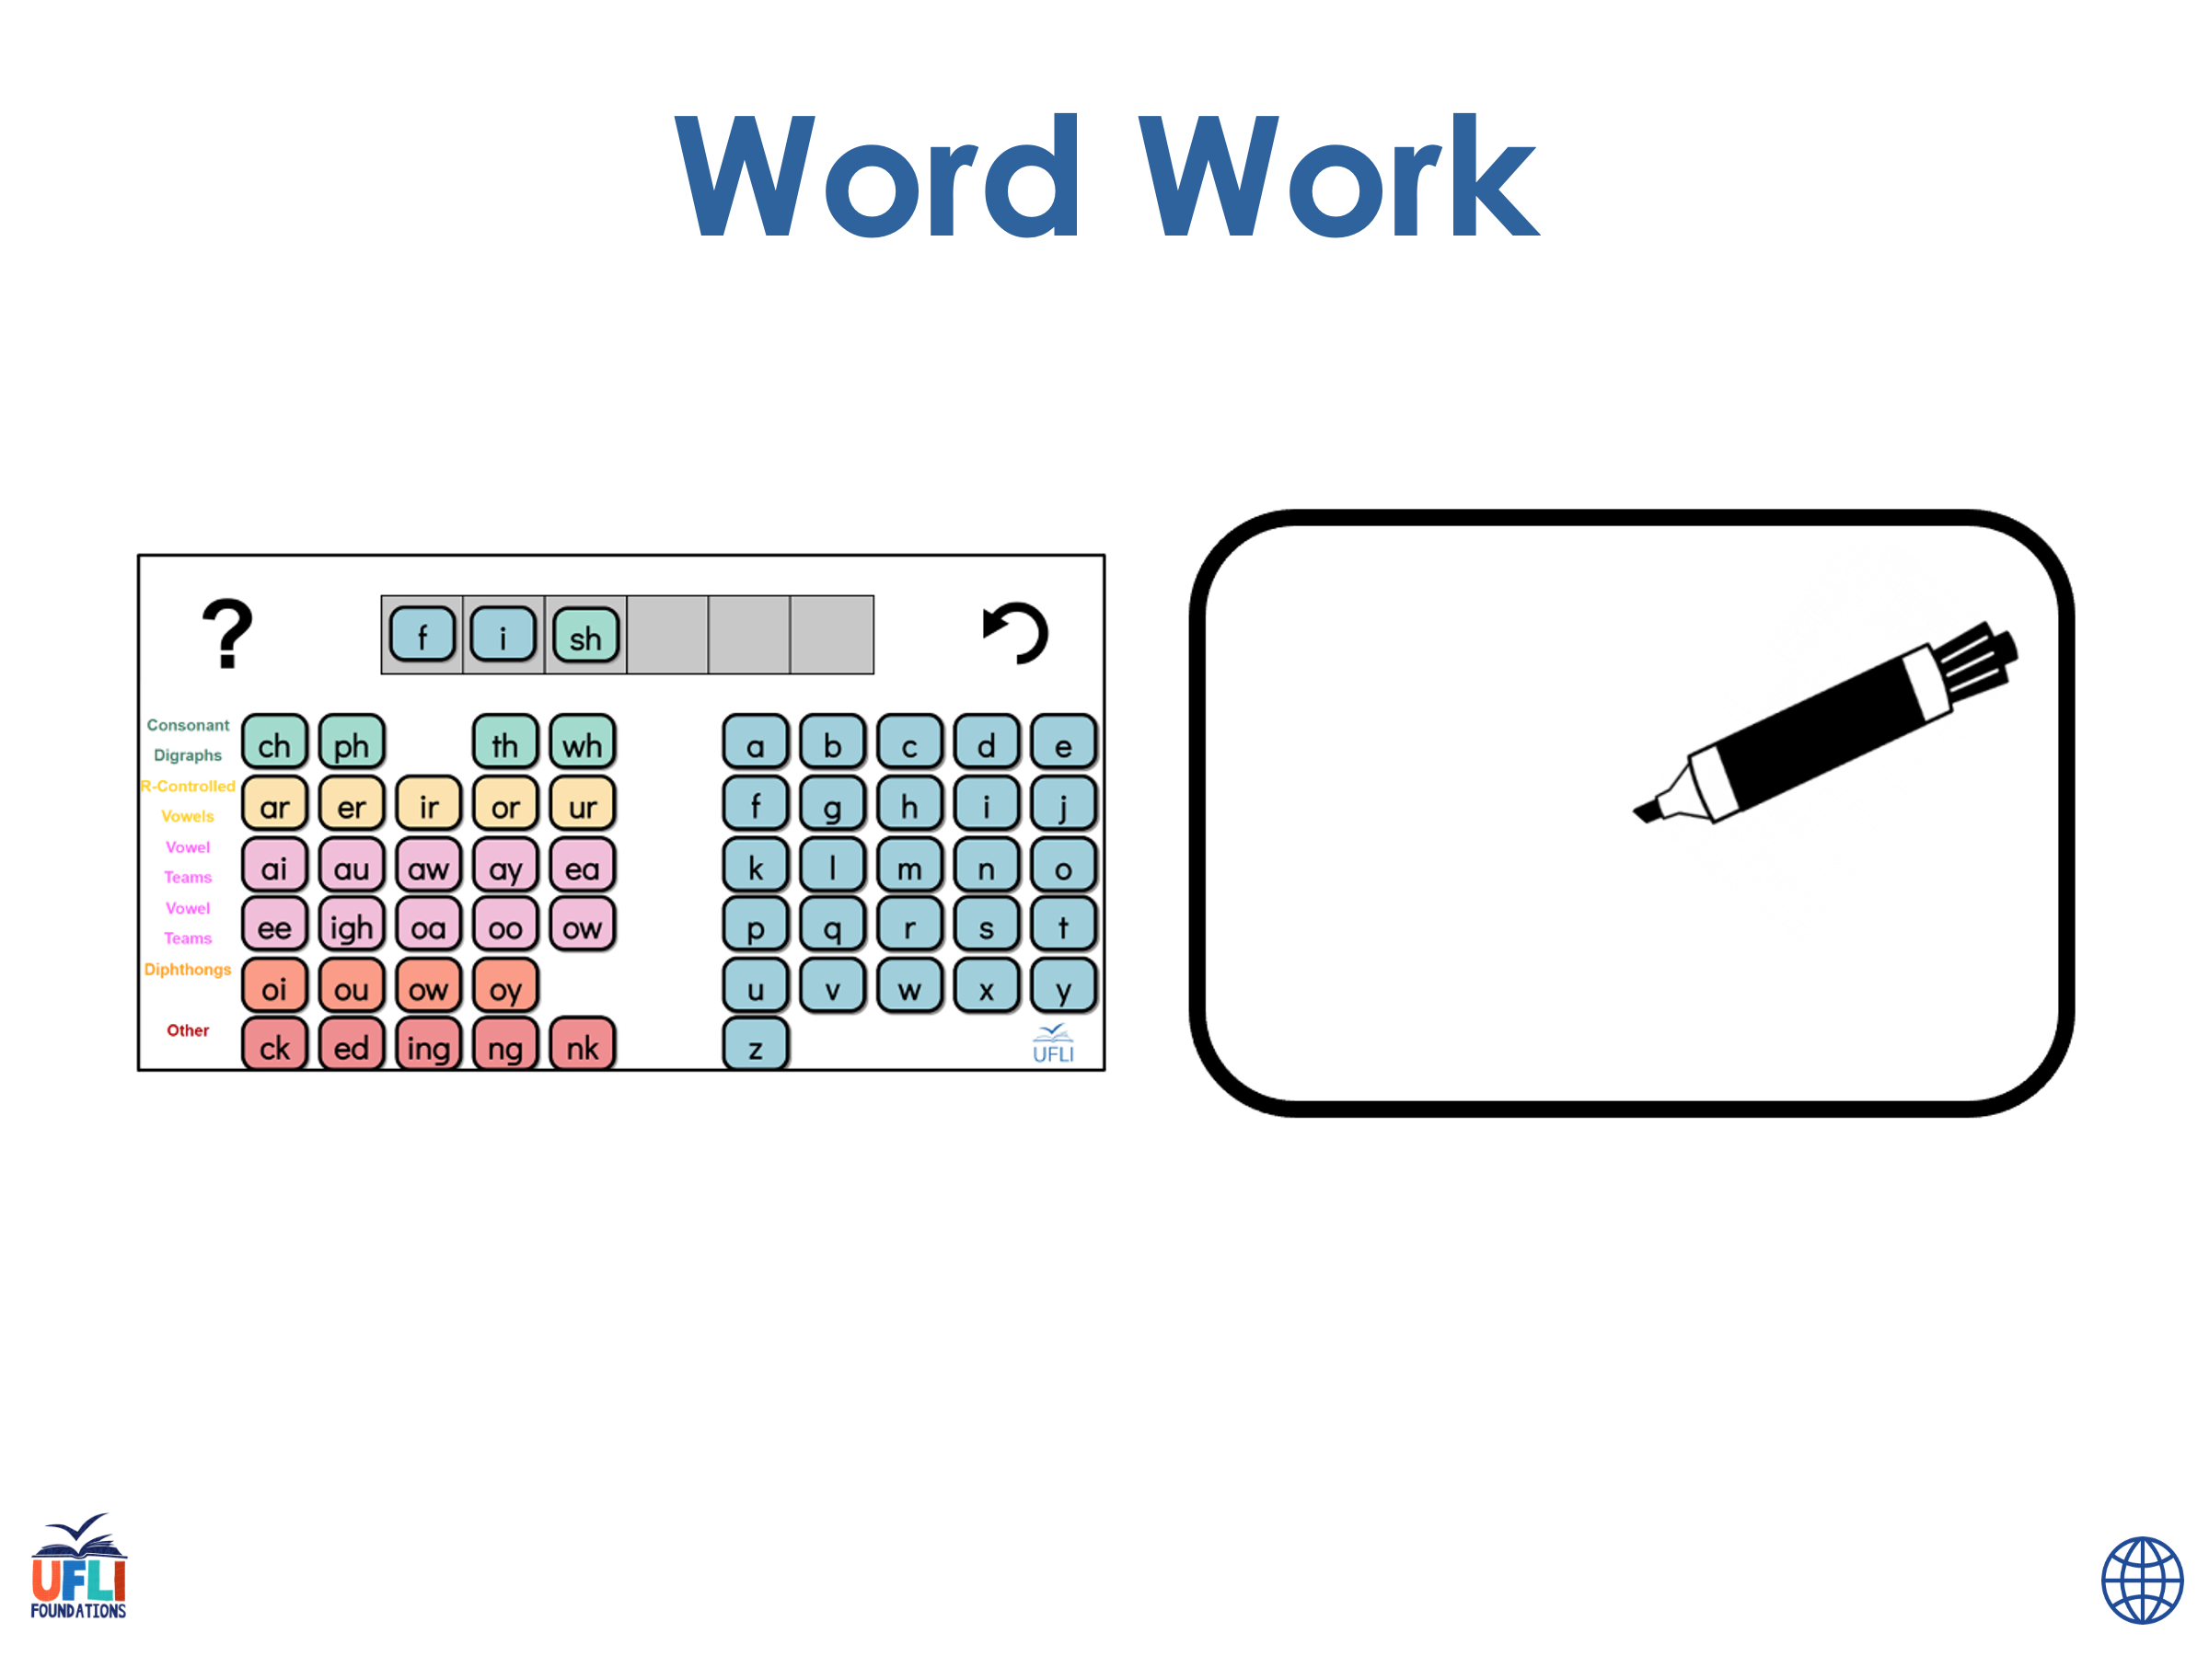
Notes:
See UFLI Foundations lesson plan Step 6 for word work activity.
Visit ufliteracy.org to access the Word Work Mat apps.

Slide 69
ra
ven

Slide 70
si
lent

Slide 71
da
ta

Slide 72
mu
sic

Slide 73
to
ken

Slide 74
pro
gram

Slide 75
cu
bic

Slide 76
pre
fix

Slide 77
se
cret

Slide 78
si
nus

Slide 79
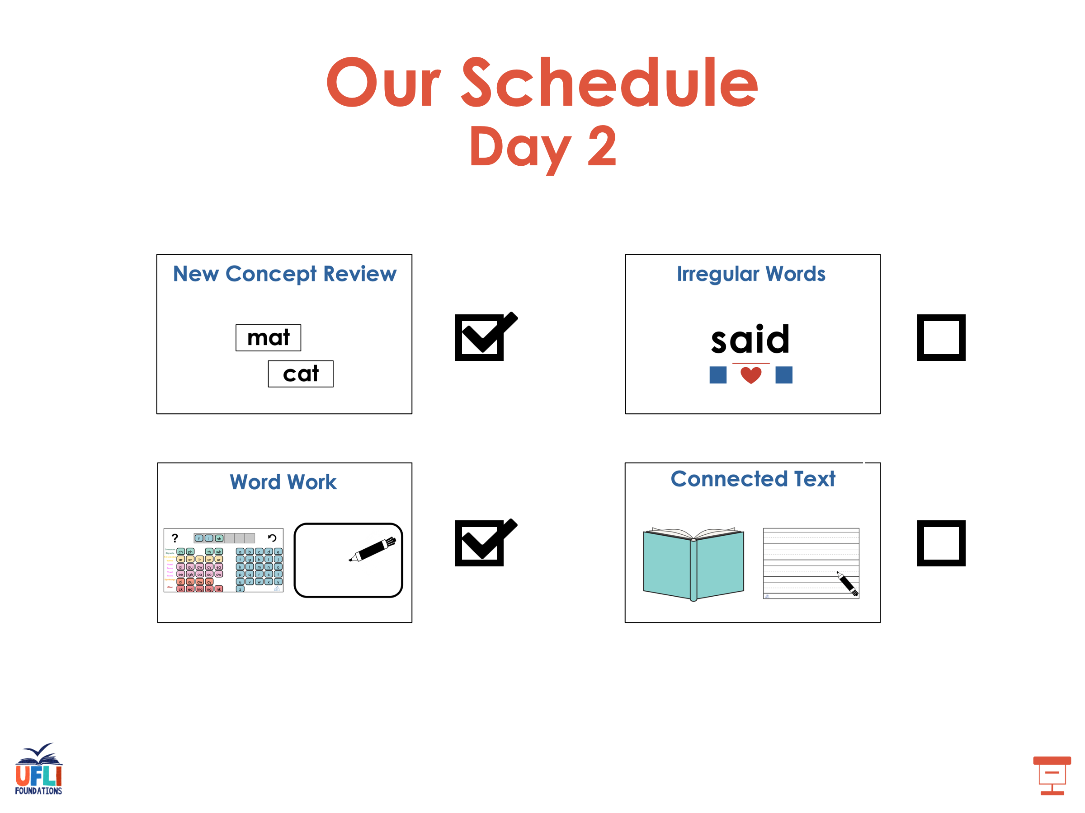

Slide 80
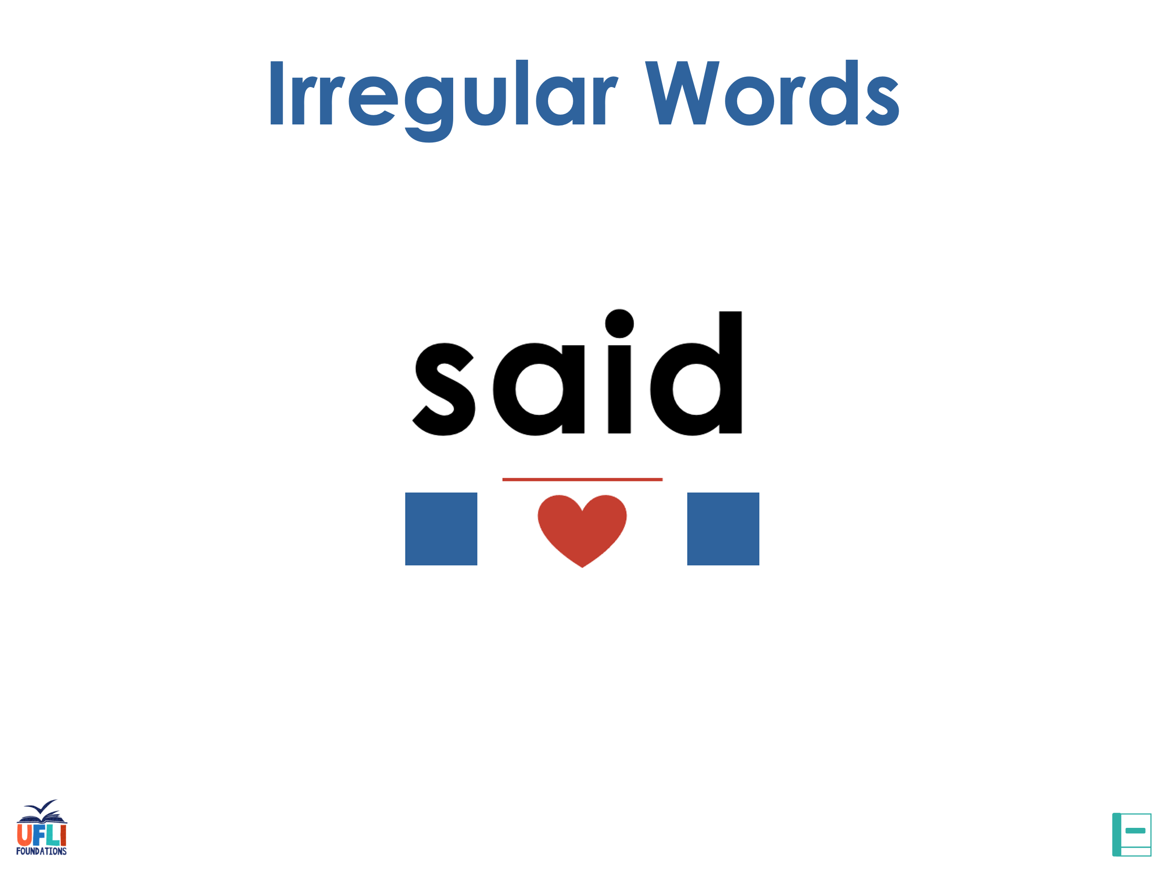
Notes:
See UFLI Foundations lesson plan Step 7 for irregular word activities.
The white rectangle under each word may be used in editing mode. Cover the heart and square icons then reveal them one at a time during instruction.

Slide 81

Notes:
See UFLI Foundations manual for more information about reviewing irregular words.

Slide 82
many
Notes:
Lessons 64-73
A represents either the /ĕ/ sound or the /ĭ/ sound, depending on dialect.
Y /ē/ has not been introduced yet.
The white rectangle under the word may be used in editing mode. Cover the heart and square icons then reveal them one at a time during instruction.

Slide 83
any
Notes:
Lessons 64-73
A represents either the /ĕ/ sound or the /ĭ/ sound, depending on dialect.
Y /ē/ has not been introduced yet.
The white rectangle under the word may be used in editing mode. Cover the heart and square icons then reveal them one at a time during instruction.

Slide 84
been
Notes:
Lesson 65+
EE represents the /ĕ/ sound or the /ĭ/ sound, depending on dialect.
In some dialects, the EE in been is pronounced /ē/. In this case, been would be temporarily irregular until lesson 85 when EE /ē/ is introduced.
The white rectangle under the word may be used in editing mode. Cover the heart and square icons then reveal them one at a time during instruction.

Slide 85
into
Notes:
Lesson 65+
O represents the /ū/ sound.
The white rectangle under the word may be used in editing mode. Cover the heart and square icons then reveal them one at a time during instruction.

Slide 86
friend
Notes:
Lesson 66+
IE represents the /ĕ/ or /ĭ/ sound, depending on dialect.
The white rectangle under the word may be used in editing mode. Cover the heart and square icons then reveal them one at a time during instruction.

Slide 87
because
Notes:
Lesson 67a+
AU represents the /ŭ/ sound.
In some dialects, AU represents the /aw/ sound. In this case, the AU in because would be temporarily irregular until lesson 93 when AU /aw/ is introduced.
The final E is silent but does not follow the long vowel VCe pattern.
The white rectangle under the word may be used in editing mode. Cover the heart and square icons then reveal them one at a time during instruction.

Slide 88
Notes:
Handwriting paper for irregular word spelling practice. Use as needed.
See UFLI Foundations manual for more information about reviewing irregular words.

Slide 89
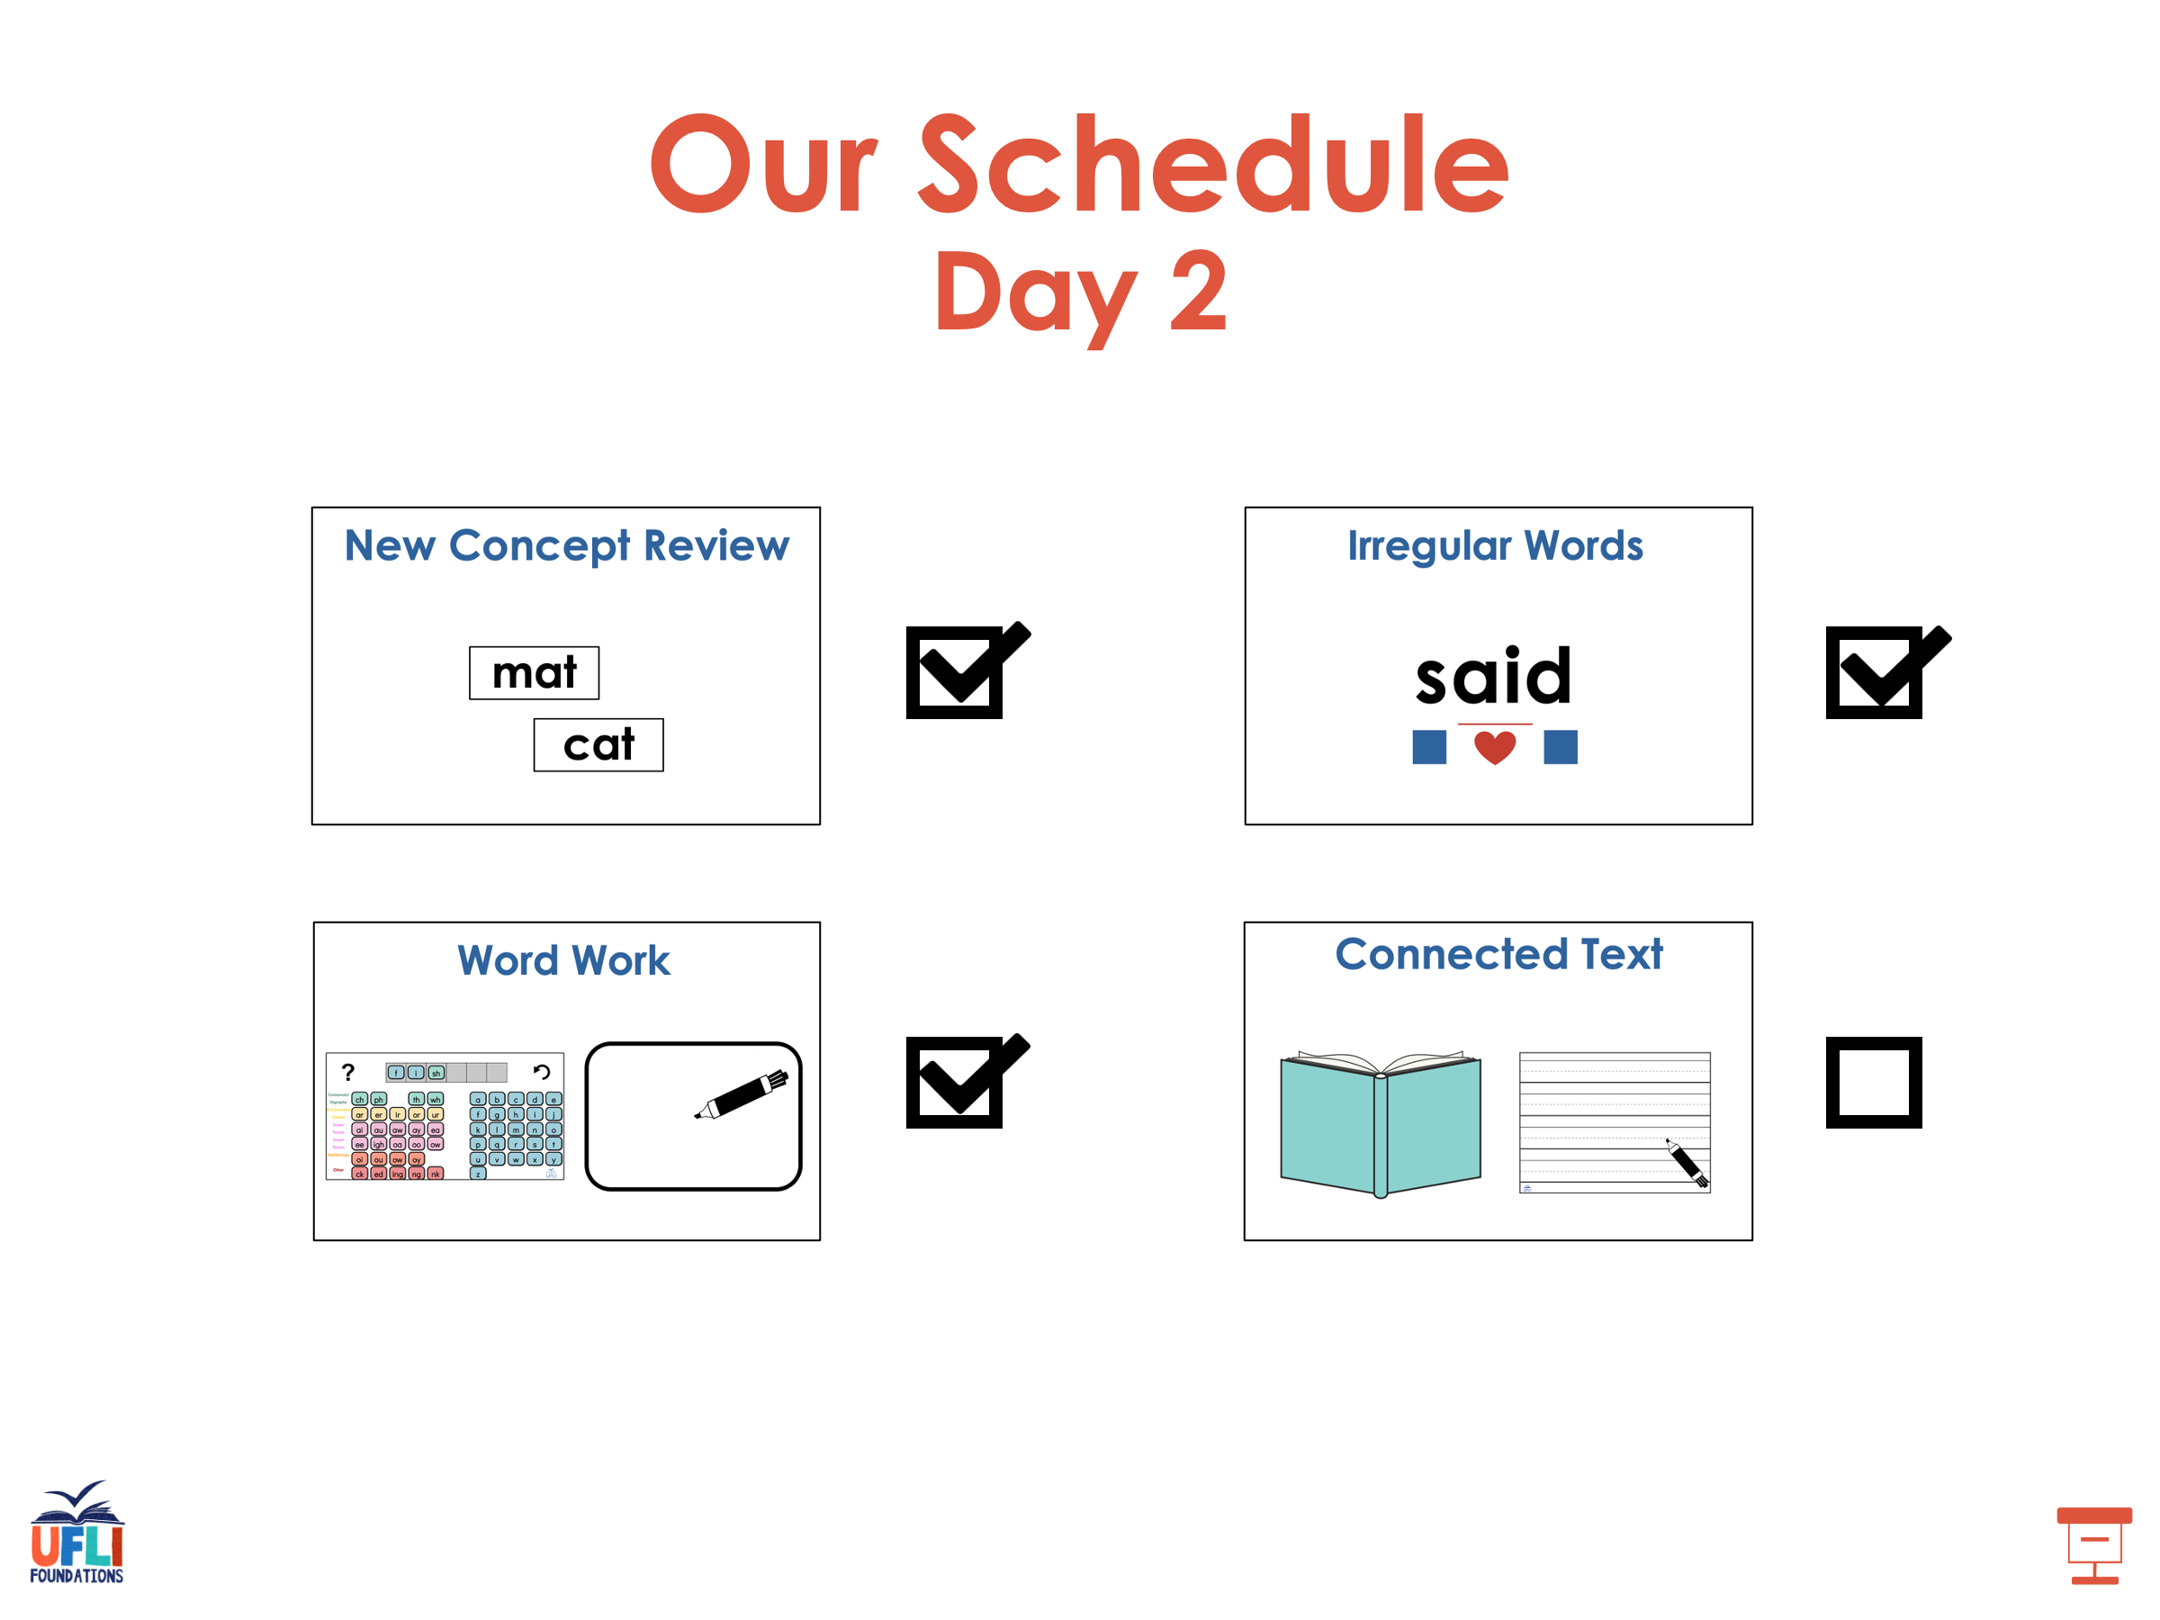

Slide 90
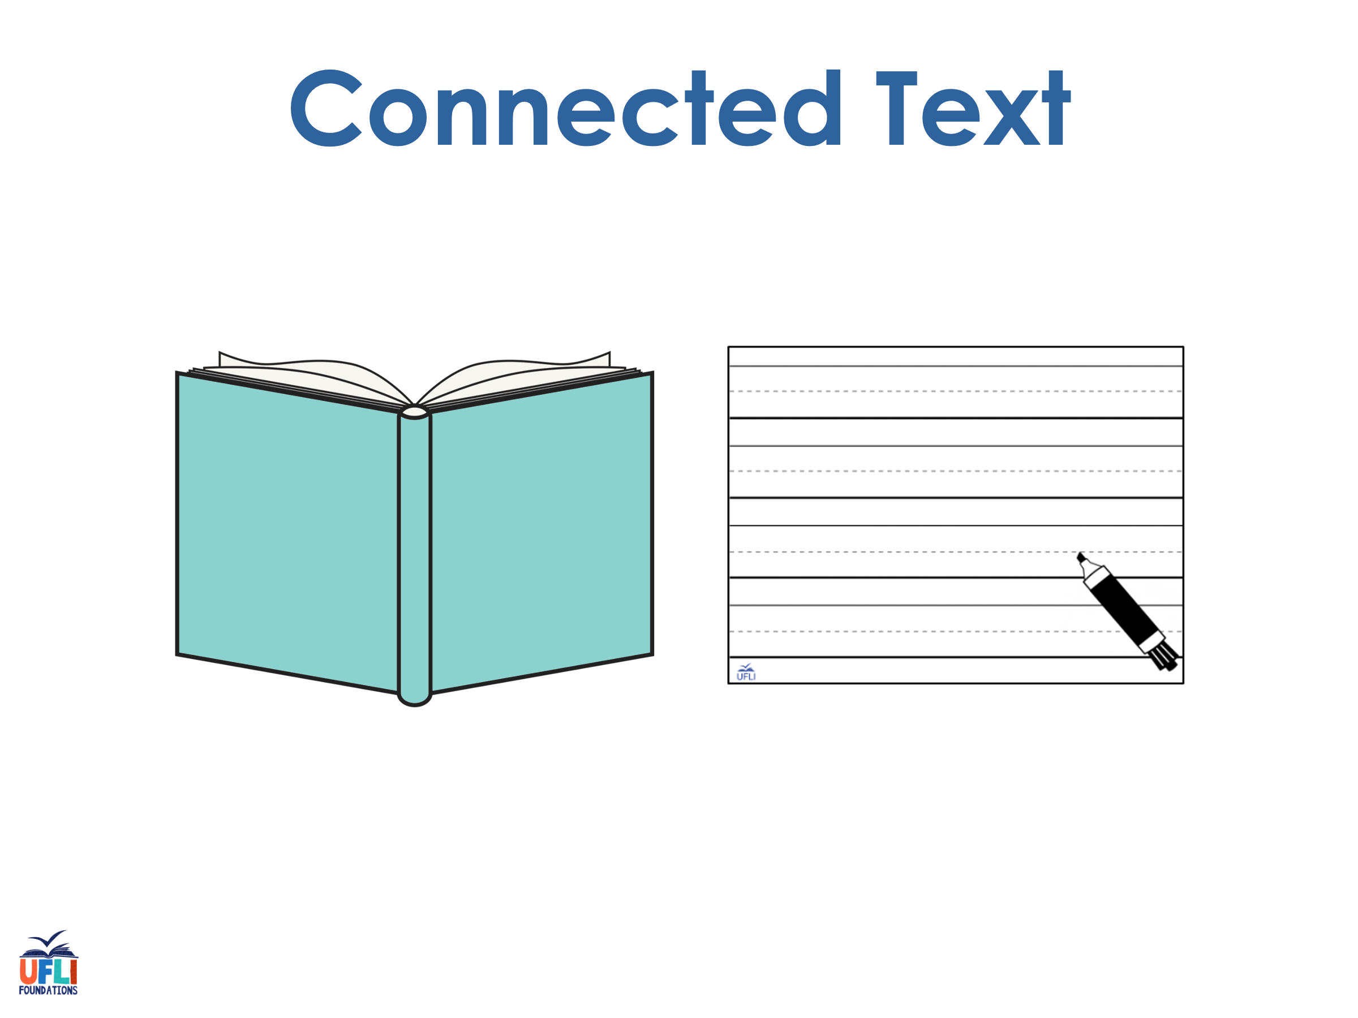
Notes:
See UFLI Foundations lesson plan Step 8 for connected text activities.

Slide 91
My phone has been on silent.

Slide 92
Did your friend begin the race?

Slide 93
I love music class because we sing!

Slide 94
Notes:
See UFLI Foundations lesson plan Step 8 for sentences to write.

Slide 95
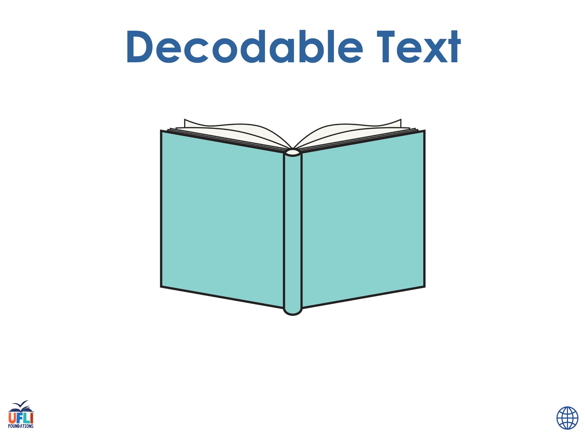
Notes:
The UFLI Foundations decodable text is provided here. See UFLI Foundations decodable text guide for additional text options.

Slide 96
Music Class
Music class is the best because we get to sing. It is no secret that I love to sing. If you sing well, you get to have a solo.

Slide 97
When I have a solo in music class, I pretend I am on a huge stage. It is silent for a moment, then I begin.
I sing and sing like time is frozen. At the end, my friends clap for me. That is a nice bonus.

Slide 98
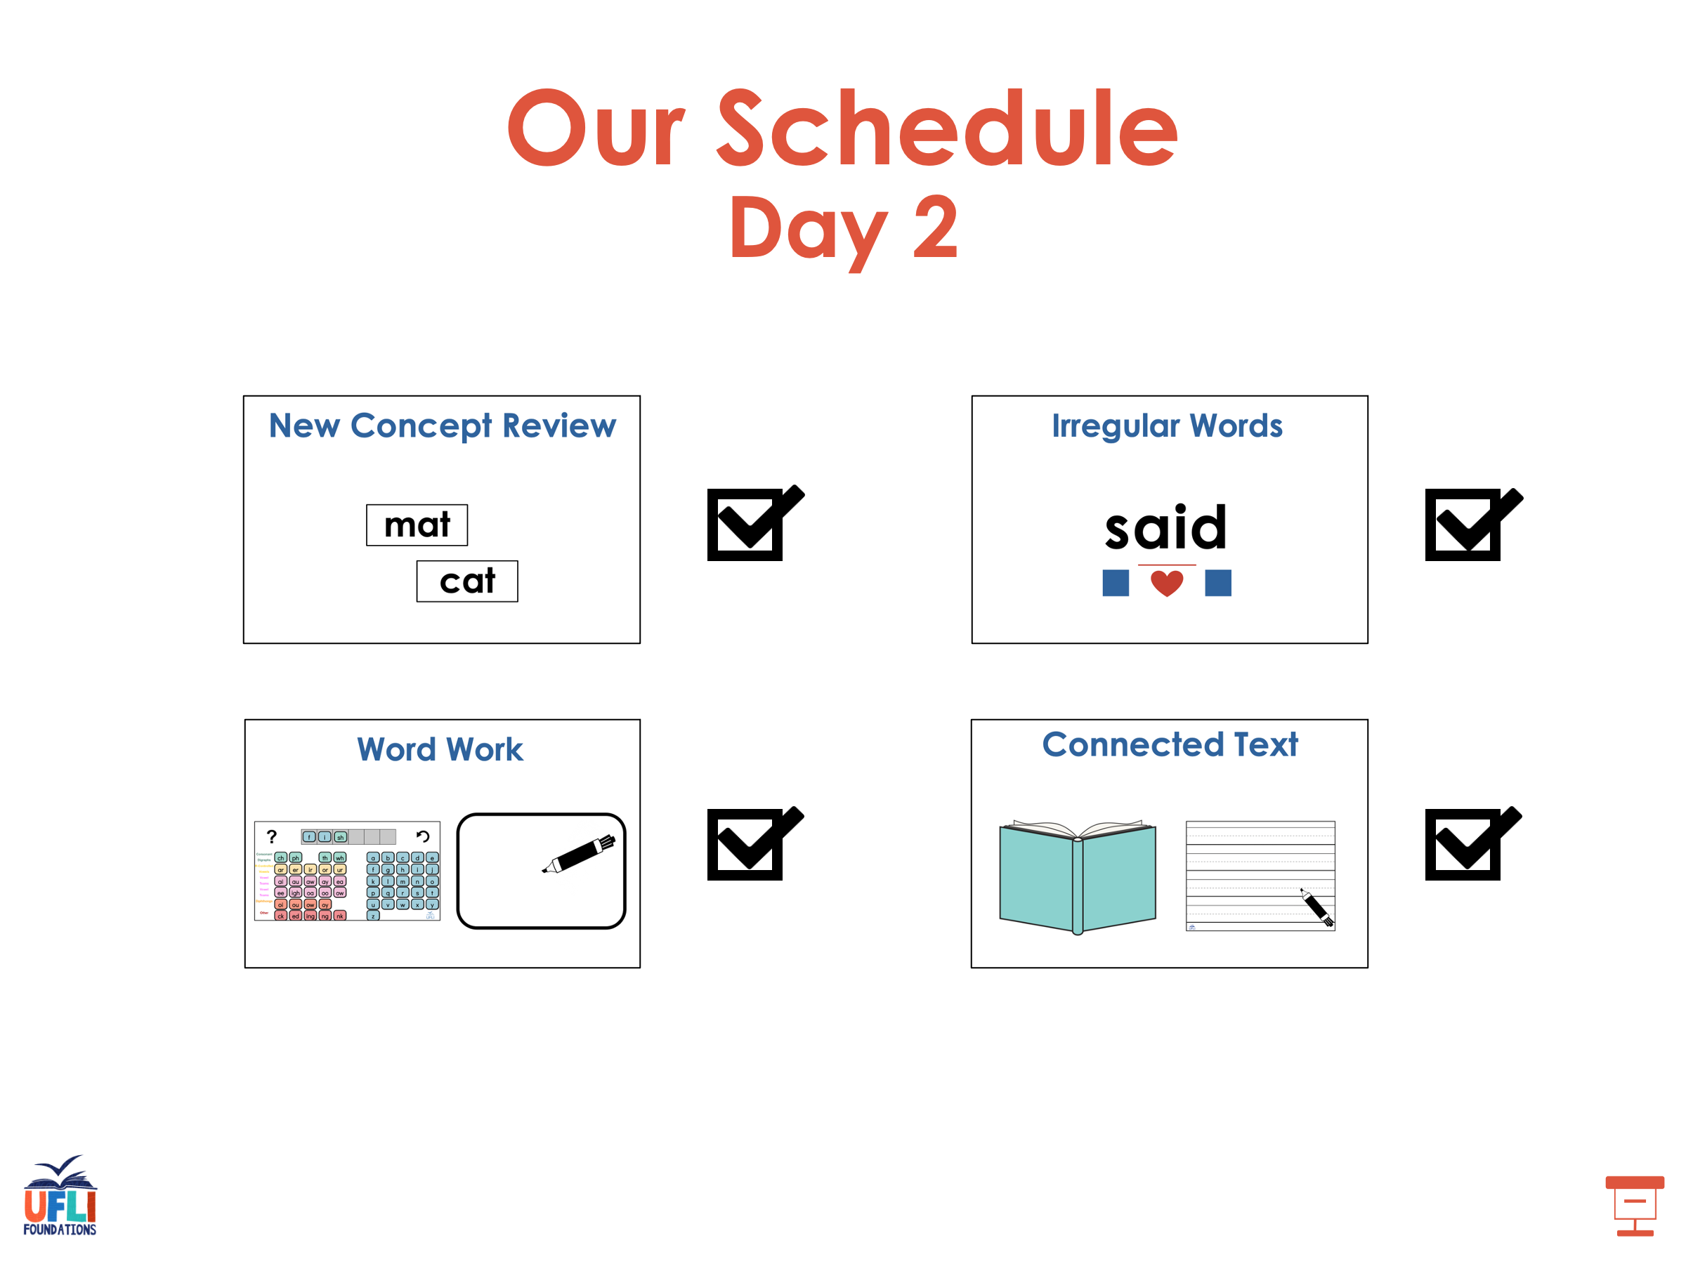

Slide 99
Insert brief reinforcement activity and/or transition to next part of reading block.

