Slide 1
Lesson 67a
Compound Words

Slide 2
Notes:
ufliteracy.org

Slide 4
Lesson 67a
Compound Words

Slide 6
Notes:
See UFLI Foundations lesson plan Step 1 for phonemic awareness activity.

Slide 8
Notes:
See UFLI Foundations lesson plan Step 2 for student phoneme responses.

Slide 9
-ed

Slide 10
g

Slide 11
c

Slide 12
a

Slide 13
i

Slide 14
o

Slide 15
e

Slide 16
u

Slide 17
nk

Slide 18
ng

Slide 19
wh

Slide 20
ph

Slide 21
ch

Slide 22
th

Slide 23
sh

Slide 24
ck

Slide 25
s

Slide 27
Notes:
See UFLI Foundations lesson plan Step 3 for auditory drill activity.

Slide 28
Notes:
No slides needed for auditory drill.

Slide 30
Notes:
See UFLI Foundations lesson plan Step 4 for blending drill word chain and grid.
Visit ufliteracy.org to access the Blending Board app.

Slide 32
Notes:
See UFLI Foundations lesson plan Step 5 for recommended teacher language and activities to introduce the new concept.

Slide 33
Syllable
A word or part of a word with one vowel sound.

Slide 34
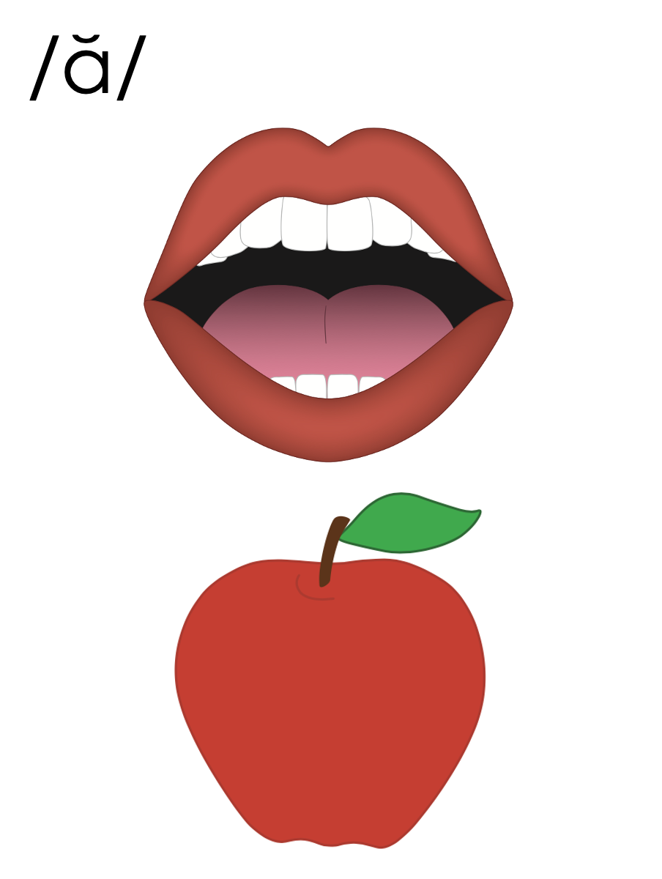
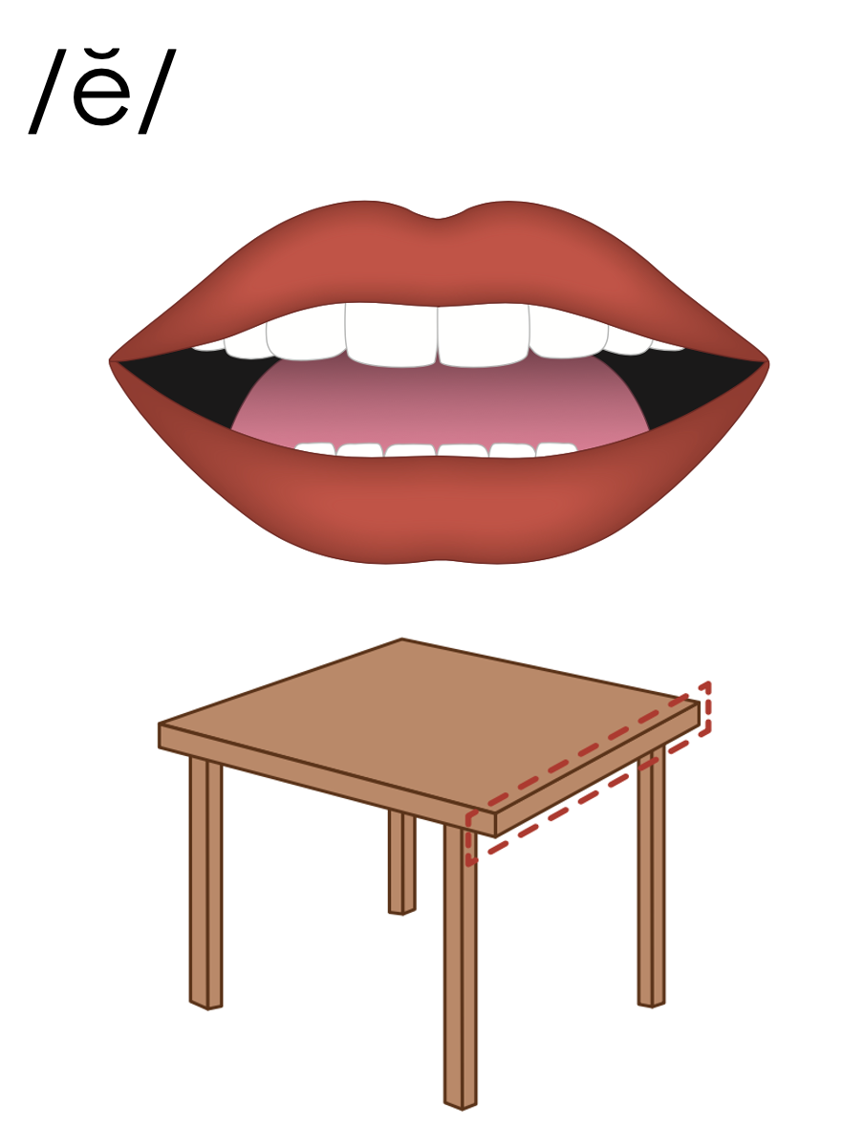
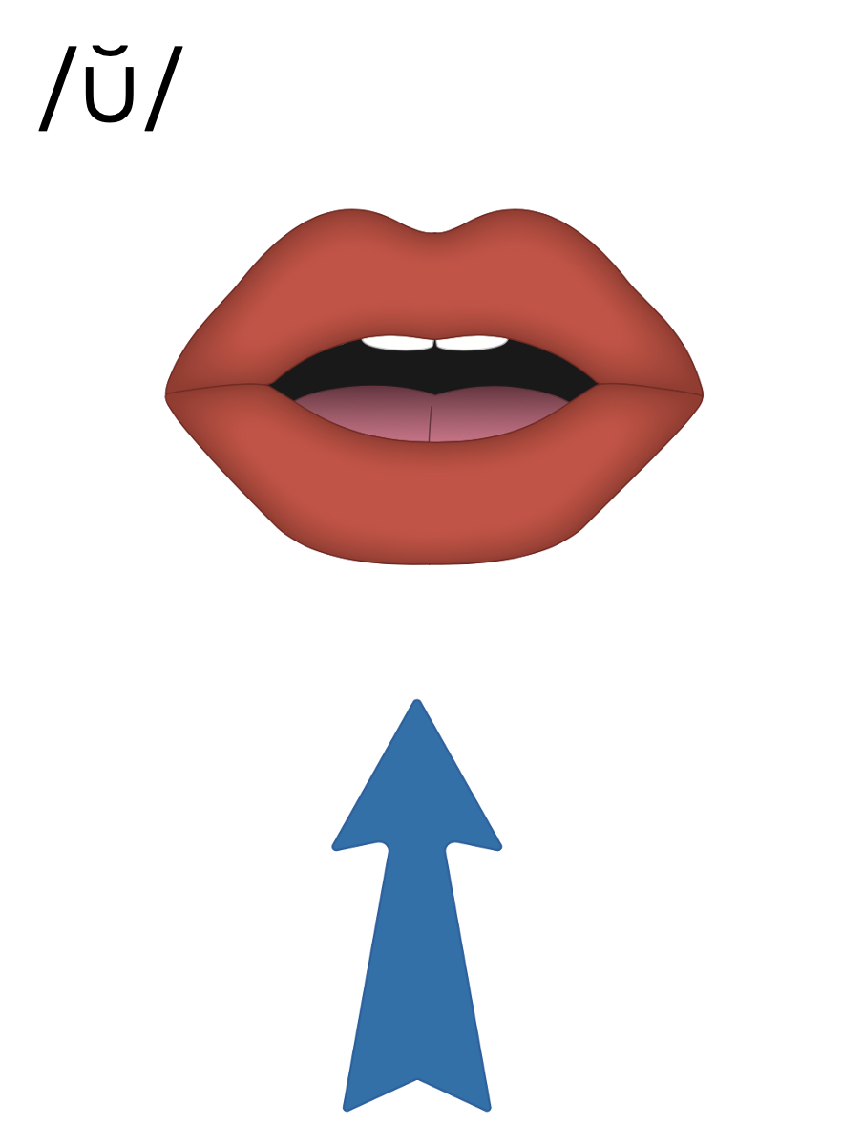
Closed Syllable
V
C

Slide 35
Closed Syllable
V
C
sun

Slide 36
Compound Word
sun
set

Slide 37
Compound Word
step
dad

Slide 38
Notes:
Handwriting paper for letter formation practice. Use as needed.
See UFLI Foundations manual for more information about letter formation.

Slide 39
hot
dog

Slide 40
hand
stand

Slide 41
itself
cannot
uphill

Slide 42
backpack
bulldog
suntan

Slide 43
sandlot
sometimes
something

Slide 44
Notes:
See UFLI Foundations lesson plan Step 5 for words to spell.
Handwriting paper to model spelling.

Slide 45
Notes:
See UFLI Foundations lesson plan Step 5 for words to spell.
Handwriting paper for guided spelling practice.

Slide 47
Insert brief reinforcement activity and/or transition to next part of reading block.

Slide 48
Lesson 67a
Compound Words

Slide 50
New Concept Review
Notes:
See UFLI Foundations lesson plan Step 5 for recommended teacher language and activities to review the new concept.

Slide 51
Syllable
A word or part of a word with one vowel sound.

Slide 52
Closed Syllable
V
C

Slide 53
Closed Syllable
V
C
sun

Slide 54
Compound Word
sun
set

Slide 55
Compound Word
step
dad

Slide 56
sometimes
himself

Slide 57
backpack
stepmom

Slide 59
Notes:
See UFLI Foundations lesson plan Step 6 for word work activity.
Visit ufliteracy.org to access the Word Work Mat apps.

Slide 60
step
mom

Slide 61
pin
ball

Slide 62
kick
off

Slide 63
pick
up

Slide 64
ant
hill

Slide 65
egg
shell

Slide 66
bath
tub

Slide 67
hand
bag

Slide 68
drum
stick

Slide 69
bull
frog

Slide 71
Notes:
See UFLI Foundations lesson plan Step 7 for irregular word activities.
The white rectangle under each word may be used in editing mode. Cover the heart and square icons then reveal them one at a time during instruction.

Slide 72
Notes:
See UFLI Foundations manual for more information about reviewing irregular words.

Slide 73
many
Notes:
Lessons 64-73
A represents either the /ĕ/ sound or the /ĭ/ sound, depending on dialect.
Y /ē/ has not been introduced yet.
The white rectangle under the word may be used in editing mode. Cover the heart and square icons then reveal them one at a time during instruction.

Slide 74
any
Notes:
Lessons 64-73
A represents either the /ĕ/ sound or the /ĭ/ sound, depending on dialect.
Y /ē/ has not been introduced yet.
The white rectangle under the word may be used in editing mode. Cover the heart and square icons then reveal them one at a time during instruction.

Slide 75
been
Notes:
Lesson 65+
EE represents the /ĕ/ sound or the /ĭ/ sound, depending on dialect.
In some dialects, the EE in been is pronounced /ē/. In this case, been would be temporarily irregular until lesson 85 when EE /ē/ is introduced.
The white rectangle under the word may be used in editing mode. Cover the heart and square icons then reveal them one at a time during instruction.

Slide 76
into
Notes:
Lesson 65+
O represents the /ū/ sound.
The white rectangle under the word may be used in editing mode. Cover the heart and square icons then reveal them one at a time during instruction.

Slide 77
friend
Notes:
Lesson 66+
IE represents the /ĕ/ or /ĭ/ sound, depending on dialect.
The white rectangle under the word may be used in editing mode. Cover the heart and square icons then reveal them one at a time during instruction.

Slide 78
Notes:
Handwriting paper for irregular word spelling practice. Use as needed.
See UFLI Foundations manual for more information about reviewing irregular words.

Slide 79
Teach
Notes:
The orange star indicates these are new irregular words that need to be introduced.
See UFLI Foundations manual for more information about teaching irregular words.

Slide 80
because
Notes:
Lesson 67a+
AU represents the /ŭ/ sound.
In some dialects, AU represents the /aw/ sound. In this case, the AU in because would be temporarily irregular until lesson 93 when AU /aw/ is introduced.
The final E is silent but does not follow the long vowel VCe pattern.
The white rectangle under the word may be used in editing mode. Cover the heart and square icons then reveal them one at a time during instruction.

Slide 81
Notes:
Handwriting paper for irregular word spelling practice. Use as needed.
See UFLI Foundations manual for more information about teaching irregular words.

Slide 83
Notes:
See UFLI Foundations lesson plan Step 8 for connected text activities.

Slide 84
He went on a long hike by himself.

Slide 85
My friend likes softball and kickball.

Slide 86
Pete got something from the sandbox.

Slide 87
Notes:
See UFLI Foundations lesson plan Step 8 for sentences to write.

Slide 88
Notes:
The UFLI Foundations decodable text is provided here. See UFLI Foundations decodable text guide for additional text options.

Slide 89
Mo and the Sandbox
Mo was at home with his grandmom. Mo sat in his sandbox while grandmom swept the tile. When grandmom was done with the tile she yelled to Mo, “bath time!”

Slide 90
Mo did not want to take a bath. He still wanted to sit in his sandbox. “Mo, you must get in the bathtub because you are full of sand,” said grandmom. “OK, fine,” said Mo. He picked up his stuff from the sandbox and got in the bathtub.

Slide 91
When Mo was done with his bath he sat with grandmom. “Can I tell you something, grandmom? The bath was not so bad. It got rid of all the sand just like you said.” Grandmom gave Mo a big hug and a kiss.

Slide 93
Insert brief reinforcement activity and/or transition to next part of reading block.

