Slide 1
Lesson 66
Closed & Open Syllables

Slide 2
Notes:
ufliteracy.org

Slide 4
Lesson 66
Closed & Open Syllables

Slide 6
Notes:
See UFLI Foundations lesson plan Step 1 for phonemic awareness activity.

Slide 8
Notes:
See UFLI Foundations lesson plan Step 2 for student phoneme responses.

Slide 9
-ed

Slide 10
g

Slide 11
c

Slide 12
a

Slide 13
i

Slide 14
o

Slide 15
e

Slide 16
u

Slide 17
nk

Slide 18
ng

Slide 19
wh

Slide 20
ph

Slide 21
ch

Slide 22
th

Slide 23
sh

Slide 24
ck

Slide 25
s

Slide 27
Notes:
See UFLI Foundations lesson plan Step 3 for auditory drill activity.

Slide 28
Notes:
No slides needed for auditory drill.

Slide 30
Notes:
See UFLI Foundations lesson plan Step 4 for blending drill word chain and grid.
Visit ufliteracy.org to access the Blending Board app.

Slide 32
Notes:
See UFLI Foundations lesson plan Step 5 for recommended teacher language and activities to introduce the new concept.

Slide 33
Syllable
A word or part of a word with one vowel sound.

Slide 34
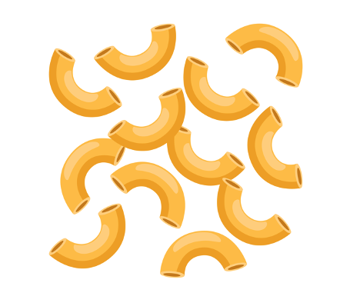
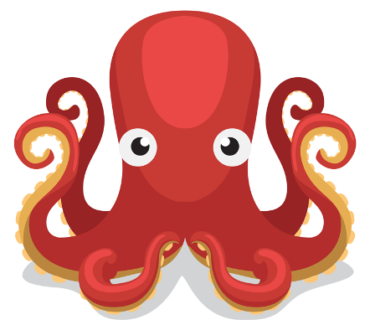
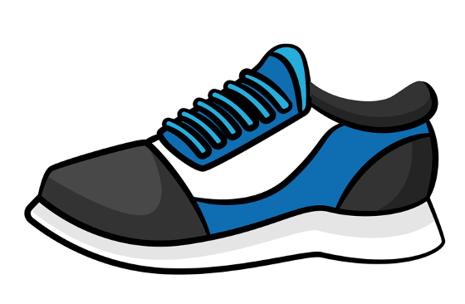
How many syllables?
2
4
3
1

Slide 35
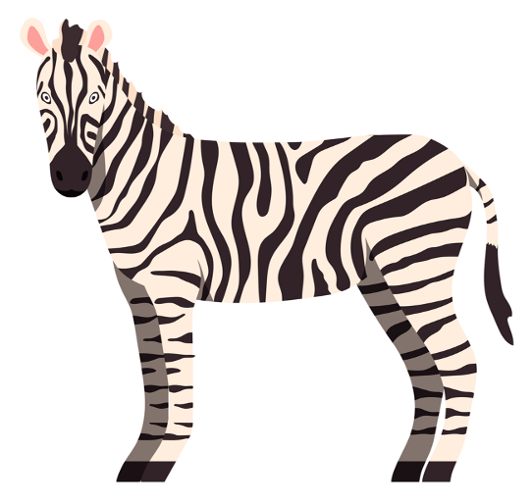
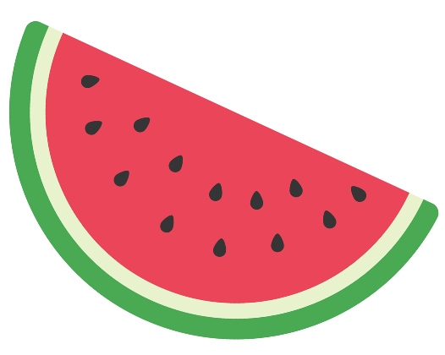
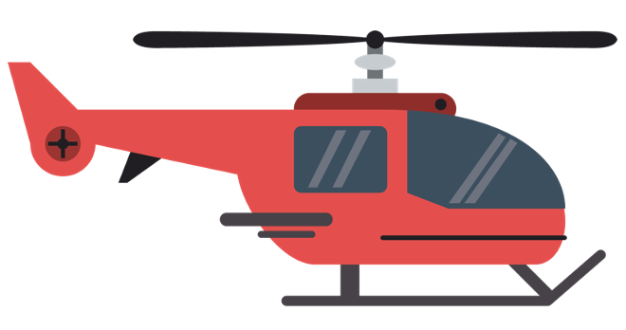
How many syllables?
3
2
4
4

Slide 36
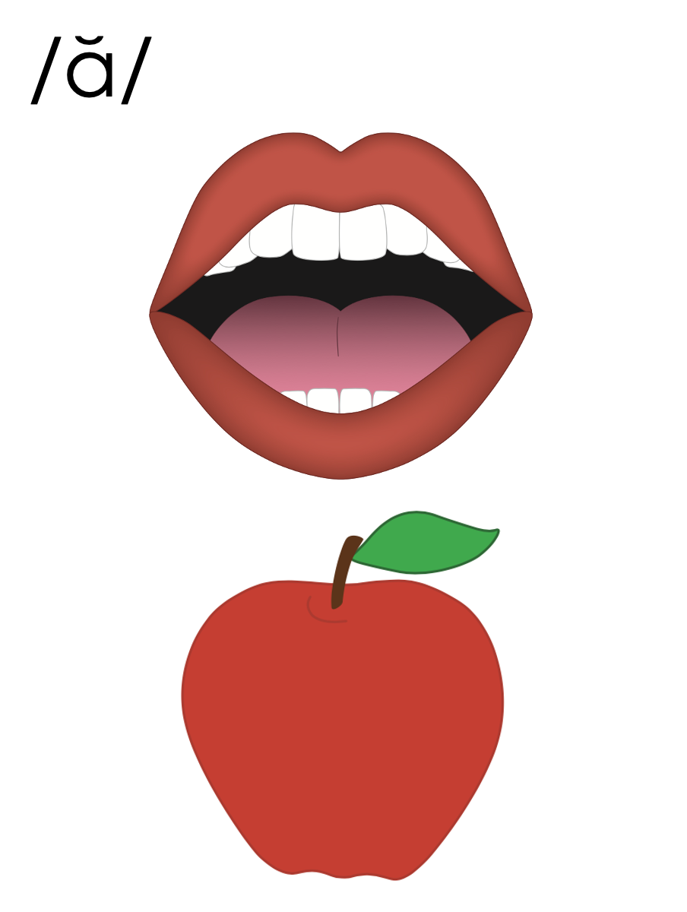
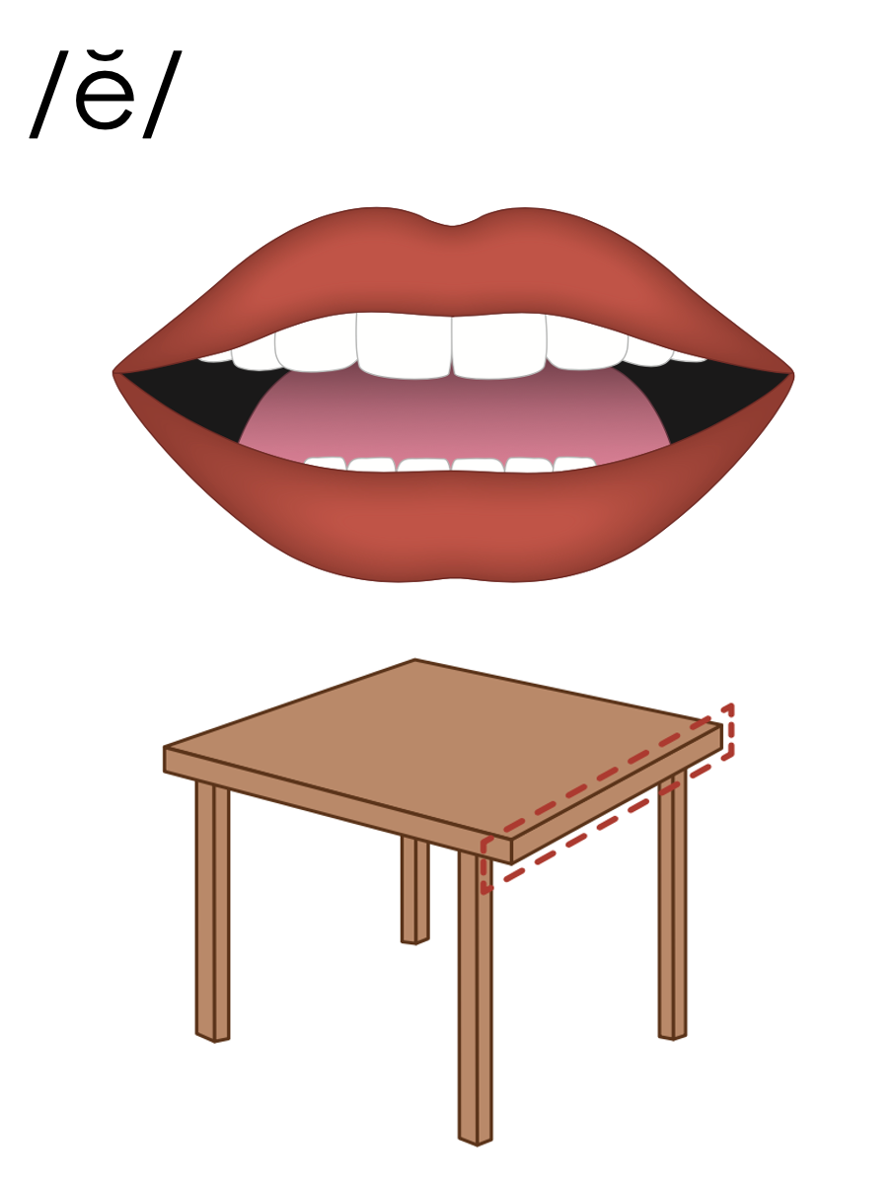
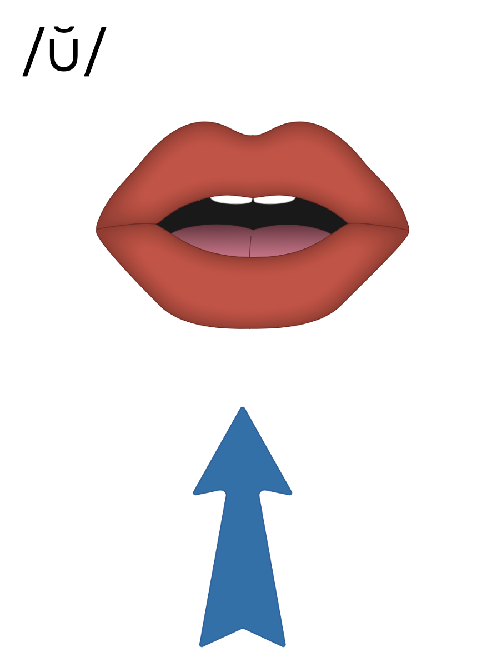
Closed Syllable
V
C

Slide 37
Closed Syllable
V
C
hop
kick
fast

Slide 38
Closed Syllable
V
C
hop
kick
fast

Slide 39
Closed Syllable
V
C
hop
kick
fast

Slide 40
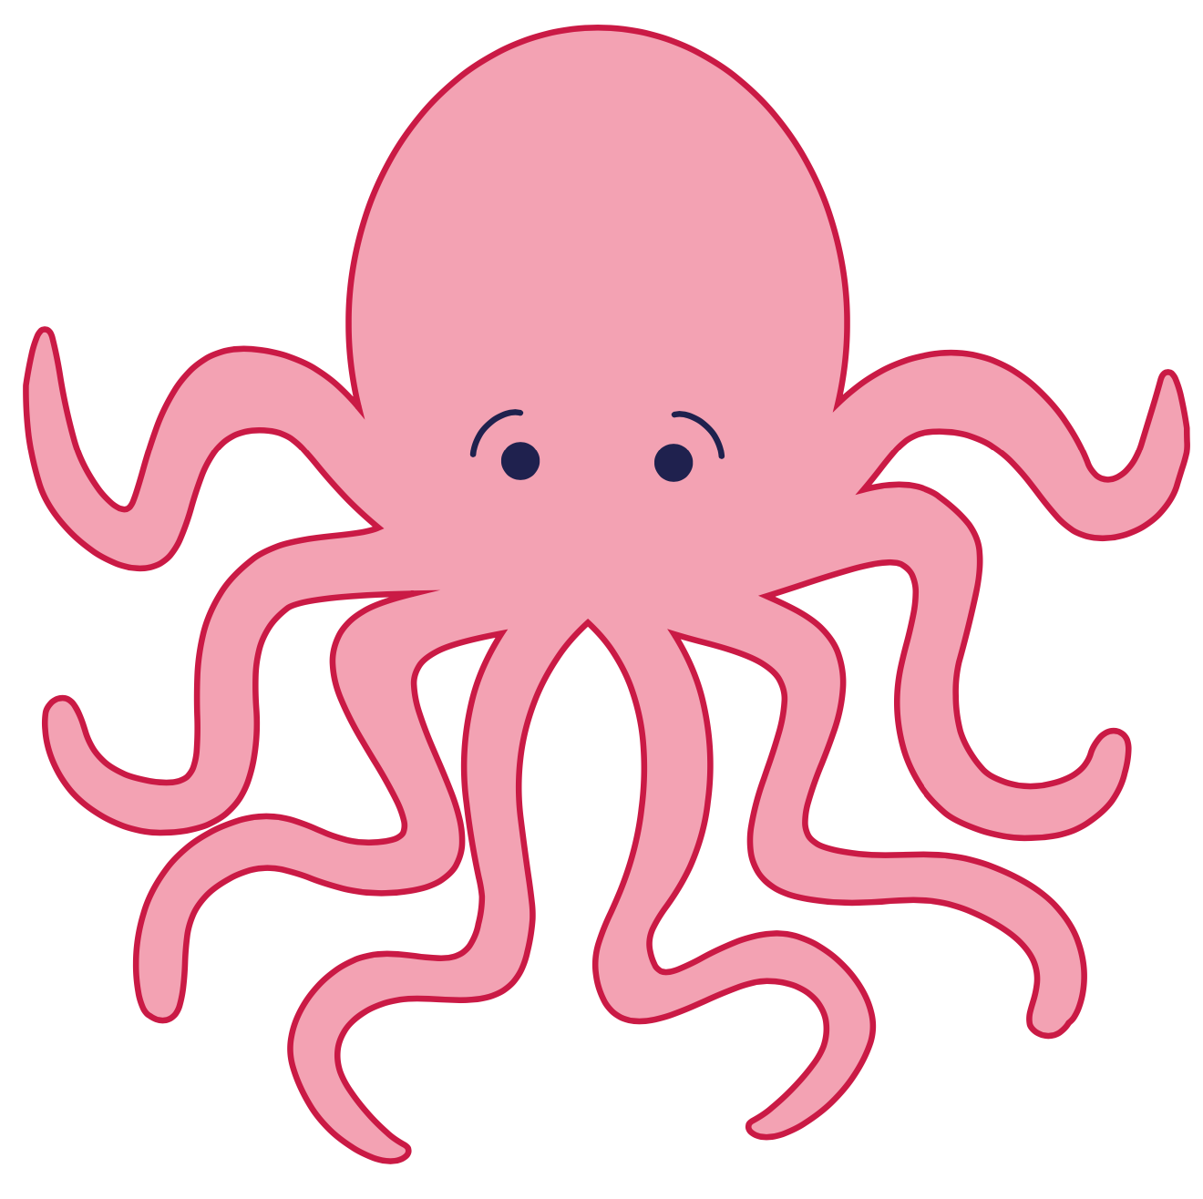
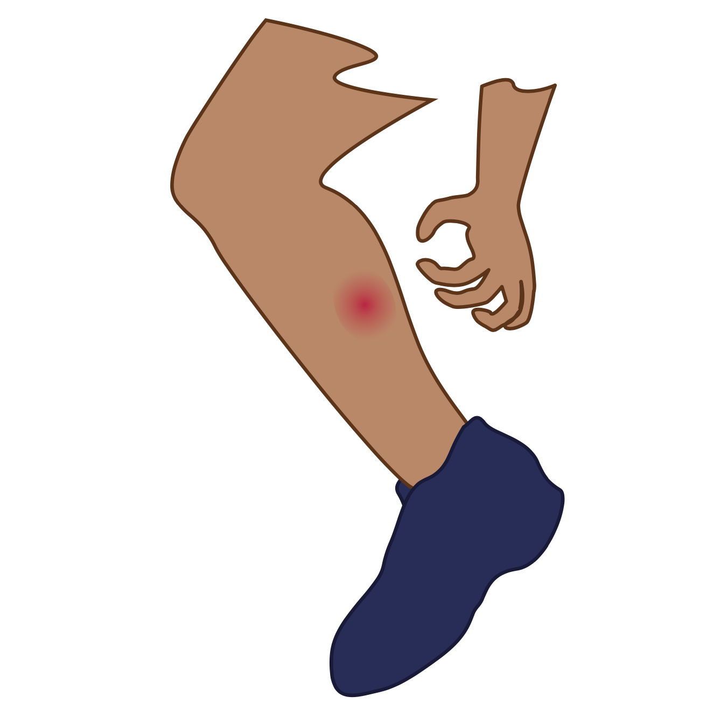
Closed Syllable
V
C
hop
kick
fast

Slide 41
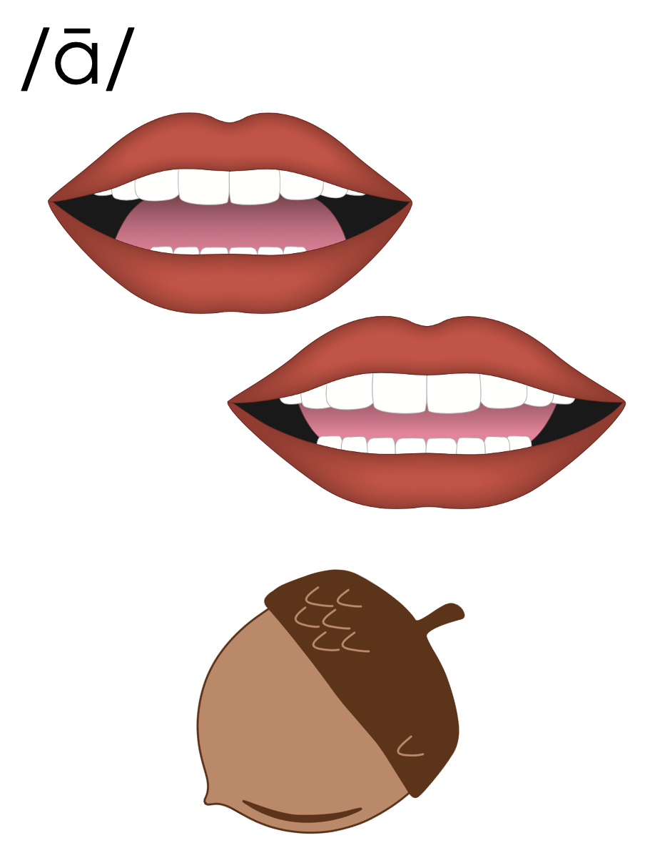
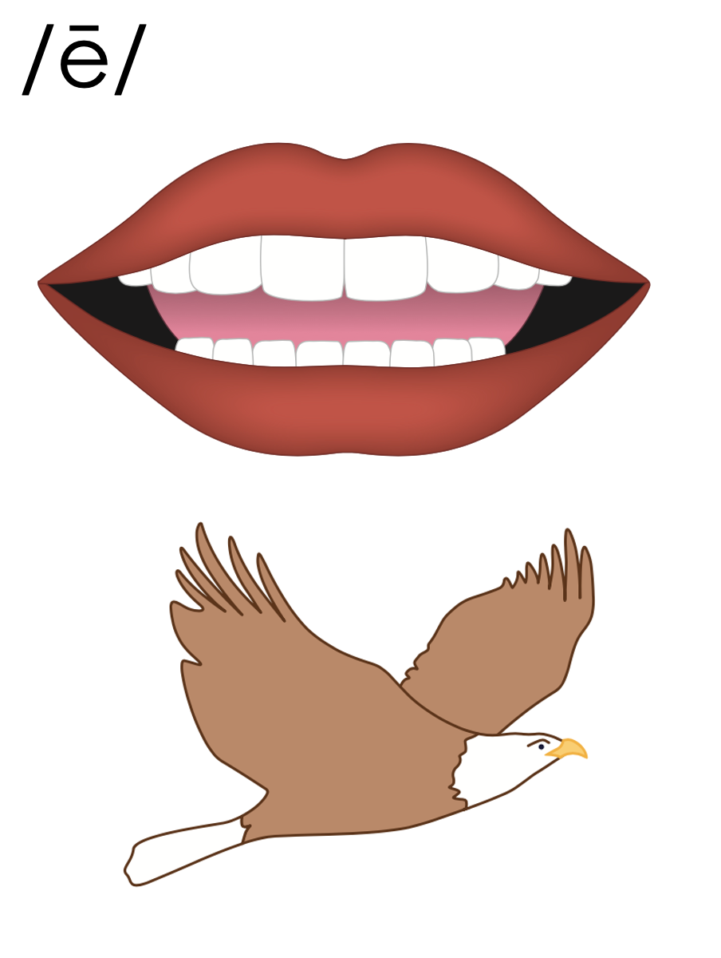
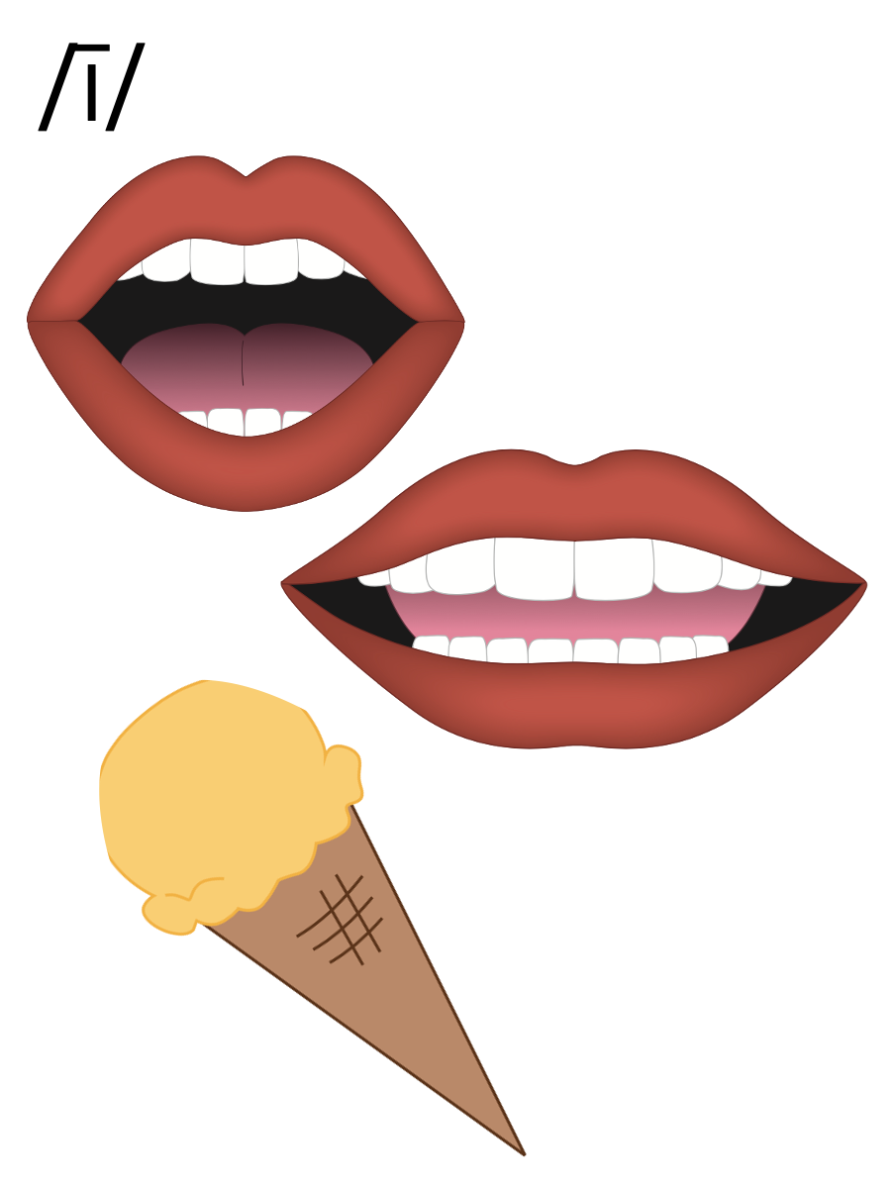
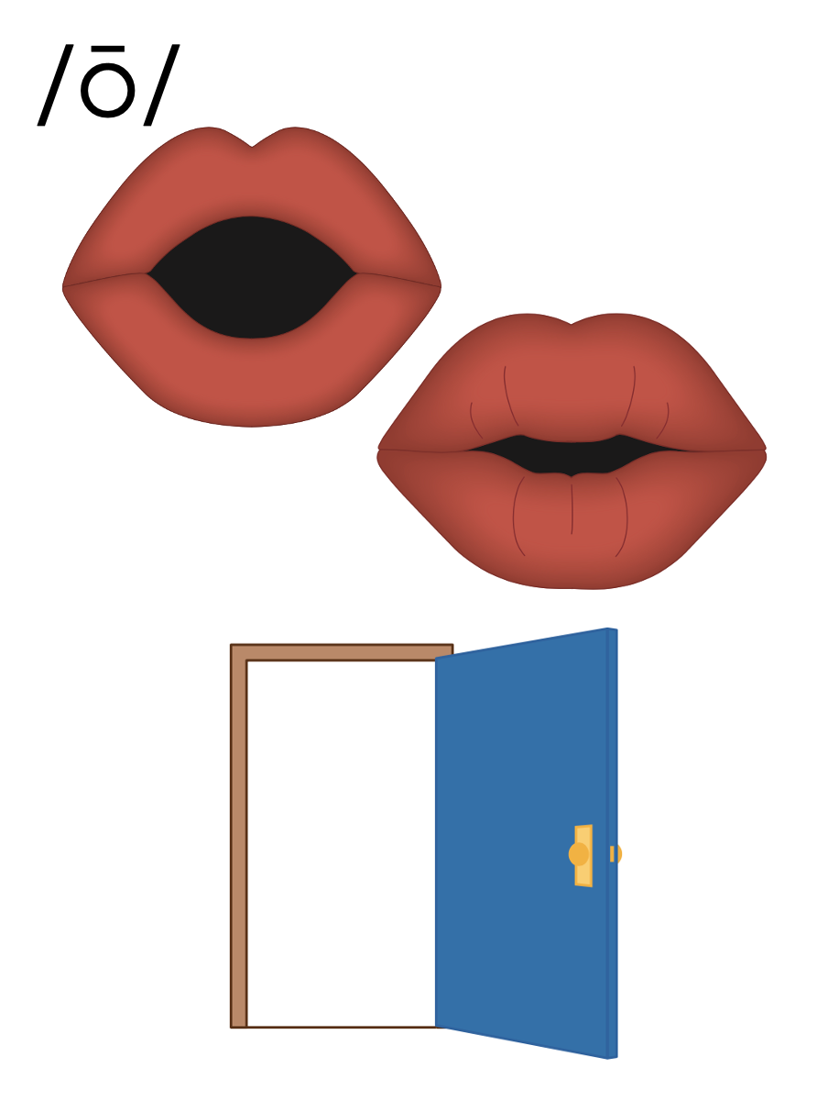
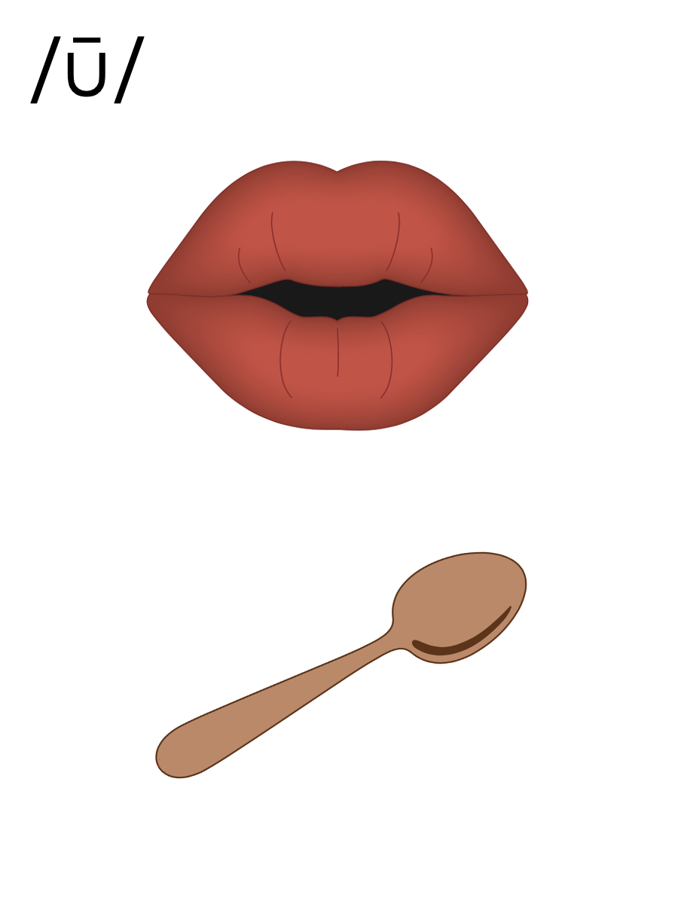
Open Syllable
V

Slide 42
Open Syllable
V
hi
go
she

Slide 43
Open Syllable
V
hi
go
she

Slide 44
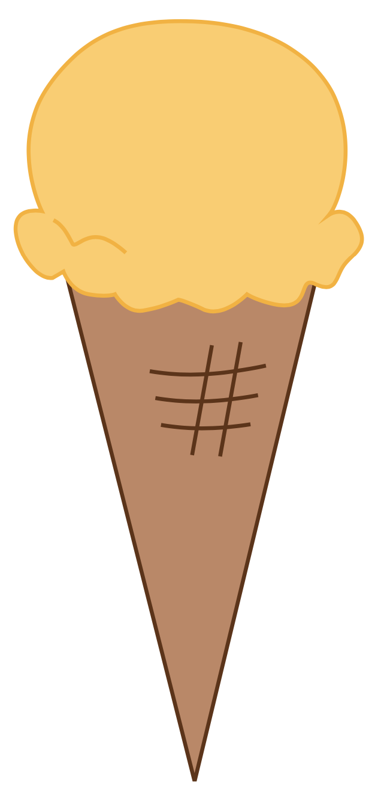
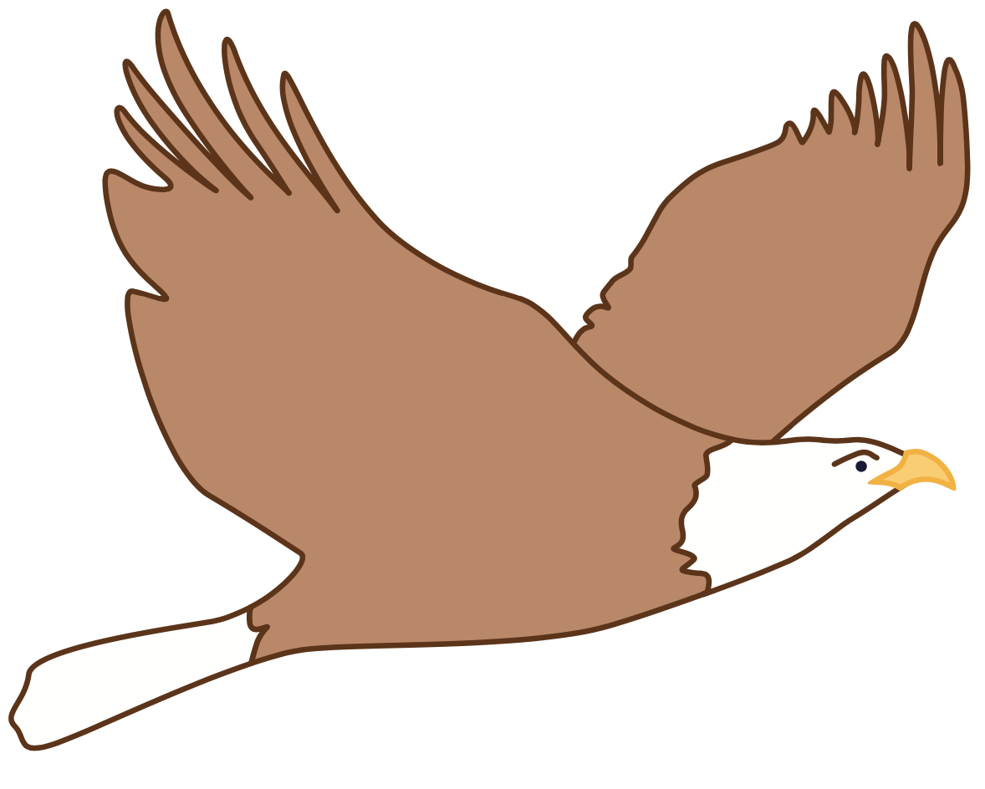
Open Syllable
V
hi
go
she

Slide 45
a_e
e_e
i_e
o_e
u_e
a
e
i
o
u

Slide 46
Notes:
Handwriting paper for letter formation practice. Use as needed.
See UFLI Foundations manual for more information about letter formation.

Slide 47
be
met

Slide 48
nap
men
go
set
hi
mash

Slide 49
we
dip
split

Slide 50
Notes:
See UFLI Foundations lesson plan Step 5 for words to spell.
Handwriting paper to model spelling.

Slide 51
Notes:
See UFLI Foundations lesson plan Step 5 for words to spell.
Handwriting paper for guided spelling practice.

Slide 53
Insert brief reinforcement activity and/or transition to next part of reading block.

Slide 54
Lesson 66
Closed & Open Syllables

Slide 56
New Concept Review
Notes:
See UFLI Foundations lesson plan Step 5 for recommended teacher language and activities to review the new concept.

Slide 57
Syllable
A word or part of a word with one vowel sound.

Slide 58
Closed Syllable
V
C

Slide 59
Closed Syllable
V
C
hop
kick
fast

Slide 60
Closed Syllable
V
C
hop
kick
fast

Slide 61
Open Syllable
V

Slide 62
Open Syllable
V
hi
go
she

Slide 63
Open Syllable
V
hi
go
she

Slide 64
a_e
e_e
i_e
o_e
u_e
a
e
i
o
u

Slide 65
go
got
we
wet

Slide 67
Notes:
See UFLI Foundations lesson plan Step 6 for word work activity.
Visit ufliteracy.org to access the Word Work Mat apps.

Slide 69
Notes:
See UFLI Foundations lesson plan Step 7 for irregular word activities.
The white rectangle under each word may be used in editing mode. Cover the heart and square icons then reveal them one at a time during instruction.

Slide 70
Notes:
See UFLI Foundations manual for more information about reviewing irregular words.

Slide 71
two
Notes:
Lesson 63+
W is silent.
O represents the /ū/ sound.
The TW in TWO can be connected with other TW words related to the number 2 (e.g., TWIN, TWELVE, TWICE). This connection can help children remember why TWO is spelled with a W.
The white rectangle under the word may be used in editing mode. Cover the heart and square icons then reveal them one at a time during instruction.

Slide 72
does
Notes:
Lesson 63+
O represents the /ŭ/ sound.
ES spells /z/. This is an irregular way to add the -ES ending to a word.
The white rectangle under the word may be used in editing mode. Cover the heart and square icons then reveal them one at a time during instruction.

Slide 73
many
Notes:
Lessons 64-73
A represents either the /ĕ/ sound or the /ĭ/ sound, depending on dialect.
Y /ē/ has not been introduced yet.
The white rectangle under the word may be used in editing mode. Cover the heart and square icons then reveal them one at a time during instruction.

Slide 74
any
Notes:
Lessons 64-73
A represents either the /ĕ/ sound or the /ĭ/ sound, depending on dialect.
Y /ē/ has not been introduced yet.
The white rectangle under the word may be used in editing mode. Cover the heart and square icons then reveal them one at a time during instruction.

Slide 75
been
Notes:
Lesson 65+
EE represents the /ĕ/ sound or the /ĭ/ sound, depending on dialect.
In some dialects, the EE in been is pronounced /ē/. In this case, been would be temporarily irregular until lesson 85 when EE /ē/ is introduced.
The white rectangle under the word may be used in editing mode. Cover the heart and square icons then reveal them one at a time during instruction.

Slide 76
into
Notes:
Lesson 65+
O represents the /ū/ sound.
The white rectangle under the word may be used in editing mode. Cover the heart and square icons then reveal them one at a time during instruction.

Slide 77
Notes:
Handwriting paper for irregular word spelling practice. Use as needed.
See UFLI Foundations manual for more information about reviewing irregular words.

Slide 78
Teach
Notes:
The orange star indicates these are new irregular words that need to be introduced.
See UFLI Foundations manual for more information about teaching irregular words.

Slide 79
friend
Notes:
Lesson 66+
IE represents the /ĕ/ or /ĭ/ sound, depending on dialect.
The white rectangle under the word may be used in editing mode. Cover the heart and square icons then reveal them one at a time during instruction.

Slide 80
Notes:
Handwriting paper for irregular word spelling practice. Use as needed.
See UFLI Foundations manual for more information about teaching irregular words.

Slide 82
Notes:
See UFLI Foundations lesson plan Step 8 for connected text activities.

Slide 83
My friend and I want to go camping in June.

Slide 84
Have you been sticking the stamps here?

Slide 85
The two friends have not missed the bus yet.

Slide 86
Notes:
See UFLI Foundations lesson plan Step 8 for sentences to write.

Slide 87
Notes:
The UFLI Foundations decodable text is provided here. See UFLI Foundations decodable text guide for additional text options.

Slide 88
Jo’s Friend Russ
Jo has a best friend named Russ. Russ and Jo go on bike rides in the fall. In the spring, they swim in the lake. At the lake, Jo brings snacks and Russ brings drinks.

Slide 89
They also love acting, singing, and telling jokes. Russ likes spending time with Jo and Jo likes spending time with Russ. Russ and Jo will be friends for a long time.

Slide 91
Insert brief reinforcement activity and/or transition to next part of reading block.

