Slide 1
Lesson 59
VCe Review 2

Slide 2
Notes:
ufliteracy.org

Slide 4
Lesson 59
VCe Review 2

Slide 6
Notes:
See UFLI Foundations lesson plan Step 1 for phonemic awareness activity.

Slide 8
Notes:
See UFLI Foundations lesson plan Step 2 for student phoneme responses.

Slide 9
a

Slide 10
i

Slide 11
o

Slide 12
e

Slide 13
u

Slide 14
nk

Slide 15
ng

Slide 16
wh

Slide 17
ph

Slide 18
ch

Slide 19
th

Slide 20
sh

Slide 21
ck

Slide 22
ff

Slide 23
ll

Slide 24
ss

Slide 25
zz

Slide 26
s

Slide 28
Notes:
See UFLI Foundations lesson plan Step 3 for auditory drill activity.

Slide 29
Notes:
No slides needed for auditory drill.

Slide 31
Notes:
See UFLI Foundations lesson plan Step 4 for blending drill word chain and grid.
Visit ufliteracy.org to access the Blending Board app.

Slide 33
Notes:
See UFLI Foundations lesson plan Step 5 for recommended teacher language and activities to introduce the new concept.

Slide 34
e

Slide 35
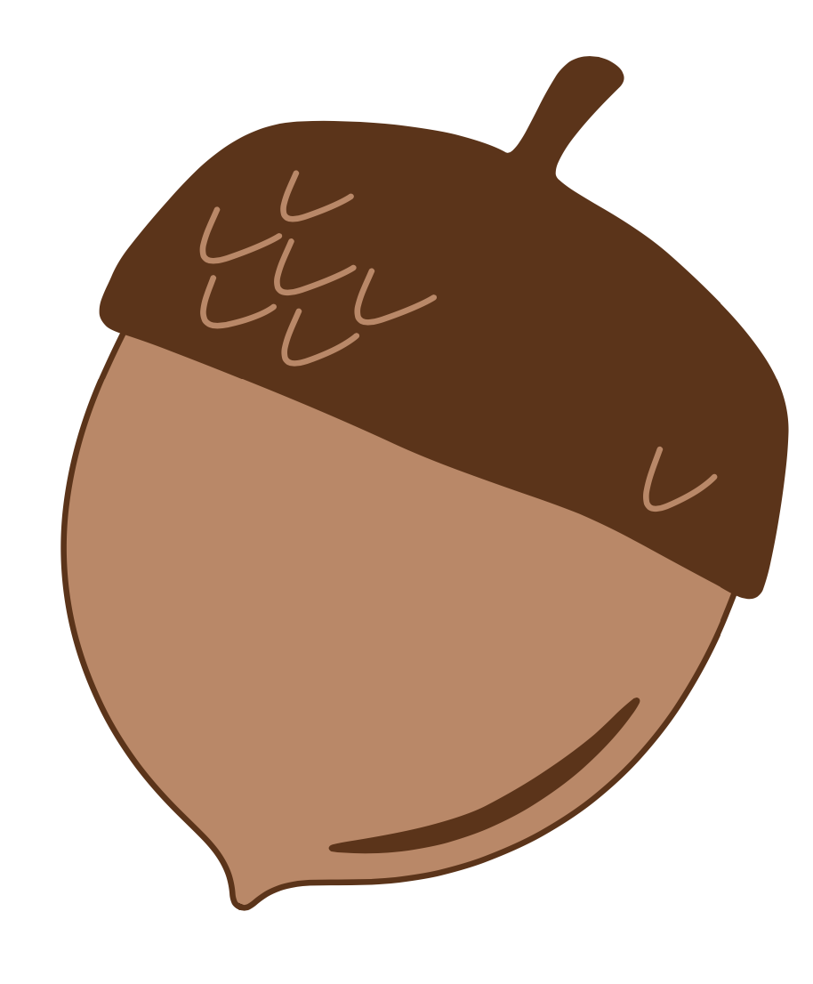
a

Slide 36
m
a
k
e

Slide 37
f
a
m
e

Slide 38
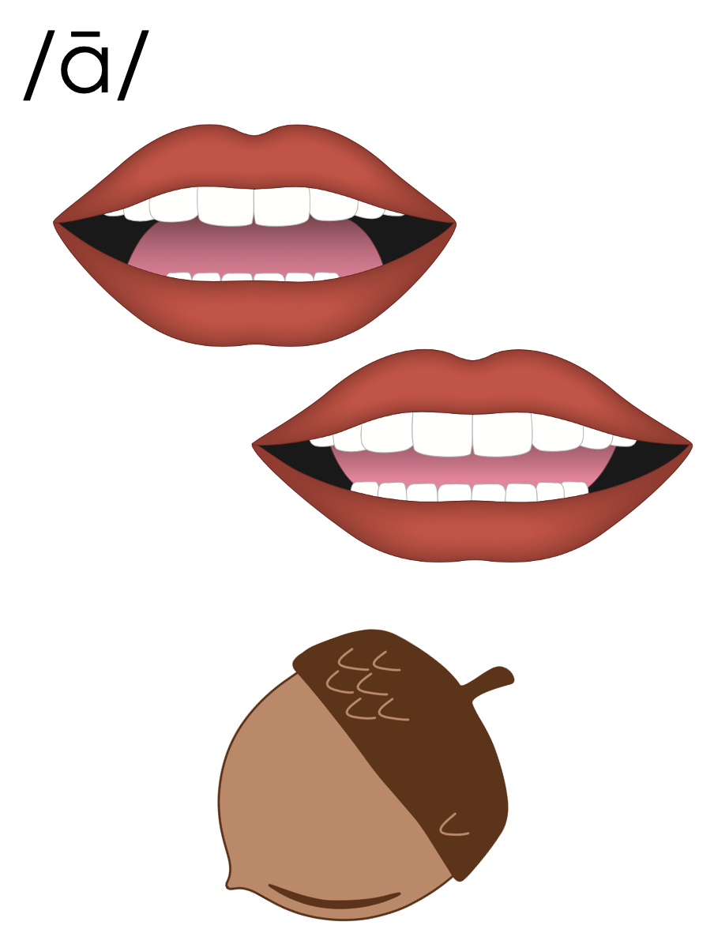
a_e

Slide 39
i

Slide 40
b
i
k
e

Slide 41
m
i
n
e

Slide 42
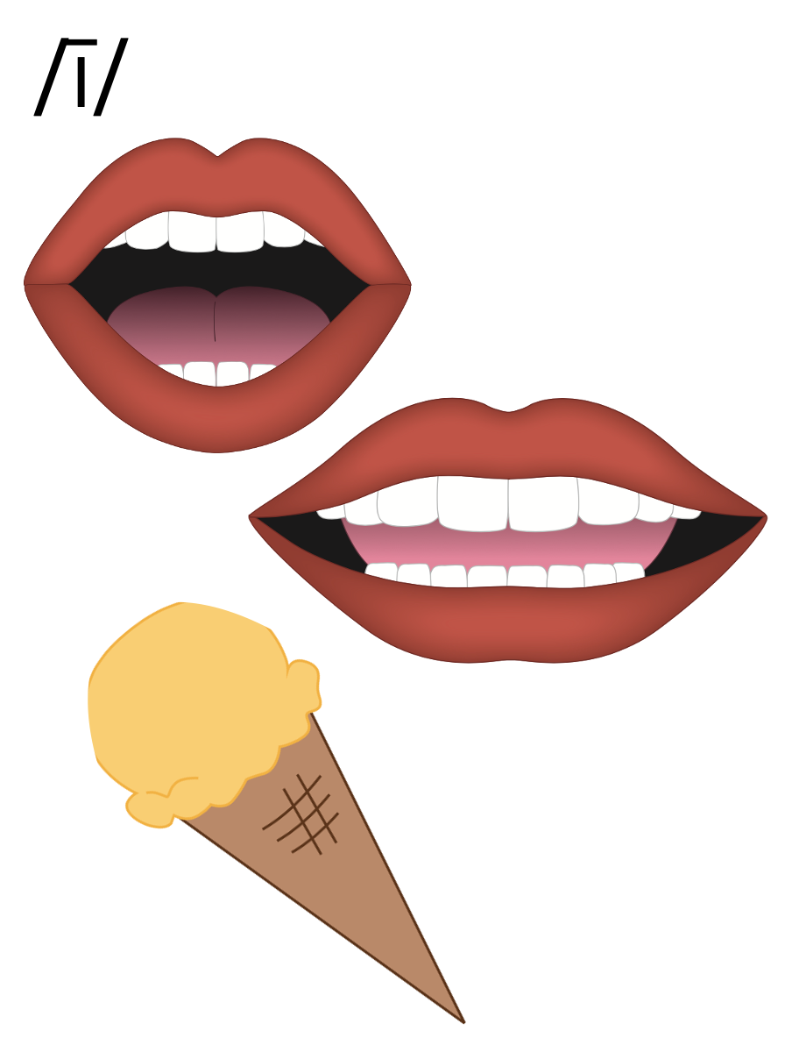
i_e

Slide 43
o

Slide 44
j
o
k
e

Slide 45
s
t
o
n
e

Slide 46
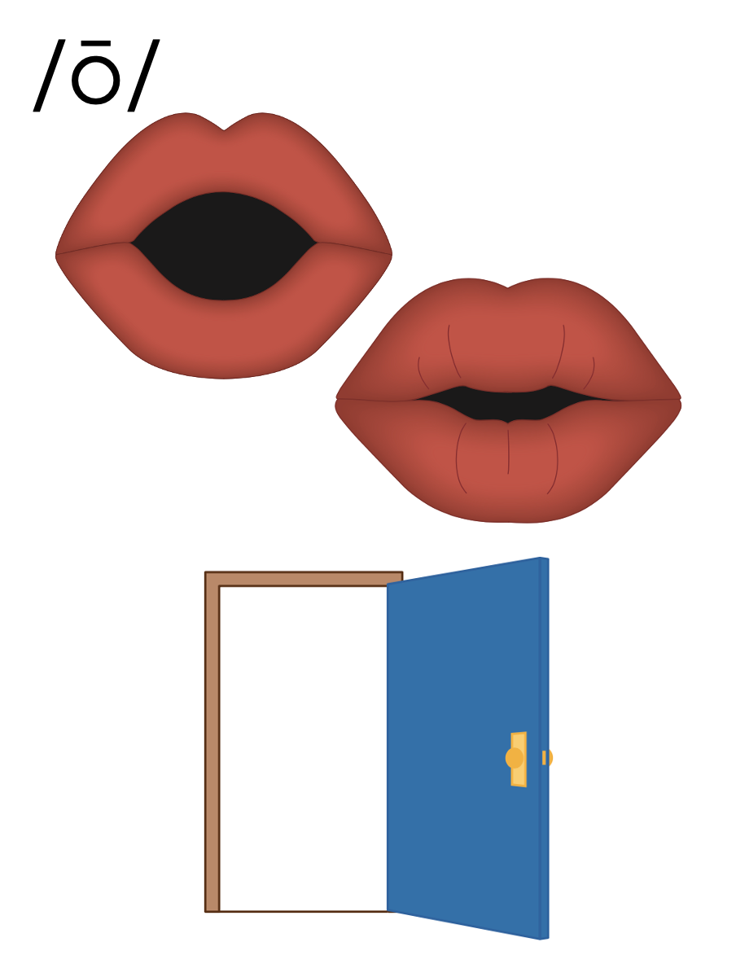
o_e

Slide 47
e

Slide 48
e
v
e

Slide 49
th
e
m
e

Slide 50
e
e

Slide 51
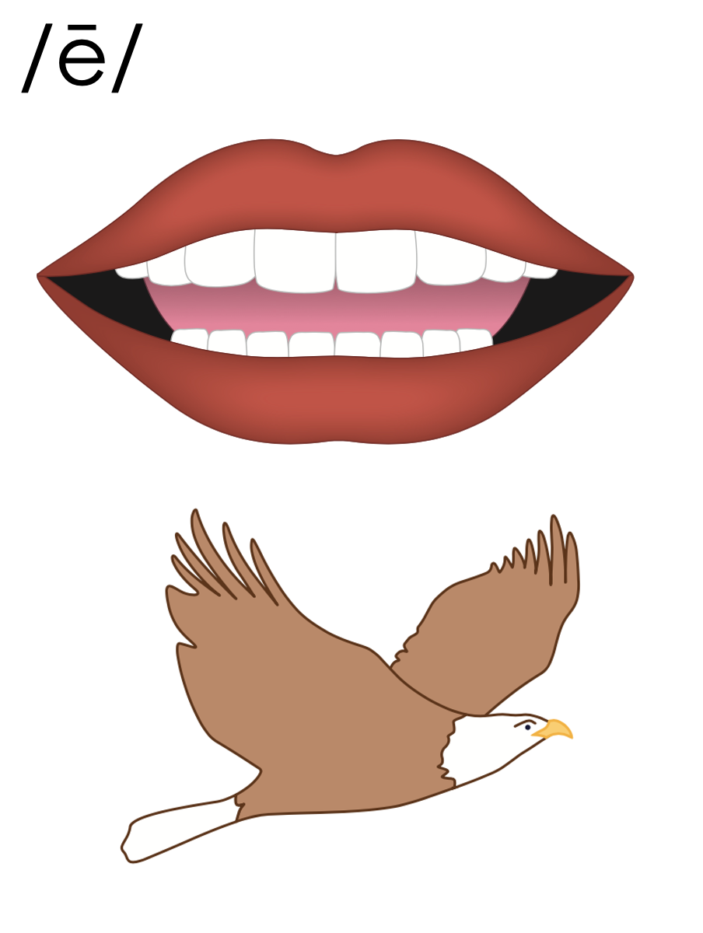
e_e

Slide 52
u

Slide 53
f
l
u
t
e

Slide 54
c
u
b
e

Slide 55
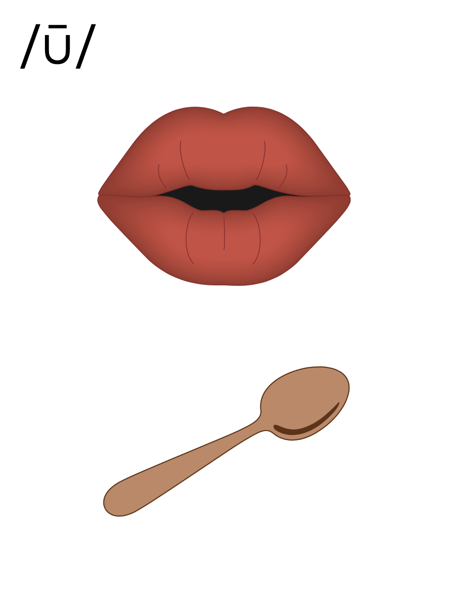
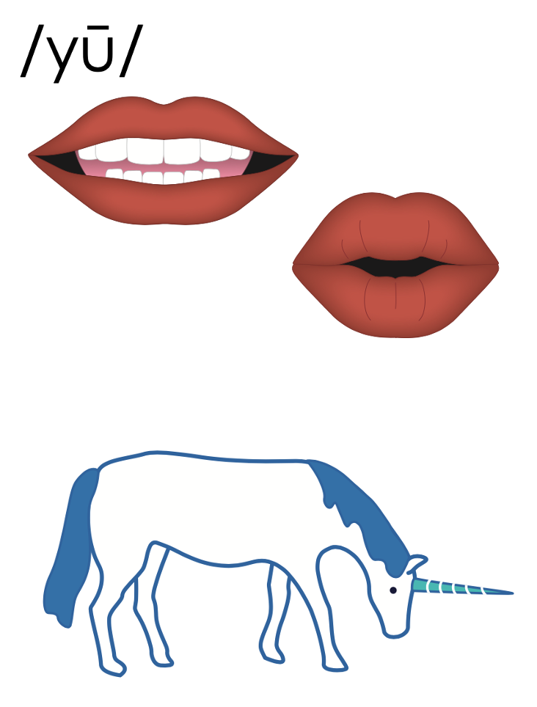
u_e
u_e

Slide 56
e

Slide 57
c
a
p

Slide 58
c
a
p
e

Slide 59
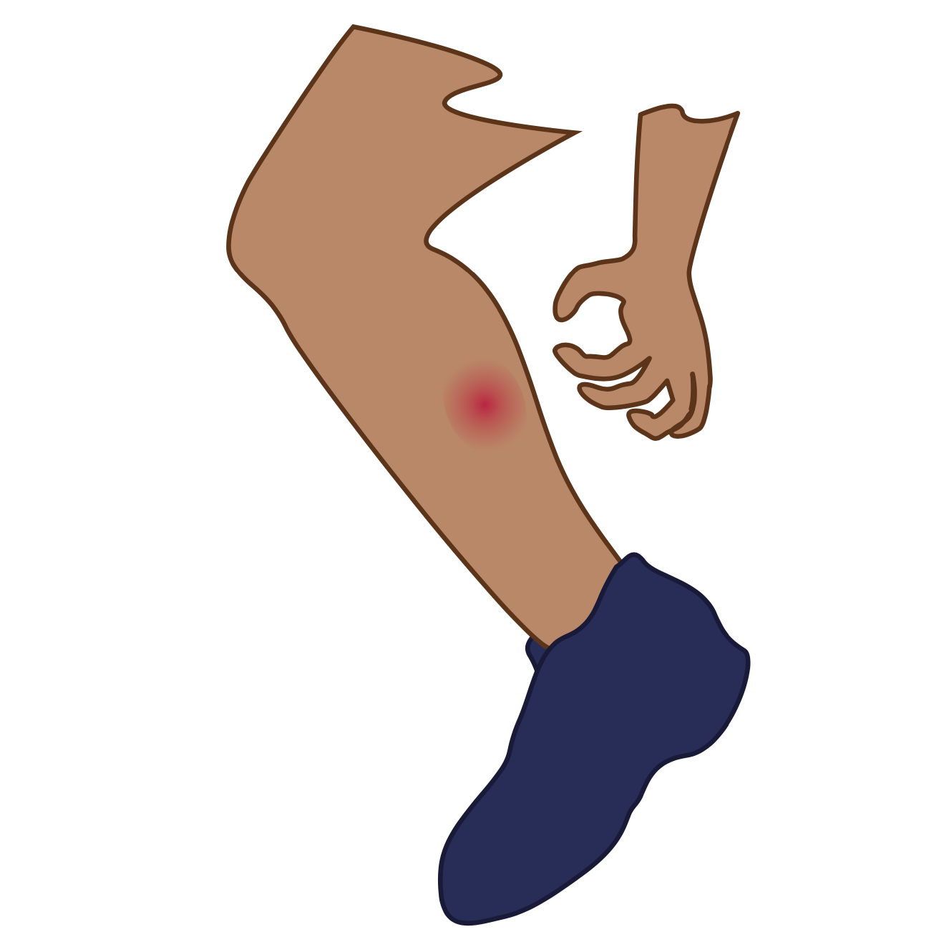
T
i
m

Slide 60
t
i
m
e

Slide 61
h
o
p

Slide 62
h
o
p
e

Slide 63
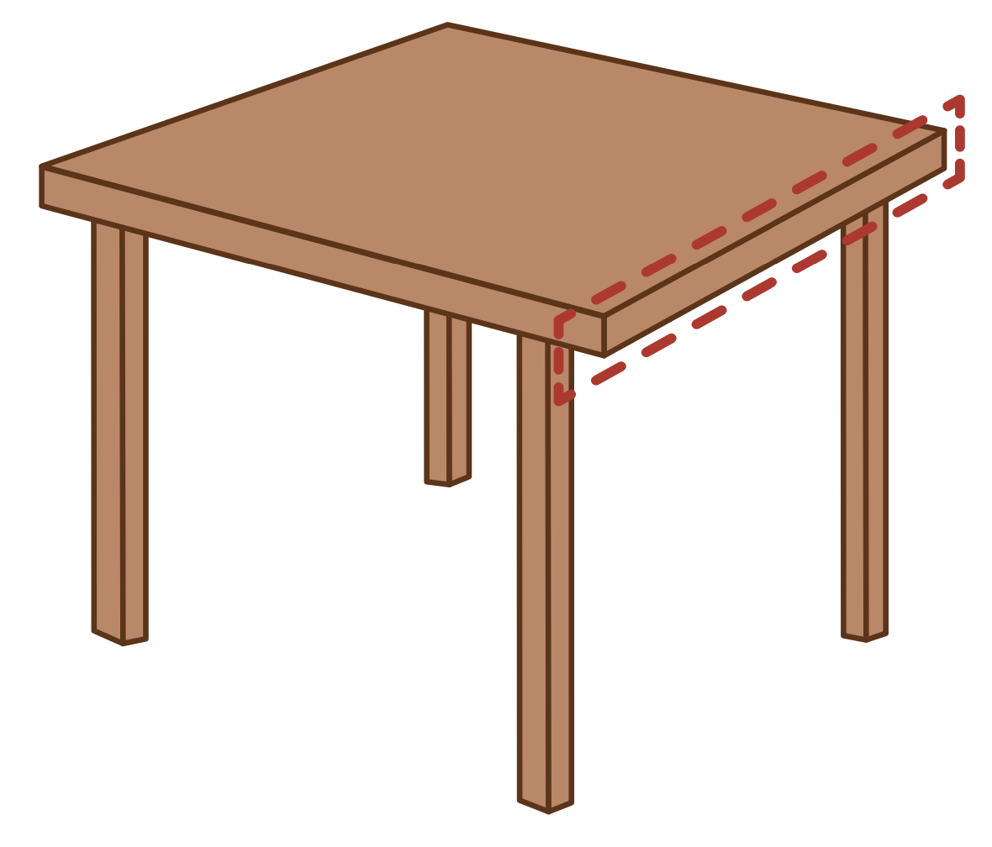
p
e
t

Slide 64
P
e
t
e

Slide 65
c
u
b

Slide 66
c
u
b
e

Slide 67
Notes:
Handwriting paper for letter formation practice. Use as needed.
See UFLI Foundations manual for more information about letter formation.

Slide 68
made
bone
cube

Slide 69
name
grade
hole
drove
chime
shines

Slide 70
eve
these
theme
June
tube
tune

Slide 71
Notes:
See UFLI Foundations lesson plan Step 5 for words to spell.
Handwriting paper to model spelling.

Slide 72
Notes:
See UFLI Foundations lesson plan Step 5 for words to spell.
Handwriting paper for guided spelling practice.

Slide 74
Insert brief reinforcement activity and/or transition to next part of reading block.

Slide 75
Lesson 59
VCe Review 2

Slide 77
New Concept Review
Notes:
See UFLI Foundations lesson plan Step 5 for recommended teacher language and activities to review the new concept.

Slide 78
e

Slide 79
a

Slide 80
l
a
t
e

Slide 81
a_e

Slide 82
i

Slide 83
t
i
m
e

Slide 84
i_e

Slide 85
o

Slide 86
h
o
m
e

Slide 87
o_e

Slide 88
e

Slide 89
th
e
s
e

Slide 90
e_e

Slide 91
u

Slide 92
f
l
u
t
e

Slide 93
c
u
b
e

Slide 94
u_e
u_e

Slide 95
e

Slide 96
cute
time
same
here
phone

Slide 98
Notes:
See UFLI Foundations lesson plan Step 6 for word work activity.
Visit ufliteracy.org to access the Word Work Mat apps.

Slide 100
Notes:
See UFLI Foundations lesson plan Step 7 for irregular word activities.
The white rectangle under each word may be used in editing mode. Cover the heart and square icons then reveal them one at a time during instruction.

Slide 101
Notes:
See UFLI Foundations manual for more information about reviewing irregular words.

Slide 102
who
Notes:
Lesson 54+
WH represents the /h/ sound.
O represents the /ū/ sound.
The white rectangle under the word may be used in editing mode. Cover the heart and square icons then reveal them one at a time during instruction.

Slide 103
by
Notes:
Lessons 55-72
*Temporarily irregular
Y /ī/ has not been introduced yet.
The white rectangle under the word may be used in editing mode. Cover the heart and square icons then reveal them one at a time during instruction.

Slide 104
my
Notes:
Lessons 55-72
*Temporarily irregular
Y /ī/ has not been introduced yet.
The white rectangle under the word may be used in editing mode. Cover the heart and square icons then reveal them one at a time during instruction.

Slide 105
one
Notes:
Lesson 58+
O represents the sounds /w/+/ŭ/.
The final E is silent but does not follow the long vowel VCe pattern.
The white rectangle under the word may be used in editing mode. Cover the heart and square icons then reveal them one at a time during instruction.

Slide 106
once
Notes:
Lessons 58-59
O represents the sounds /w/+/ŭ/.
_CE /s/ has not been introduced yet.
The white rectangle under the word may be used in editing mode. Cover the heart and square icons then reveal them one at a time during instruction.

Slide 107
Notes:
Handwriting paper for irregular word spelling practice. Use as needed.
See UFLI Foundations manual for more information about reviewing irregular words.

Slide 109
Notes:
See UFLI Foundations lesson plan Step 8 for connected text activities.

Slide 110
I see he gave Jane one white rose.

Slide 111
Should Steve bake the cake at home?

Slide 112
Luke could not make them smile once.

Slide 113
Notes:
See UFLI Foundations lesson plan Step 8 for sentences to write.

Slide 114
Notes:
The UFLI Foundations decodable text is provided here. See UFLI Foundations decodable text guide for additional text options.

Slide 115
A Cake for Tess
Niles and Blake want to bake a cake for Tess. Tess is their big sis. She will be a bride, so they want to bake a white cake. Niles and Blake mix the cake while Dad gets one pan. The mix goes, Drip! Drip! into the pan.

Slide 116
They ask Dad for help with the stove. The cake bakes for a long time. Next the cake goes on a glass plate. “The cake looks so cute. I want to take a bite!” says Niles. “We can not take a bite. This cake is for Tess!” says Blake.

Slide 118
Insert brief reinforcement activity and/or transition to next part of reading block.

