Slide 1
Lesson 58
u_e /ū/, /yū/

Slide 2
Notes:
ufliteracy.org

Slide 4
Lesson 58
u_e /ū/, /yū/

Slide 6
Notes:
See UFLI Foundations lesson plan Step 1 for phonemic awareness activity.

Slide 8
Notes:
See UFLI Foundations lesson plan Step 2 for student phoneme responses.

Slide 9
a

Slide 10
i

Slide 11
o

Slide 12
e

Slide 13
nk

Slide 14
ng

Slide 15
wh

Slide 16
ph

Slide 17
ch

Slide 18
th

Slide 19
sh

Slide 20
ck

Slide 21
ff

Slide 22
ll

Slide 23
ss

Slide 24
zz

Slide 25
s

Slide 26
u

Slide 28
Notes:
See UFLI Foundations lesson plan Step 3 for auditory drill activity.

Slide 29
Notes:
No slides needed for auditory drill.

Slide 31
Notes:
See UFLI Foundations lesson plan Step 4 for blending drill word chain and grid.
Visit ufliteracy.org to access the Blending Board app.

Slide 33
Notes:
See UFLI Foundations lesson plan Step 5 for recommended teacher language and activities to introduce the new concept.

Slide 34
u

Slide 35
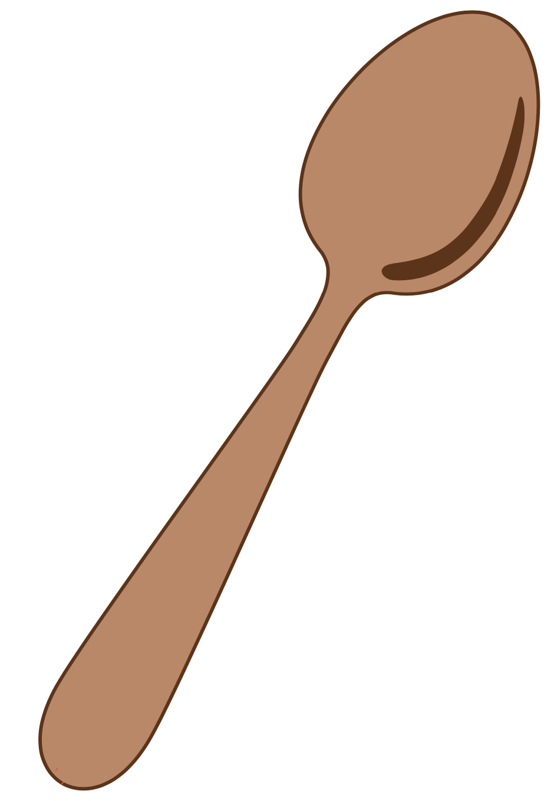
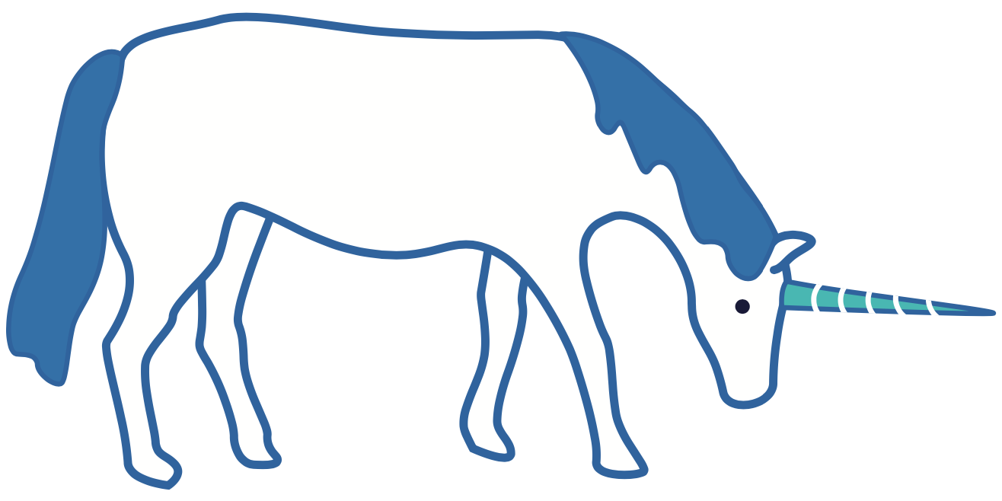
u

Slide 36
u
e

Slide 37
J
u
n
e

Slide 38
c
u
b
e

Slide 39
flute
use
tube
mute

Slide 40
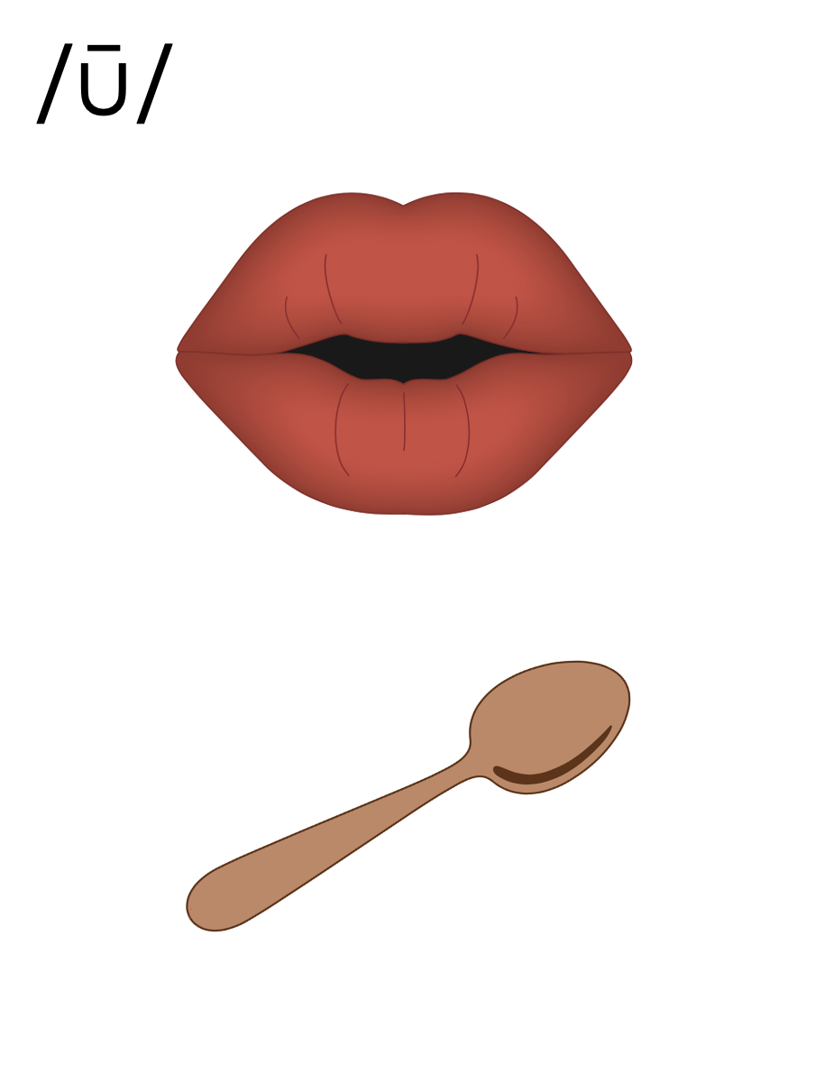

Slide 41
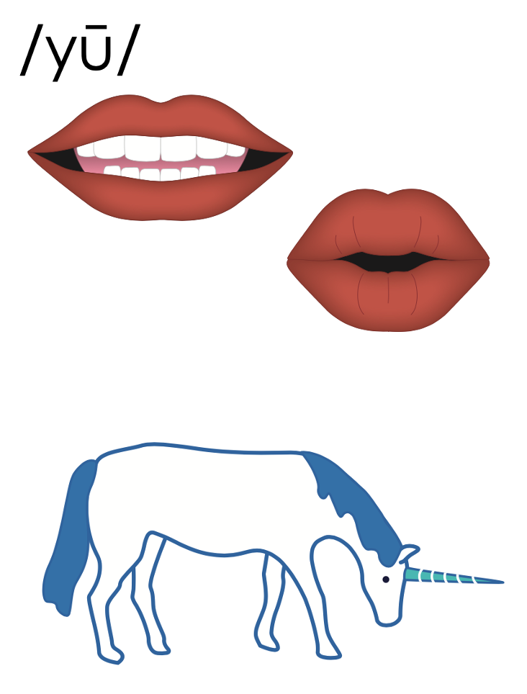

Slide 42
u_e
u_e

Slide 43
Notes:
Handwriting paper for letter formation practice. Use as needed.
See UFLI Foundations manual for more information about letter formation.

Slide 44
rude
mule

Slide 45
rule
duke
tube
tune
flute
cute

Slide 46
use
puke
mute

Slide 47
Notes:
See UFLI Foundations lesson plan Step 5 for words to spell.
Handwriting paper to model spelling.

Slide 48
Notes:
See UFLI Foundations lesson plan Step 5 for words to spell.
Handwriting paper for guided spelling practice.

Slide 50
Insert brief reinforcement activity and/or transition to next part of reading block.

Slide 51
Lesson 58
u_e /ū/, /yū/

Slide 53
New Concept Review
Notes:
See UFLI Foundations lesson plan Step 5 for recommended teacher language and activities to review the new concept.

Slide 54
u

Slide 55
u

Slide 56
u
e

Slide 57
J
u
n
e

Slide 58
c
u
b
e

Slide 59
flute
use
tube
mute

Slide 62
u_e
u_e

Slide 63
use
mute
June
rude

Slide 65
Notes:
See UFLI Foundations lesson plan Step 6 for word work activity.
Visit ufliteracy.org to access the Word Work Mat apps.

Slide 67
Notes:
See UFLI Foundations lesson plan Step 7 for irregular word activities.
The white rectangle under each word may be used in editing mode. Cover the heart and square icons then reveal them one at a time during instruction.

Slide 68
Notes:
See UFLI Foundations manual for more information about reviewing irregular words.

Slide 69
there
Notes:
Lesson 52+
ERE represents the /air/ sound.
The white rectangle under the word may be used in editing mode. Cover the heart and square icons then reveal them one at a time during instruction.

Slide 70
where
Notes:
Lesson 52+
ERE represents the /air/ sound.
The white rectangle under the word may be used in editing mode. Cover the heart and square icons then reveal them one at a time during instruction.

Slide 71
who
Notes:
Lesson 54+
WH represents the /h/ sound.
O represents the /ū/ sound.
The white rectangle under the word may be used in editing mode. Cover the heart and square icons then reveal them one at a time during instruction.

Slide 72
by
Notes:
Lessons 55-72
*Temporarily irregular
Y /ī/ has not been introduced yet.
The white rectangle under the word may be used in editing mode. Cover the heart and square icons then reveal them one at a time during instruction.

Slide 73
my
Notes:
Lessons 55-72
*Temporarily irregular
Y /ī/ has not been introduced yet.
The white rectangle under the word may be used in editing mode. Cover the heart and square icons then reveal them one at a time during instruction.

Slide 74
Notes:
Handwriting paper for irregular word spelling practice. Use as needed.
See UFLI Foundations manual for more information about reviewing irregular words.

Slide 75
Teach
Notes:
The orange star indicates these are new irregular words that need to be introduced.
See UFLI Foundations manual for more information about teaching irregular words.

Slide 76
one
Notes:
Lesson 58+
O represents the sounds /w/+/ŭ/.
The final E is silent but does not follow the long vowel VCe pattern.
The white rectangle under the word may be used in editing mode. Cover the heart and square icons then reveal them one at a time during instruction.

Slide 77
once
Notes:
Lessons 58-59
O represents the sounds /w/+/ŭ/.
_CE /s/ has not been introduced yet.
The white rectangle under the word may be used in editing mode. Cover the heart and square icons then reveal them one at a time during instruction.

Slide 78
Notes:
Handwriting paper for irregular word spelling practice. Use as needed.
See UFLI Foundations manual for more information about teaching irregular words.

Slide 80
Notes:
See UFLI Foundations lesson plan Step 8 for connected text activities.

Slide 81
Luke broke a rule.

Slide 82
Did you see that cute dog?

Slide 83
June could use the flute if it was in tune.

Slide 84
Notes:
See UFLI Foundations lesson plan Step 8 for sentences to write.

Slide 85
Notes:
The UFLI Foundations decodable text is provided here. See UFLI Foundations decodable text guide for additional text options.

Slide 86
June’s Flute
June has a flute. June likes to use the flute to make tunes. There is one tune June likes best. She likes the song Sand Dunes. June has a pal, Luke. Luke has no flute, but Luke likes to sing.

Slide 87
Once, June and Luke made tunes at lunch for their pals. The last song they did was Sand Dunes. June was on the flute and Luke sang. They did a fine job!

Slide 89
Insert brief reinforcement activity and/or transition to next part of reading block.

