Slide 1
Lesson 39a
Short U Review

Slide 2
Notes:
ufliteracy.org

Slide 4
Lesson 39a
Short U Review

Slide 6
Notes:
See UFLI Foundations lesson plan Step 1 for phonemic awareness activity.

Slide 8
Notes:
See UFLI Foundations lesson plan Step 2 for student phoneme responses.

Slide 9
o

Slide 10
i

Slide 11
a

Slide 12
m

Slide 13
s

Slide 14
t

Slide 15
p

Slide 16
f

Slide 17
n

Slide 18
d

Slide 19
c

Slide 20
g

Slide 21
b

Slide 22
k

Slide 23
h

Slide 24
r

Slide 25
l

Slide 26
w

Slide 27
j

Slide 28
y

Slide 29
x

Slide 30
qu

Slide 31
v

Slide 32
z

Slide 34
Notes:
See UFLI Foundations lesson plan Step 3 for auditory drill activity.

Slide 35
Notes:
No slides needed for auditory drill.

Slide 37
Notes:
See UFLI Foundations lesson plan Step 4 for blending drill word chain and grid.
Visit ufliteracy.org to access the Blending Board app.

Slide 39
Notes:
See UFLI Foundations lesson plan Step 5 for recommended teacher language and activities to introduce the new concept.

Slide 40
u

Slide 41
cut
run
u

Slide 42
up
us
u

Slide 43
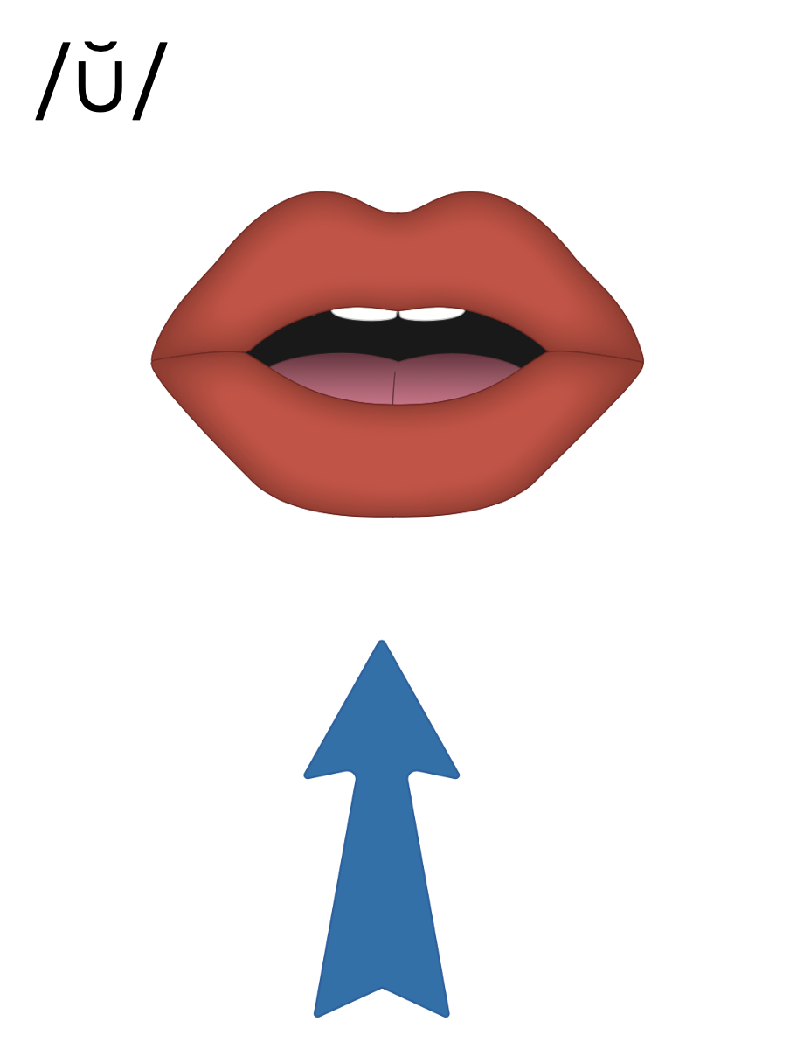
u

Slide 46
Notes:
Lowercase u gif

Slide 47
cup

Slide 48
up
us
fun
mud
run
but

Slide 49
sun
cut
bus

Slide 50
Notes:
See UFLI Foundations lesson plan Step 5 for words to spell.
Handwriting paper to model spelling.

Slide 51
Notes:
See UFLI Foundations lesson plan Step 5 for words to spell.
Handwriting paper for guided spelling practice.

Slide 53
Insert brief reinforcement activity and/or transition to next part of reading block.

Slide 54
Lesson 39a
Short U Review

Slide 56
New Concept Review
Notes:
See UFLI Foundations lesson plan Step 5 for recommended teacher language and activities to review the new concept.

Slide 57
u

Slide 58
cut
run
u

Slide 59
up
us
u

Slide 60
u

Slide 61
Notes:
Uppercase U gif

Slide 62
up
us
cut
run

Slide 64
Notes:
See UFLI Foundations lesson plan Step 6 for word work activity.
Visit ufliteracy.org to access the Word Work Mat apps.

Slide 66
Notes:
See UFLI Foundations lesson plan Step 7 for irregular word activities.
The white rectangle under each word may be used in editing mode. Cover the heart and square icons then reveal them one at a time during instruction.

Slide 67
Notes:
See UFLI Foundations manual for more information about reviewing irregular words.

Slide 68
look
Notes:
Lessons 26-88
*Temporarily irregular
OO /oo/ has not been introduced yet.
The white rectangle under the word may be used in editing mode. Cover the heart and square icons then reveal them one at a time during instruction.

Slide 69
book
Notes:
Lessons 26-88
*Temporarily irregular
OO /oo/ has not been introduced yet.
The white rectangle under the word may be used in editing mode. Cover the heart and square icons then reveal them one at a time during instruction.

Slide 70
are
Notes:
Lessons 27-76
AR /ar/ has not been introduced yet.
The final E is silent but does not follow the long vowel VCe pattern.
The white rectangle under the word may be used in editing mode. Cover the heart and square icons then reveal them one at a time during instruction.

Slide 71
was
Notes:
Lesson 29+
A represents the /ŭ/ sound.​
S /z/ has already been introduced.
The white rectangle under the word may be used in editing mode. Cover the heart and square icons then reveal them one at a time during instruction.

Slide 72
Notes:
Handwriting paper for irregular word spelling practice. Use as needed.
See UFLI Foundations manual for more information about reviewing irregular words.

Slide 74
Notes:
See UFLI Foundations lesson plan Step 8 for connected text activities.

Slide 75
Are the pigs in the mud?

Slide 76
Look at the bug in the tub!

Slide 77
The mug was on the book.

Slide 78
Notes:
See UFLI Foundations lesson plan Step 8 for sentences to write.

Slide 79
Notes:
The UFLI Foundations decodable text is provided here. See UFLI Foundations decodable text guide for additional text options.

Slide 80
Cub and Pup
Cub and Pup are buds.
Cub and Pup have lots of fun.
Cub runs in the sun.
Pup digs in the mud.

Slide 81
Cub and Pup are hot and wet.
The fun must stop.
Cub and Pup must get in the tub.

Slide 82
The buds have fun in the suds.
The fun did not stop!

Slide 84
Insert brief reinforcement activity and/or transition to next part of reading block.

