Slide 1

Lesson 18
e /ĕ/

Slide 2
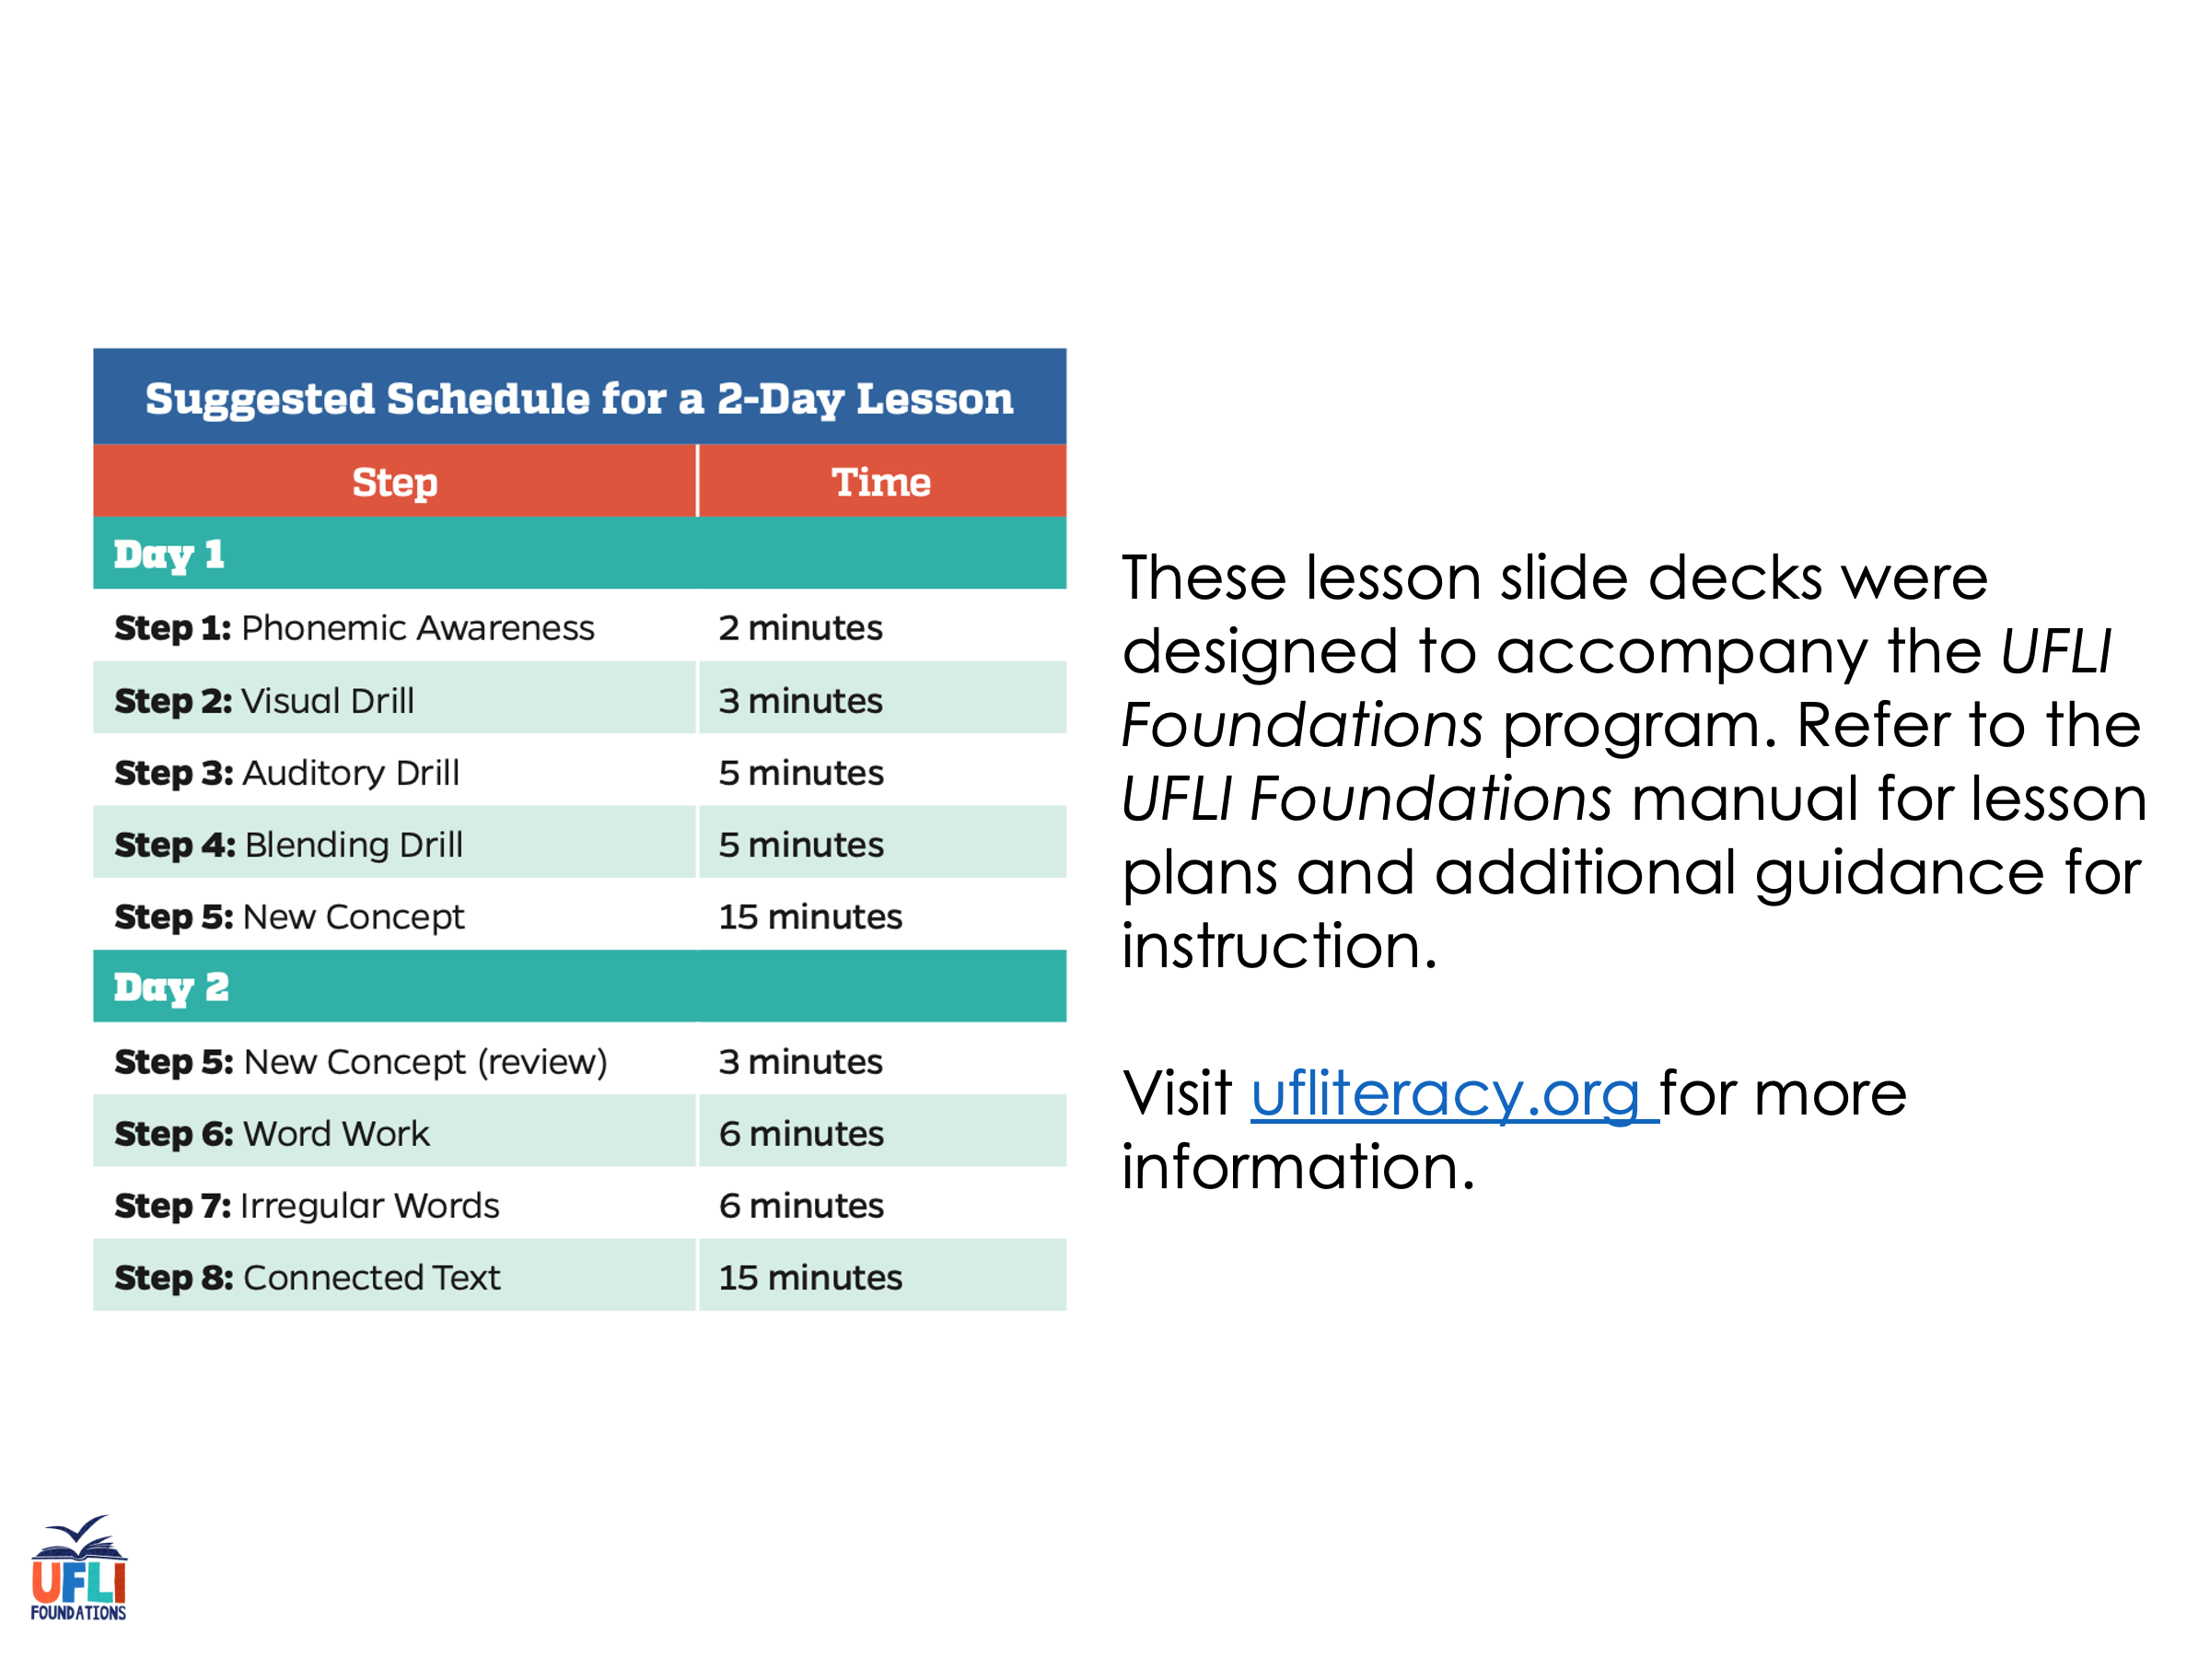
Notes:
ufliteracy.org

Slide 3
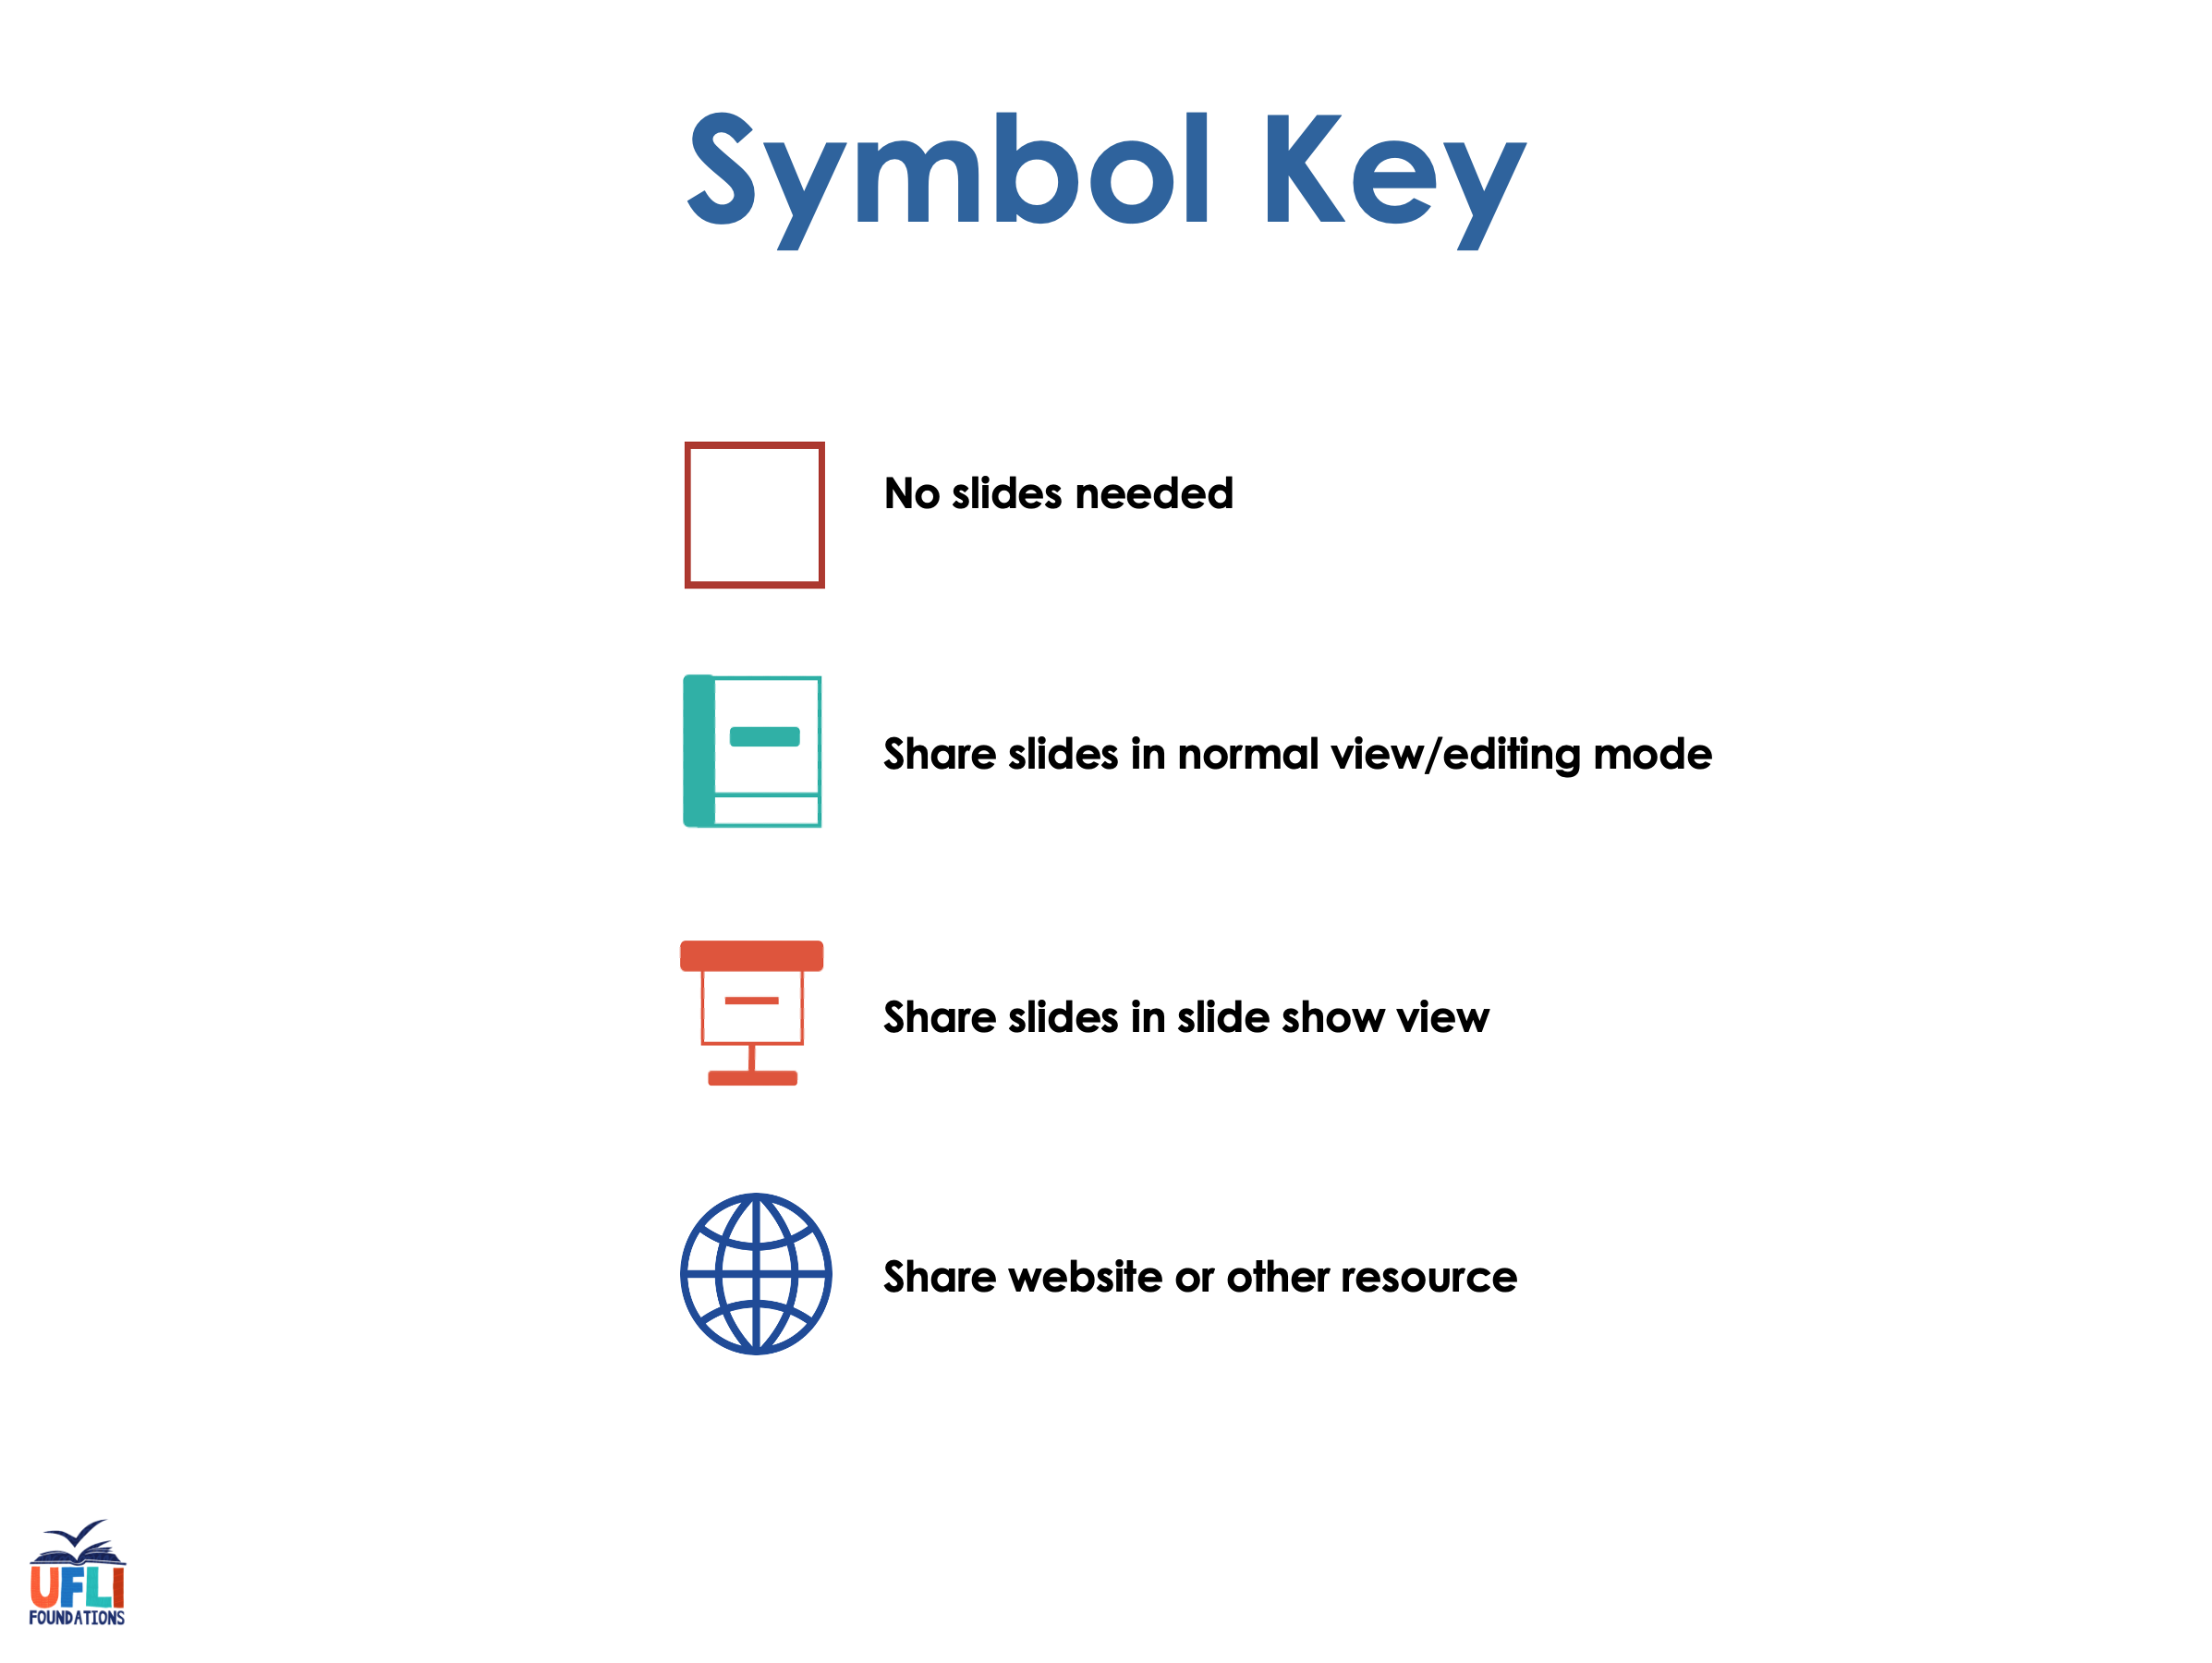

Slide 4

Lesson 18
e /ĕ/

Slide 5
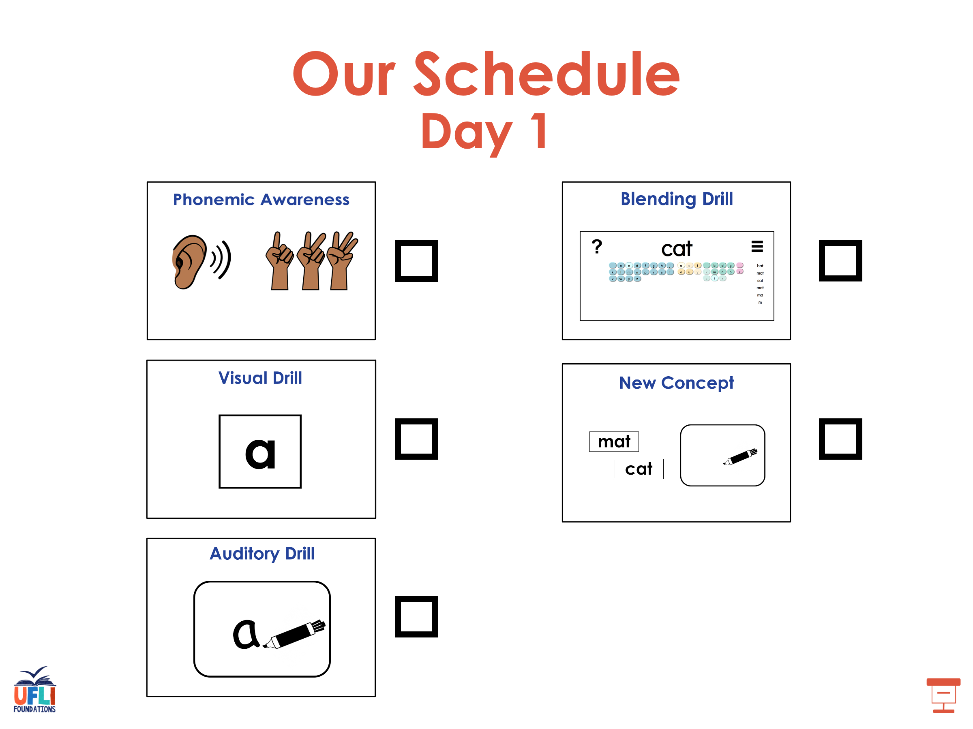

Slide 6
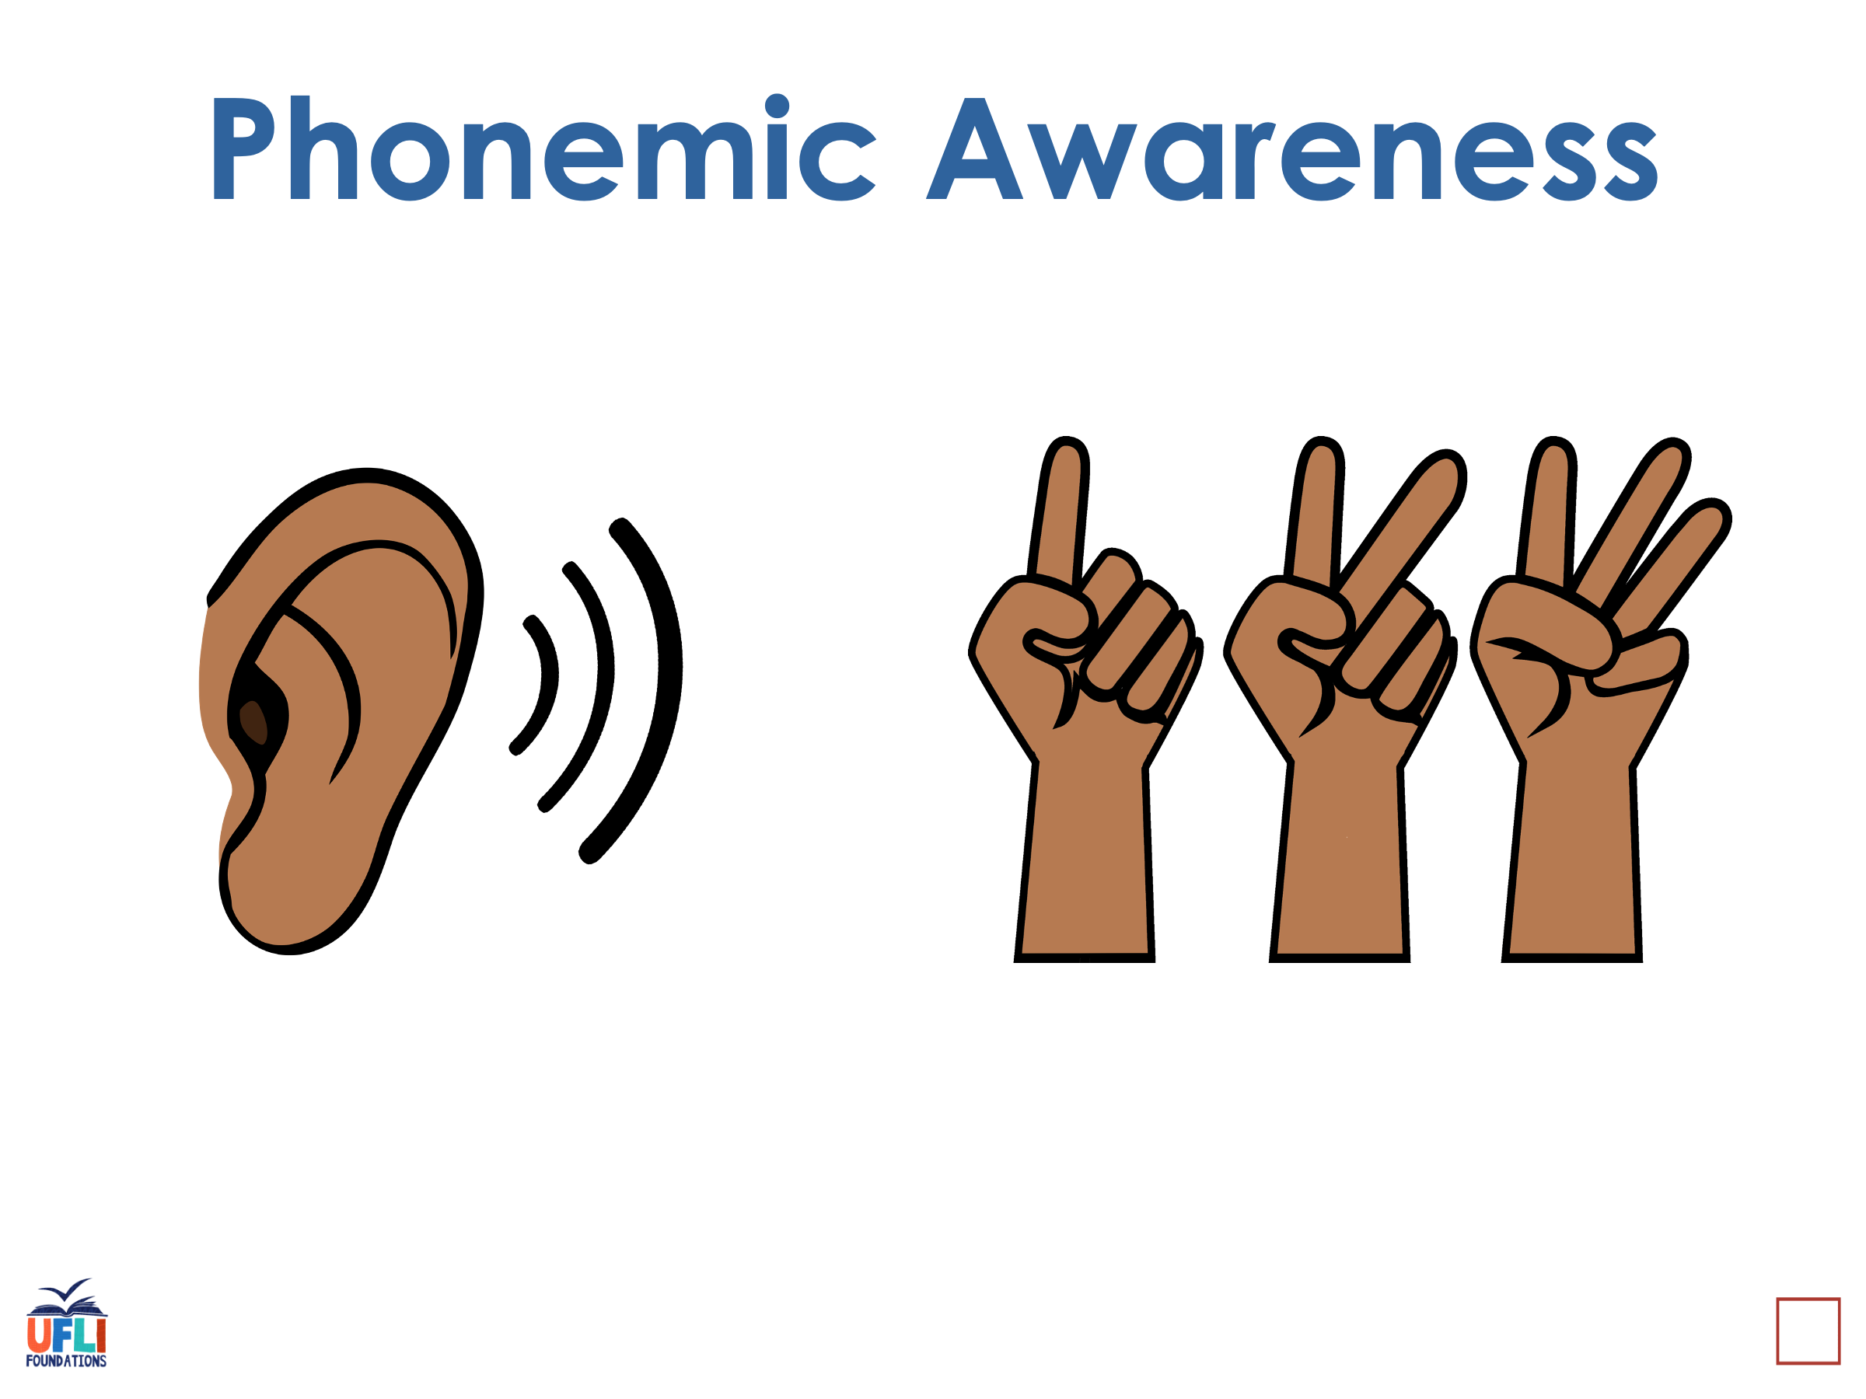
Notes:
See UFLI Foundations lesson plan Step 1 for phonemic awareness activity.

Slide 7
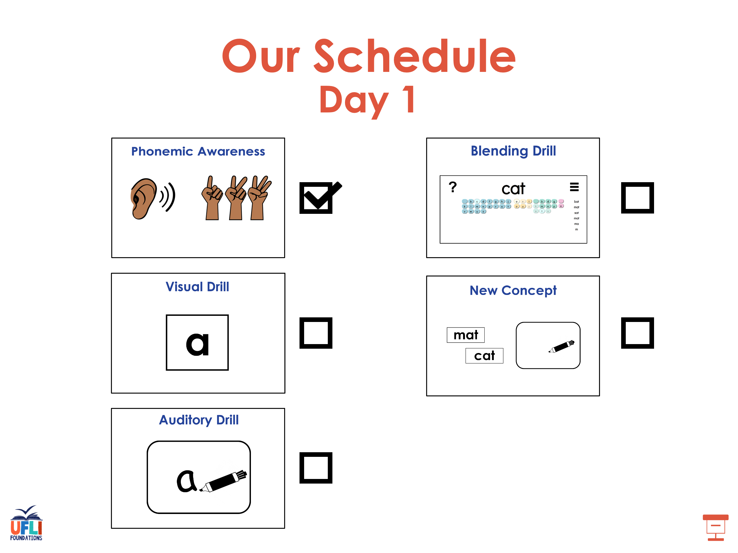

Slide 8
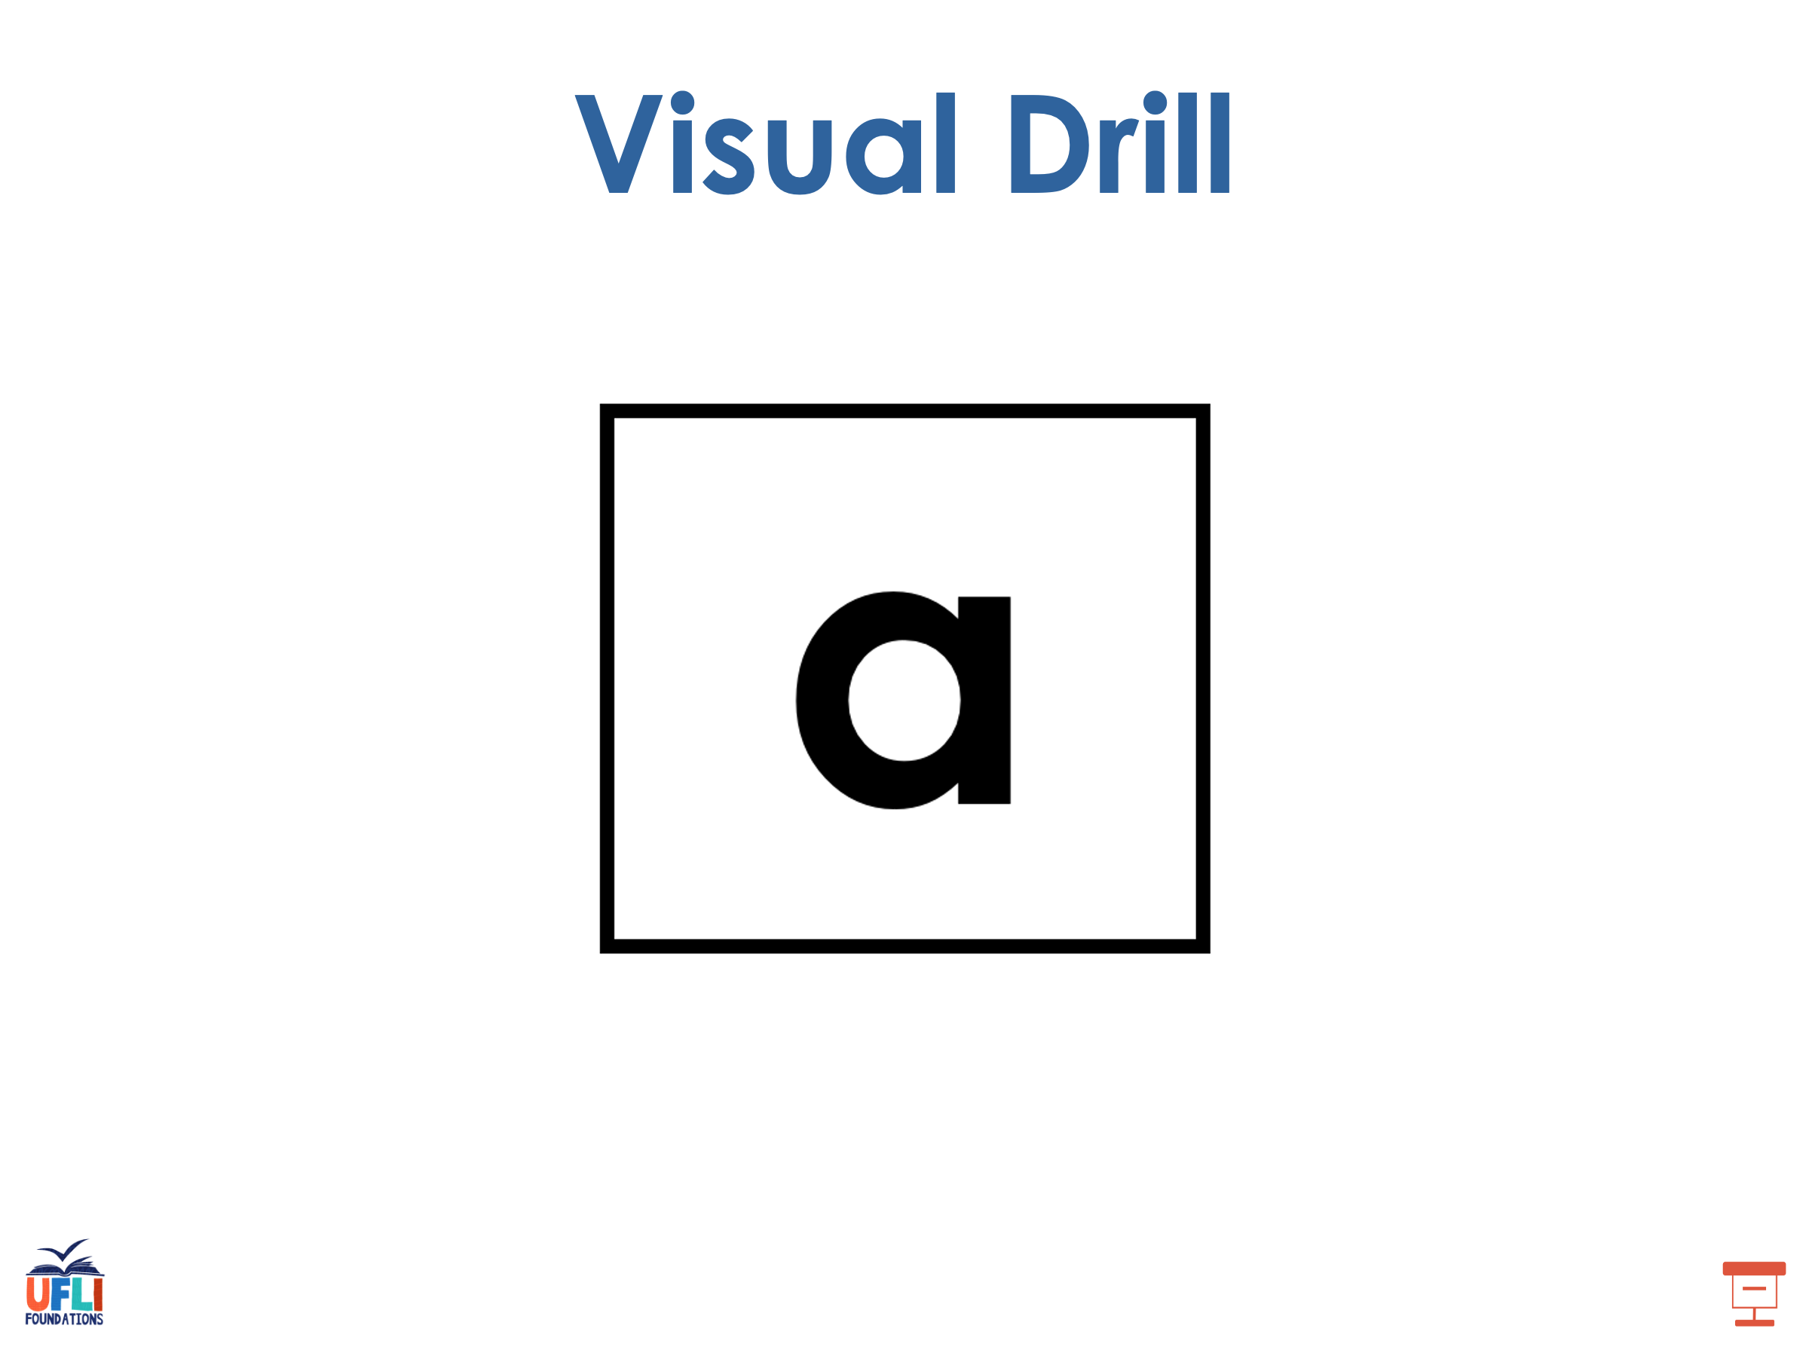
Notes:
See UFLI Foundations lesson plan Step 2 for student phoneme responses.

Slide 9
b

Slide 10
g

Slide 11
u

Slide 12
c

Slide 13
d

Slide 14
o

Slide 15
n

Slide 16
i

Slide 17
f

Slide 18
p

Slide 19
t

Slide 20
s

Slide 21
m

Slide 22
a

Slide 23
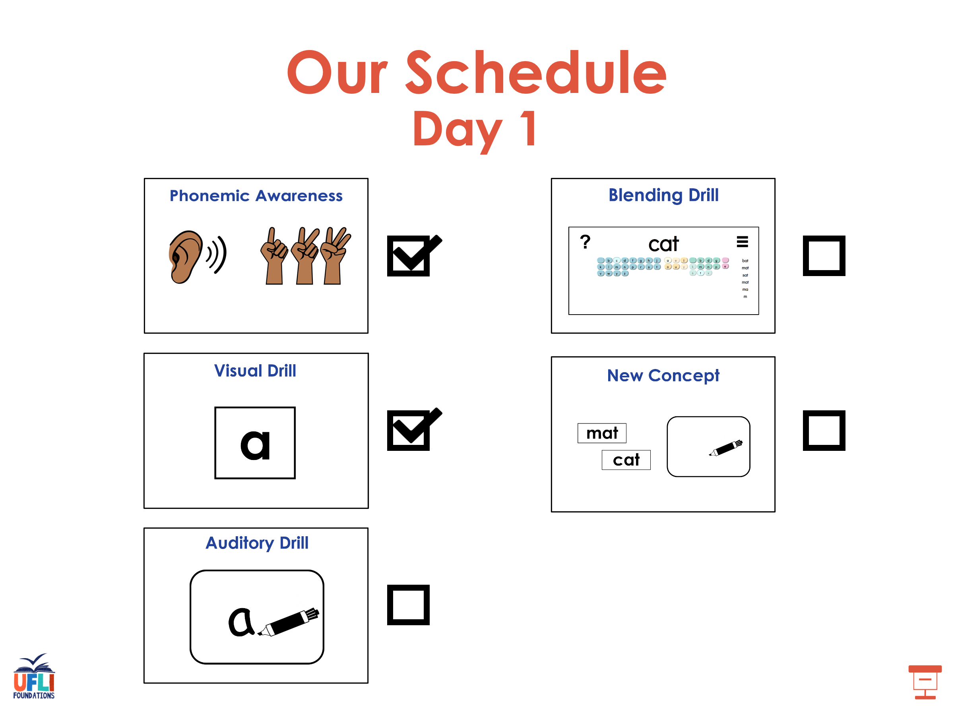

Slide 24
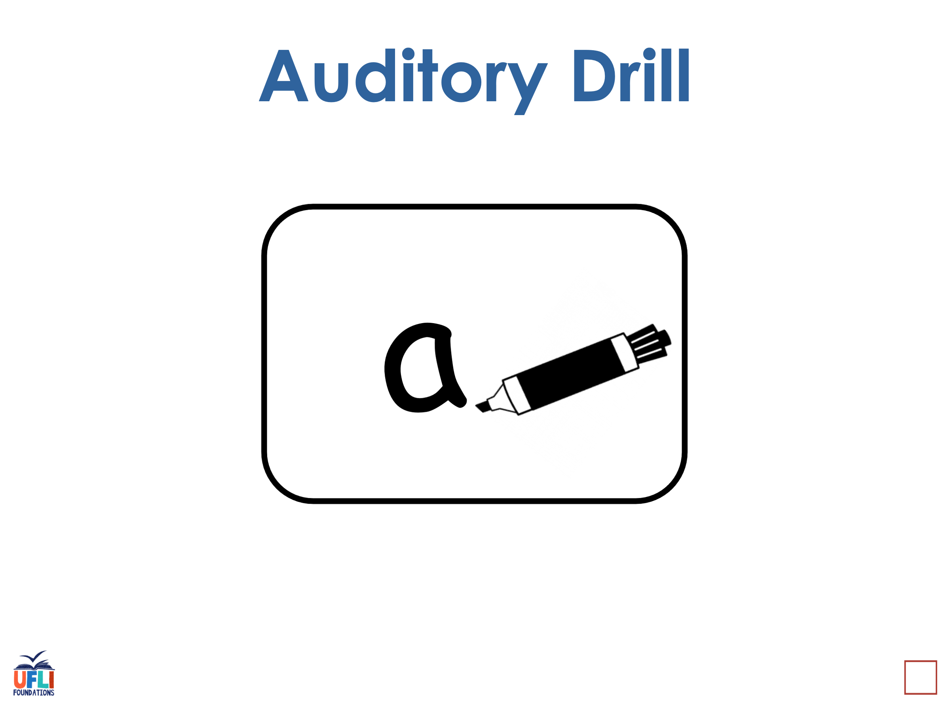
Notes:
See UFLI Foundations lesson plan Step 3 for auditory drill activity.

Slide 25
Notes:
No slides needed for auditory drill.

Slide 26
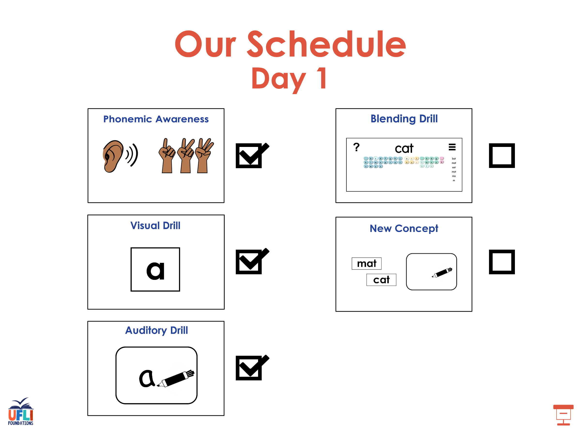

Slide 27
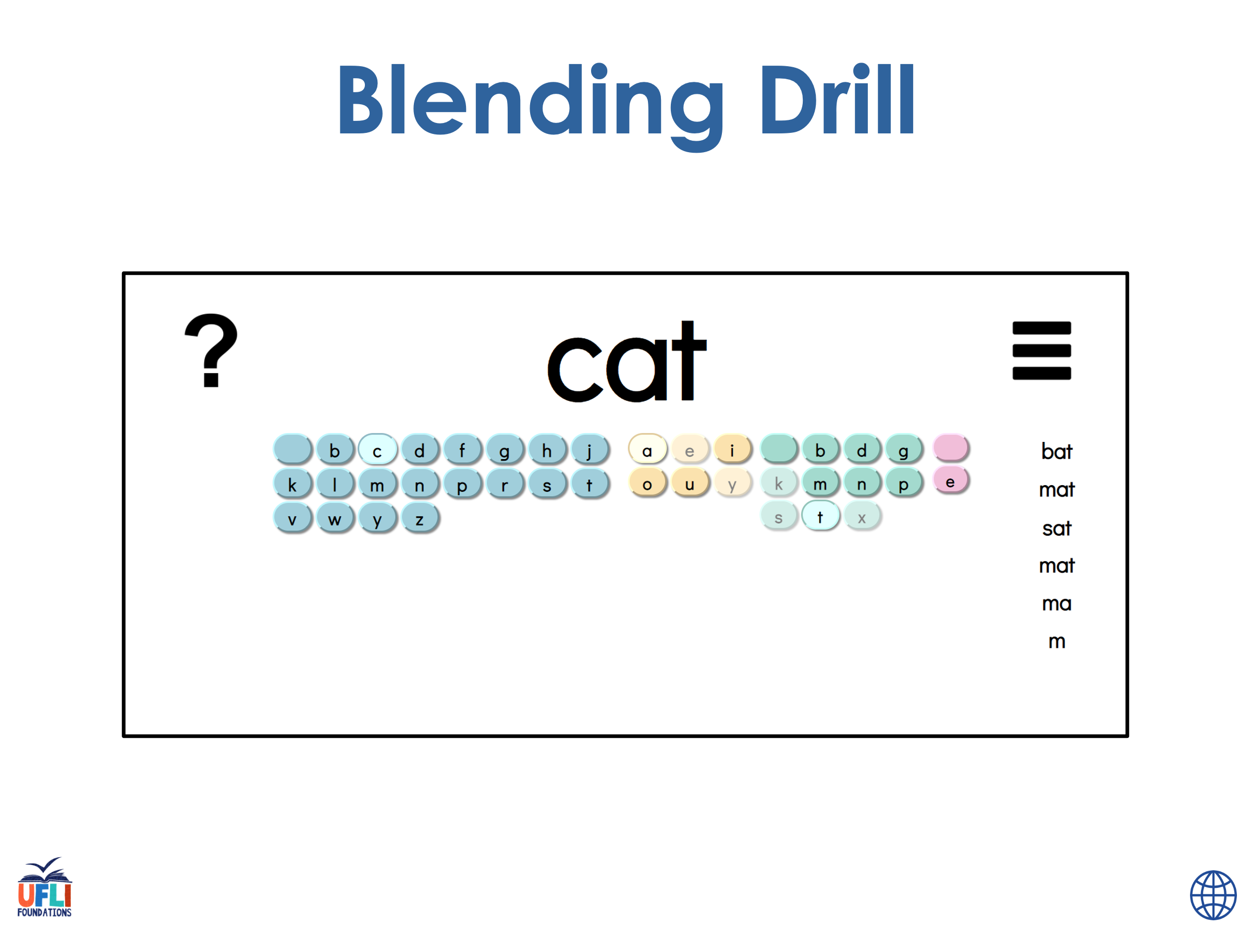
Notes:
See UFLI Foundations lesson plan Step 4 for blending drill word chain and grid.
Visit ufliteracy.org to access the Blending Board app.

Slide 28
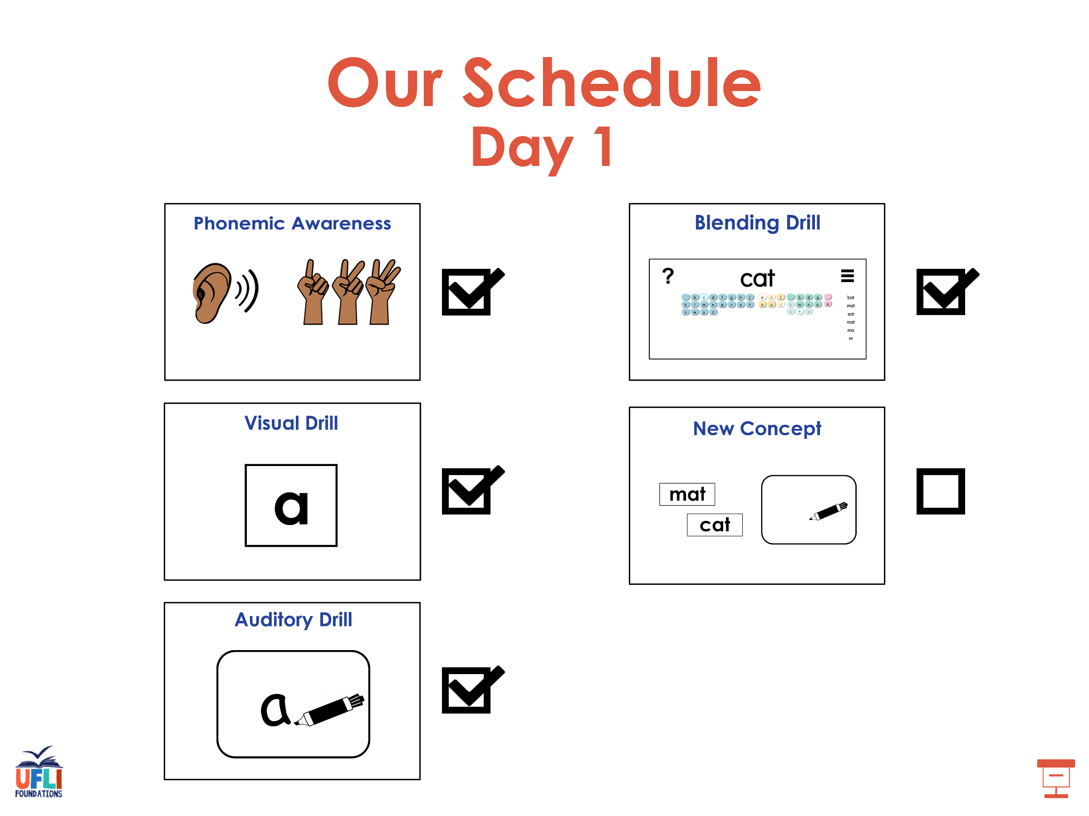

Slide 29
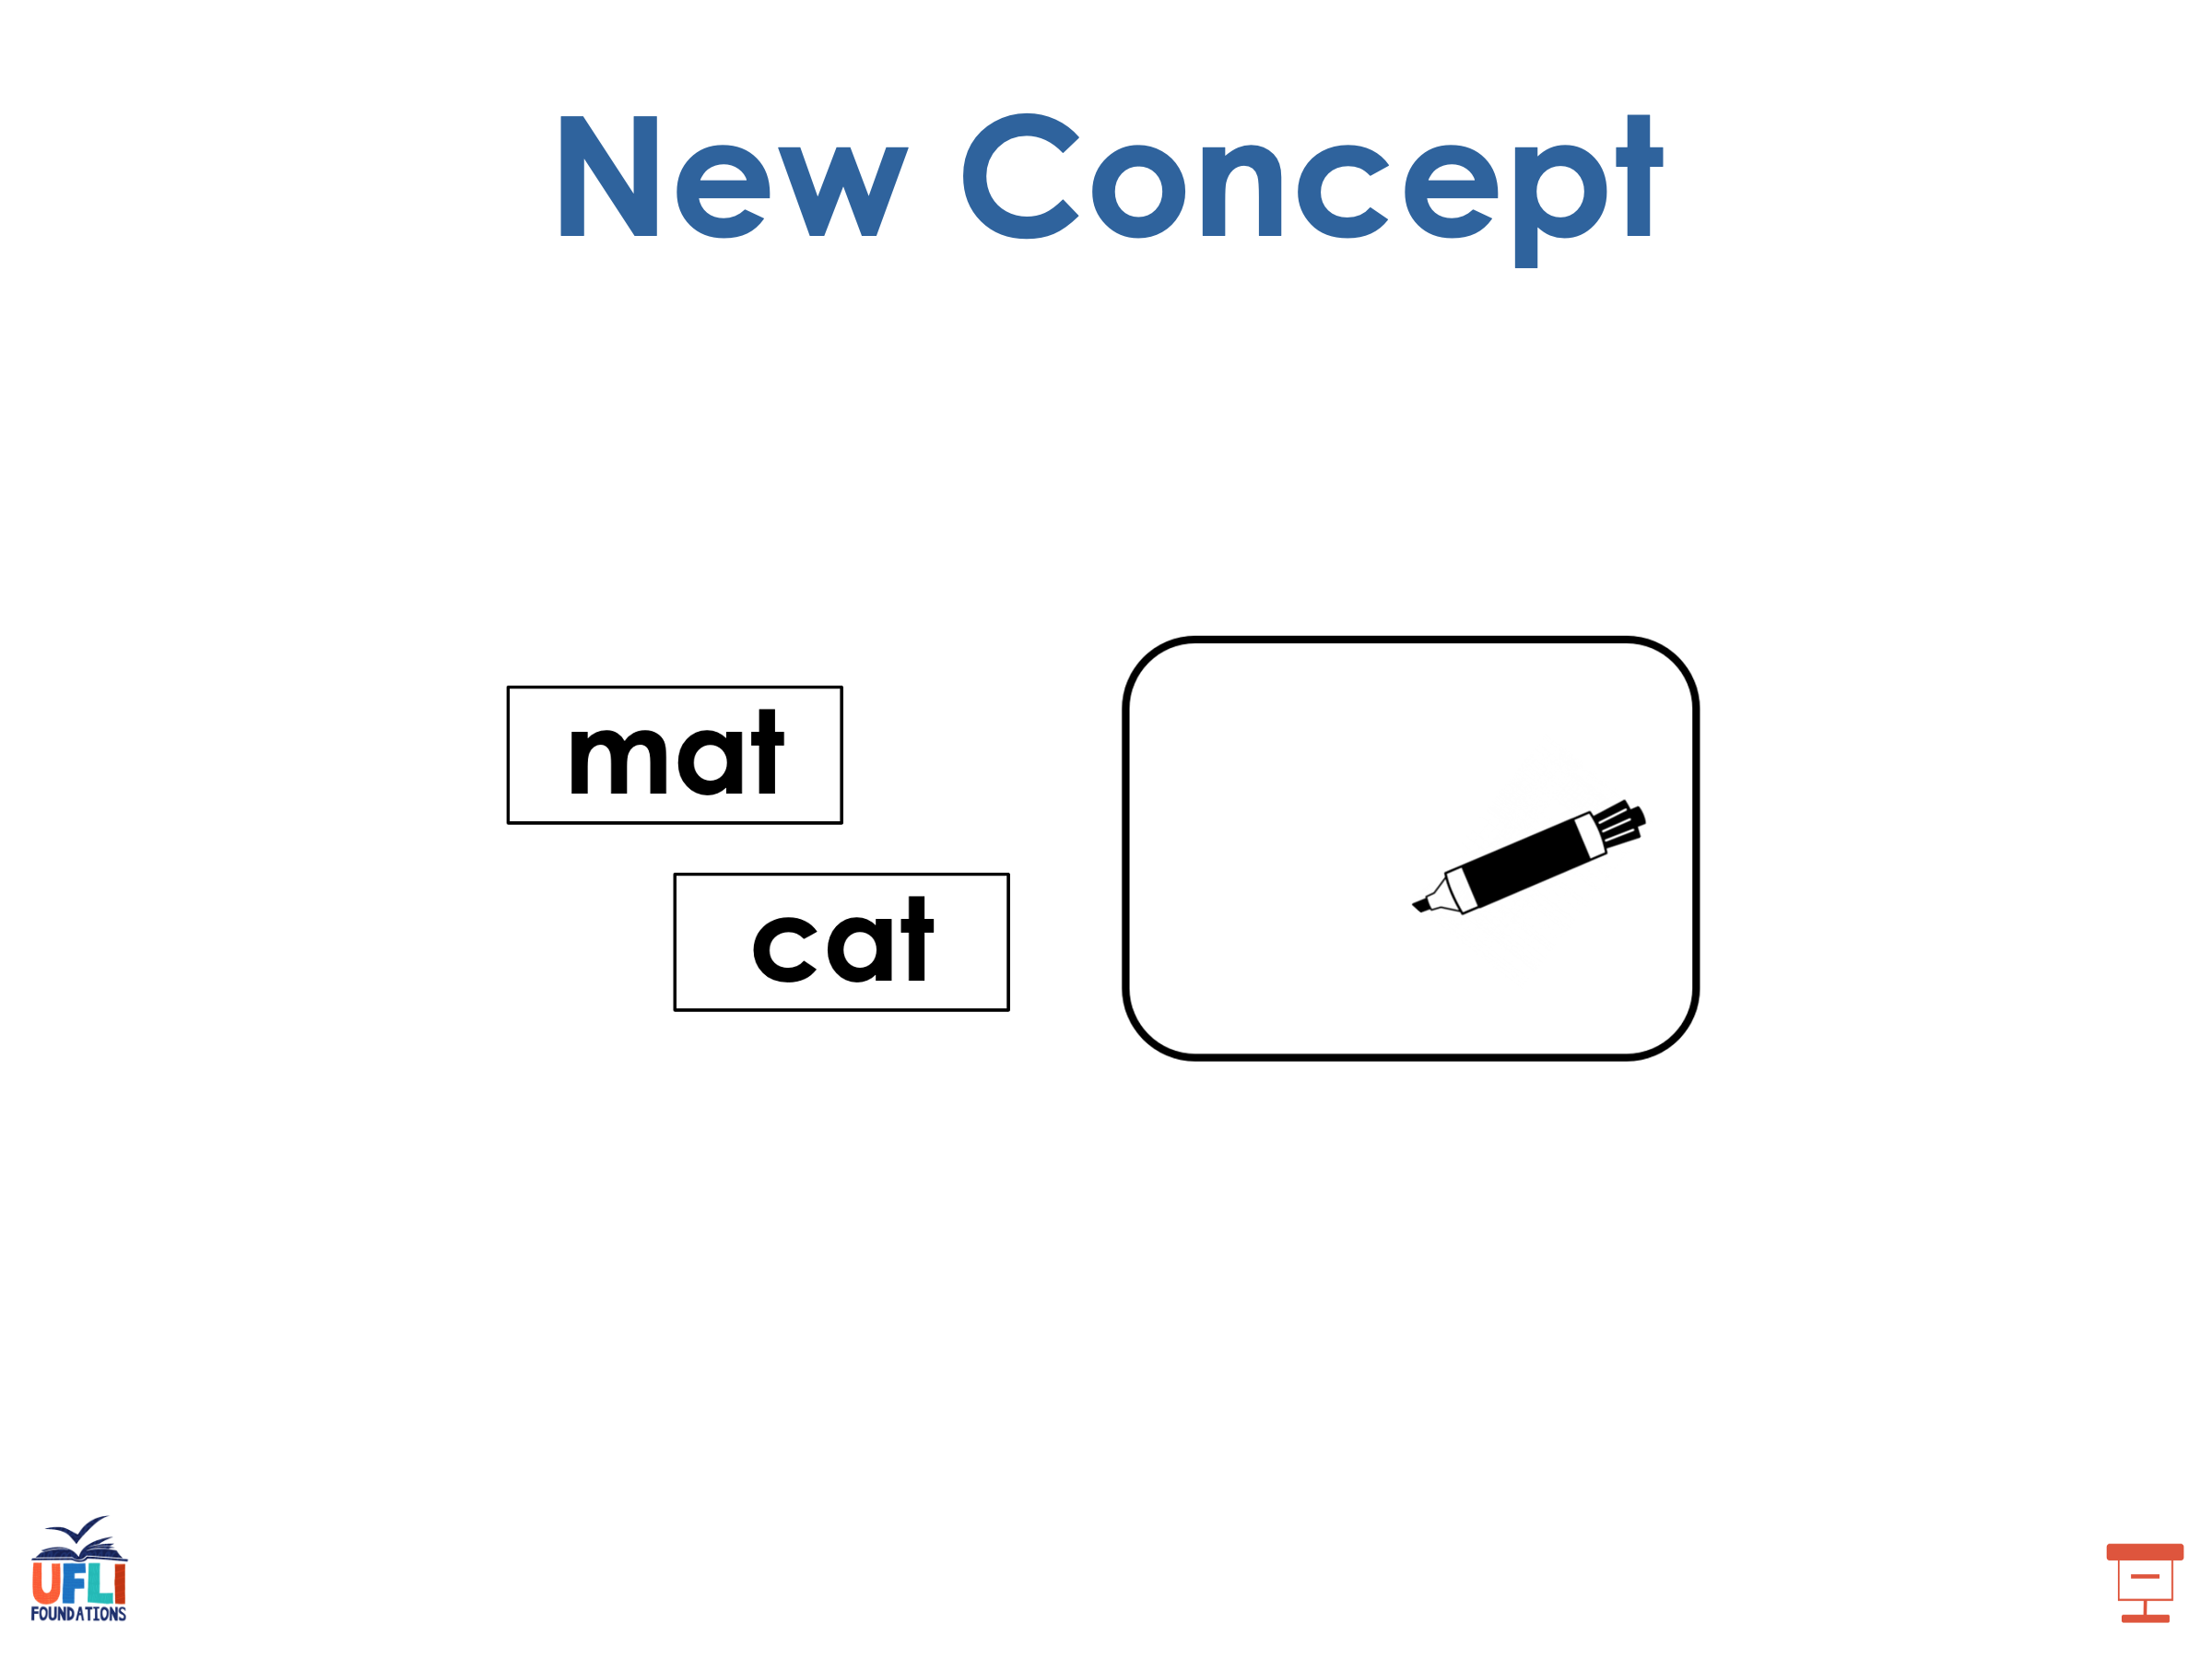
Notes:
See UFLI Foundations lesson plan Step 5 for recommended teacher language and activities to introduce the new concept.

Slide 30
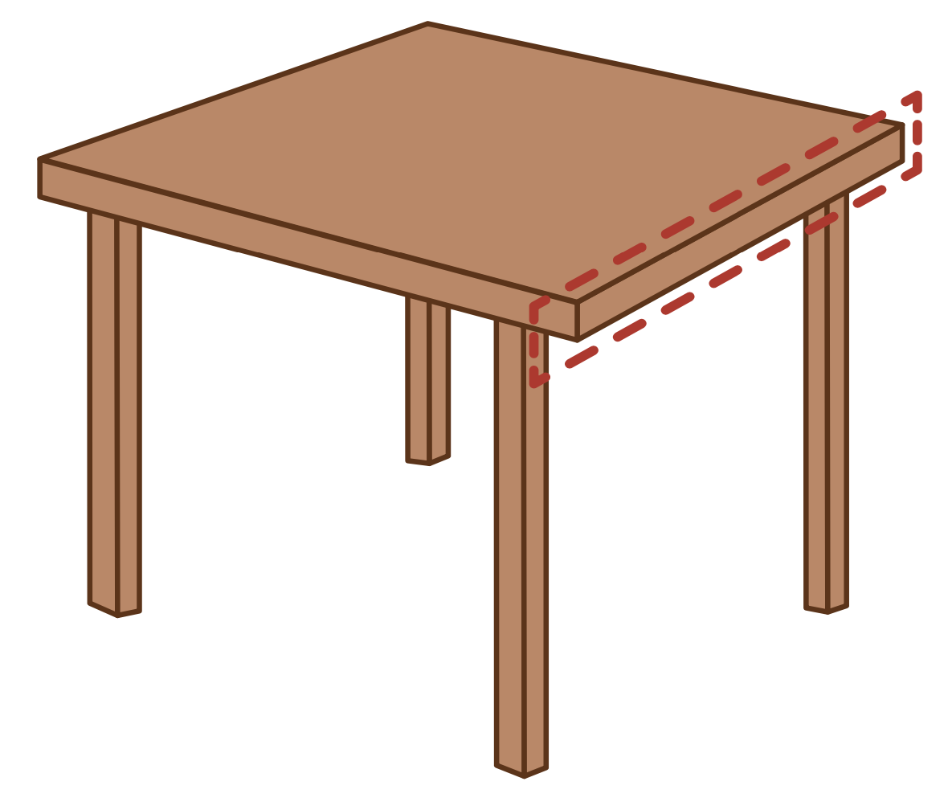
e

Slide 31
men
get
e

Slide 32
end
Ed
e

Slide 33
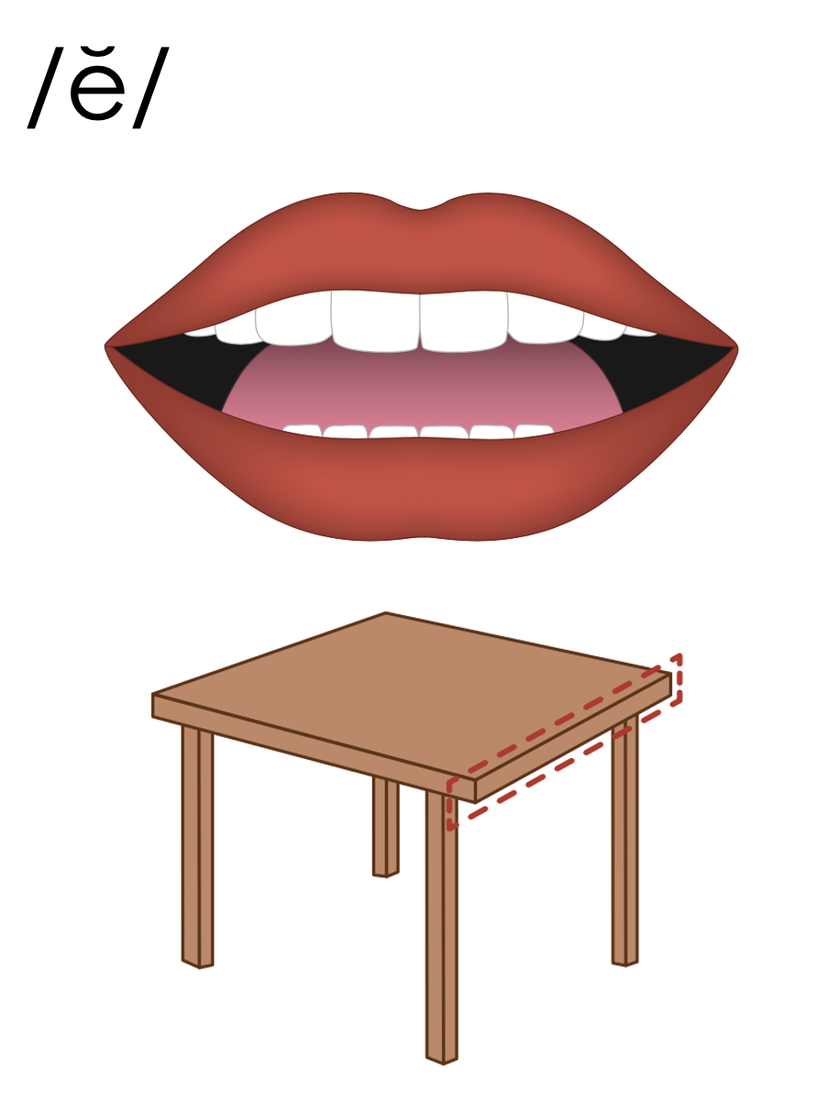
e

Slide 34

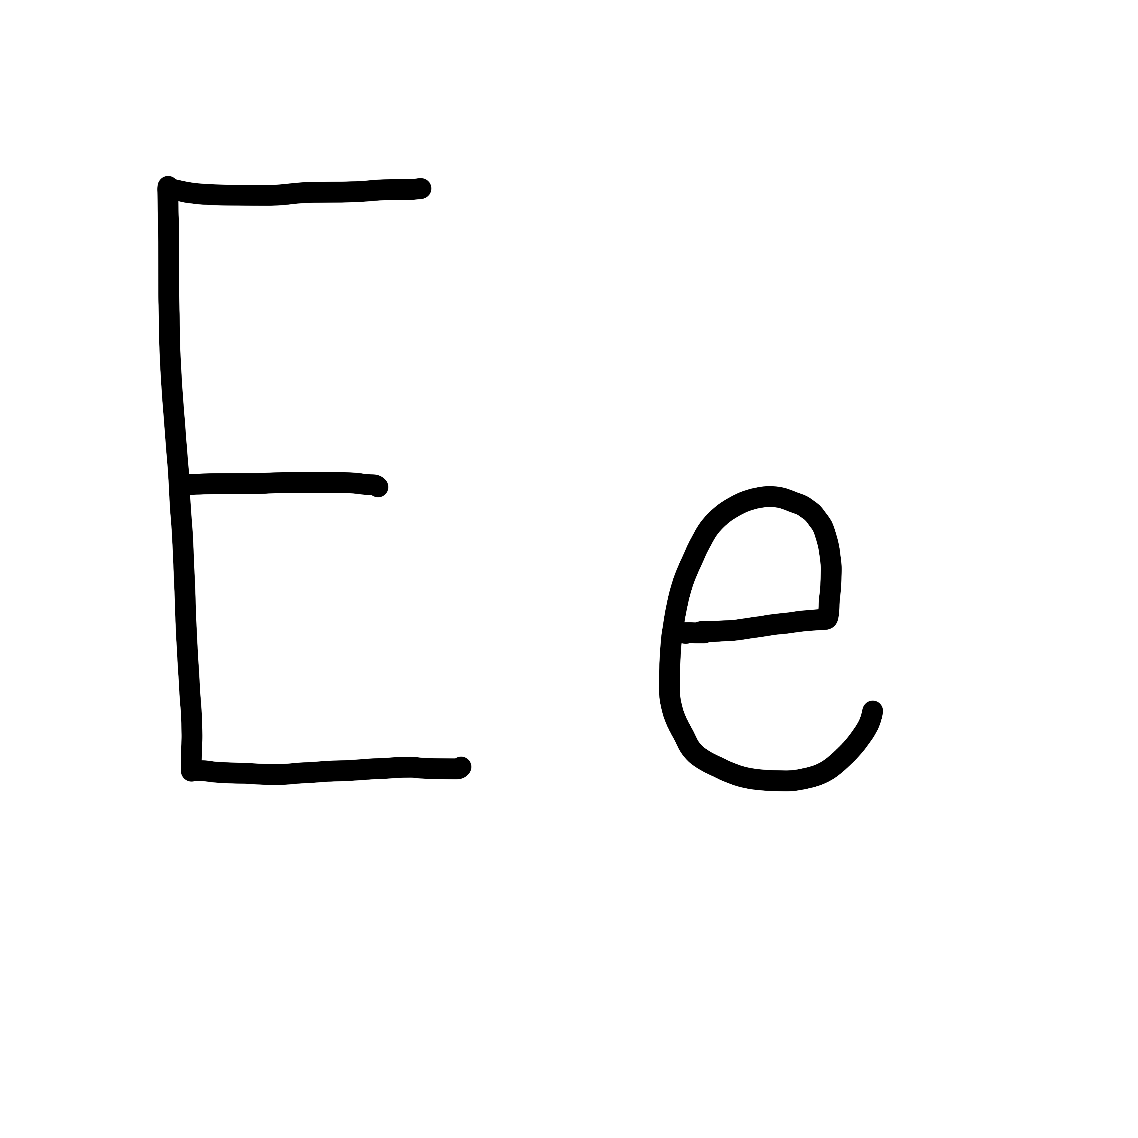

Slide 35
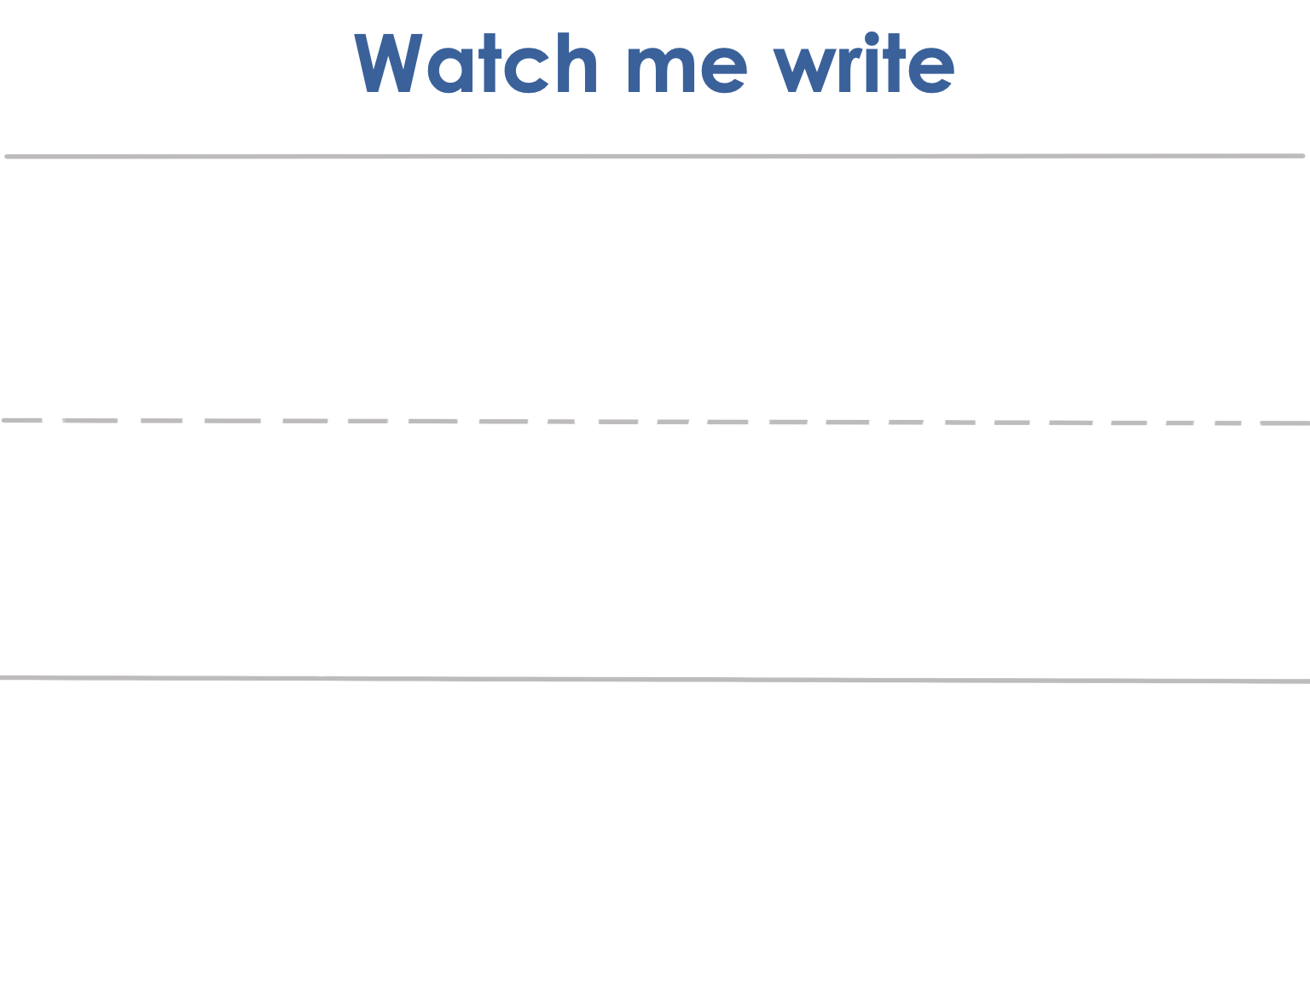


Slide 36
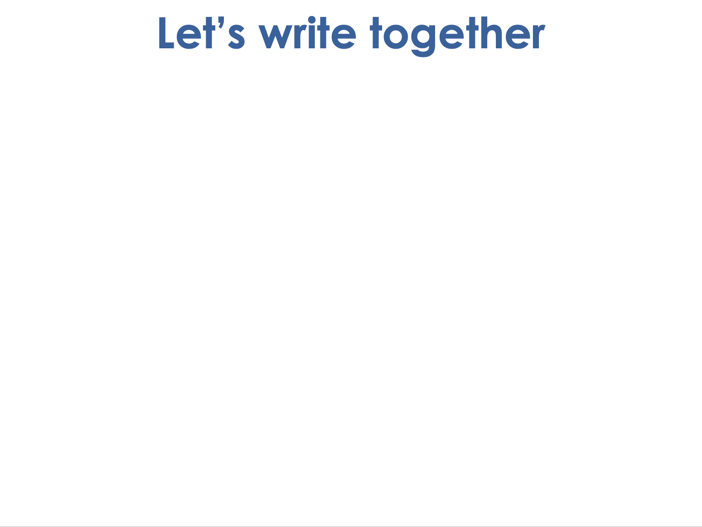
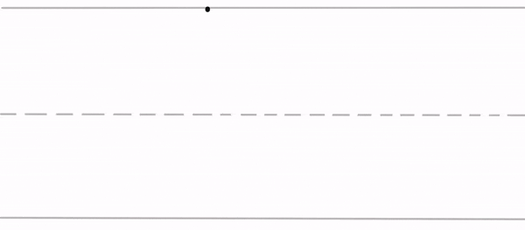
Notes:
Uppercase E gif

Slide 37


Slide 38

Notes:
Lowercase e gif

Slide 39
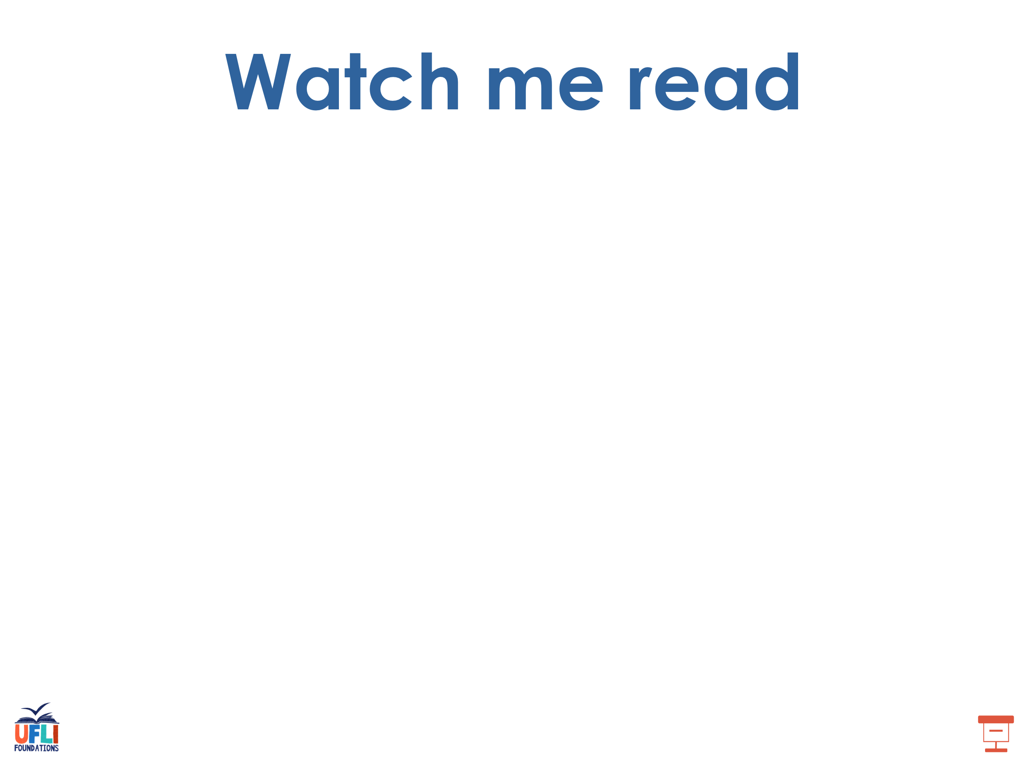
men

Slide 40
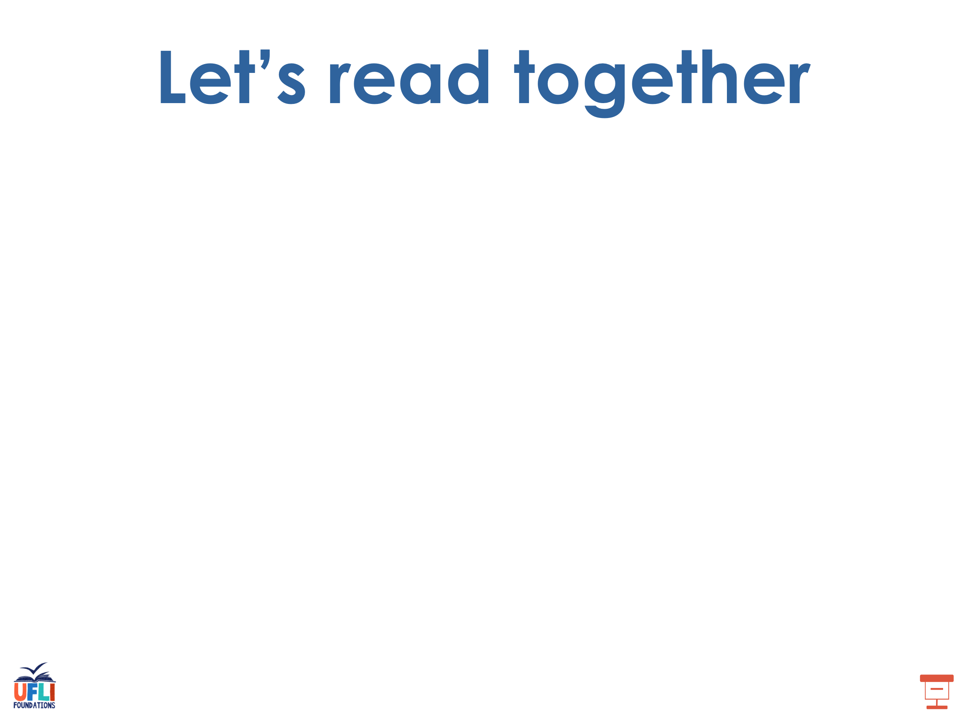
set
fed
ten
get
bed
pet

Slide 41
beg
pen
bet

Slide 42
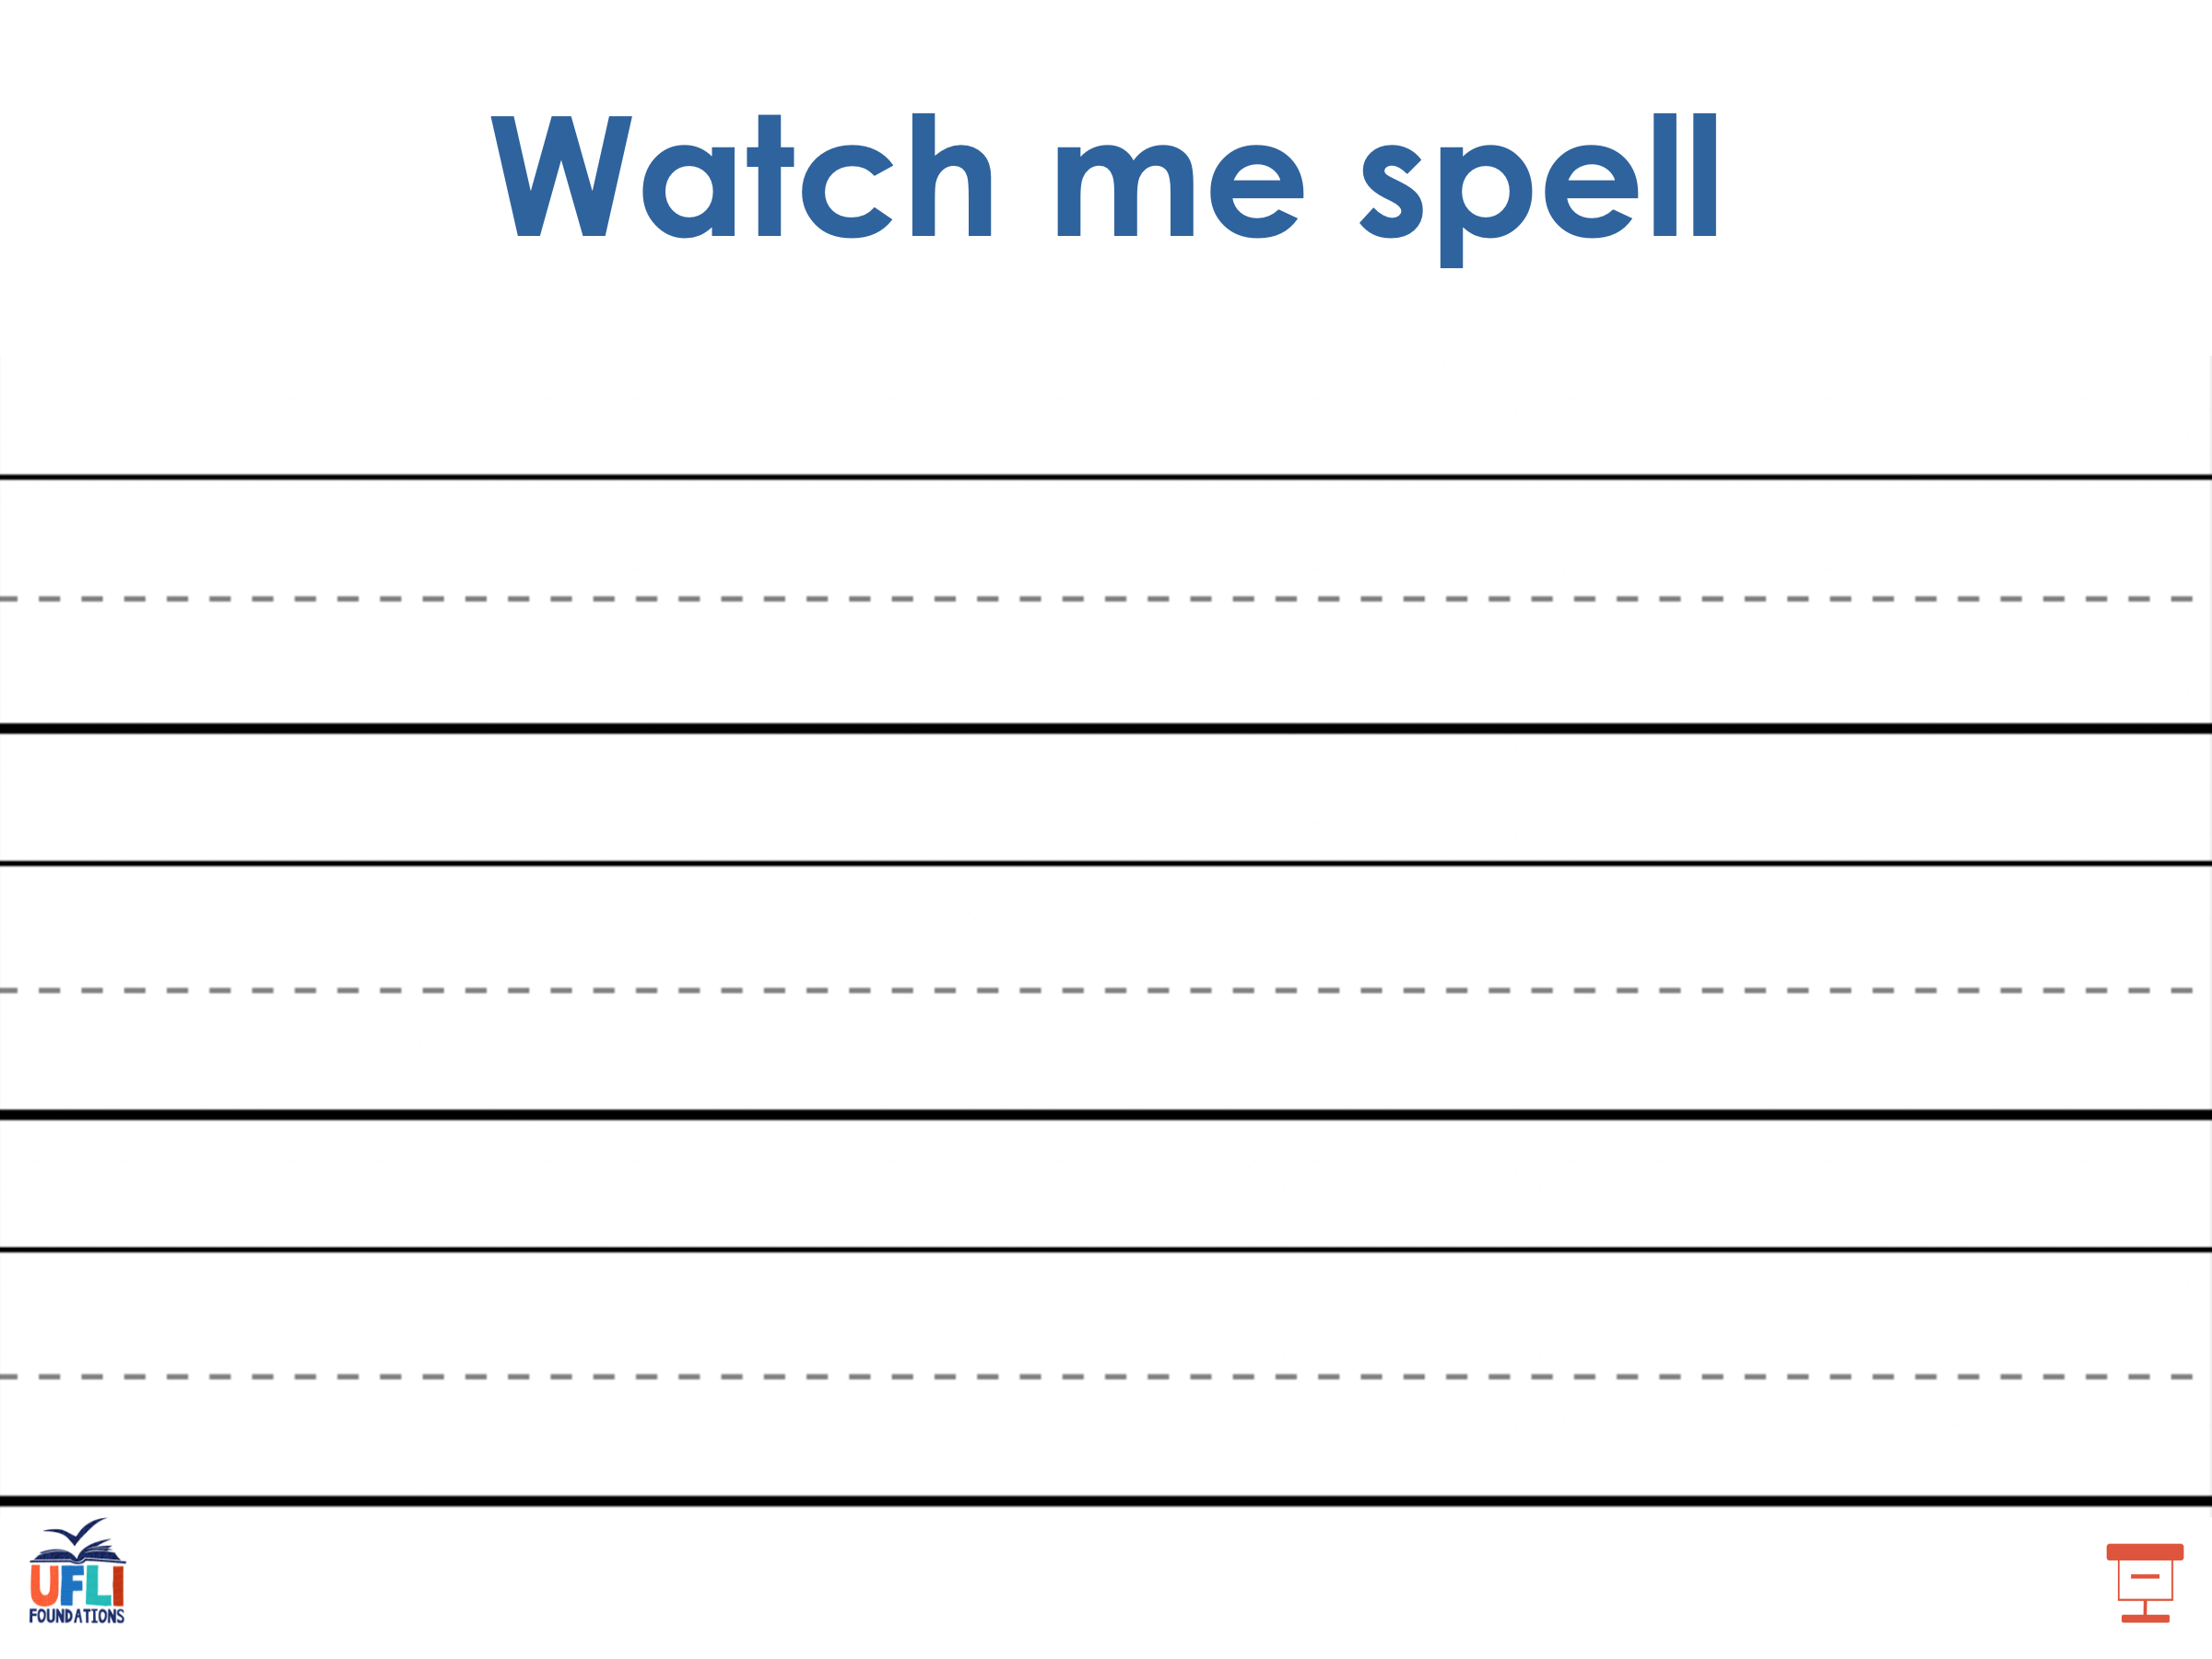
Notes:
See UFLI Foundations lesson plan Step 5 for words to spell.
Handwriting paper to model spelling.

Slide 43
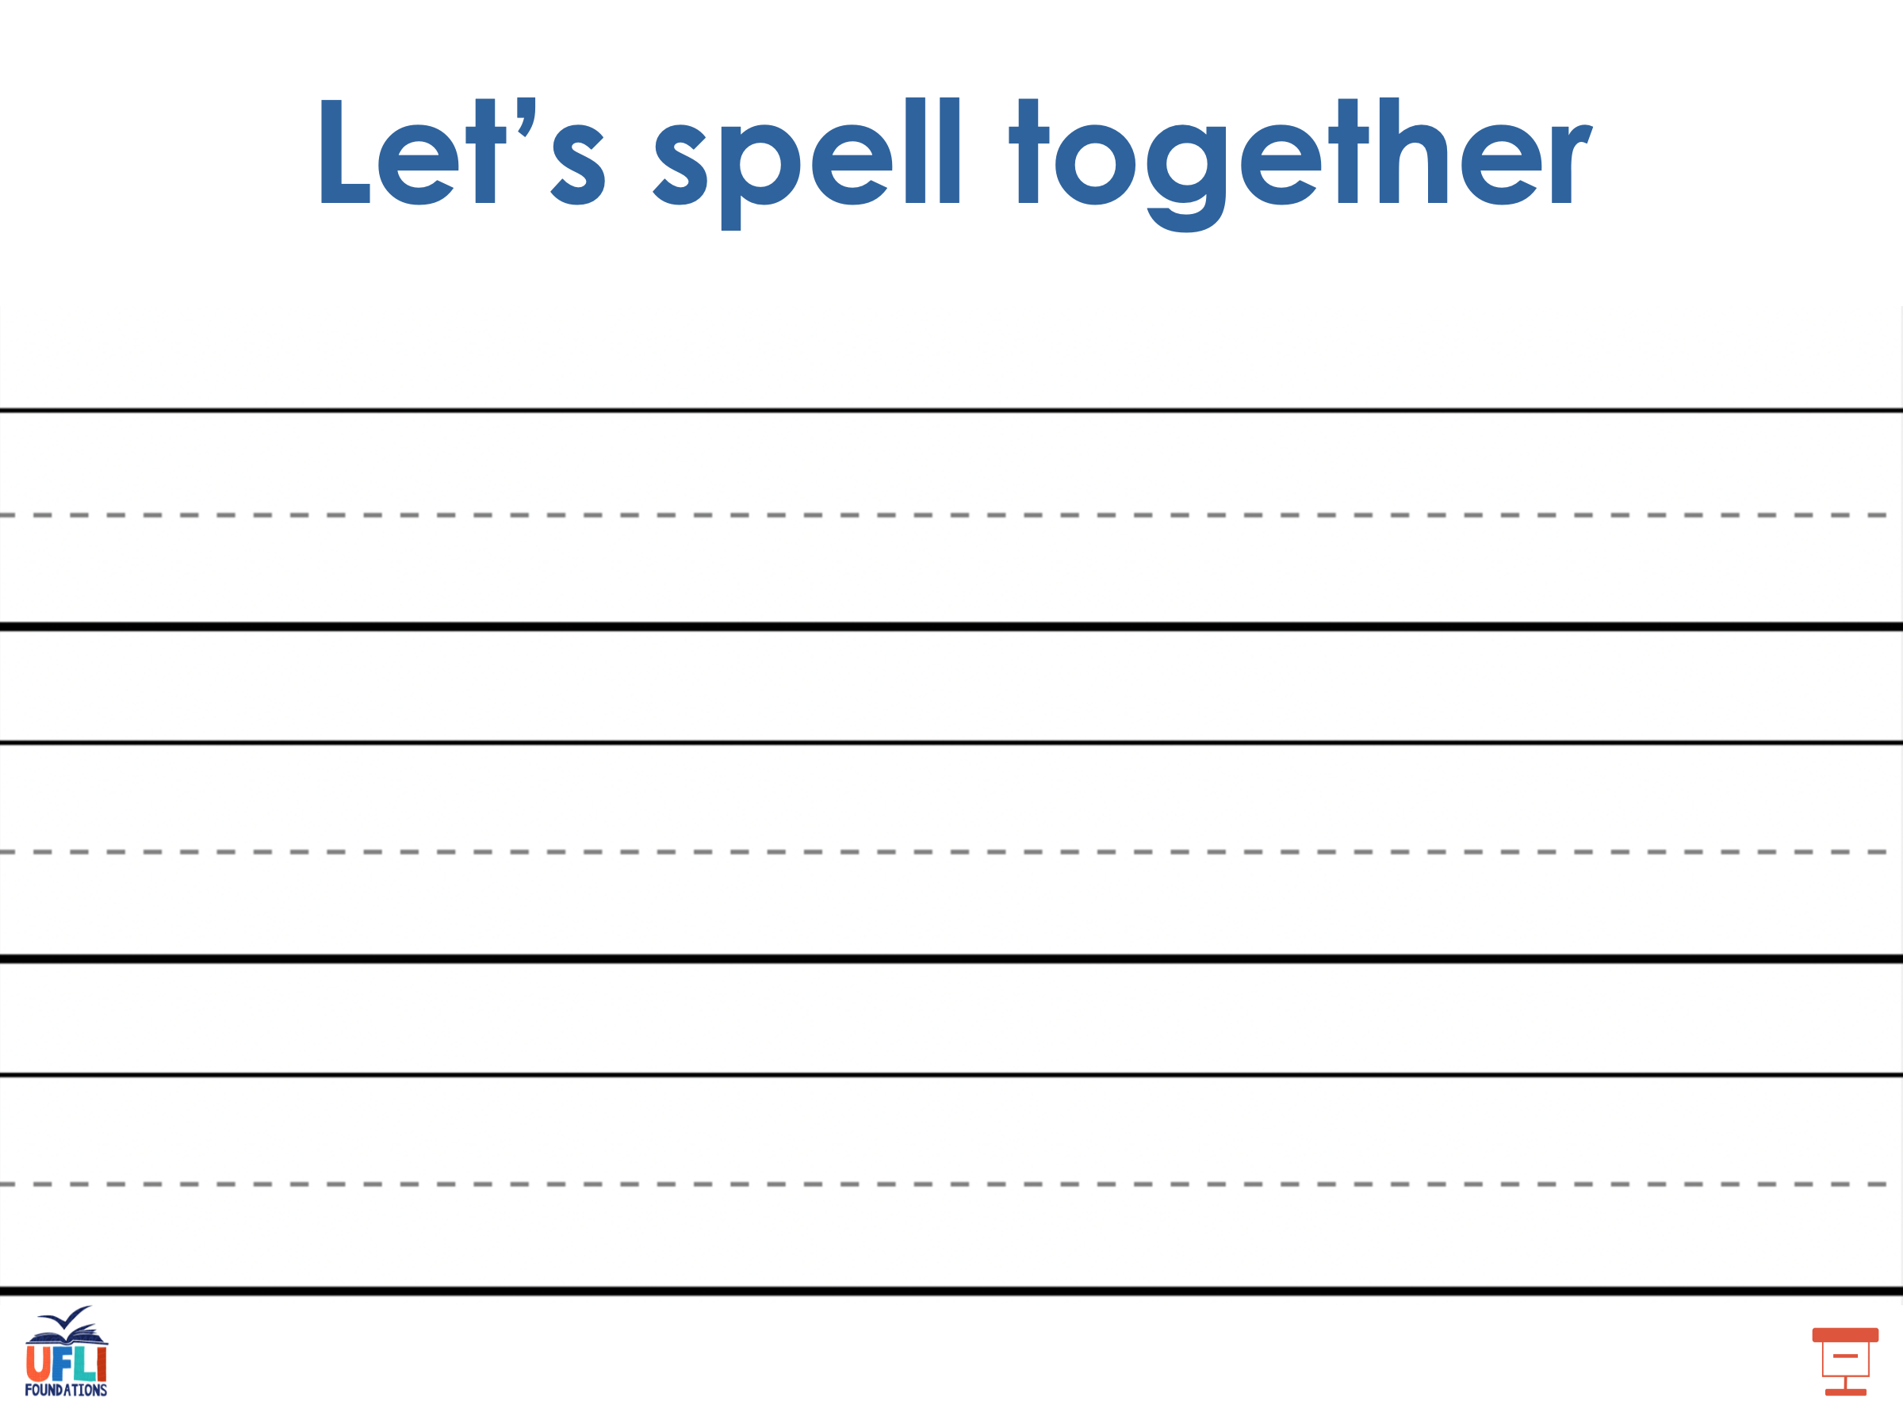
Notes:
See UFLI Foundations lesson plan Step 5 for words to spell.
Handwriting paper for guided spelling practice.

Slide 44
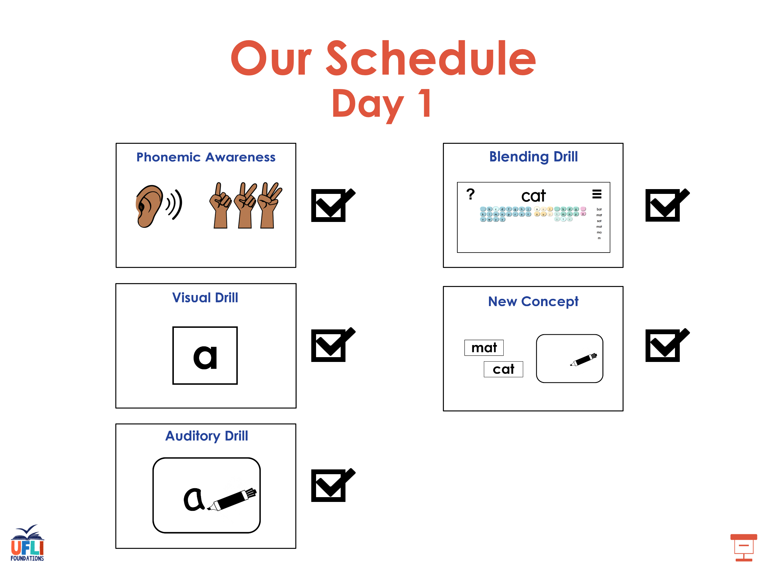

Slide 45

Insert brief reinforcement activity and/or transition to next part of reading block.

Slide 46

Lesson 18
e /ĕ/

Slide 47
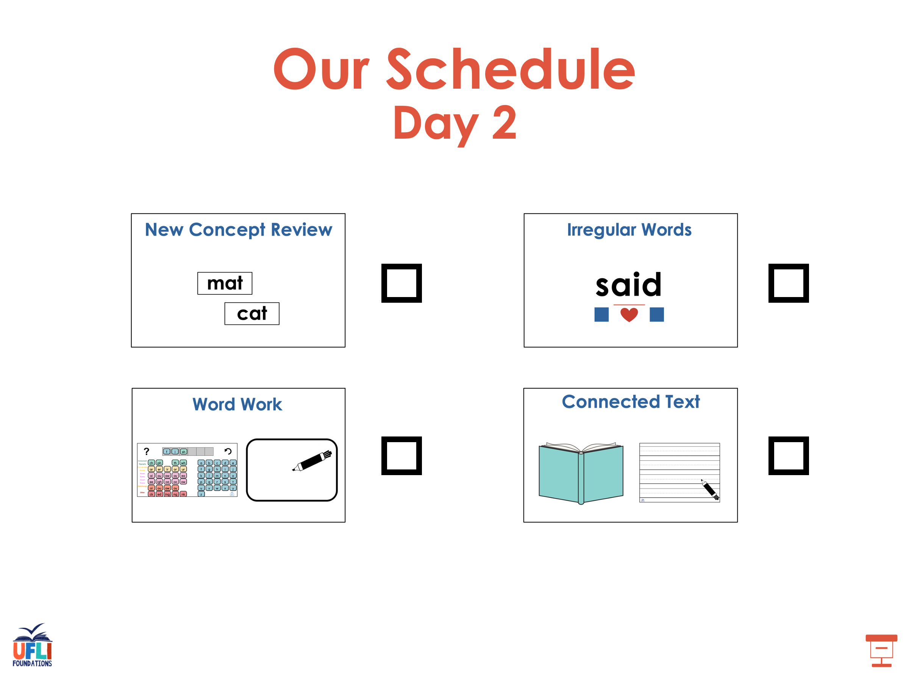

Slide 48



New Concept Review
Notes:
See UFLI Foundations lesson plan Step 5 for recommended teacher language and activities to review the new concept.

Slide 49
e

Slide 50
men
get
e

Slide 51
end
Ed
e

Slide 52
e

Slide 53
Notes:
Lowercase e gif

Slide 54
ten
get
set
men

Slide 55
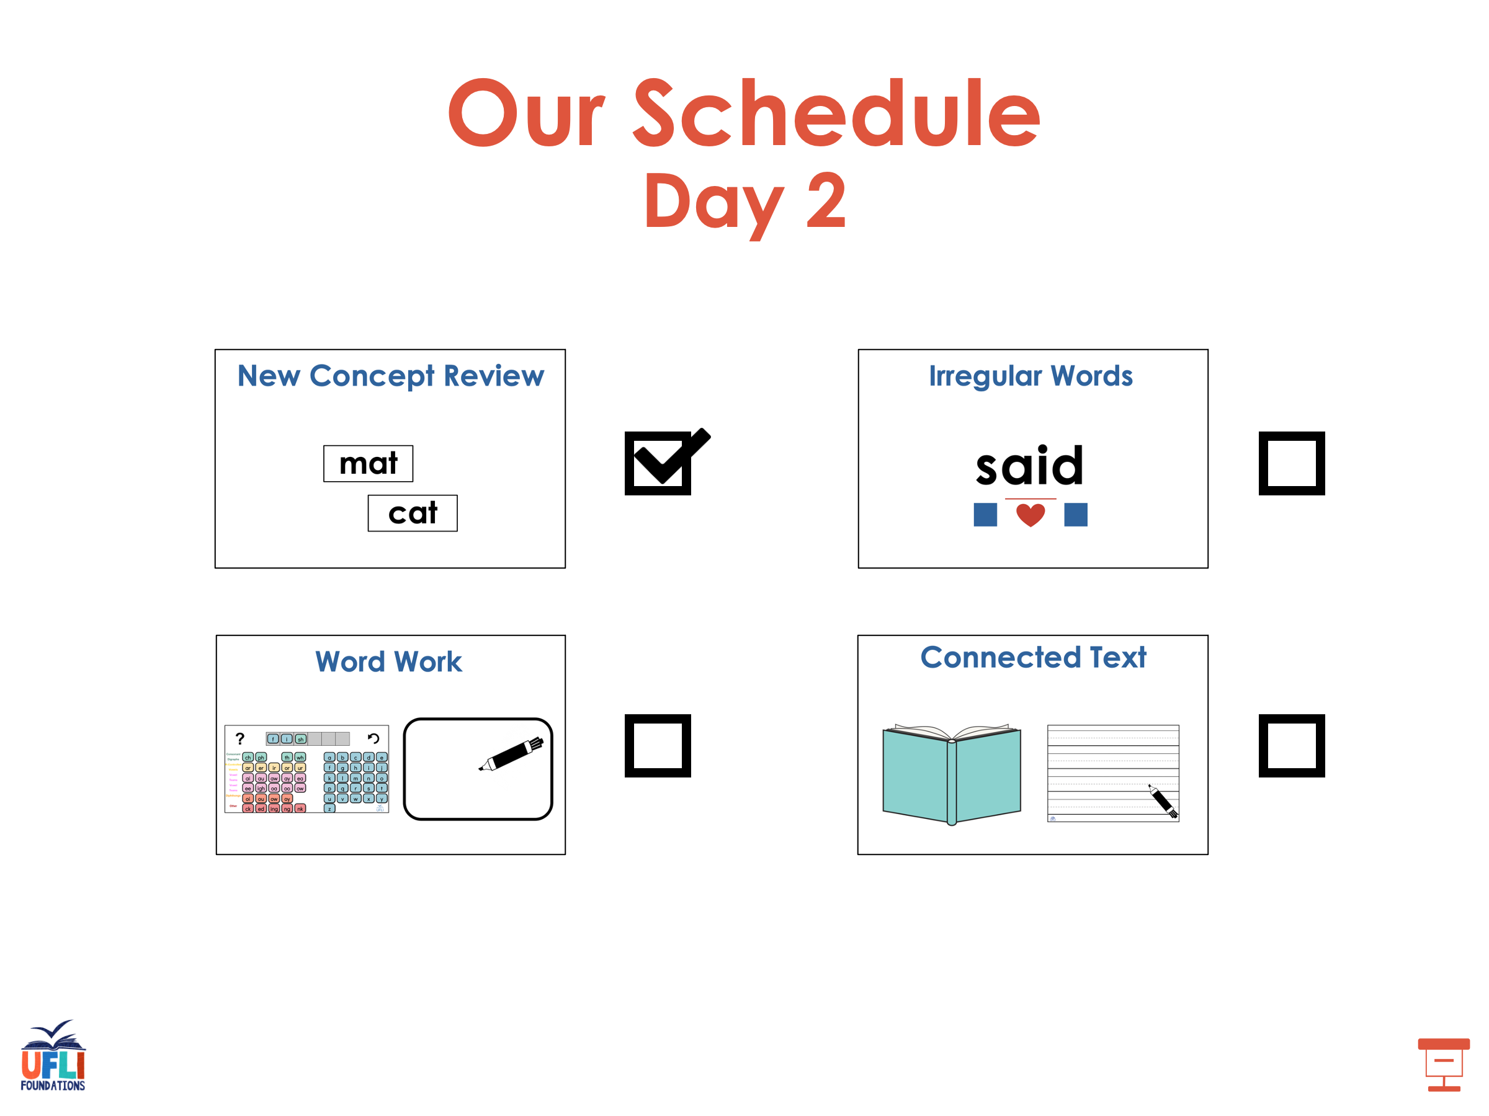

Slide 56
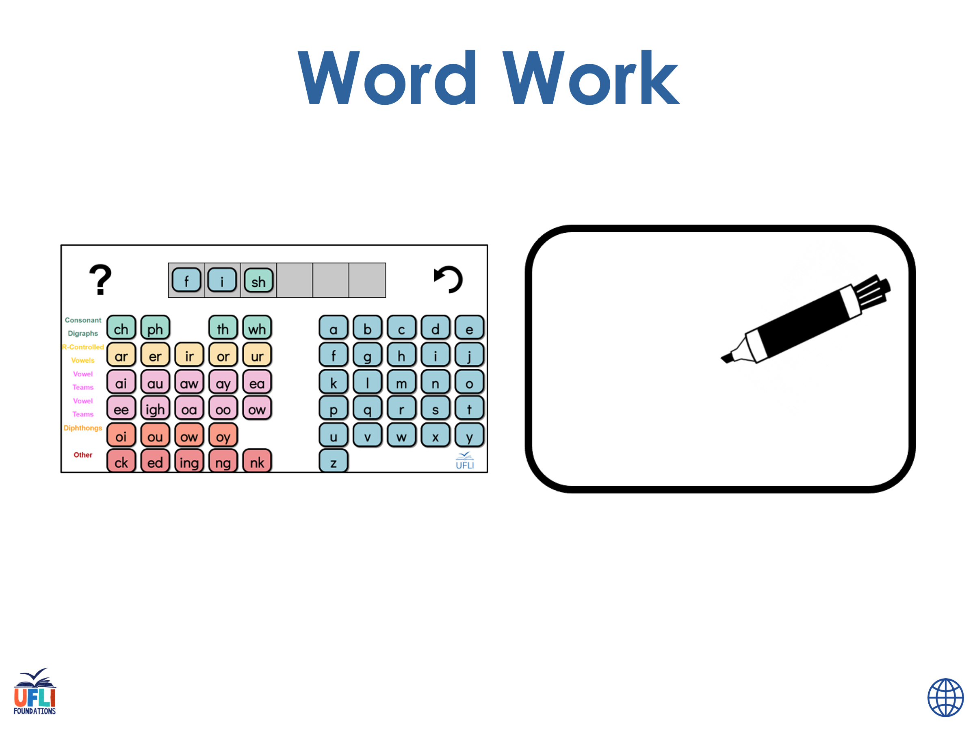
Notes:
See UFLI Foundations lesson plan Step 6 for word work activity.
Visit ufliteracy.org to access the Word Work Mat apps.

Slide 57
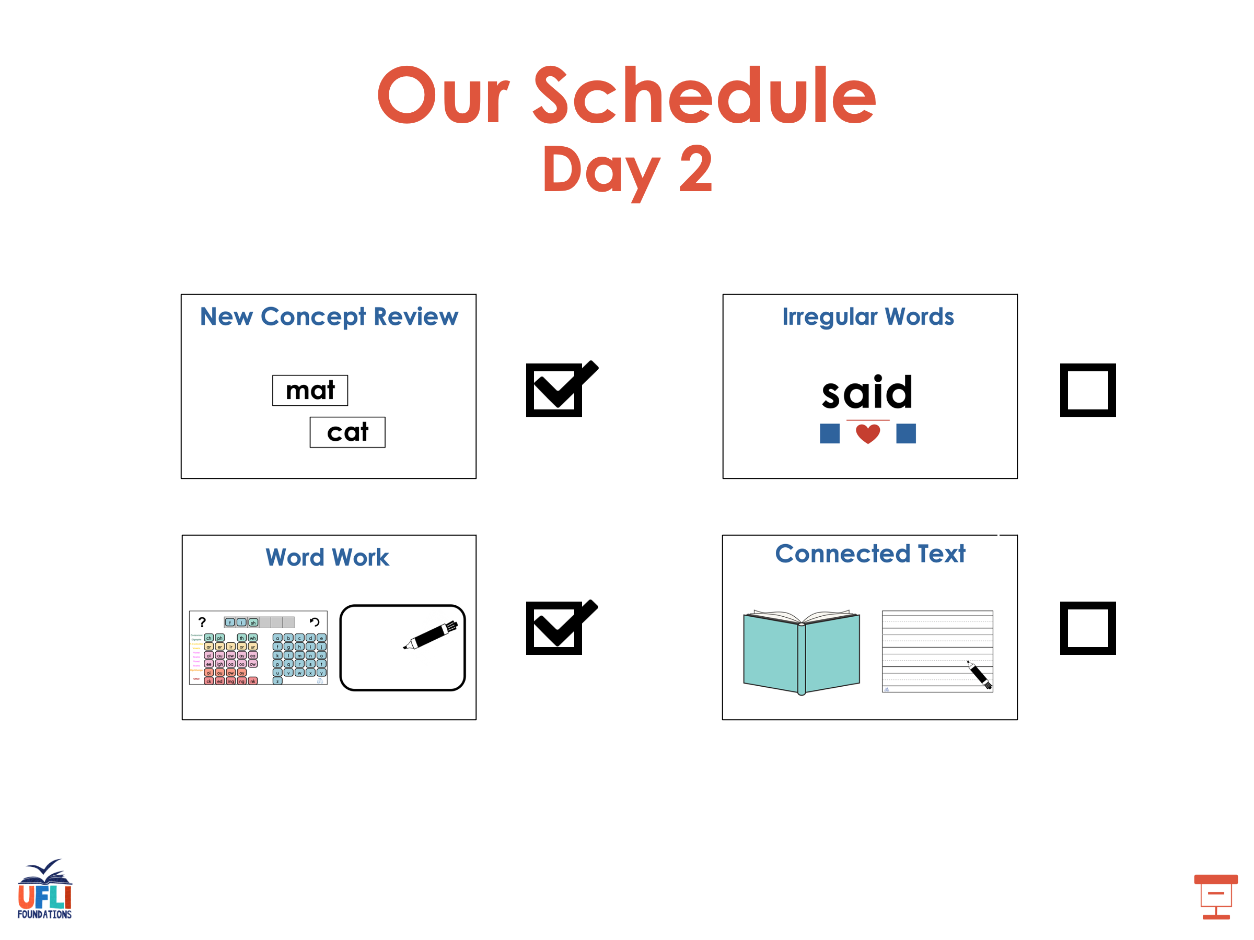

Slide 58
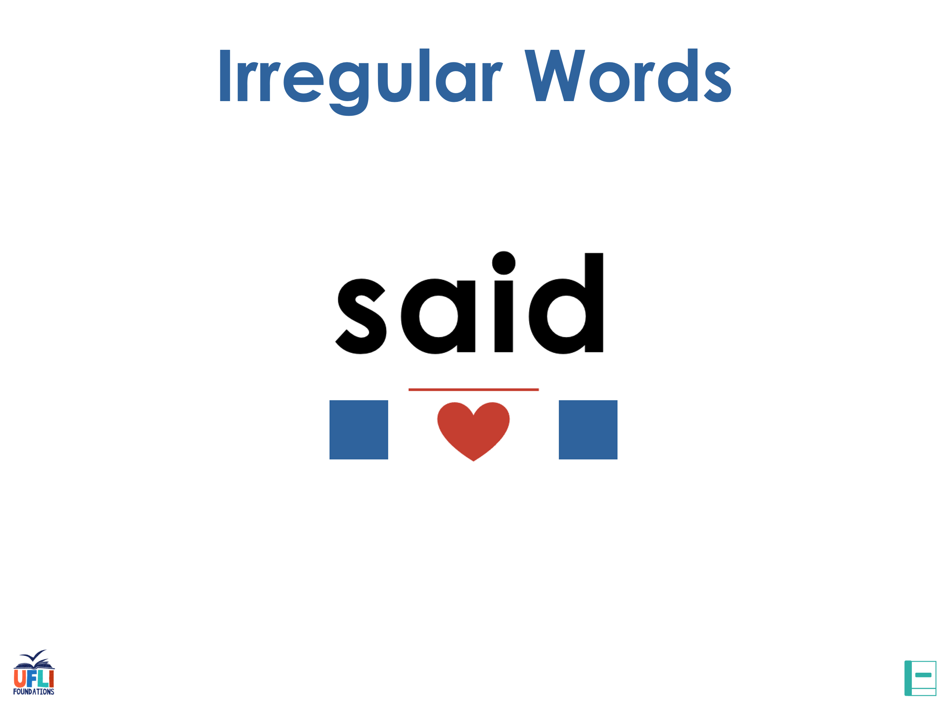
Notes:
See UFLI Foundations lesson plan Step 7 for irregular word activities.
The white rectangle under each word may be used in editing mode. Cover the heart and square icons then reveal them one at a time during instruction.

Slide 59

Notes:
See UFLI Foundations manual for more information about reviewing irregular words.

Slide 60
and
Notes:
Lessons 11-12
*Temporarily irregular
D /d/ has not been introduced yet.
The white rectangle under the word may be used in editing mode. Cover the heart and square icons then reveal them one at a time during instruction.

Slide 61
a
Notes:
Lesson 7+
A as a word can be pronounced /ā/ or /ŭ/.
The white rectangle under the word may be used in editing mode. Cover the heart and square icons then reveal them one at a time during instruction.

Slide 62
is
Notes:
Lessons 9-20
*Temporarily irregular
S /z/ has not been introduced yet.
The white rectangle under the word may be used in editing mode. Cover the heart and square icons then reveal them one at a time during instruction.

Slide 63
as
Notes:
Lessons 11-20
*Temporarily irregular
S /z/ has not been introduced yet.
The white rectangle under the word may be used in editing mode. Cover the heart and square icons then reveal them one at a time during instruction.

Slide 64
said
Notes:
Lesson 13+
AI represents the /ĕ/ sound.
The white rectangle under the word may be used in editing mode. Cover the heart and square icons then reveal them one at a time during instruction.

Slide 65
to
Notes:
Lesson 15+
O represents the /ū/ sound.
The white rectangle under the word may be used in editing mode. Cover the heart and square icons then reveal them one at a time during instruction.

Slide 66
do
Notes:
Lesson 15+
O represents the /ū/ sound.
The white rectangle under the word may be used in editing mode. Cover the heart and square icons then reveal them one at a time during instruction.

Slide 67
of
Notes:
Lesson 17+
O represents the /ŭ/ sound.
F represents the /v/ sound.
The white rectangle under the word may be used in editing mode. Cover the heart and square icons then reveal them one at a time during instruction.

Slide 68
Notes:
Handwriting paper for irregular word spelling practice. Use as needed.
See UFLI Foundations manual for more information about reviewing irregular words.

Slide 69
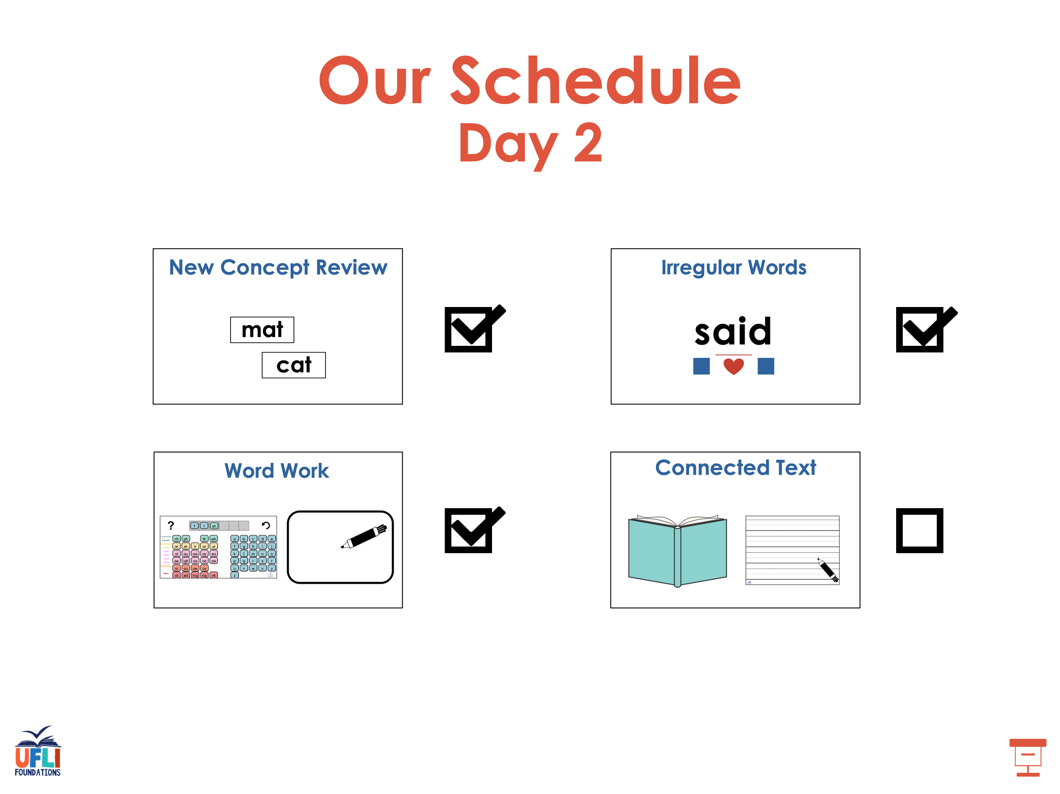

Slide 70
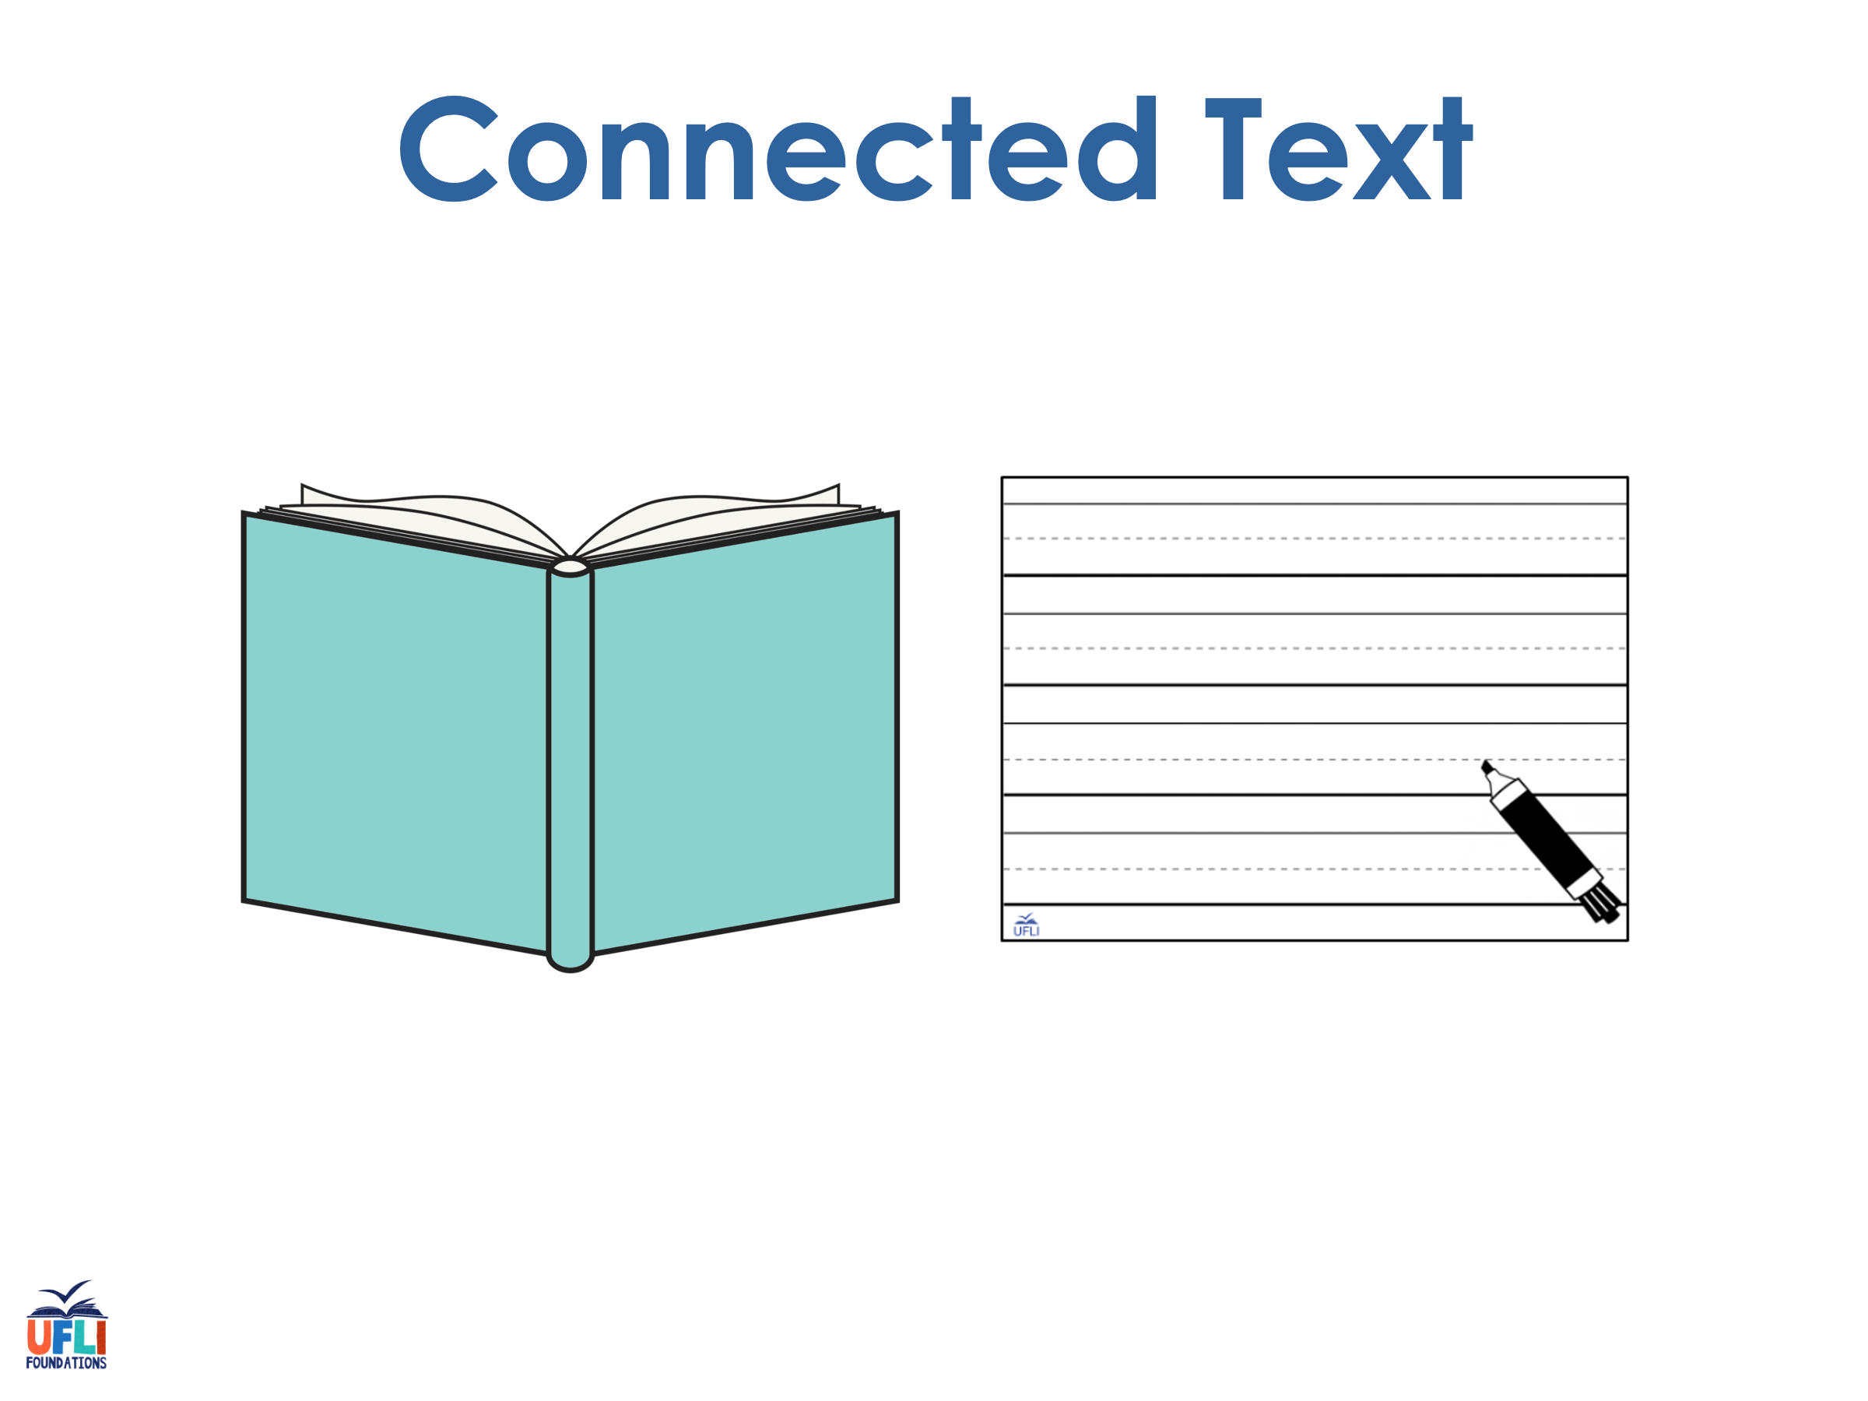
Notes:
See UFLI Foundations lesson plan Step 8 for connected text activities.

Slide 71
The pet did not beg.

Slide 72
I get to the gig at ten.

Slide 73
The men set up the bed.

Slide 74
Notes:
See UFLI Foundations lesson plan Step 8 for sentences to write.

Slide 75

Notes:
The UFLI Foundations decodable text is provided here. See UFLI Foundations decodable text guide for additional text options.

Slide 76
Ten on the Bed
Mom and Dad get a big bed.
Ben and Ted get on the big bed.

Slide 77
Gab and Dot get on the big bed.
Tam the cat and Gus the dog get on the big bed.

Slide 78
Ned and Ed get on the big bed.
Mom and Dad get on the big bed.
Ten fit on the big bed!

Slide 79
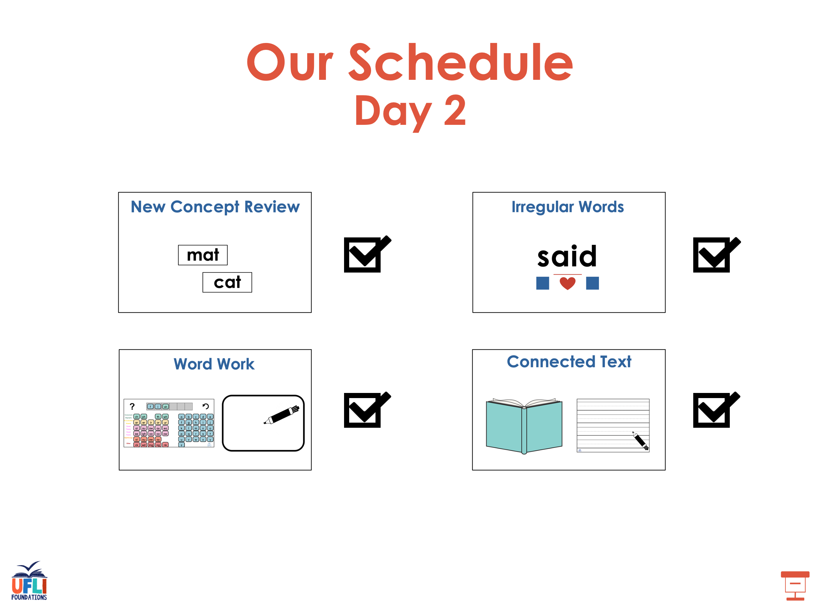

Slide 80
Insert brief reinforcement activity and/or transition to next part of reading block.

