Slide 1
Lesson 127
uni-, bi-, tri-

Slide 2
Notes:
ufliteracy.org

Slide 4
Lesson 127
uni-, bi-, tri-

Slide 6
Notes:
See UFLI Foundations lesson plan Step 1 for phonemic awareness activity.

Slide 8
Notes:
See UFLI Foundations lesson plan Step 2 for student phoneme responses.

Slide 9
ai

Slide 10
ay

Slide 11
aigh

Slide 12
oa

Slide 13
ou

Slide 14
igh

Slide 15
ea

Slide 16
oo

Slide 18
Notes:
See UFLI Foundations lesson plan Step 3 for auditory drill activity.

Slide 19
Notes:
No slides needed for auditory drill.

Slide 21
Notes:
See UFLI Foundations lesson plan Step 4 for blending drill word chain and grid.
Visit ufliteracy.org to access the Blending Board app.

Slide 23
Notes:
See UFLI Foundations lesson plan Step 5 for recommended teacher language and activities to introduce the new concept.

Slide 24
Prefixes
added to the beginning of a word to change the word’s meaning
uni-
bi-
tri-

Slide 25
uni-
one 1
uniform

Slide 26
bi-
two 2
bisect

Slide 27
tri-
three 3
triangle
triple

Slide 28
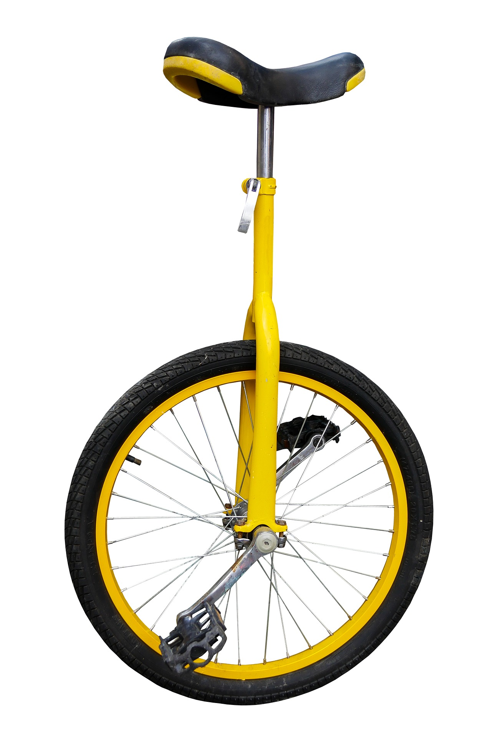
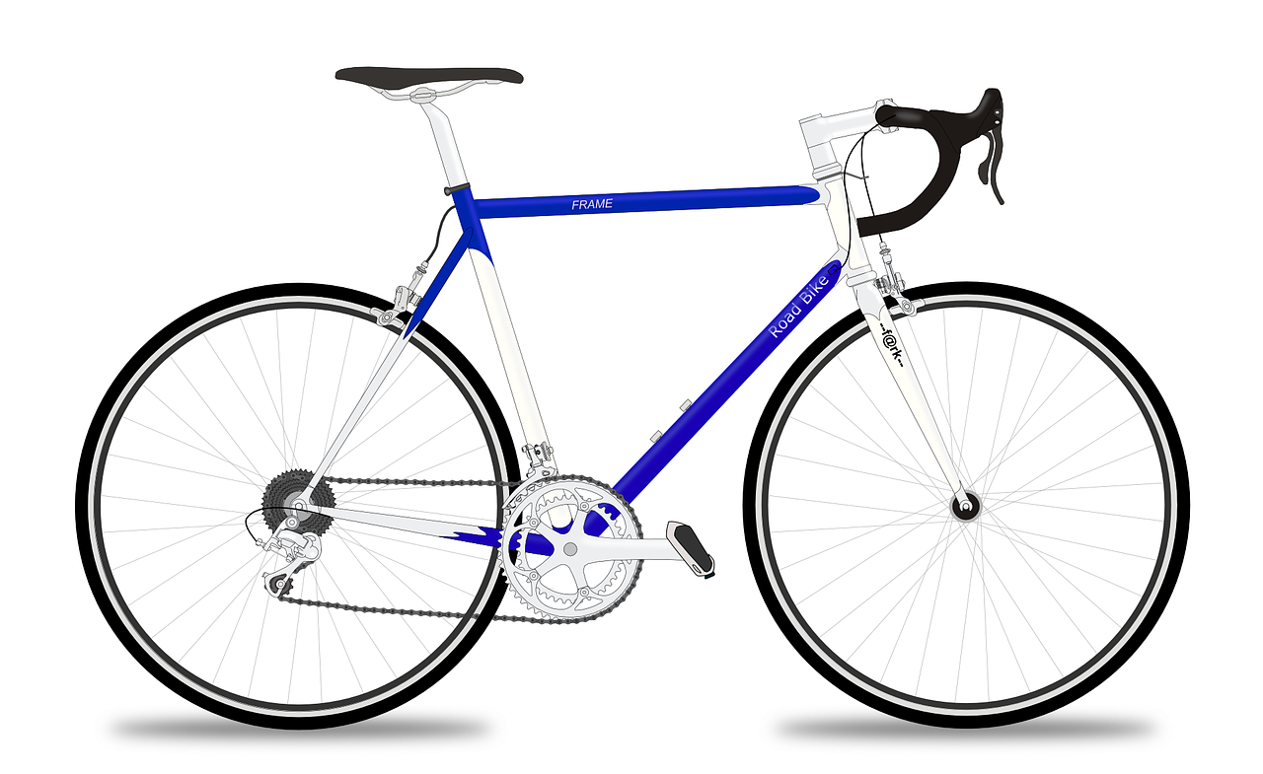
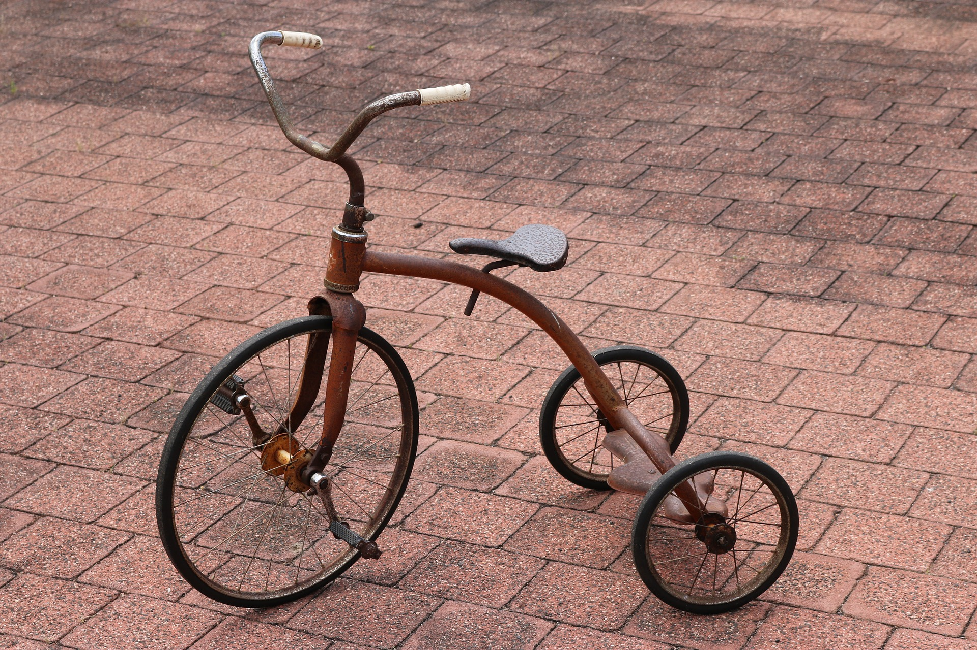
unicycle
bicycle
tricycle

Slide 29
unicycle
bicycle
tricycle

Slide 30
uniform
unify
biweekly
bilingual
triathlon
tripod

Slide 31
Notes:
See UFLI Foundations lesson plan Step 5 for words to spell.
Handwriting paper to model spelling.

Slide 32
Notes:
See UFLI Foundations lesson plan Step 5 for words to spell.
Handwriting paper for guided spelling practice.

Slide 34
Insert brief reinforcement activity and/or transition to next part of reading block.

Slide 35
Lesson 127
uni-, bi-, tri-

Slide 37
New Concept Review
Notes:
See UFLI Foundations lesson plan Step 5 for recommended teacher language and activities to review the new concept.

Slide 38
Prefixes
added to the beginning of a word to change the word’s meaning
uni-
bi-
tri-

Slide 39
uni-
one 1
uniform

Slide 40
bi-
two 2
bisect

Slide 41
tri-
three 3
triangle
triple

Slide 42
unicycle
bicycle
tricycle

Slide 43
unicorn
biweekly

Slide 44
triangle
uniform

Slide 46
Notes:
See UFLI Foundations lesson plan Step 6 for word work activity.
Visit ufliteracy.org to access the Word Work Mat apps.

Slide 47
word | definition
uniform | A uniform is one outfit that people wear to work or school.
bilingual
triangle

Slide 48
word | definition
triple
triplet

Slide 50
Notes:
See UFLI Foundations lesson plan Step 7 for irregular word activities.
The white rectangle under each word may be used in editing mode. Cover the heart and square icons then reveal them one at a time during instruction.

Slide 51
Notes:
See UFLI Foundations manual for more information about reviewing irregular words.

Slide 52
Insert slides for previously taught irregular words students have not mastered yet.
Notes:
Lessons 123-128

Slide 53
Notes:
Handwriting paper for irregular word spelling practice. Use as needed.
See UFLI Foundations manual for more information about reviewing irregular words.

Slide 55
Notes:
See UFLI Foundations lesson plan Step 8 for connected text activities.

Slide 56
Macy, Stacy, and Tracy are triplets.

Slide 57
At some jobs you need to wear a uniform.

Slide 58
If you can speak two languages you are bilingual.

Slide 59
Notes:
See UFLI Foundations lesson plan Step 8 for sentences to write.

Slide 60
Notes:
The UFLI Foundations decodable text is provided here. See UFLI Foundations decodable text guide for additional text options.

Slide 61
The Triplets Go to School
Macy, Stacy, and Tracy are triplets. They do everything together. Each morning they wake up and put on matching uniforms. Then, they get on their bicycles and ride to school. At school, they take all the same classes.

Slide 62
Their first class is French. The triplets are bilingual because they already speak English and Spanish. Once they learn French, they will be trilingual! Their next class is math. In math class, they learn all about different kinds of triangles. Then, in music class they practice a new song. They always sing in unison at the biweekly show.

Slide 63
After lunch, they go to reading class. This is the triplets’ favorite class. Their teacher is reading the last book in a new trilogy to them. They can not wait to learn how this story ends. At the end of the day, the triplets get back on their bicycles and ride home together. They are an unbreakable trio.

Slide 65
Insert brief reinforcement activity and/or transition to next part of reading block.

