Slide 1
Lesson 123
-y

Slide 2
Notes:
ufliteracy.org

Slide 4
Lesson 123
-y

Slide 6
Notes:
See UFLI Foundations lesson plan Step 1 for phonemic awareness activity.

Slide 8
Notes:
See UFLI Foundations lesson plan Step 2 for student phoneme responses.

Slide 9
y

Slide 10
dge

Slide 11
g

Slide 12
ch

Slide 13
tch

Slide 14
-ed

Slide 15
c

Slide 16
a

Slide 17
i

Slide 18
o

Slide 19
e

Slide 20
u

Slide 21
nk

Slide 22
ng

Slide 23
wh

Slide 24
ph

Slide 25
th

Slide 26
sh

Slide 27
ck

Slide 29
Notes:
See UFLI Foundations lesson plan Step 3 for auditory drill activity.

Slide 30
Notes:
No slides needed for auditory drill.

Slide 32
Notes:
See UFLI Foundations lesson plan Step 4 for blending drill word chain and grid.
Visit ufliteracy.org to access the Blending Board app.

Slide 34
Notes:
See UFLI Foundations lesson plan Step 5 for recommended teacher language and activities to introduce the new concept.

Slide 35
Suffixes
added to the end of a word to change the word’s meaning

Slide 36
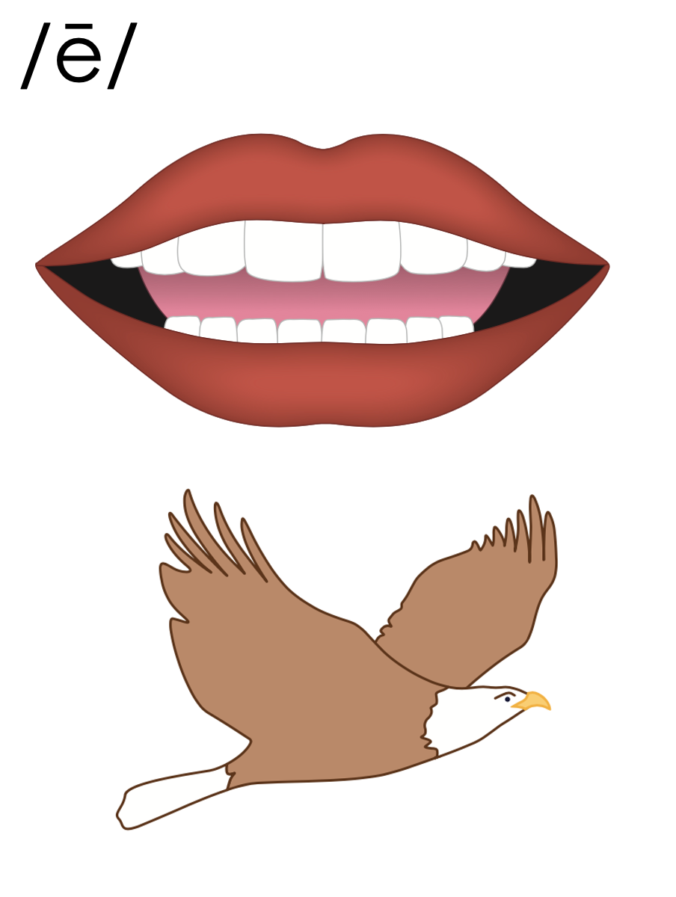
-y
full of or described as

Slide 37
cloudy

Slide 38
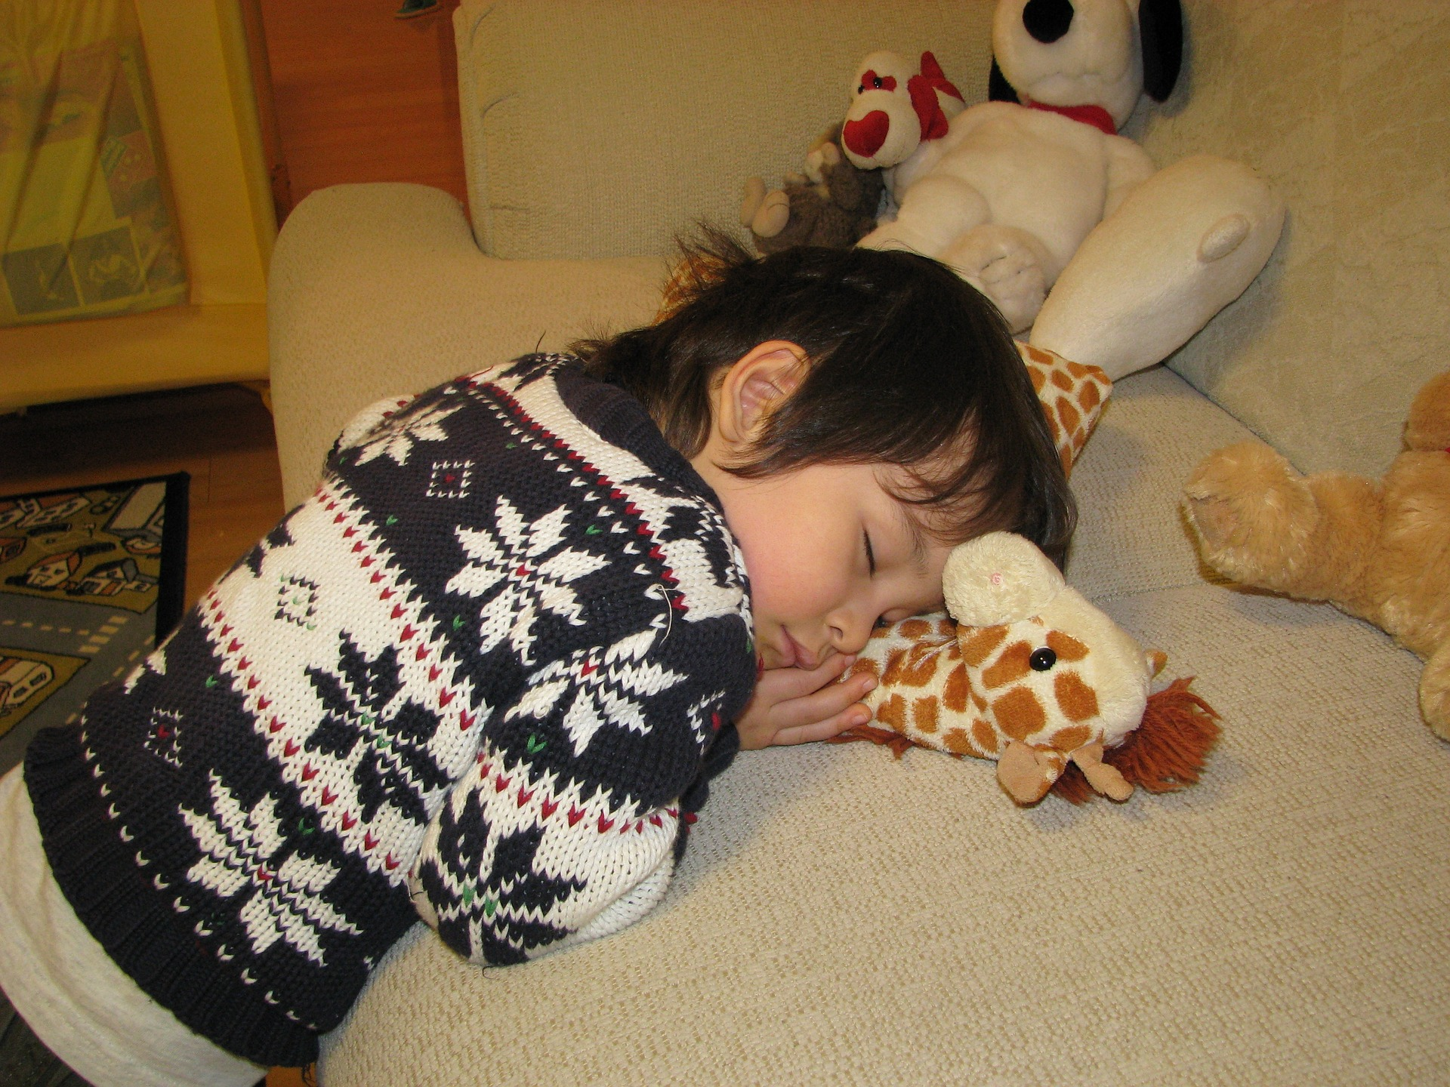
sleepy

Slide 39
Double Consonant Rule
sun
sunny
sun
ny
v c
1 1

Slide 40
Drop E Rule
juic
e
y
+

Slide 41
muddy

Slide 42
runny
spooky
whiny
healthy
sandy
grumpy

Slide 43
Notes:
See UFLI Foundations lesson plan Step 5 for words to spell.
Handwriting paper to model spelling.

Slide 44
Notes:
See UFLI Foundations lesson plan Step 5 for words to spell.
Handwriting paper for guided spelling practice.

Slide 46
Insert brief reinforcement activity and/or transition to next part of reading block.

Slide 47
Lesson 123
-y

Slide 49
New Concept Review
Notes:
See UFLI Foundations lesson plan Step 5 for recommended teacher language and activities to review the new concept.

Slide 50
Suffixes
added to the end of a word to change the word’s meaning

Slide 51
-y
full of or described as

Slide 52
cloudy

Slide 53
sleepy

Slide 54
Double Consonant Rule
sun
sunny
sun
ny
v c
1 1

Slide 55
Drop E Rule
juic
e
y
+

Slide 56
lucky
bumpy

Slide 57
sweaty
rainy

Slide 59
Notes:
See UFLI Foundations lesson plan Step 6 for word work activity.
Visit ufliteracy.org to access the Word Work Mat apps.

Slide 60
noun | adjective (add -y) | adjective definition
curl | curly | Curly means full of curls or spiral shapes. Hair can be curly.
cloud
sweat
grouch

Slide 61
noun | adjective (add -y) | adjective definition
storm
breeze
sun

Slide 63
Notes:
See UFLI Foundations lesson plan Step 7 for irregular word activities.
The white rectangle under each word may be used in editing mode. Cover the heart and square icons then reveal them one at a time during instruction.

Slide 64
Notes:
See UFLI Foundations manual for more information about reviewing irregular words.

Slide 65
Insert slides for previously taught irregular words students have not mastered yet.

Slide 66
Notes:
Handwriting paper for irregular word spelling practice. Use as needed.
See UFLI Foundations manual for more information about reviewing irregular words.

Slide 68
Notes:
See UFLI Foundations lesson plan Step 8 for connected text activities.

Slide 69
The sea looks extra shiny on this sunny day.

Slide 70
When I play in the yard I always get muddy and sweaty.

Slide 71
I need an umbrella because it is cloudy and rainy today.

Slide 72
Notes:
See UFLI Foundations lesson plan Step 8 for sentences to write.

Slide 73
Notes:
The UFLI Foundations decodable text is provided here. See UFLI Foundations decodable text guide for additional text options.

Slide 74
The Haunted House
There is a spooky two-story house at the end of Eighth Street. Nobody knows who lives there, and nobody ever goes in or comes out. Most of the kids in the neighborhood think this house is haunted.

Slide 75
Sammy, a fifth grader with curly brown hair, always wondered what would happen if she knocked on the door of that spooky old house. One stormy night, Sammy and her younger brother walked over to the spooky house and crept up to the front porch. The dusty wood floor creaked under their feet.

Slide 76
Sammy raised her shaky arm and knocked on the door. All of a sudden, the siblings heard a loud noise. They were too scared to wait to find out what it was. They made a speedy exit across the muddy yard and ran all the way home.

Slide 77
By the time they got home, they were messy and sweaty and ready for a bath. Sammy and her brother knew they would never go back to the spooky old house again, particularly on such a dark and stormy night. They may never find out if the house was truly haunted.

Slide 79
Insert brief reinforcement activity and/or transition to next part of reading block.

