Slide 1
Lesson 119
-sion, -tion

Slide 2
Notes:
ufliteracy.org

Slide 4
Lesson 119
-sion, -tion

Slide 6
Notes:
See UFLI Foundations lesson plan Step 1 for phonemic awareness activity.

Slide 8
Notes:
See UFLI Foundations lesson plan Step 2 for student phoneme responses.

Slide 9
ch

Slide 10
gn

Slide 11
gh

Slide 12
c

Slide 13
g

Slide 14
ough

Slide 15
ew

Slide 16
eu

Slide 17
ue

Slide 18
ou

Slide 19
ei

Slide 20
eigh

Slide 21
ey

Slide 22
aigh

Slide 23
air

Slide 24
are

Slide 25
ear

Slide 26
or

Slide 27
ar

Slide 28
-ed

Slide 30
Notes:
See UFLI Foundations lesson plan Step 3 for auditory drill activity.

Slide 31
Notes:
No slides needed for auditory drill.

Slide 33
Notes:
See UFLI Foundations lesson plan Step 4 for blending drill word chain and grid.
Visit ufliteracy.org to access the Blending Board app.

Slide 35
Notes:
See UFLI Foundations lesson plan Step 5 for recommended teacher language and activities to introduce the new concept.

Slide 36
Syllables
Words or word parts with one vowel sound.

Slide 37
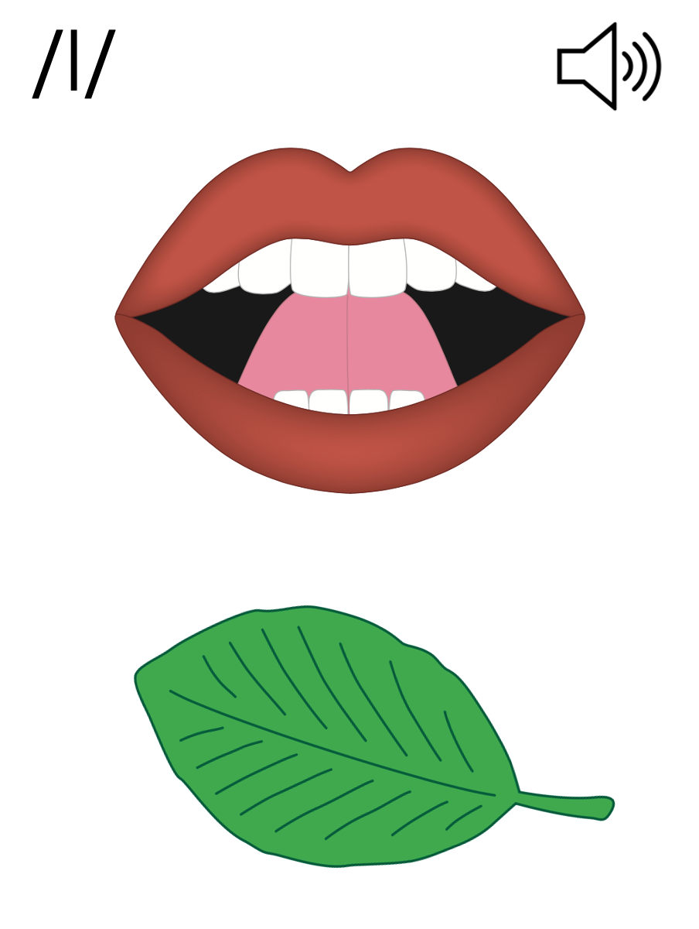
Final Stable Syllables
__ le
apple
puzzle

Slide 38
Final Stable Syllables
-sion
-tion

Slide 39
-sion
vision
diversion

Slide 40
-sion
passion
extension

Slide 41
-tion
fiction
question

Slide 42
ro
ta
tion
Notes:
**display in slideshow mode for animations

Slide 43
division

Slide 44
fraction
portion
section
question
invasion
vision

Slide 45
decision
confusion
equation

Slide 46
Notes:
See UFLI Foundations lesson plan Step 5 for words to spell.
Handwriting paper to model spelling.

Slide 47
Notes:
See UFLI Foundations lesson plan Step 5 for words to spell.
Handwriting paper for guided spelling practice.

Slide 49
Insert brief reinforcement activity and/or transition to next part of reading block.

Slide 50
Lesson 119
-sion, -tion

Slide 52
New Concept Review
Notes:
See UFLI Foundations lesson plan Step 5 for recommended teacher language and activities to review the new concept.

Slide 53
Syllables
Words or word parts with one vowel sound.

Slide 54
Final Stable Syllables
__ le
apple
puzzle

Slide 55
Final Stable Syllables
-sion
-tion

Slide 56
-sion
vision
diversion

Slide 57
-sion
passion
extension

Slide 58
-tion
fiction
question

Slide 59
ro
ta
tion
Notes:
**display in slideshow mode for animations

Slide 60
nation
portion

Slide 61
vision
question

Slide 63
Notes:
See UFLI Foundations lesson plan Step 6 for word work activity.
Visit ufliteracy.org to access the Word Work Mat apps.

Slide 64
Notes:
Display this slide in editing mode. Click and hold to drag words into the appropriate box.

Slide 66
Notes:
See UFLI Foundations lesson plan Step 7 for irregular word activities.
The white rectangle under each word may be used in editing mode. Cover the heart and square icons then reveal them one at a time during instruction.

Slide 67
Notes:
See UFLI Foundations manual for more information about reviewing irregular words.

Slide 68
guess
Notes:
Lesson 117+
UE represents the /ĕ/ sound, or U is silent.
The white rectangle under the word may be used in editing mode. Cover the heart and square icons then reveal them one at a time during instruction.

Slide 69
guest
Notes:
Lesson 117+
UE represents the /ĕ/ sound, or U is silent.
The white rectangle under the word may be used in editing mode. Cover the heart and square icons then reveal them one at a time during instruction.

Slide 70
guide
Notes:
Lesson 117+
UI represents the /ī/ sound, or U is silent.
The white rectangle under the word may be used in editing mode. Cover the heart and square icons then reveal them one at a time during instruction.

Slide 71
young
Notes:
Lesson 118+
OU represents the /ŭ/ sound.
The white rectangle under the word may be used in editing mode. Cover the heart and square icons then reveal them one at a time during instruction.

Slide 72
touch
Notes:
Lesson 118+
OU represents the /ŭ/ sound.
The white rectangle under the word may be used in editing mode. Cover the heart and square icons then reveal them one at a time during instruction.

Slide 73
Notes:
Handwriting paper for irregular word spelling practice. Use as needed.
See UFLI Foundations manual for more information about reviewing irregular words.

Slide 74
Teach
Notes:
The orange star indicates these are new irregular words that need to be introduced.
See UFLI Foundations manual for more information about teaching irregular words.

Slide 75
enough
Notes:
Lesson 119+
OU represents the /ŭ/ sound.
GH represents the /f/ sound.
Alternatively, O represents the /ŭ/ sound, and UGH represents the /f/ sound.
The white rectangle under the word may be used in editing mode. Cover the heart and square icons then reveal them one at a time during instruction.

Slide 76
tough
Notes:
Lesson 119+
OU represents the /ŭ/ sound.
GH represents the /f/ sound.
Alternatively, O represents the /ŭ/ sound, and UGH represents the /f/ sound
The white rectangle under the word may be used in editing mode. Cover the heart and square icons then reveal them one at a time during instruction.

Slide 77
rough
Notes:
Lesson 119+
OU represents the /ŭ/ sound.
GH represents the /f/ sound.
Alternatively, O represents the /ŭ/ sound, and UGH represents the /f/ sound
The white rectangle under the word may be used in editing mode. Cover the heart and square icons then reveal them one at a time during instruction.

Slide 78
Notes:
Handwriting paper for irregular word spelling practice. Use as needed.
See UFLI Foundations manual for more information about teaching irregular words.

Slide 80
Notes:
See UFLI Foundations lesson plan Step 8 for connected text activities.

Slide 81
It is time for a vacation because we have worked enough.

Slide 82
They are on a mission to stop the invasion!

Slide 83
Reading fiction and watching television are my passions.

Slide 84
Notes:
See UFLI Foundations lesson plan Step 8 for sentences to write.

Slide 85
Notes:
The UFLI Foundations decodable text is provided here. See UFLI Foundations decodable text guide for additional text options.

Slide 86
The Audition
Today is a big day for Ricardo. The theater club is holding auditions for the school play. Acting is Ricardo’s passion. He is auditioning for the lead role. This year’s play is about a mission to outer space. It is packed with action and ends with a real explosion!

Slide 87
Ricardo walked into the theater club meeting. He excitedly handed his permission slip to the director and found a seat. He listened as the director explained how the audition would work. “Remember to be creative and use your imaginations. Any questions before we begin?”

Slide 88
No questions. Everyone was ready to begin. The students took turns auditioning for the director. There was a lot of competition, but Ricardo did a great job! Once the auditions were finished, the director announced the parts.

Slide 89
“This was a tough decision,” she said. “You each made a great impression. The lead role goes to...Ricardo!” Ricardo leaped out of his seat with joy. His friends clapped for him. He could not wait to run home and start memorizing his lines.

Slide 91
Insert brief reinforcement activity and/or transition to next part of reading block.

