Slide 1
Getting Ready
Lesson A

Slide 2
Notes:
ufliteracy.org

Slide 5
Notes:
See UFLI Foundations Getting Ready lesson plans for sound wall activity.

Slide 6
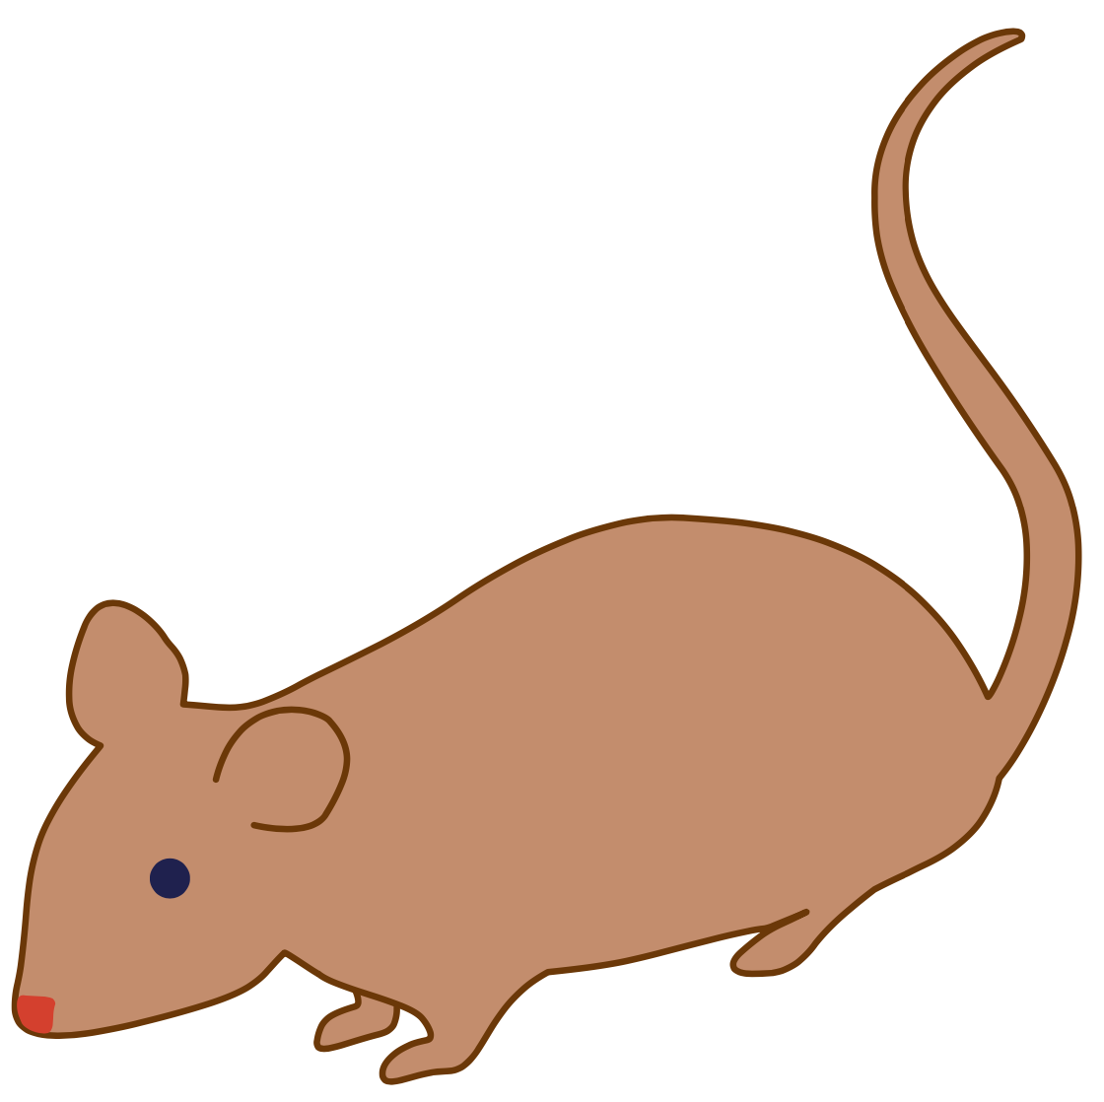
Notes:
Introduction: Sounds
/mmm/ (mouse)

Slide 7
Notes:
/sss/ (sun)

Slide 8
Notes:
/ăăă/ (apple)

Slide 9
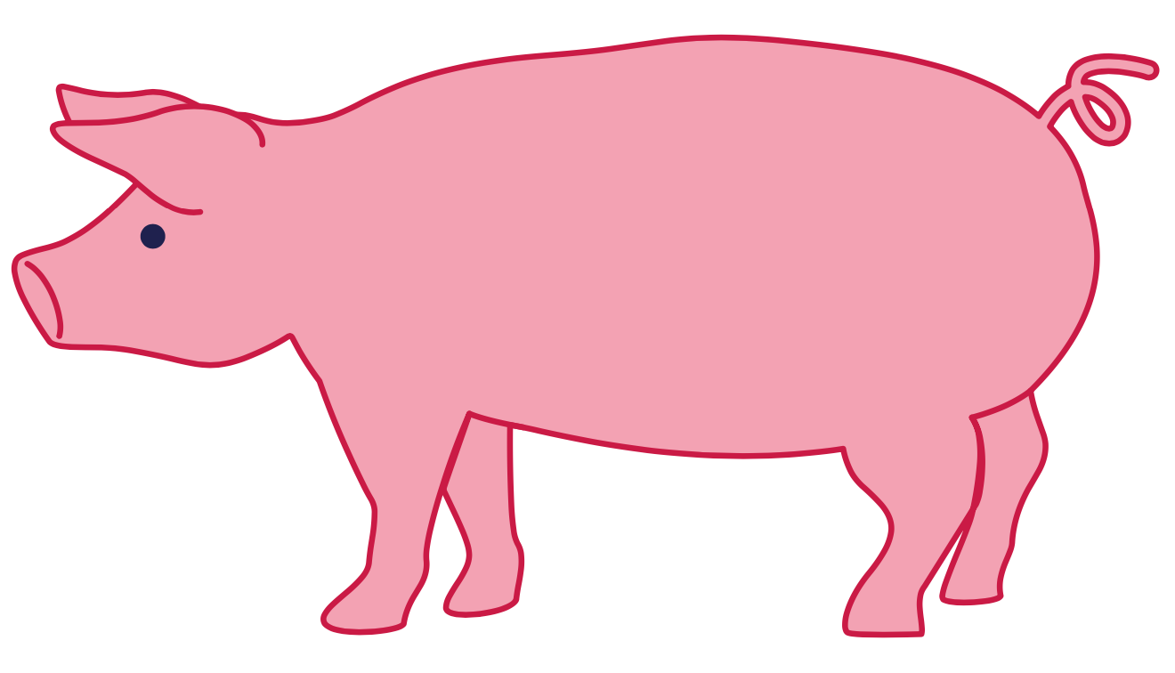
Notes:
/p/ (pig)

Slide 10
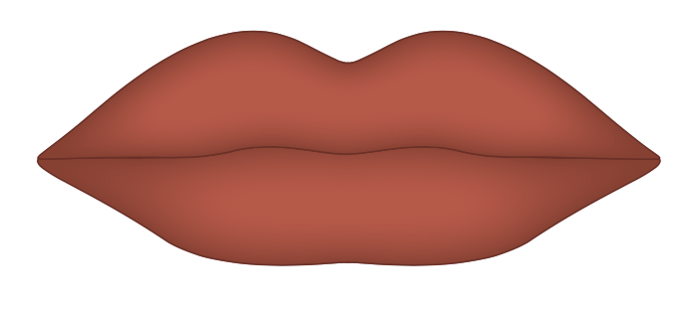
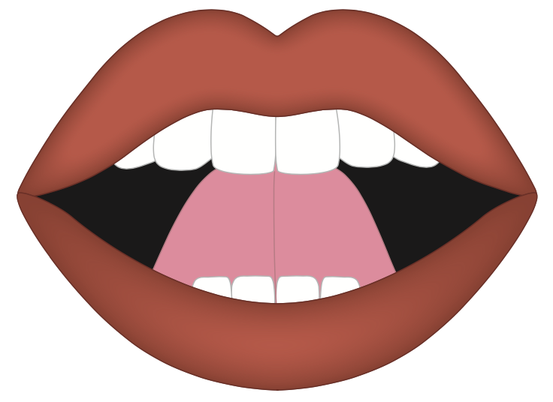
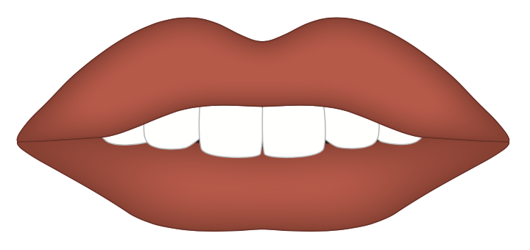

Slide 11
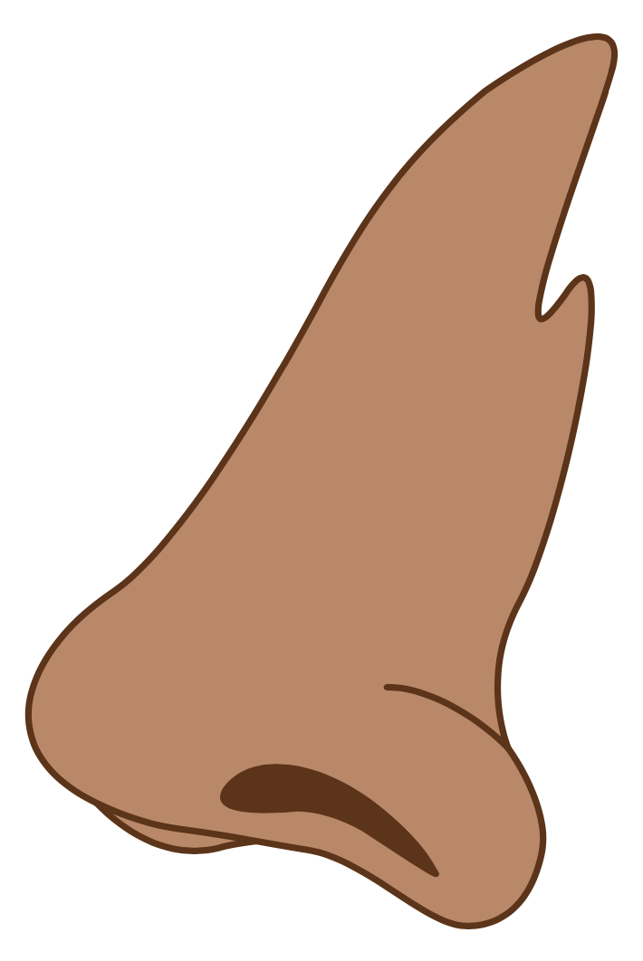

Slide 12
Notes:
Voiced & Unvoiced Sounds

Slide 14
Notes:
See UFLI Foundations Getting Ready lesson plans for alphabet knowledge and letter formation activity.

Slide 15
Let’s practice sky writing!

Slide 16
Let’s practice tracing!

Slide 17
Let’s practice circles!

Slide 19
Watch me write

Slide 20
Let’s write together
Notes:
circle gif

Slide 21
Let’s practice curves!

Slide 22
hump
half circle
smile

Slide 23
Watch me write

Slide 24
Let’s write together
Notes:
half circle gif

Slide 25
Watch me write

Slide 26
Let’s write together
Notes:
smile gif

Slide 27
Watch me write

Slide 28
Let’s write together
Notes:
hump gif

Slide 30
Insert brief reinforcement activity and/or transition to next part of reading block.

