Slide 1
Lesson 6
p /p/

Slide 2
Notes:
ufliteracy.org

Slide 4
Lesson 6
p /p/

Slide 6
Notes:
See UFLI Foundations lesson plan Step 1 for phonemic awareness activity.

Slide 8
Notes:
See UFLI Foundations lesson plan Step 2 for student phoneme responses.

Slide 9
t

Slide 10
s

Slide 11
m

Slide 12
a

Slide 14
Notes:
See UFLI Foundations lesson plan Step 3 for auditory drill activity.

Slide 15
Notes:
No slides needed for auditory drill.

Slide 17
Notes:
See UFLI Foundations lesson plan Step 4 for blending drill word chain and grid.
Visit ufliteracy.org to access the Blending Board app.

Slide 19
Notes:
See UFLI Foundations lesson plan Step 5 for recommended teacher language and activities to introduce the new concept.

Slide 20
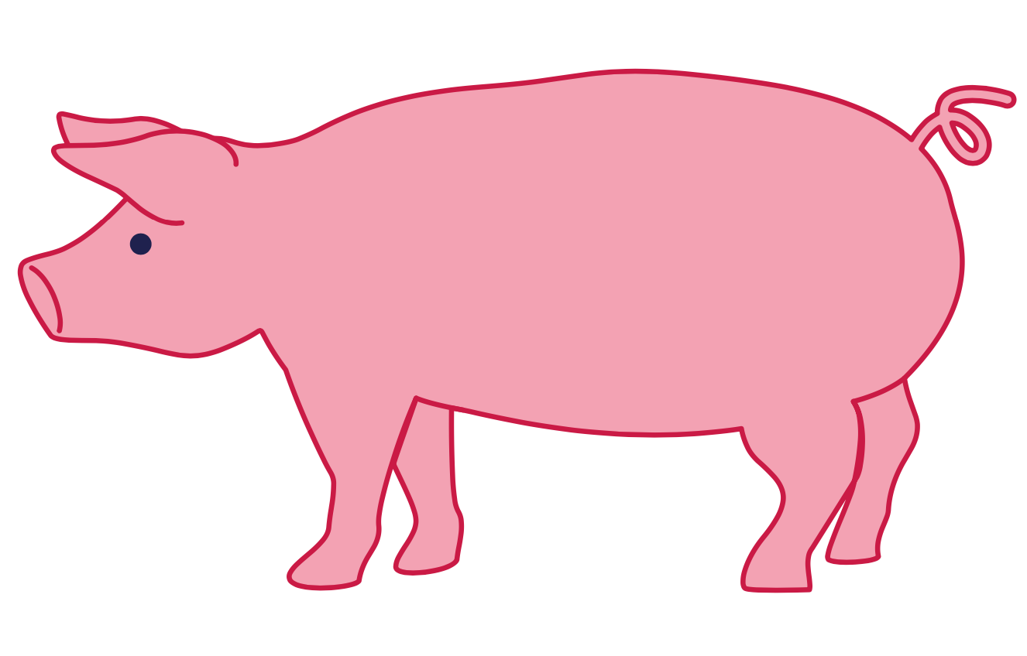
p

Slide 21
pot
pig
p

Slide 22
hop
nap
p

Slide 23
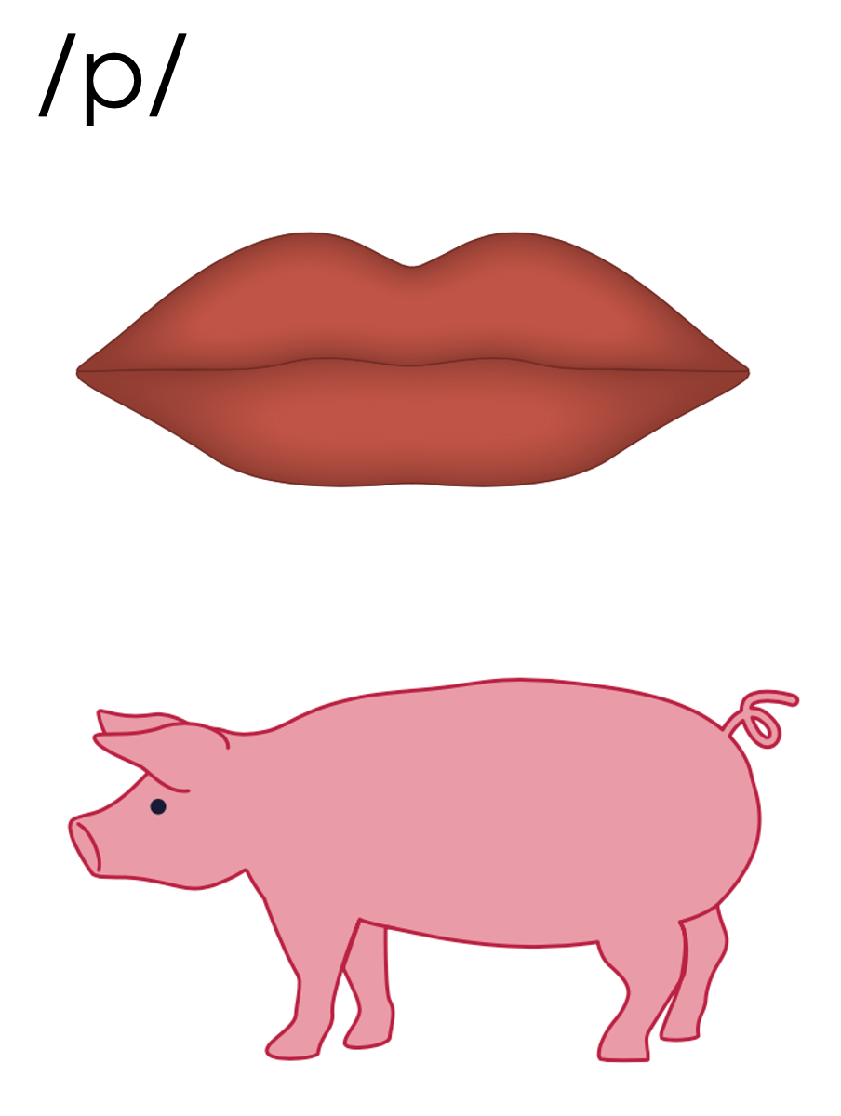
p

Slide 26
Notes:
Uppercase P gif

Slide 28
Notes:
Lowercase p gif

Slide 29
map

Slide 30
map
sap
pat
tap

Slide 31
Notes:
See UFLI Foundations lesson plan Step 5 for words to spell.
Handwriting paper to model spelling.

Slide 32
Notes:
See UFLI Foundations lesson plan Step 5 for words to spell.
Handwriting paper for guided spelling practice.

Slide 34
Insert brief reinforcement activity and/or transition to next part of reading block.

Slide 35
Lesson 6
p /p/

Slide 37
New Concept Review
Notes:
See UFLI Foundations lesson plan Step 5 for recommended teacher language and activities to review the new concept.

Slide 38
p

Slide 39
pot
pig
p

Slide 40
hop
nap
p

Slide 41
p

Slide 42
Notes:
Lowercase p gif

Slide 43
pat
map
tap

Slide 45
Notes:
See UFLI Foundations lesson plan Step 6 for word work activity.
Visit ufliteracy.org to access the Word Work Mat apps.

Slide 47
Notes:
See UFLI Foundations lesson plan Step 7 for irregular word activities.
The white rectangle under each word may be used in editing mode. Cover the heart and square icons then reveal them one at a time during instruction.

Slide 48
Notes:
See UFLI Foundations manual for more information about reviewing irregular words.

Slide 49
the
Notes:
Lessons 1-45
The digraph TH has not been introduced yet.
E represents the /ŭ/ or /ə/ sound depending on stress.
The white rectangle under the word may be used in editing mode. Cover the heart and square icons then reveal them one at a time during instruction.

Slide 50
I
Notes:
Lessons 3-65
*Temporarily irregular
I /ī/ has not been introduced yet.
The white rectangle under the word may be used in editing mode. Cover the heart and square icons then reveal them one at a time during instruction.

Slide 51
and
Notes:
Lessons 5-10
*Temporarily irregular
Nasalized A (an) has not been introduced yet.
N /n/ is not introduced until Lesson 9.
D /d/ is not introduced until Lesson 13.
The white rectangle under the word may be used in editing mode. Cover the heart and square icons then reveal them one at a time during instruction.

Slide 52
Notes:
Handwriting paper for irregular word spelling practice. Use as needed.
See UFLI Foundations manual for more information about reviewing irregular words.

Slide 54
Notes:
See UFLI Foundations lesson plan Step 8 for connected text activities.

Slide 55
I tap and pat.

Slide 56
Tap the map!

Slide 57
Notes:
See UFLI Foundations lesson plan Step 8 for sentences to write.

Slide 59
Insert brief reinforcement activity and/or transition to next part of reading block.

