Slide 1
Lesson 61
_ge /j/

Slide 2
Notes:
ufliteracy.org

Slide 4
Lesson 61
_ge /j/

Slide 6
Notes:
See UFLI Foundations lesson plan Step 1 for phonemic awareness activity.

Slide 8
Notes:
See UFLI Foundations lesson plan Step 2 for student phoneme responses.

Slide 9
c

Slide 10
a

Slide 11
i

Slide 12
o

Slide 13
e

Slide 14
u

Slide 15
nk

Slide 16
ng

Slide 17
wh

Slide 18
ph

Slide 19
th

Slide 20
ch

Slide 21
sh

Slide 22
ck

Slide 23
ff

Slide 24
ll

Slide 25
ss

Slide 26
zz

Slide 27
s

Slide 29
Notes:
See UFLI Foundations lesson plan Step 3 for auditory drill activity.

Slide 30
Notes:
No slides needed for auditory drill.

Slide 32
Notes:
See UFLI Foundations lesson plan Step 4 for blending drill word chain and grid.
Visit ufliteracy.org to access the Blending Board app.

Slide 34
Notes:
See UFLI Foundations lesson plan Step 5 for recommended teacher language and activities to introduce the new concept.

Slide 35
e

Slide 36
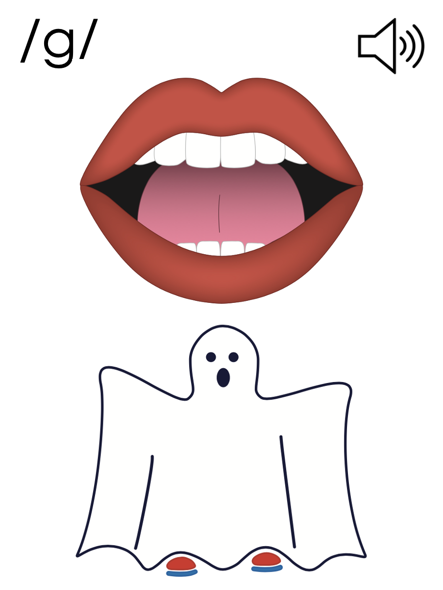
g

Slide 37
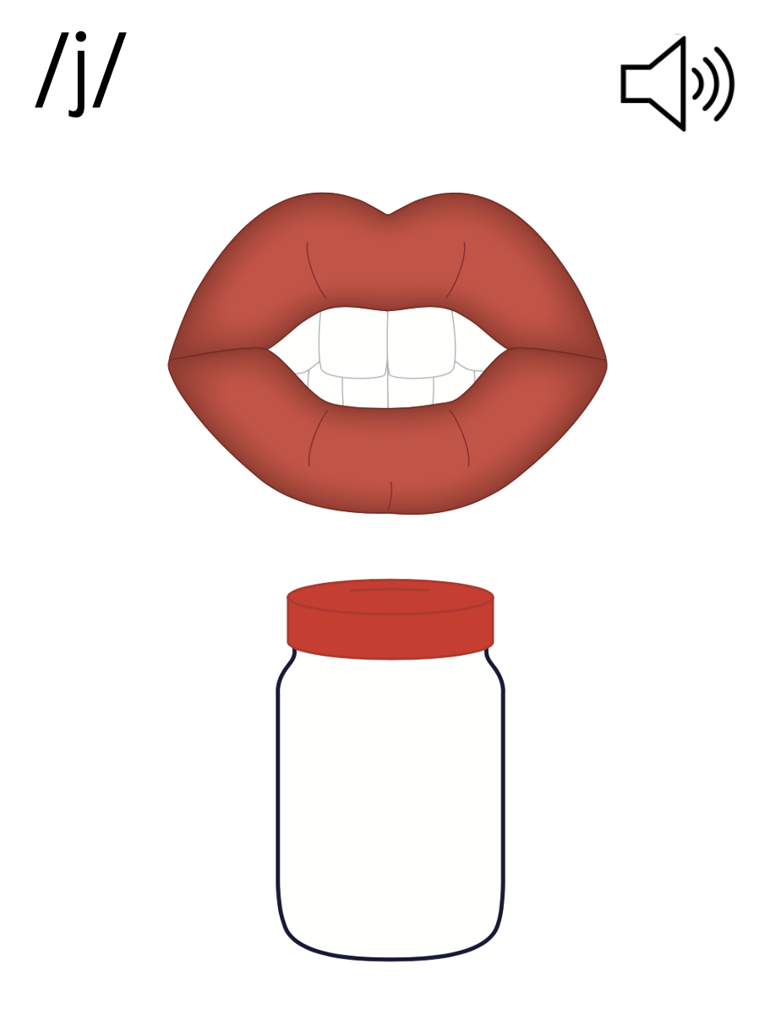
g

Slide 38
c
a
g
e

Slide 39
j
_ge

Slide 40
Notes:
Handwriting paper for letter formation practice. Use as needed.
See UFLI Foundations manual for more information about letter formation.

Slide 41
page

Slide 42
age
huge
wage
cage
rage
stage

Slide 43
range
change
strange

Slide 44
Notes:
See UFLI Foundations lesson plan Step 5 for words to spell.
Handwriting paper to model spelling.

Slide 45
Notes:
See UFLI Foundations lesson plan Step 5 for words to spell.
Handwriting paper for guided spelling practice.

Slide 47
Insert brief reinforcement activity and/or transition to next part of reading block.

Slide 48
Lesson 61
_ge /j/

Slide 50
New Concept Review
Notes:
See UFLI Foundations lesson plan Step 5 for recommended teacher language and activities to review the new concept.

Slide 51
e

Slide 52
g

Slide 53
g

Slide 54
c
a
g
e

Slide 55
j
_ge

Slide 56
page
stage
huge
change

Slide 58
Notes:
See UFLI Foundations lesson plan Step 6 for word work activity.
Visit ufliteracy.org to access the Word Work Mat apps.

Slide 60
Notes:
See UFLI Foundations lesson plan Step 7 for irregular word activities.
The white rectangle under each word may be used in editing mode. Cover the heart and square icons then reveal them one at a time during instruction.

Slide 61
Notes:
See UFLI Foundations manual for more information about reviewing irregular words.

Slide 62
could
Notes:
Lesson 50+
OUL represents the /oo/ sound.
The white rectangle under the word may be used in editing mode. Cover the heart and square icons then reveal them one at a time during instruction.

Slide 63
would
Notes:
Lesson 50+
OUL represents the /oo/ sound.
The white rectangle under the word may be used in editing mode. Cover the heart and square icons then reveal them one at a time during instruction.

Slide 64
should
Notes:
Lesson 50+
OUL represents the /oo/ sound.
The white rectangle under the word may be used in editing mode. Cover the heart and square icons then reveal them one at a time during instruction.

Slide 65
one
Notes:
Lesson 58+
O represents the sounds /w/+/ŭ/.
The final E is silent but does not follow the long vowel VCe pattern.
The white rectangle under the word may be used in editing mode. Cover the heart and square icons then reveal them one at a time during instruction.

Slide 66
once
Notes:
Lessons 60+
O represents the sounds /w/+/ŭ/.
The white rectangle under the word may be used in editing mode. Cover the heart and square icons then reveal them one at a time during instruction.

Slide 67
Notes:
Handwriting paper for irregular word spelling practice. Use as needed.
See UFLI Foundations manual for more information about reviewing irregular words.

Slide 69
Notes:
See UFLI Foundations lesson plan Step 8 for connected text activities.

Slide 70
Did Bruce like the rice?

Slide 71
The mice in that cage are huge.

Slide 72
The stage is a place where Grace shines!

Slide 73
Notes:
See UFLI Foundations lesson plan Step 8 for sentences to write.

Slide 74
Notes:
The UFLI Foundations decodable text is provided here. See UFLI Foundations decodable text guide for additional text options.

Slide 75
Pete’s Pet Snake
Pete got a pet snake. Pete gave the snake a name. “You are Steve,” Pete said to the snake. Steve has a huge glass cage. Pete has to lock the cage, so Steve is safe.

Slide 76
Steve likes his cage. He can hide next to the rocks. He can rest in the sunshine or the shade. At his age, Steve’s skin sheds and his scales change. This looks a bit strange, but Pete likes Steve all the same.

Slide 78
Insert brief reinforcement activity and/or transition to next part of reading block.

