Slide 1
Lesson 60
_ce /s/

Slide 2
Notes:
ufliteracy.org

Slide 4
Lesson 60
_ce /s/

Slide 6
Notes:
See UFLI Foundations lesson plan Step 1 for phonemic awareness activity.

Slide 8
Notes:
See UFLI Foundations lesson plan Step 2 for student phoneme responses.

Slide 9
a

Slide 10
i

Slide 11
o

Slide 12
e

Slide 13
u

Slide 14
nk

Slide 15
ng

Slide 16
wh

Slide 17
ph

Slide 18
ch

Slide 19
th

Slide 20
sh

Slide 21
ck

Slide 22
ff

Slide 23
ll

Slide 24
ss

Slide 25
zz

Slide 26
s

Slide 28
Notes:
See UFLI Foundations lesson plan Step 3 for auditory drill activity.

Slide 29
Notes:
No slides needed for auditory drill.

Slide 31
Notes:
See UFLI Foundations lesson plan Step 4 for blending drill word chain and grid.
Visit ufliteracy.org to access the Blending Board app.

Slide 33
Notes:
See UFLI Foundations lesson plan Step 5 for recommended teacher language and activities to introduce the new concept.

Slide 34
e

Slide 35
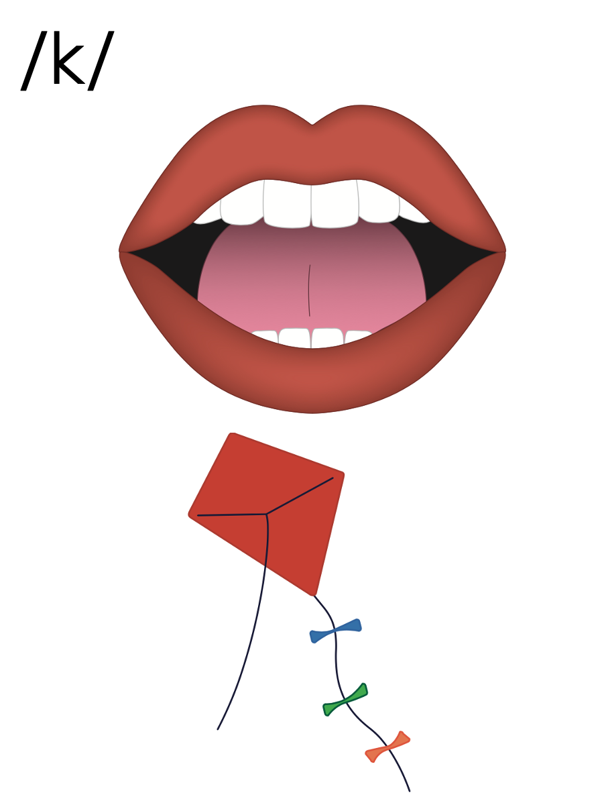
c

Slide 36
c

Slide 37
r
i
c
e

Slide 38
s
ss
_ce

Slide 39
Notes:
Handwriting paper for letter formation practice. Use as needed.
See UFLI Foundations manual for more information about letter formation.

Slide 40
pace
twice

Slide 41
face
race
place
space
trace
ice

Slide 42
mice
nice
price

Slide 43
Notes:
See UFLI Foundations lesson plan Step 5 for words to spell.
Handwriting paper to model spelling.

Slide 44
Notes:
See UFLI Foundations lesson plan Step 5 for words to spell.
Handwriting paper for guided spelling practice.

Slide 46
Insert brief reinforcement activity and/or transition to next part of reading block.

Slide 47
Lesson 60
_ce /s/

Slide 49
New Concept Review
Notes:
See UFLI Foundations lesson plan Step 5 for recommended teacher language and activities to review the new concept.

Slide 50
e

Slide 51
c

Slide 52
c

Slide 53
r
i
c
e

Slide 54
s
ss
_ce

Slide 55
face
place
nice
twice

Slide 57
Notes:
See UFLI Foundations lesson plan Step 6 for word work activity.
Visit ufliteracy.org to access the Word Work Mat apps.

Slide 59
Notes:
See UFLI Foundations lesson plan Step 7 for irregular word activities.
The white rectangle under each word may be used in editing mode. Cover the heart and square icons then reveal them one at a time during instruction.

Slide 60
Notes:
See UFLI Foundations manual for more information about reviewing irregular words.

Slide 61
who
Notes:
Lesson 54+
WH represents the /h/ sound.
O represents the /ū/ sound.
The white rectangle under the word may be used in editing mode. Cover the heart and square icons then reveal them one at a time during instruction.

Slide 62
by
Notes:
Lessons 55-72
*Temporarily irregular
Y /ī/ has not been introduced yet.
The white rectangle under the word may be used in editing mode. Cover the heart and square icons then reveal them one at a time during instruction.

Slide 63
my
Notes:
Lessons 55-72
*Temporarily irregular
Y /ī/ has not been introduced yet.
The white rectangle under the word may be used in editing mode. Cover the heart and square icons then reveal them one at a time during instruction.

Slide 64
one
Notes:
Lesson 58+
O represents the sounds /w/+/ŭ/.
The final E is silent but does not follow the long vowel VCe pattern.
The white rectangle under the word may be used in editing mode. Cover the heart and square icons then reveal them one at a time during instruction.

Slide 65
once
Notes:
Lessons 60+
O represents the sounds /w/+/ŭ/.
The white rectangle under the word may be used in editing mode. Cover the heart and square icons then reveal them one at a time during instruction.

Slide 66
Notes:
Handwriting paper for irregular word spelling practice. Use as needed.
See UFLI Foundations manual for more information about reviewing irregular words.

Slide 68
Notes:
See UFLI Foundations lesson plan Step 8 for connected text activities.

Slide 69
I use a plate for my rice.

Slide 70
Do you want ice for your drink?

Slide 71
What is the price for this nice dress?

Slide 72
Notes:
See UFLI Foundations lesson plan Step 8 for sentences to write.

Slide 73
Notes:
The UFLI Foundations decodable text is provided here. See UFLI Foundations decodable text guide for additional text options.

Slide 74
The Mice Can Race
“What is the price for the box of white mice?” Grace asks. The man at the pet shop tells Grace they cost five bucks. “I have five bucks! I would like to take these mice,” says Grace. The man hands the box of mice to Grace.

Slide 75
Grace takes the mice home. Grace makes a track for the white mice. She wants them to race. Grace will place the mice on the track. When Grace says “GO!” the mice race. They run the track twice. “These mice are so fast!” says Grace.

Slide 77
Insert brief reinforcement activity and/or transition to next part of reading block.

