Slide 1
Lesson 55
i_e /ī/

Slide 2
Notes:
ufliteracy.org

Slide 4
Lesson 55
i_e /ī/

Slide 6
Notes:
See UFLI Foundations lesson plan Step 1 for phonemic awareness activity.

Slide 8
Notes:
See UFLI Foundations lesson plan Step 2 for student phoneme responses.

Slide 9
a

Slide 10
nk

Slide 11
ng

Slide 12
wh

Slide 13
ph

Slide 14
ch

Slide 15
th

Slide 16
sh

Slide 17
ck

Slide 18
ff

Slide 19
ll

Slide 20
ss

Slide 21
zz

Slide 22
s

Slide 23
i

Slide 24
o

Slide 25
u

Slide 26
e

Slide 28
Notes:
See UFLI Foundations lesson plan Step 3 for auditory drill activity.

Slide 29
Notes:
No slides needed for auditory drill.

Slide 31
Notes:
See UFLI Foundations lesson plan Step 4 for blending drill word chain and grid.
Visit ufliteracy.org to access the Blending Board app.

Slide 33
Notes:
See UFLI Foundations lesson plan Step 5 for recommended teacher language and activities to introduce the new concept.

Slide 34
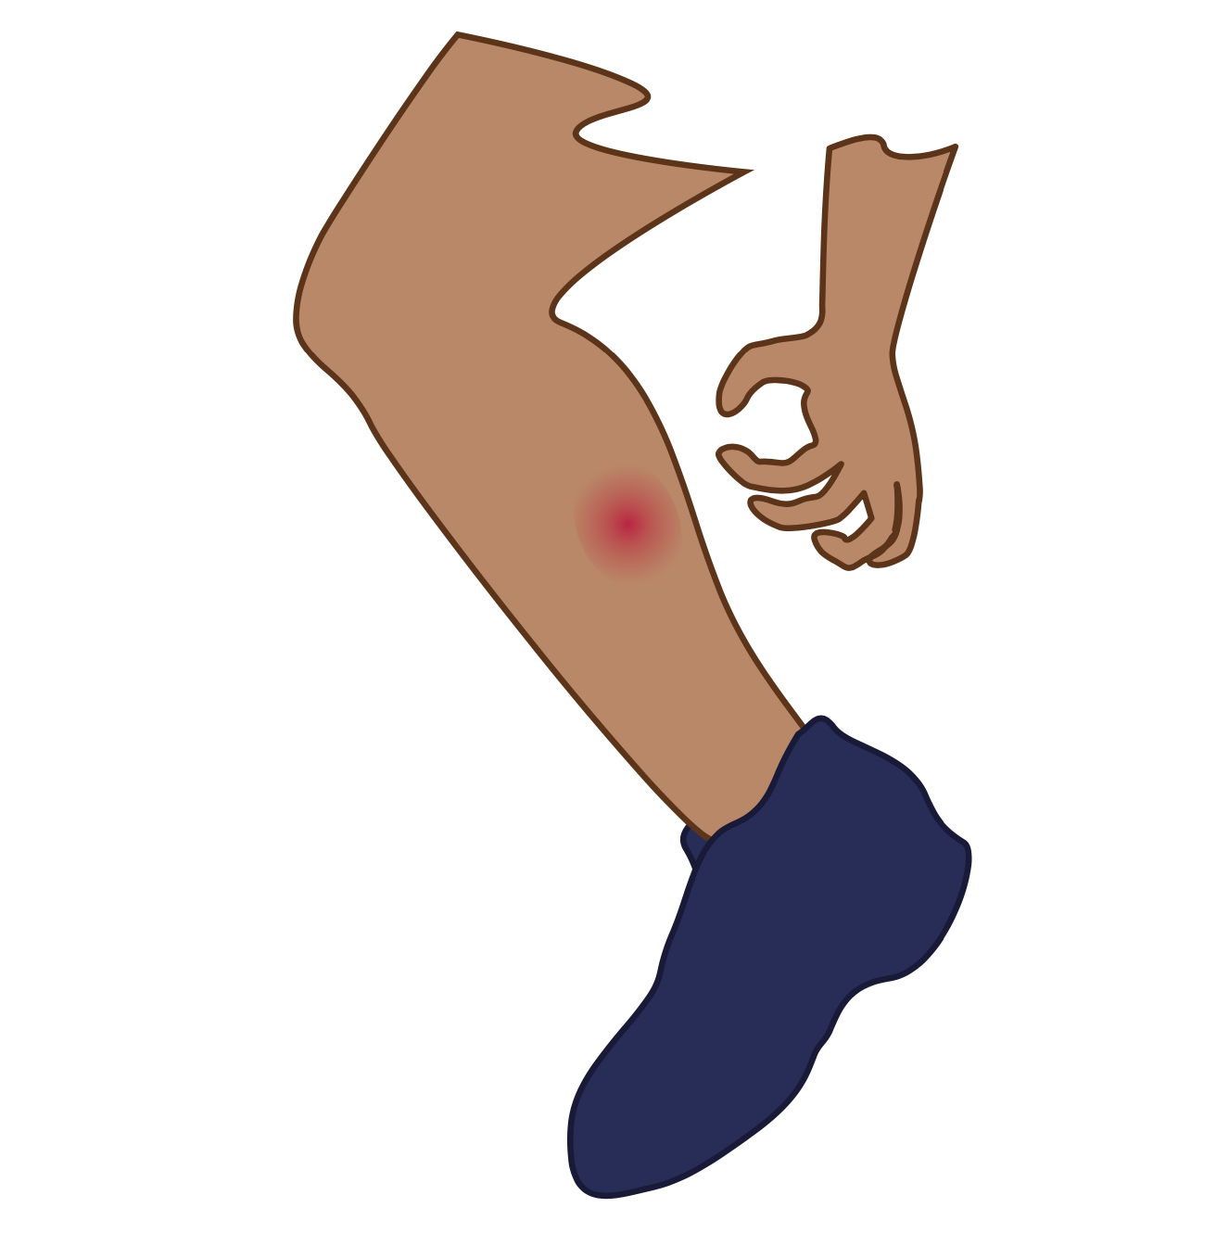
i

Slide 35
i

Slide 36
i
e

Slide 37
b
i
k
e

Slide 38
s
i
d
e

Slide 39
e
five
ride
kite

Slide 40
b
i
t

Slide 41
b
i
t
e

Slide 42
f
i
n

Slide 43
f
i
n
e

Slide 44
h
i
d

Slide 45
h
i
d
e

Slide 46
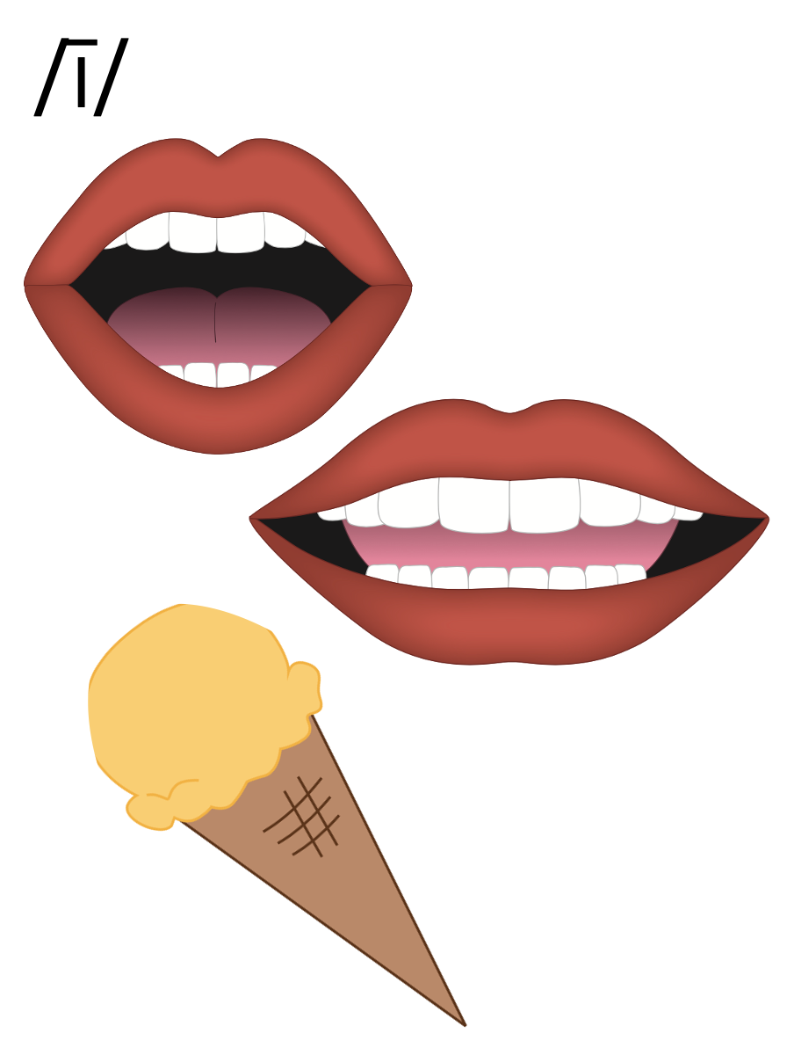
i_e

Slide 47
Notes:
Handwriting paper for letter formation practice. Use as needed.
See UFLI Foundations manual for more information about letter formation.

Slide 48
fine
ride

Slide 49
like
side
line
time
five
mile

Slide 50
life
while
white

Slide 51
Notes:
See UFLI Foundations lesson plan Step 5 for words to spell.
Handwriting paper to model spelling.

Slide 52
Notes:
See UFLI Foundations lesson plan Step 5 for words to spell.
Handwriting paper for guided spelling practice.

Slide 54
Insert brief reinforcement activity and/or transition to next part of reading block.

Slide 55
Lesson 55
i_e /ī/

Slide 57
New Concept Review
Notes:
See UFLI Foundations lesson plan Step 5 for recommended teacher language and activities to review the new concept.

Slide 58
i

Slide 59
i

Slide 60
i
e

Slide 61
b
i
k
e

Slide 62
s
i
d
e

Slide 63
e
five
ride
kite

Slide 64
f
i
n

Slide 65
f
i
n
e

Slide 66
i_e

Slide 67
like
five
side
white

Slide 69
Notes:
See UFLI Foundations lesson plan Step 6 for word work activity.
Visit ufliteracy.org to access the Word Work Mat apps.

Slide 71
Notes:
See UFLI Foundations lesson plan Step 7 for irregular word activities.
The white rectangle under each word may be used in editing mode. Cover the heart and square icons then reveal them one at a time during instruction.

Slide 72
Notes:
See UFLI Foundations manual for more information about reviewing irregular words.

Slide 73
or
Notes:
Lessons 51-77
*Temporarily irregular
OR /or/ has not been introduced yet.
The white rectangle under the word may be used in editing mode. Cover the heart and square icons then reveal them one at a time during instruction.

Slide 74
for
Notes:
Lessons 51-77
*Temporarily irregular
OR /or/ has not been introduced yet.
The white rectangle under the word may be used in editing mode. Cover the heart and square icons then reveal them one at a time during instruction.

Slide 75
there
Notes:
Lesson 52+
ERE represents the /air/ sound.
The white rectangle under the word may be used in editing mode. Cover the heart and square icons then reveal them one at a time during instruction.

Slide 76
where
Notes:
Lesson 52+
ERE represents the /air/ sound.
The white rectangle under the word may be used in editing mode. Cover the heart and square icons then reveal them one at a time during instruction.

Slide 77
who
Notes:
Lesson 54+
WH represents the /h/ sound.
O represents the /ū/ sound.
The white rectangle under the word may be used in editing mode. Cover the heart and square icons then reveal them one at a time during instruction.

Slide 78
Notes:
Handwriting paper for irregular word spelling practice. Use as needed.
See UFLI Foundations manual for more information about reviewing irregular words.

Slide 79
Teach
Notes:
The orange star indicates these are new irregular words that need to be introduced.
See UFLI Foundations manual for more information about teaching irregular words.

Slide 80
by
Notes:
Lessons 55-72
*Temporarily irregular
Y /ī/ has not been introduced yet.
The white rectangle under the word may be used in editing mode. Cover the heart and square icons then reveal them one at a time during instruction.

Slide 81
my
Notes:
Lessons 55-72
*Temporarily irregular
Y /ī/ has not been introduced yet.
The white rectangle under the word may be used in editing mode. Cover the heart and square icons then reveal them one at a time during instruction.

Slide 82
Notes:
Handwriting paper for irregular word spelling practice. Use as needed.
See UFLI Foundations manual for more information about teaching irregular words.

Slide 84
Notes:
See UFLI Foundations lesson plan Step 8 for connected text activities.

Slide 85
Mike likes to ride his bike.

Slide 86
I will get my white kite for Beth.

Slide 87
Jake likes to dive by the tall slide.

Slide 88
Notes:
See UFLI Foundations lesson plan Step 8 for sentences to write.

Slide 89
Notes:
The UFLI Foundations decodable text is provided here. See UFLI Foundations decodable text guide for additional text options.

Slide 90
Kites for Sale
Mike can ride his bike quite well. Mike likes to ride his bike to sell kites. Mike takes nine kites and a bit of twine. He strings the kites to his bike with the twine. As he rides, the kites go up, up, up. You can see the kites for miles.

Slide 91
Mike stops by a red gate and lets the kites wave. “Kites for sale!” he yells. Kids run to his bike. Mike sells his kites for a dime. “Thank you, Mike!” yell the kids as they take their kites.

Slide 93
Insert brief reinforcement activity and/or transition to next part of reading block.

