Slide 1
Lesson 41a
Short Vowels Review

Slide 2
Notes:
ufliteracy.org

Slide 4
Lesson 41a
Short Vowels Review

Slide 6
Notes:
See UFLI Foundations lesson plan Step 1 for phonemic awareness activity.

Slide 8
Notes:
See UFLI Foundations lesson plan Step 2 for student phoneme responses.

Slide 9
u

Slide 10
o

Slide 11
i

Slide 12
a

Slide 13
m

Slide 14
s

Slide 15
t

Slide 16
p

Slide 17
f

Slide 18
n

Slide 19
d

Slide 20
c

Slide 21
g

Slide 22
b

Slide 23
k

Slide 24
h

Slide 25
r

Slide 26
l

Slide 27
w

Slide 28
j

Slide 29
y

Slide 30
x

Slide 31
qu

Slide 32
v

Slide 33
z

Slide 35
Notes:
See UFLI Foundations lesson plan Step 3 for auditory drill activity.

Slide 36
Notes:
No slides needed for auditory drill.

Slide 38
Notes:
See UFLI Foundations lesson plan Step 4 for blending drill word chain and grid.
Visit ufliteracy.org to access the Blending Board app.

Slide 40
Notes:
See UFLI Foundations lesson plan Step 5 for recommended teacher language and activities to introduce the new concept.

Slide 41
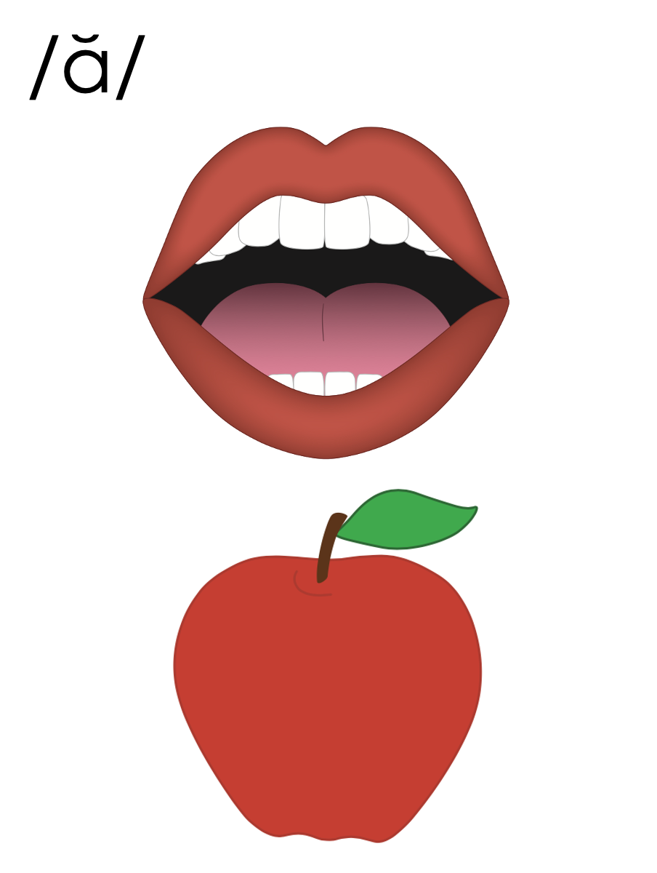
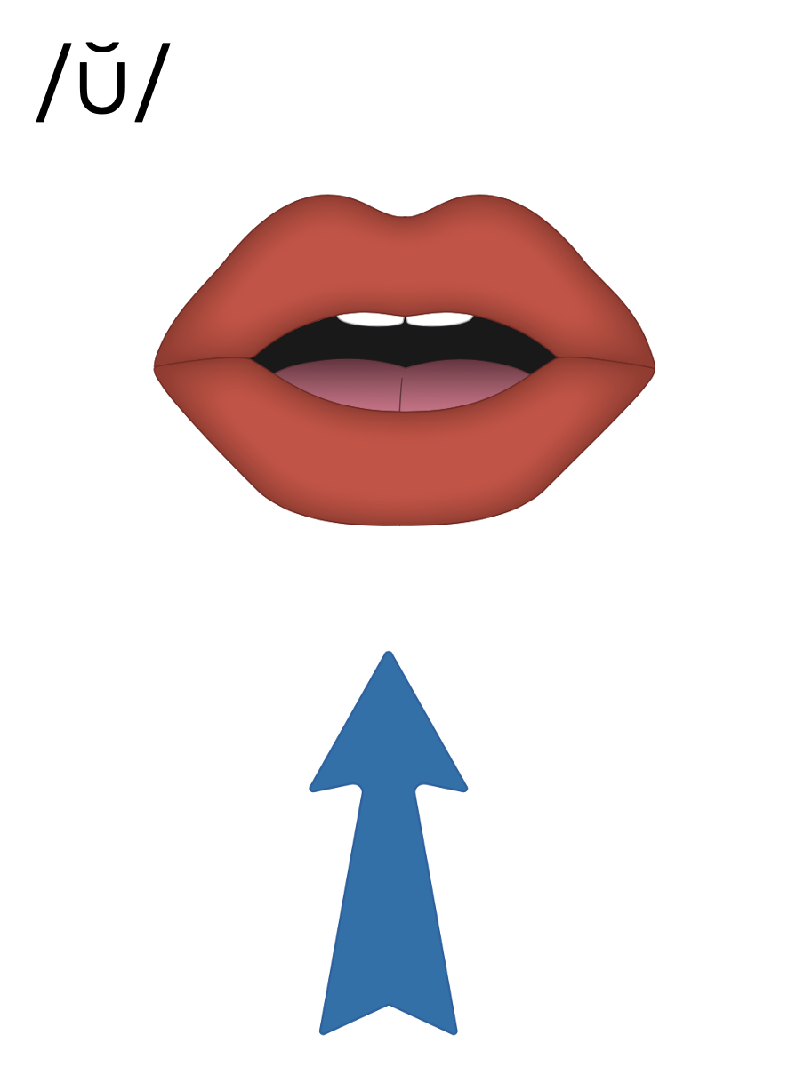
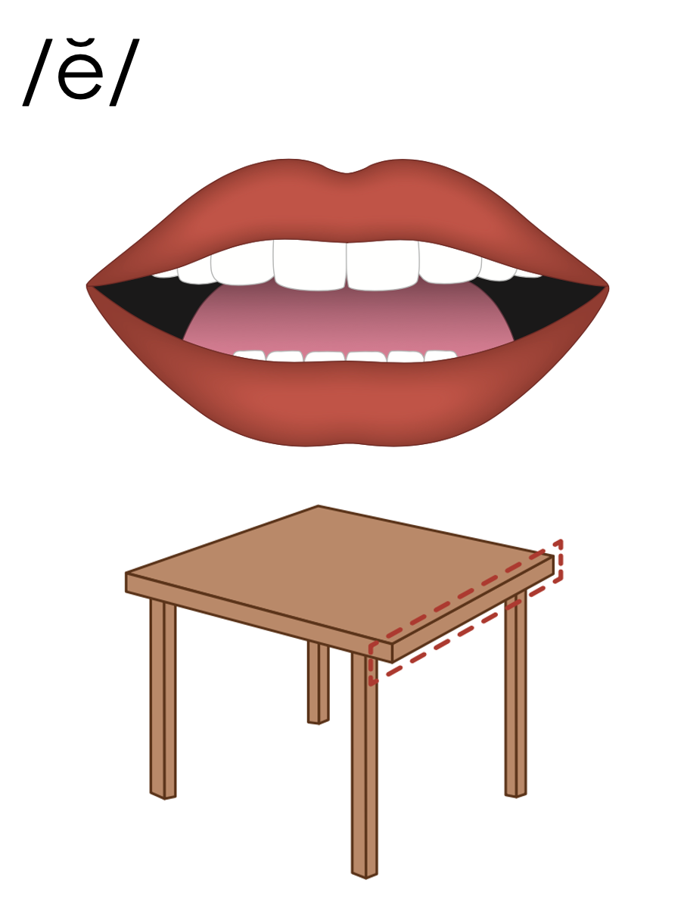

Slide 42
a

Slide 43
cat
map
a

Slide 44
at
as
a

Slide 45
am
an
am
an
jam
can

Slide 46
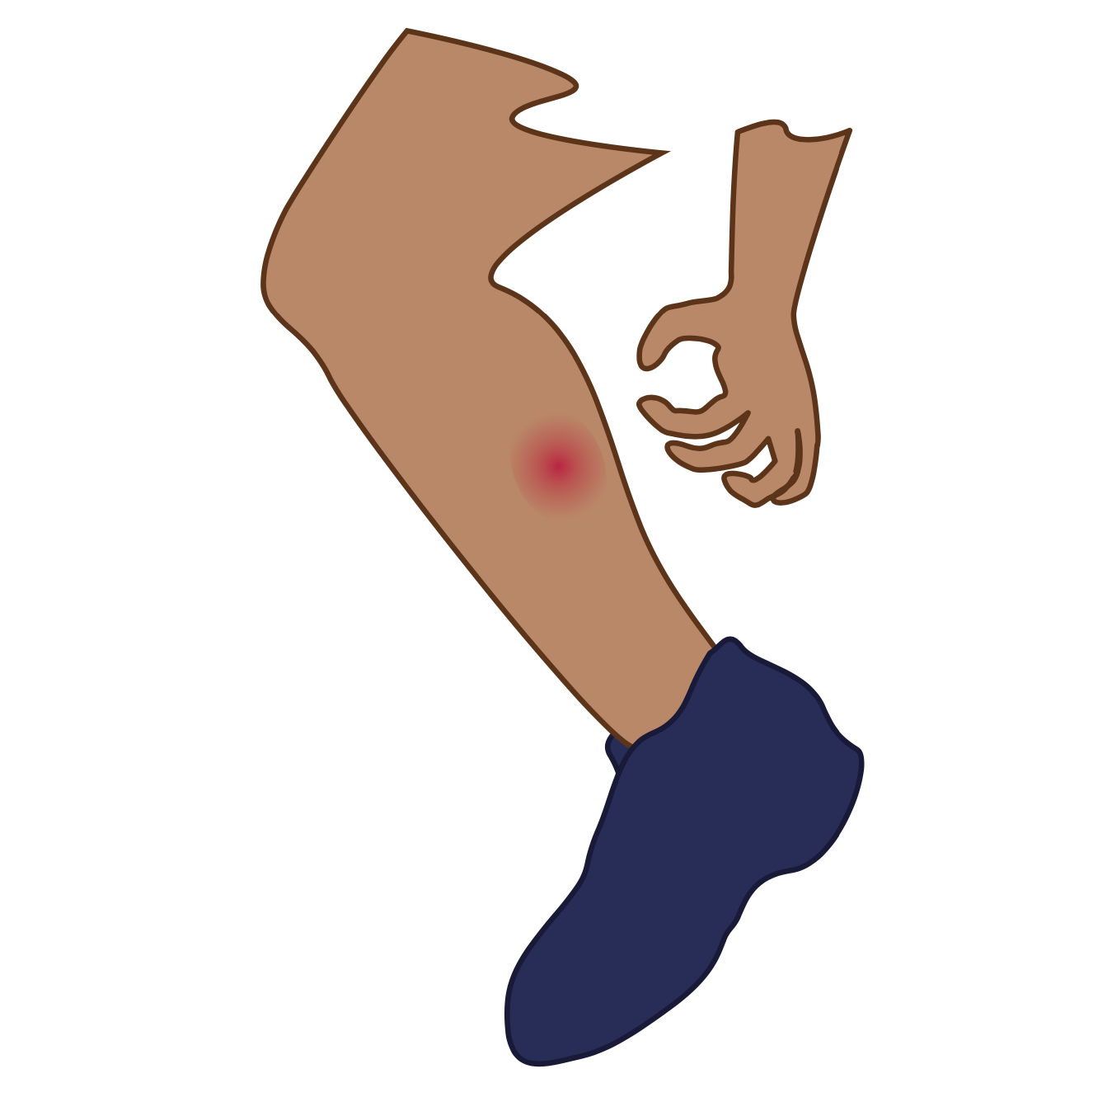
i

Slide 47
sit
big
i

Slide 48
is
in
i

Slide 49
o

Slide 50
hot
mop
o

Slide 51
on
ox
o

Slide 52
u

Slide 53
cut
run
u

Slide 54
up
us
u

Slide 55
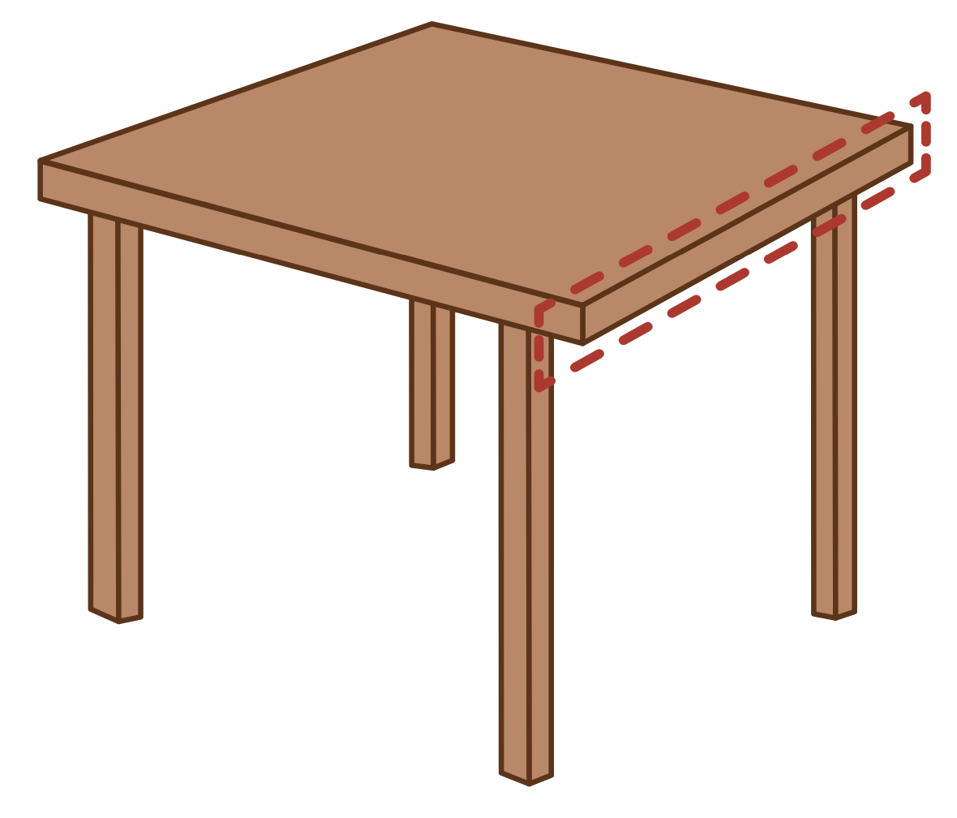
e

Slide 56
men
get
e

Slide 57
elf
end
e

Slide 58
a
i
o
u
e

Slide 59
Notes:
Handwriting paper for letter formation practice. Use as needed.
See UFLI Foundations manual for more information about letter formation.

Slide 60
mat
sit
not
mud
let

Slide 61
sat
had
can
six
fit
on

Slide 62
got
job
us
run
red
ten

Slide 63
Notes:
See UFLI Foundations lesson plan Step 5 for words to spell.
Handwriting paper to model spelling.

Slide 64
Notes:
See UFLI Foundations lesson plan Step 5 for words to spell.
Handwriting paper for guided spelling practice.

Slide 66
Insert brief reinforcement activity and/or transition to next part of reading block.

Slide 67
Lesson 41a
Short Vowels Review

Slide 69
New Concept Review
Notes:
See UFLI Foundations lesson plan Step 5 for recommended teacher language and activities to review the new concept.

Slide 70
a

Slide 71
cat
map
a

Slide 72
at
as
a

Slide 73
am
an
am
an
jam
can

Slide 74
i

Slide 75
sit
big
i

Slide 76
is
in
i

Slide 77
o

Slide 78
hot
mop
o

Slide 79
on
ox
o

Slide 80
u

Slide 81
cut
run
u

Slide 82
up
us
u

Slide 83
e

Slide 84
men
get
e

Slide 85
elf
end
e

Slide 86
a
i
o
u
e

Slide 87
had
sit
got
but
red

Slide 89
Notes:
See UFLI Foundations lesson plan Step 6 for word work activity.
Visit ufliteracy.org to access the Word Work Mat apps.

Slide 91
Notes:
See UFLI Foundations lesson plan Step 7 for irregular word activities.
The white rectangle under each word may be used in editing mode. Cover the heart and square icons then reveal them one at a time during instruction.

Slide 92
Notes:
See UFLI Foundations manual for more information about reviewing irregular words.

Slide 93
the
Notes:
Lessons 1-45
The digraph TH has not been introduced yet.
E represents the /ŭ/ or /ə/ sound depending on stress.
The white rectangle under the word may be used in editing mode. Cover the heart and square icons then reveal them one at a time during instruction.

Slide 94
I
Notes:
Lessons 3-65
*Temporarily irregular
I /ī/ has not been introduced yet.
The white rectangle under the word may be used in editing mode. Cover the heart and square icons then reveal them one at a time during instruction.

Slide 95
a
Notes:
Lesson 7+
A as a word can be pronounced /ā/ or /ŭ/.
The white rectangle under the word may be used in editing mode. Cover the heart and square icons then reveal them one at a time during instruction.

Slide 96
said
Notes:
Lesson 13+
AI represents the /ĕ/ sound.
The white rectangle under the word may be used in editing mode. Cover the heart and square icons then reveal them one at a time during instruction.

Slide 97
to
Notes:
Lesson 15+
O represents the /ū/ sound.
The white rectangle under the word may be used in editing mode. Cover the heart and square icons then reveal them one at a time during instruction.

Slide 98
do
Notes:
Lesson 15+
O represents the /ū/ sound.
The white rectangle under the word may be used in editing mode. Cover the heart and square icons then reveal them one at a time during instruction.

Slide 99
of
Notes:
Lesson 17+
O represents the /ŭ/ sound.
F represents the /v/ sound.
The white rectangle under the word may be used in editing mode. Cover the heart and square icons then reveal them one at a time during instruction.

Slide 100
see
Notes:
Lessons 19-84
*Temporarily irregular
EE /ē/ has not been introduced yet.
The white rectangle under the word may be used in editing mode. Cover the heart and square icons then reveal them one at a time during instruction.

Slide 101
he
Notes:
Lessons 23-65
*Temporarily irregular
E /ē/ has not been introduced yet.
The white rectangle under the word may be used in editing mode. Cover the heart and square icons then reveal them one at a time during instruction.

Slide 102
be
Notes:
Lessons 23-65
*Temporarily irregular
E /ē/ has not been introduced yet.
The white rectangle under the word may be used in editing mode. Cover the heart and square icons then reveal them one at a time during instruction.

Slide 103
me
Notes:
Lessons 23-65
*Temporarily irregular
E /ē/ has not been introduced yet.
The white rectangle under the word may be used in editing mode. Cover the heart and square icons then reveal them one at a time during instruction.

Slide 104
from
Notes:
Lesson 25+
O represents the /ŭ/ sound.
The white rectangle under the word may be used in editing mode. Cover the heart and square icons then reveal them one at a time during instruction.

Slide 105
look
Notes:
Lessons 26-88
*Temporarily irregular
OO /oo/ has not been introduced yet.
The white rectangle under the word may be used in editing mode. Cover the heart and square icons then reveal them one at a time during instruction.

Slide 106
book
Notes:
Lessons 26-88
*Temporarily irregular
OO /oo/ has not been introduced yet.
The white rectangle under the word may be used in editing mode. Cover the heart and square icons then reveal them one at a time during instruction.

Slide 107
are
Notes:
Lessons 27-76
AR /ar/ has not been introduced yet.
The final E is silent but does not follow the long vowel VCe pattern.
The white rectangle under the word may be used in editing mode. Cover the heart and square icons then reveal them one at a time during instruction.

Slide 108
was
Notes:
Lesson 29+
A represents the /ŭ/ sound.​
S /z/ has already been introduced.
The white rectangle under the word may be used in editing mode. Cover the heart and square icons then reveal them one at a time during instruction.

Slide 109
you
Notes:
Lessons 31-114
*Temporarily irregular
OU /ū/ has not been introduced yet.
The white rectangle under the word may be used in editing mode. Cover the heart and square icons then reveal them one at a time during instruction.

Slide 110
what
Notes:
Lessons 33-49
WH /w/ has not been introduced yet.
A represents the /ŭ/ sound or the /ŏ/ sound, depending on dialect.
The white rectangle under the word may be used in editing mode. Cover the heart and square icons then reveal them one at a time during instruction.

Slide 111
have
Notes:
Lessons 33-61
*Temporarily irregular
The final E is silent but does not follow the long vowel VCe pattern.
The silent E is there because English words can not end with the letter V.
The white rectangle under the word may be used in editing mode. Cover the heart and square icons then reveal them one at a time during instruction.

Slide 112
Notes:
Handwriting paper for irregular word spelling practice. Use as needed.
See UFLI Foundations manual for more information about reviewing irregular words.

Slide 114
Notes:
See UFLI Foundations lesson plan Step 8 for connected text activities.

Slide 115
I have a pig and a hen.

Slide 116
He was not on the bus.

Slide 117
Do you see the big fan?

Slide 118
Notes:
See UFLI Foundations lesson plan Step 8 for sentences to write.

Slide 119
Notes:
The UFLI Foundations decodable text is provided here. See UFLI Foundations decodable text guide for additional text options.

Slide 120
The Fox and the Red Hen
The fox can not get up.
He is in a pit.
The red hen looks at the fox.
“Oh no! You are in the pit.”

Slide 121
“Yes, I am in the pit. Can you help me?” asks the fox.
“Yes, I can help, but do not jump on me!” said the red hen.
The red hen helps the fox.

Slide 122
The fox did not jump on the red hen.
The red hen and the fox are glad the fox is not in the pit.

Slide 124
Insert brief reinforcement activity and/or transition to next part of reading block.

