Slide 1
Lesson 39b
Short U Advanced

Slide 2
Notes:
ufliteracy.org

Slide 4
Lesson 39b
Short U Advanced

Slide 6
Notes:
See UFLI Foundations lesson plan Step 1 for phonemic awareness activity.

Slide 8
Notes:
See UFLI Foundations lesson plan Step 2 for student phoneme responses.

Slide 9
o

Slide 10
i

Slide 11
a

Slide 12
m

Slide 13
s

Slide 14
t

Slide 15
p

Slide 16
f

Slide 17
n

Slide 18
d

Slide 19
c

Slide 20
g

Slide 21
b

Slide 22
k

Slide 23
h

Slide 24
r

Slide 25
l

Slide 26
w

Slide 27
j

Slide 28
y

Slide 29
x

Slide 30
qu

Slide 31
v

Slide 32
z

Slide 34
Notes:
See UFLI Foundations lesson plan Step 3 for auditory drill activity.

Slide 35
Notes:
No slides needed for auditory drill.

Slide 37
Notes:
See UFLI Foundations lesson plan Step 4 for blending drill word chain and grid.
Visit ufliteracy.org to access the Blending Board app.

Slide 39
Notes:
See UFLI Foundations lesson plan Step 5 for recommended teacher language and activities to introduce the new concept.

Slide 40
u

Slide 41
cut
run
u

Slide 42
up
us
u

Slide 43
c u t s

Slide 44
r u s t

Slide 45
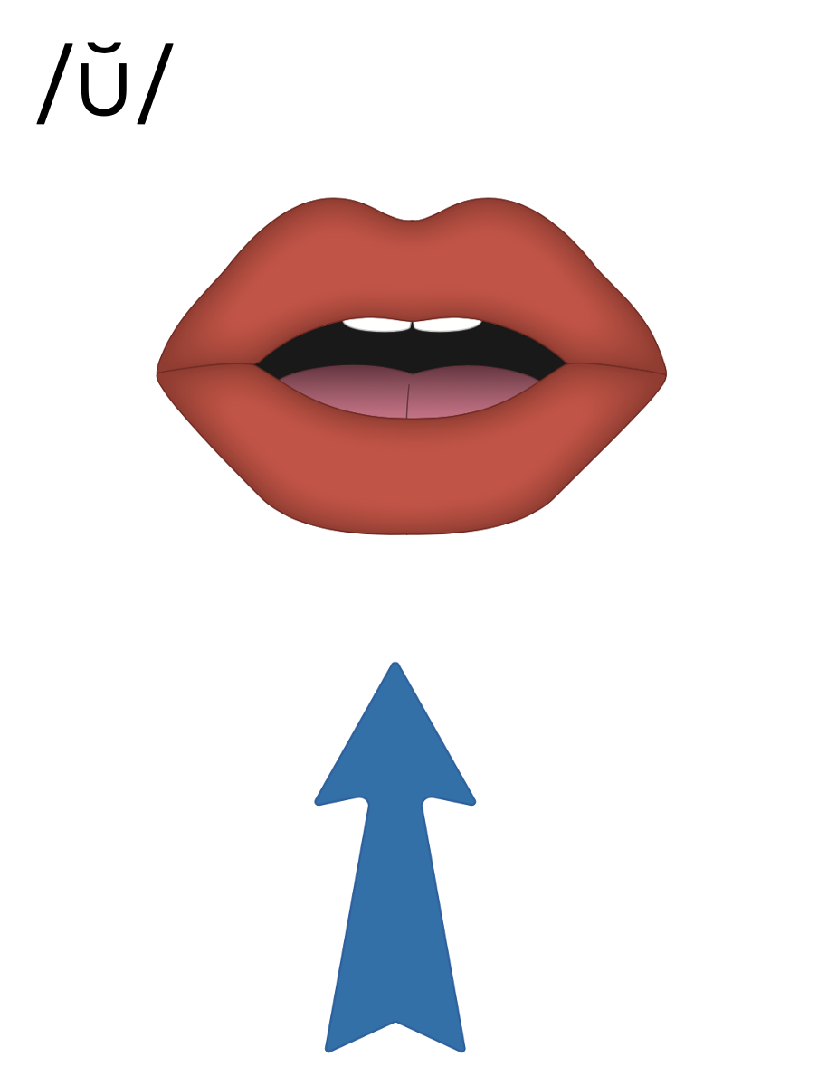
u

Slide 48
Notes:
Uppercase U gif

Slide 49
up
run
slug
dusk

Slide 50
us
but
sun
cut
hugs
runs

Slide 51
plug
must
jump
just
hunt

Slide 52
Notes:
See UFLI Foundations lesson plan Step 5 for words to spell.
Handwriting paper to model spelling.

Slide 53
Notes:
See UFLI Foundations lesson plan Step 5 for words to spell.
Handwriting paper for guided spelling practice.

Slide 55
Insert brief reinforcement activity and/or transition to next part of reading block.

Slide 56
Lesson 39b
Short U Advanced

Slide 58
New Concept Review
Notes:
See UFLI Foundations lesson plan Step 5 for recommended teacher language and activities to review the new concept.

Slide 59
u

Slide 60
cut
run
u

Slide 61
up
us
u

Slide 62
c u t s

Slide 63
r u s t

Slide 64
u

Slide 65
Notes:
Uppercase U gif

Slide 66
plus
jump
just
must

Slide 68
Notes:
See UFLI Foundations lesson plan Step 6 for word work activity.
Visit ufliteracy.org to access the Word Work Mat apps.

Slide 70
Notes:
See UFLI Foundations lesson plan Step 7 for irregular word activities.
The white rectangle under each word may be used in editing mode. Cover the heart and square icons then reveal them one at a time during instruction.

Slide 71
Notes:
See UFLI Foundations manual for more information about reviewing irregular words.

Slide 72
look
Notes:
Lessons 26-88
*Temporarily irregular
OO /oo/ has not been introduced yet.
The white rectangle under the word may be used in editing mode. Cover the heart and square icons then reveal them one at a time during instruction.

Slide 73
book
Notes:
Lessons 26-88
*Temporarily irregular
OO /oo/ has not been introduced yet.
The white rectangle under the word may be used in editing mode. Cover the heart and square icons then reveal them one at a time during instruction.

Slide 74
are
Notes:
Lessons 27-76
AR /ar/ has not been introduced yet.
The final E is silent but does not follow the long vowel VCe pattern.
The white rectangle under the word may be used in editing mode. Cover the heart and square icons then reveal them one at a time during instruction.

Slide 75
was
Notes:
Lesson 29+
A represents the /ŭ/ sound.​
S /z/ has already been introduced.
The white rectangle under the word may be used in editing mode. Cover the heart and square icons then reveal them one at a time during instruction.

Slide 76
Notes:
Handwriting paper for irregular word spelling practice. Use as needed.
See UFLI Foundations manual for more information about reviewing irregular words.

Slide 78
Notes:
See UFLI Foundations lesson plan Step 8 for connected text activities.

Slide 79
Look at the fast slug!

Slide 80
Was there rust on the lamp?

Slide 81
The drum set has a lot of dust.

Slide 82
Notes:
See UFLI Foundations lesson plan Step 8 for sentences to write.

Slide 83
Notes:
The UFLI Foundations decodable text is provided here. See UFLI Foundations decodable text guide for additional text options.

Slide 84
Gus the Pup
Gus the pup was in the mud.
He dug in the mud and got a bug.
Gus ran to the rug with his bug.
Mom sees Gus on the rug.

Slide 85
“No Gus! No bugs on the rug!”
Mom jumps up to stop Gus, but he is fast.
Gus runs to the mud.
Mom grabs Gus and dumps him in the tub.

Slide 86
Mom scrubs Gus.
Gus looks glum.
Mom pets Gus.
Gus is not glum.

Slide 88
Insert brief reinforcement activity and/or transition to next part of reading block.

