Slide 1
Lesson 38a
Short A, I, O Review

Slide 2
Notes:
ufliteracy.org

Slide 4
Lesson 38a
Short A, I, O Review

Slide 6
Notes:
See UFLI Foundations lesson plan Step 1 for phonemic awareness activity.

Slide 8
Notes:
See UFLI Foundations lesson plan Step 2 for student phoneme responses.

Slide 9
m

Slide 10
s

Slide 11
t

Slide 12
p

Slide 13
f

Slide 14
n

Slide 15
d

Slide 16
c

Slide 17
g

Slide 18
b

Slide 19
k

Slide 20
h

Slide 21
r

Slide 22
l

Slide 23
w

Slide 24
j

Slide 25
y

Slide 26
x

Slide 27
qu

Slide 28
v

Slide 29
z

Slide 31
Notes:
See UFLI Foundations lesson plan Step 3 for auditory drill activity.

Slide 32
Notes:
No slides needed for auditory drill.

Slide 34
Notes:
See UFLI Foundations lesson plan Step 4 for blending drill word chain and grid.
Visit ufliteracy.org to access the Blending Board app.

Slide 36
Notes:
See UFLI Foundations lesson plan Step 5 for recommended teacher language and activities to introduce the new concept.

Slide 37
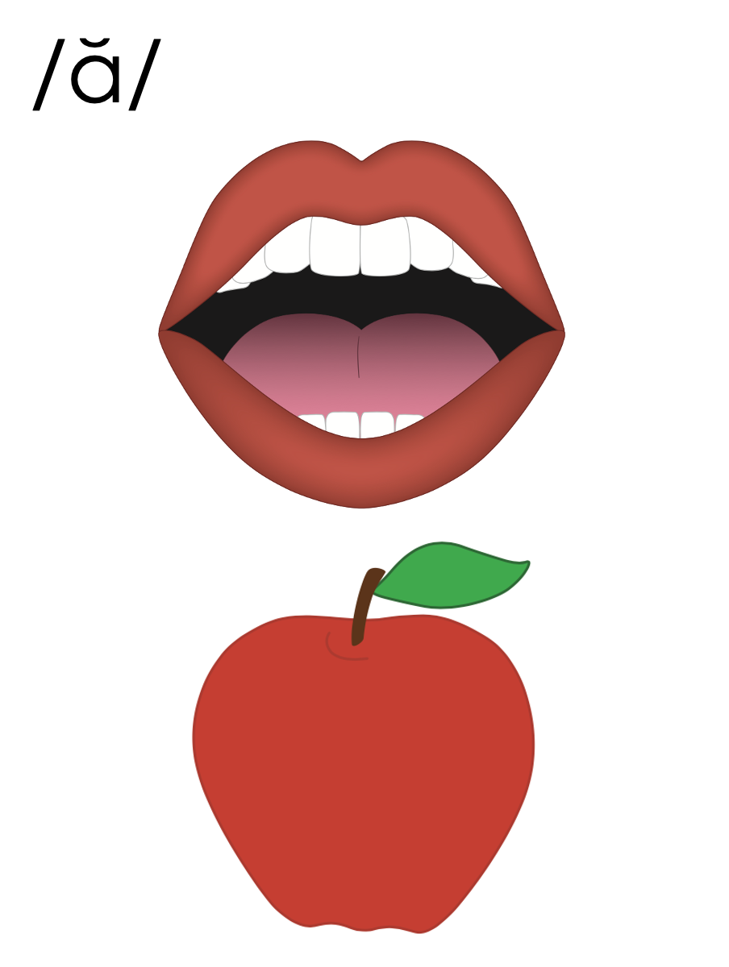
a
i
o

Slide 38
a

Slide 39
cat
map
a

Slide 40
at
as
a

Slide 41
am
an
am
an
jam
can

Slide 42
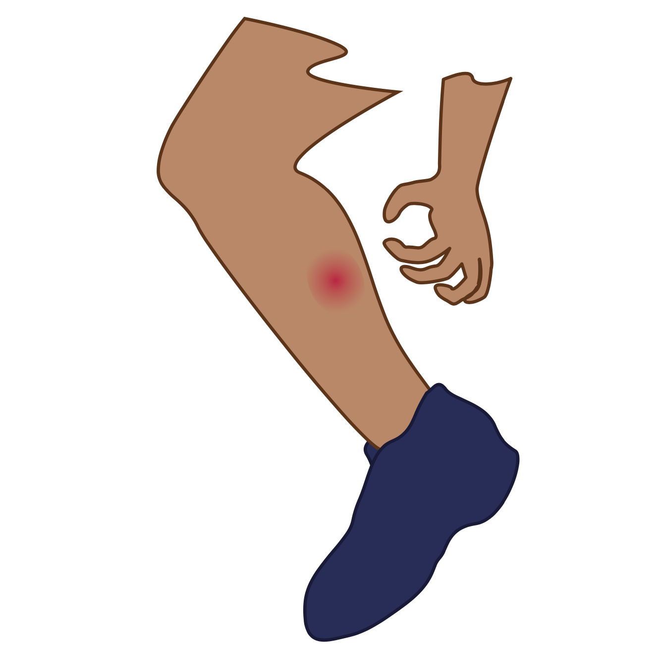
i

Slide 43
lip
him
i

Slide 44
in
is
i

Slide 45
o

Slide 46
hot
mop
o

Slide 47
on
ox
o

Slide 48
a
i
o

Slide 49
Notes:
Handwriting paper for letter formation practice. Use as needed.
See UFLI Foundations manual for more information about letter formation.

Slide 50
at
map
is
him
on
job

Slide 51
sat
had
and
man
if
sit

Slide 52
his
six
not
got
lot
top

Slide 53
Notes:
See UFLI Foundations lesson plan Step 5 for words to spell.
Handwriting paper to model spelling.

Slide 54
Notes:
See UFLI Foundations lesson plan Step 5 for words to spell.
Handwriting paper for guided spelling practice.

Slide 56
Insert brief reinforcement activity and/or transition to next part of reading block.

Slide 57
Lesson 38a
Short A, I, O Review

Slide 59
New Concept Review
Notes:
See UFLI Foundations lesson plan Step 5 for recommended teacher language and activities to review the new concept.

Slide 60
a
i
o

Slide 61
a

Slide 62
cat
map
a

Slide 63
at
as
a

Slide 64
am
an
am
an
jam
can

Slide 65
i

Slide 66
lip
him
i

Slide 67
in
is
i

Slide 68
o

Slide 69
hot
mop
o

Slide 70
on
ox
o

Slide 71
a
i
o

Slide 72
has
can
did
not

Slide 74
Notes:
See UFLI Foundations lesson plan Step 6 for word work activity.
Visit ufliteracy.org to access the Word Work Mat apps.

Slide 76
Notes:
See UFLI Foundations lesson plan Step 7 for irregular word activities.
The white rectangle under each word may be used in editing mode. Cover the heart and square icons then reveal them one at a time during instruction.

Slide 77
Notes:
See UFLI Foundations manual for more information about reviewing irregular words.

Slide 78
the
Notes:
Lessons 1-45
The digraph TH has not been introduced yet.
E represents the /ŭ/ or /ə/ sound depending on stress.
The white rectangle under the word may be used in editing mode. Cover the heart and square icons then reveal them one at a time during instruction.

Slide 79
I
Notes:
Lessons 3-65
*Temporarily irregular
I /ī/ has not been introduced yet.
The white rectangle under the word may be used in editing mode. Cover the heart and square icons then reveal them one at a time during instruction.

Slide 80
a
Notes:
Lesson 7+
A as a word can be pronounced /ā/ or /ŭ/.
The white rectangle under the word may be used in editing mode. Cover the heart and square icons then reveal them one at a time during instruction.

Slide 81
said
Notes:
Lesson 13+
AI represents the /ĕ/ sound.
The white rectangle under the word may be used in editing mode. Cover the heart and square icons then reveal them one at a time during instruction.

Slide 82
to
Notes:
Lesson 15+
O represents the /ū/ sound.
The white rectangle under the word may be used in editing mode. Cover the heart and square icons then reveal them one at a time during instruction.

Slide 83
do
Notes:
Lesson 15+
O represents the /ū/ sound.
The white rectangle under the word may be used in editing mode. Cover the heart and square icons then reveal them one at a time during instruction.

Slide 84
of
Notes:
Lesson 17+
O represents the /ŭ/ sound.
F represents the /v/ sound.
The white rectangle under the word may be used in editing mode. Cover the heart and square icons then reveal them one at a time during instruction.

Slide 85
see
Notes:
Lessons 19-84
*Temporarily irregular
EE /ē/ has not been introduced yet.
The white rectangle under the word may be used in editing mode. Cover the heart and square icons then reveal them one at a time during instruction.

Slide 86
he
Notes:
Lessons 23-65
*Temporarily irregular
E /ē/ has not been introduced yet.
The white rectangle under the word may be used in editing mode. Cover the heart and square icons then reveal them one at a time during instruction.

Slide 87
be
Notes:
Lessons 23-65
*Temporarily irregular
E /ē/ has not been introduced yet.
The white rectangle under the word may be used in editing mode. Cover the heart and square icons then reveal them one at a time during instruction.

Slide 88
me
Notes:
Lessons 23-65
*Temporarily irregular
E /ē/ has not been introduced yet.
The white rectangle under the word may be used in editing mode. Cover the heart and square icons then reveal them one at a time during instruction.

Slide 89
from
Notes:
Lesson 25+
O represents the /ŭ/ sound.
The white rectangle under the word may be used in editing mode. Cover the heart and square icons then reveal them one at a time during instruction.

Slide 90
Notes:
Handwriting paper for irregular word spelling practice. Use as needed.
See UFLI Foundations manual for more information about reviewing irregular words.

Slide 92
Notes:
See UFLI Foundations lesson plan Step 8 for connected text activities.

Slide 93
I got a hat from the big box.

Slide 94
The man did not see the pin.

Slide 95
He said the dog is on the mat.

Slide 96
Notes:
See UFLI Foundations lesson plan Step 8 for sentences to write.

Slide 97
Notes:
The UFLI Foundations decodable text is provided here. See UFLI Foundations decodable text guide for additional text options.

Slide 98
The Big Box
Nils, Jon, and Mag got a big box.
What is in the box?
Nils looks in the box.
Nils sees a hat in the box.

Slide 99
Jon looks in the box.
Jon sees a map in the box.
Mag looks in the box.
Mag sees a book in the box.

Slide 100
Next, the kids see pots and pans and bats in the box.
A lot is in this box!

Slide 102
Insert brief reinforcement activity and/or transition to next part of reading block.

