Slide 1
Lesson 36a
Short I Review

Slide 2
Notes:
ufliteracy.org

Slide 4
Lesson 36a
Short I Review

Slide 6
Notes:
See UFLI Foundations lesson plan Step 1 for phonemic awareness activity.

Slide 8
Notes:
See UFLI Foundations lesson plan Step 2 for student phoneme responses.

Slide 9
a

Slide 10
m

Slide 11
s

Slide 12
t

Slide 13
p

Slide 14
f

Slide 15
n

Slide 16
d

Slide 17
c

Slide 18
g

Slide 19
b

Slide 20
k

Slide 21
h

Slide 22
r

Slide 23
l

Slide 24
w

Slide 25
j

Slide 26
y

Slide 27
x

Slide 28
qu

Slide 29
v

Slide 30
z

Slide 32
Notes:
See UFLI Foundations lesson plan Step 3 for auditory drill activity.

Slide 33
Notes:
No slides needed for auditory drill.

Slide 35
Notes:
See UFLI Foundations lesson plan Step 4 for blending drill word chain and grid.
Visit ufliteracy.org to access the Blending Board app.

Slide 37
Notes:
See UFLI Foundations lesson plan Step 5 for recommended teacher language and activities to introduce the new concept.

Slide 38
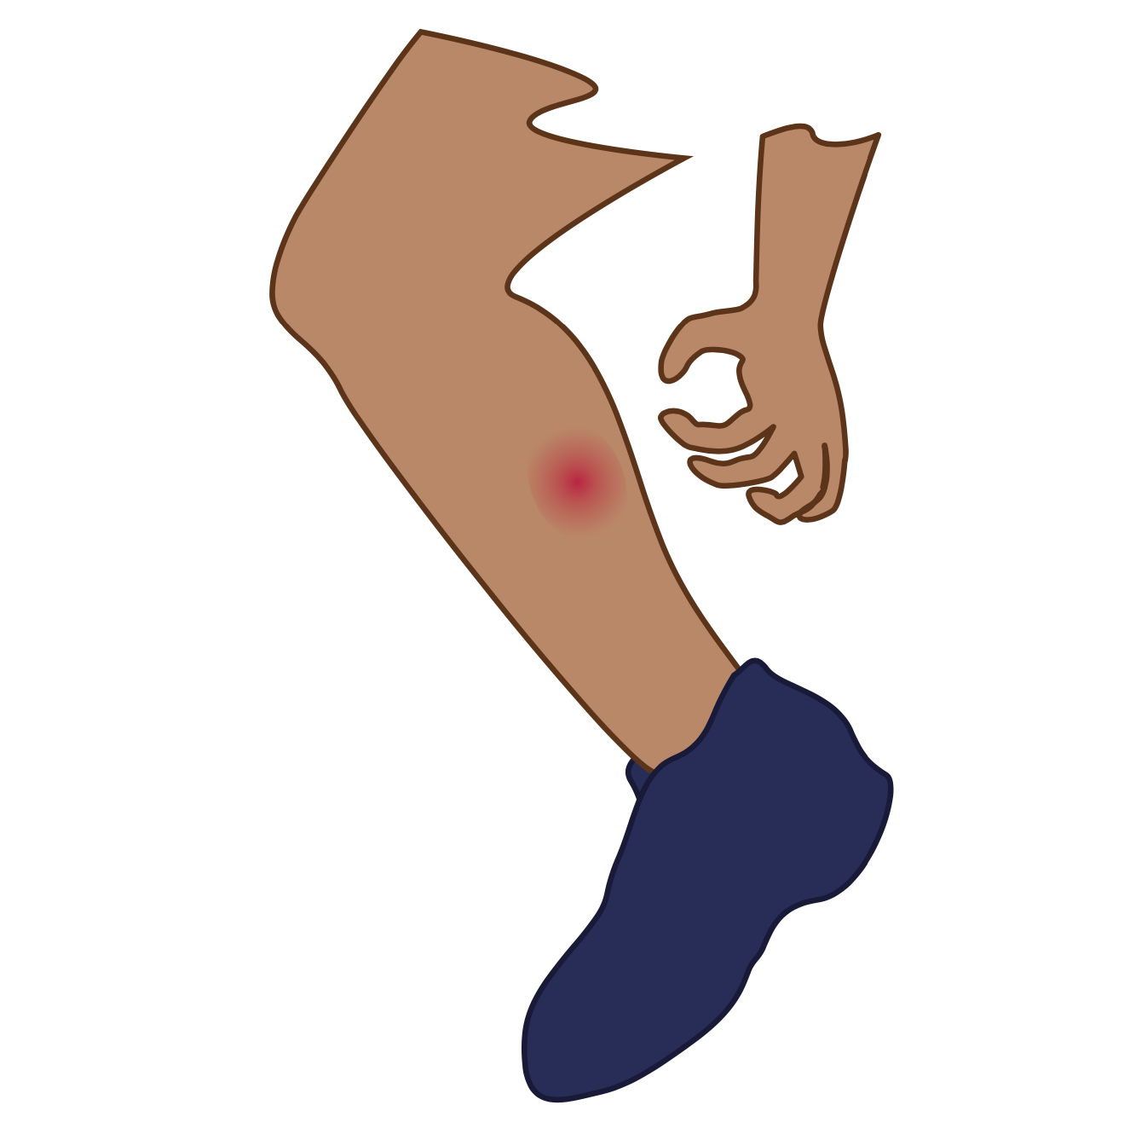
i

Slide 39
sit
big
i

Slide 40
in
is
i

Slide 41
i

Slide 42
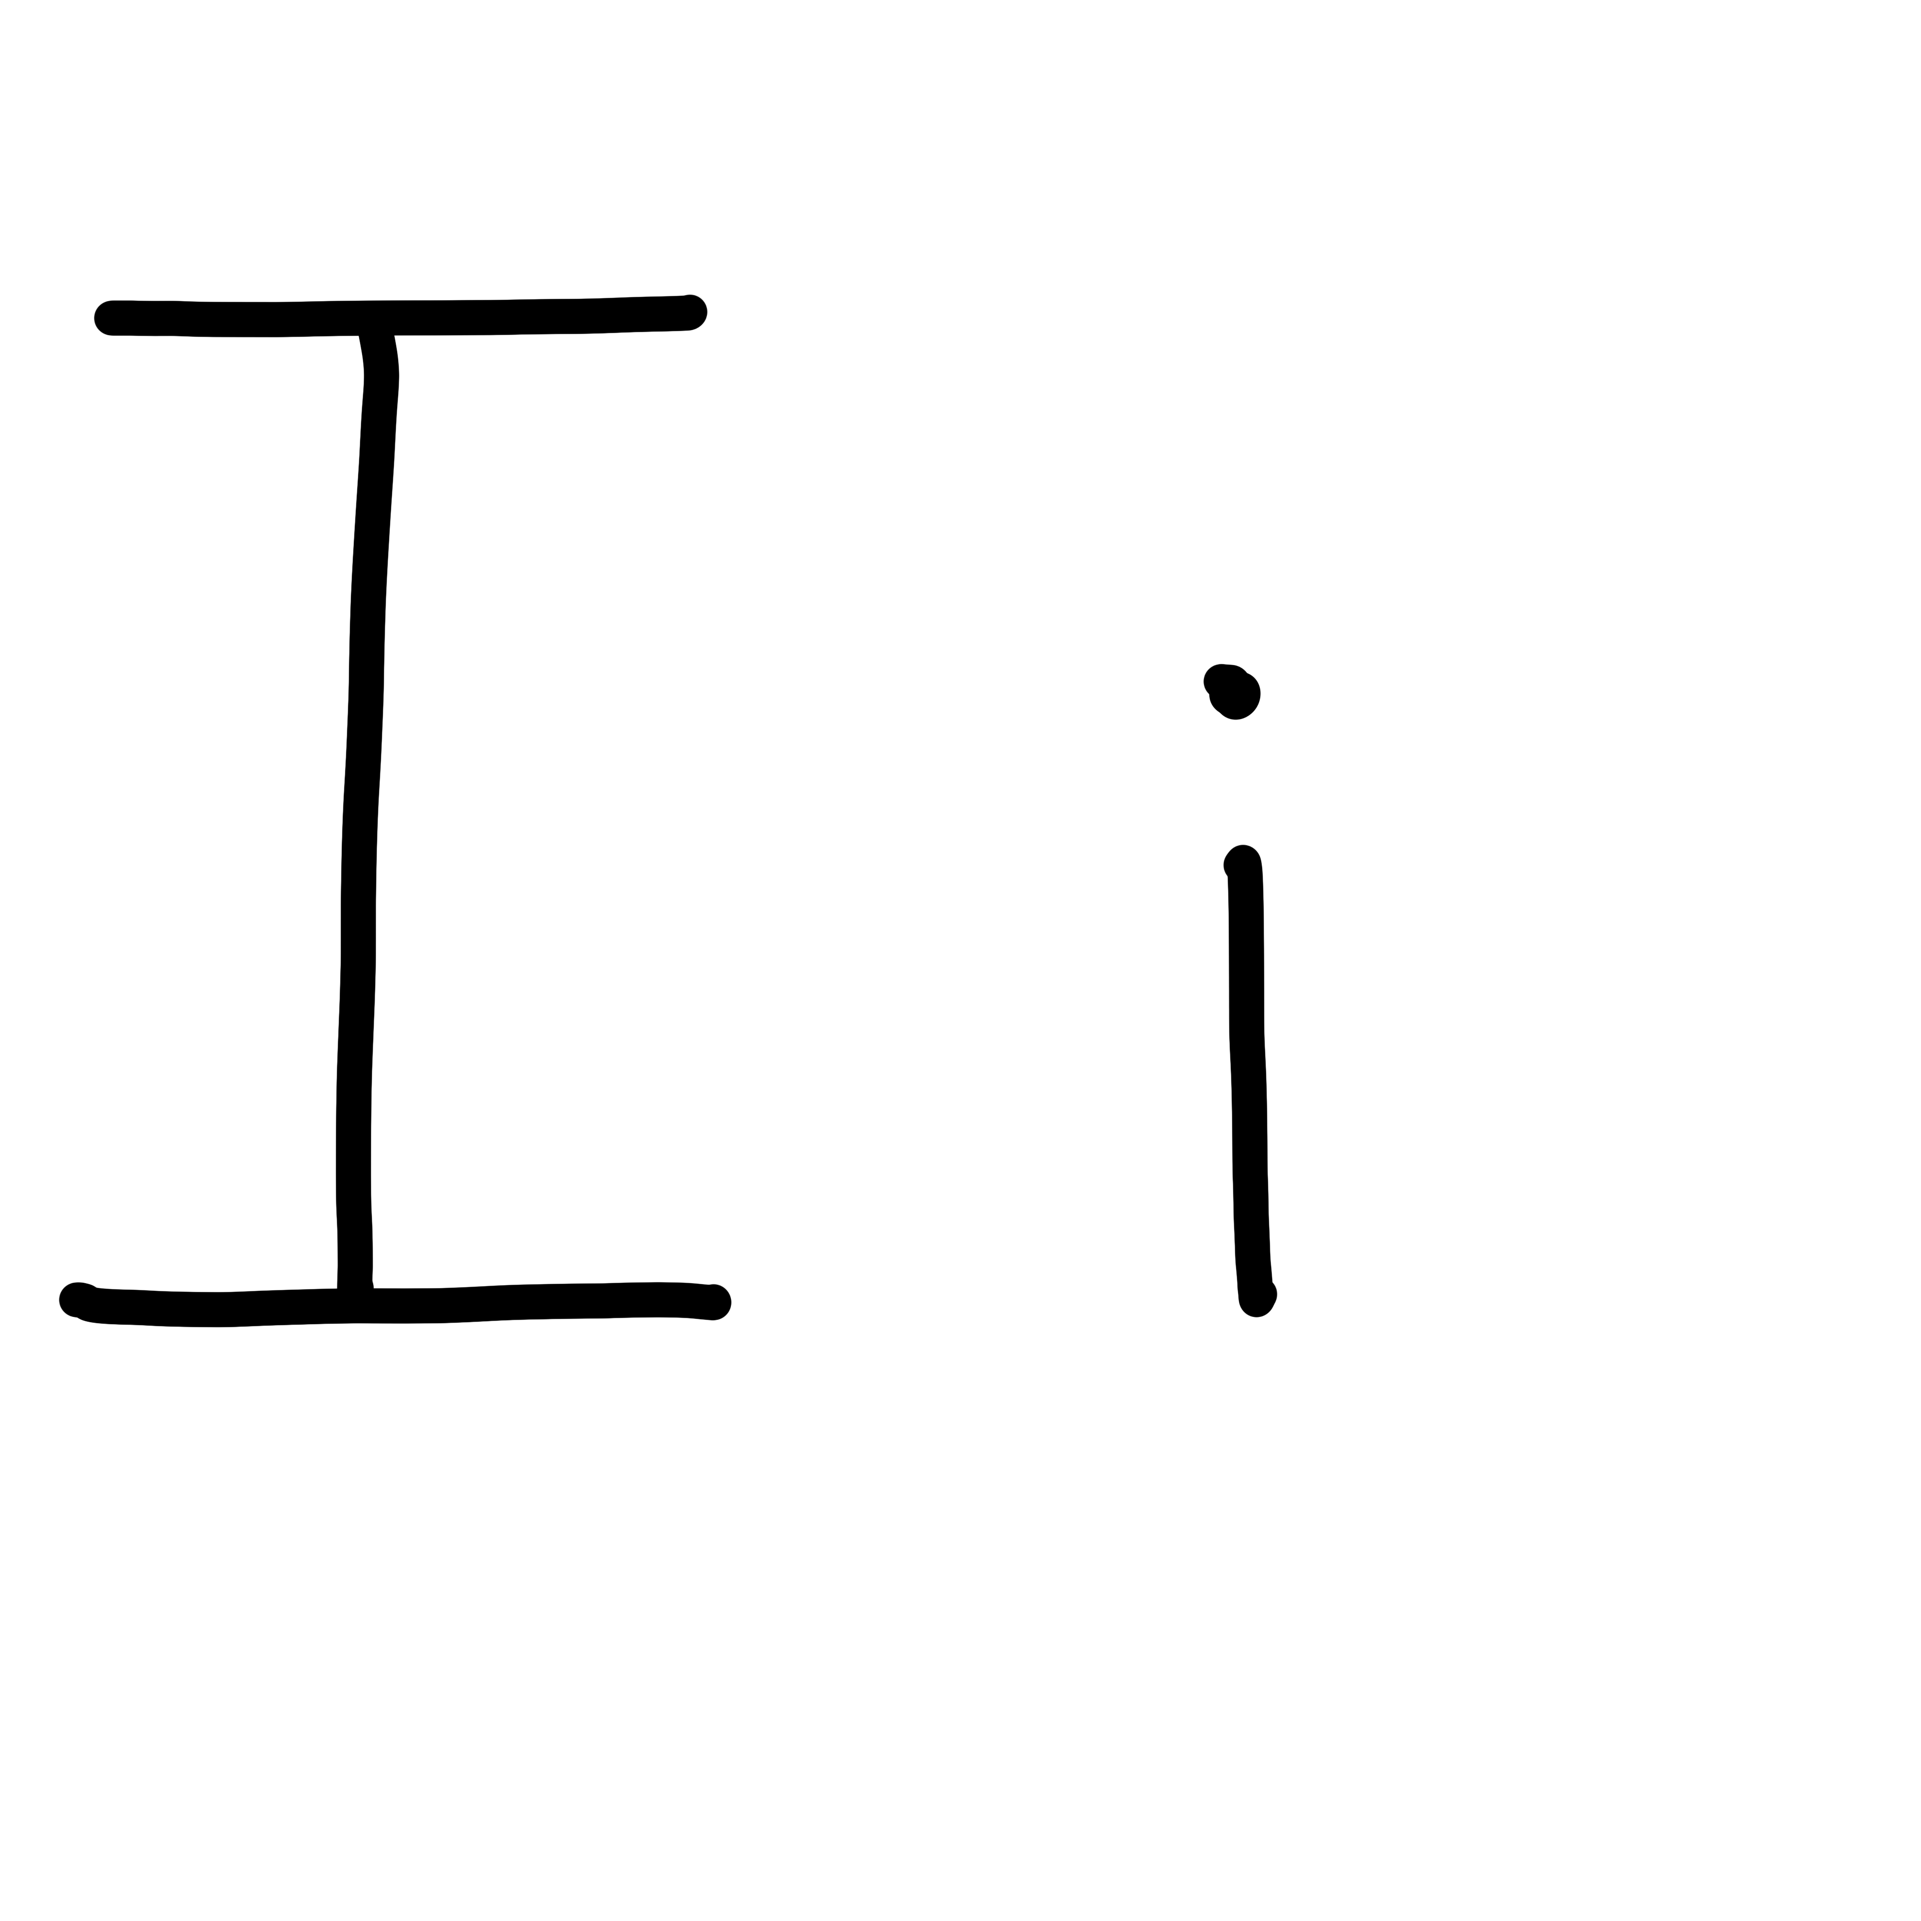

Slide 44
Notes:
Lowercase i gif

Slide 45
in
six

Slide 46
it
if
sit
win
him
big

Slide 47
did
hit
pig

Slide 48
Notes:
See UFLI Foundations lesson plan Step 5 for words to spell.
Handwriting paper to model spelling.

Slide 49
Notes:
See UFLI Foundations lesson plan Step 5 for words to spell.
Handwriting paper for guided spelling practice.

Slide 51
Insert brief reinforcement activity and/or transition to next part of reading block.

Slide 52
Lesson 36a
Short I Review

Slide 54
New Concept Review
Notes:
See UFLI Foundations lesson plan Step 5 for recommended teacher language and activities to review the new concept.

Slide 55
i

Slide 56
sit
big
i

Slide 57
in
is
i

Slide 58
i

Slide 59
Notes:
Lowercase i gif

Slide 60
if
big
six
him

Slide 62
Notes:
See UFLI Foundations lesson plan Step 6 for word work activity.
Visit ufliteracy.org to access the Word Work Mat apps.

Slide 64
Notes:
See UFLI Foundations lesson plan Step 7 for irregular word activities.
The white rectangle under each word may be used in editing mode. Cover the heart and square icons then reveal them one at a time during instruction.

Slide 65
Notes:
See UFLI Foundations manual for more information about reviewing irregular words.

Slide 66
to
Notes:
Lesson 15+
O represents the /ū/ sound.
The white rectangle under the word may be used in editing mode. Cover the heart and square icons then reveal them one at a time during instruction.

Slide 67
do
Notes:
Lesson 15+
O represents the /ū/ sound.
The white rectangle under the word may be used in editing mode. Cover the heart and square icons then reveal them one at a time during instruction.

Slide 68
of
Notes:
Lesson 17+
O represents the /ŭ/ sound.
F represents the /v/ sound.
The white rectangle under the word may be used in editing mode. Cover the heart and square icons then reveal them one at a time during instruction.

Slide 69
see
Notes:
Lessons 19-84
*Temporarily irregular
EE /ē/ has not been introduced yet.
The white rectangle under the word may be used in editing mode. Cover the heart and square icons then reveal them one at a time during instruction.

Slide 70
Notes:
Handwriting paper for irregular word spelling practice. Use as needed.
See UFLI Foundations manual for more information about reviewing irregular words.

Slide 72
Notes:
See UFLI Foundations lesson plan Step 8 for connected text activities.

Slide 73
Do I mix it?

Slide 74
Sid said to sit.

Slide 75
I see a big pig.

Slide 76
Notes:
See UFLI Foundations lesson plan Step 8 for sentences to write.

Slide 77
Notes:
The UFLI Foundations decodable text is provided here. See UFLI Foundations decodable text guide for additional text options.

Slide 78
Gil and his Pig
Gil has a big pig.
His pig is in its big pen.
A mud pit is in the pen.
The pig can swim in the mud pit.

Slide 79
The pig can dig in the mud pit.
The pig has a lot of fun in the mud pit.
Gil grins at his pig.
The pig grins at Gil.

Slide 81
Insert brief reinforcement activity and/or transition to next part of reading block.

