Slide 1
Lesson 35c
Short A Advanced

Slide 2
Notes:
ufliteracy.org

Slide 4
Lesson 35c
Short A Advanced

Slide 6
Notes:
See UFLI Foundations lesson plan Step 1 for phonemic awareness activity.

Slide 8
Notes:
See UFLI Foundations lesson plan Step 2 for student phoneme responses.

Slide 9
m

Slide 10
s

Slide 11
t

Slide 12
p

Slide 13
f

Slide 14
n

Slide 15
d

Slide 16
c

Slide 17
g

Slide 18
b

Slide 19
k

Slide 20
h

Slide 21
r

Slide 22
l

Slide 23
w

Slide 24
j

Slide 25
y

Slide 26
x

Slide 27
qu

Slide 28
v

Slide 29
z

Slide 31
Notes:
See UFLI Foundations lesson plan Step 3 for auditory drill activity.

Slide 32
Notes:
No slides needed for auditory drill.

Slide 34
Notes:
See UFLI Foundations lesson plan Step 4 for blending drill word chain and grid.
Visit ufliteracy.org to access the Blending Board app.

Slide 36
Notes:
See UFLI Foundations lesson plan Step 5 for recommended teacher language and activities to introduce the new concept.

Slide 37
a

Slide 38
cat
map
a

Slide 39
at
as
a

Slide 40
m a t s

Slide 41
l a s t

Slide 42
s n a p

Slide 43
am
an
am
jam
an
camp

Slide 44
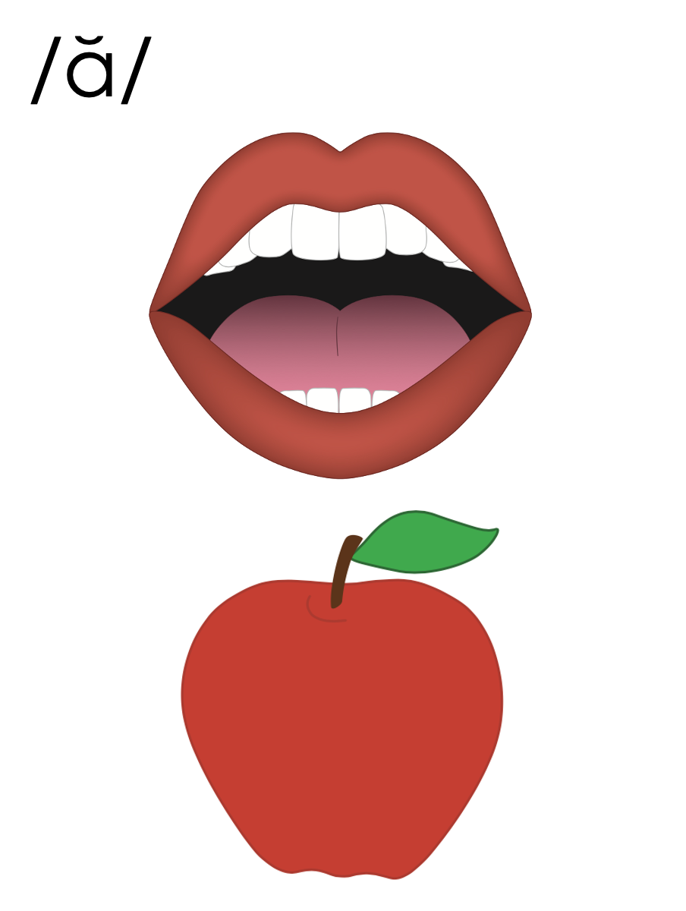

Slide 45
am
an

Slide 46
a

Slide 47
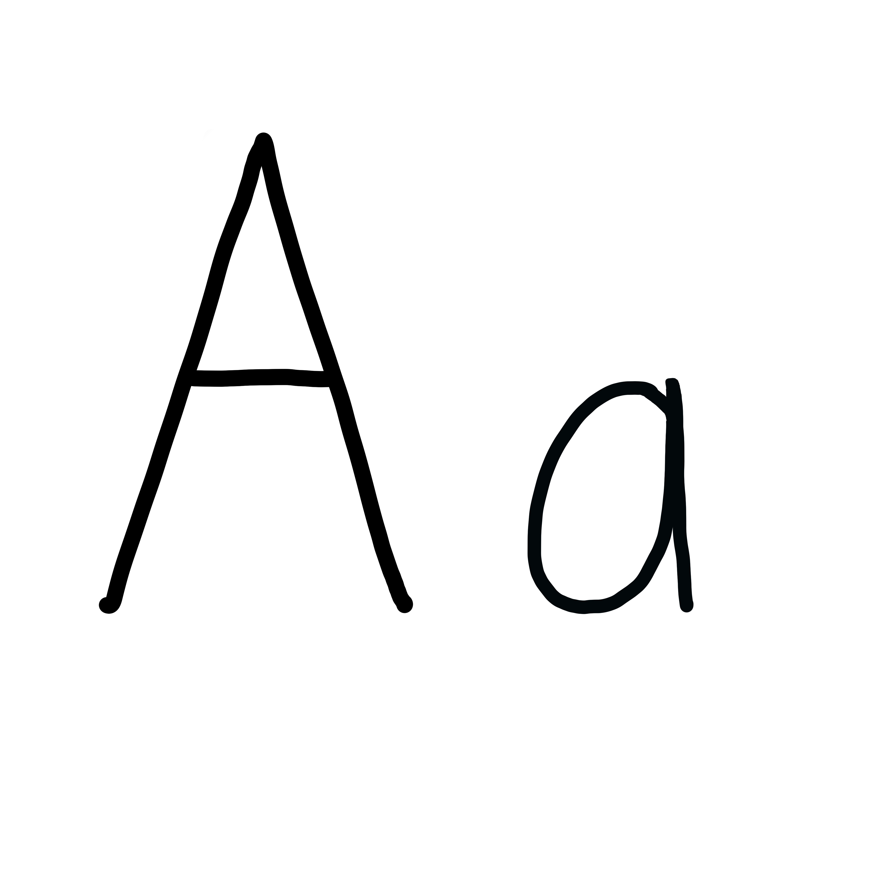

Slide 48
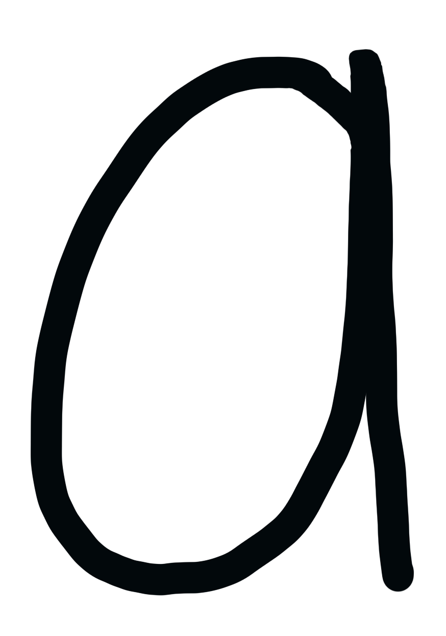

Slide 49
Notes:
Lowercase a gif

Slide 50
hat
am
can
flat
blast

Slide 51
had
has
ask
bags
fast
drag

Slide 52
an
man
hand
lamp
plant

Slide 53
Notes:
See UFLI Foundations lesson plan Step 5 for words to spell.
Handwriting paper to model spelling.

Slide 54
Notes:
See UFLI Foundations lesson plan Step 5 for words to spell.
Handwriting paper for guided spelling practice.

Slide 56
Insert brief reinforcement activity and/or transition to next part of reading block.

Slide 57
Lesson 35c
Short A Advanced

Slide 59
New Concept Review
Notes:
See UFLI Foundations lesson plan Step 5 for recommended teacher language and activities to review the new concept.

Slide 60
a

Slide 61
cat
map
a

Slide 62
at
as
a

Slide 63
m a t s

Slide 64
l a s t

Slide 65
s n a p

Slide 66
am
an
am
jam
an
camp

Slide 67
a

Slide 68
am
an

Slide 69
Notes:
Lowercase a gif

Slide 70
ask
fast
trap
land

Slide 72
Notes:
See UFLI Foundations lesson plan Step 6 for word work activity.
Visit ufliteracy.org to access the Word Work Mat apps.

Slide 74
Notes:
See UFLI Foundations lesson plan Step 7 for irregular word activities.
The white rectangle under each word may be used in editing mode. Cover the heart and square icons then reveal them one at a time during instruction.

Slide 75
Notes:
See UFLI Foundations manual for more information about reviewing irregular words.

Slide 76
the
Notes:
Lessons 1-45
The digraph TH has not been introduced yet.
E represents the /ŭ/ or /ə/ sound depending on stress.
The white rectangle under the word may be used in editing mode. Cover the heart and square icons then reveal them one at a time during instruction.

Slide 77
I
Notes:
Lessons 3-65
*Temporarily irregular
I /ī/ has not been introduced yet.
The white rectangle under the word may be used in editing mode. Cover the heart and square icons then reveal them one at a time during instruction.

Slide 78
a
Notes:
Lesson 7+
A as a word can be pronounced /ā/ or /ŭ/.
The white rectangle under the word may be used in editing mode. Cover the heart and square icons then reveal them one at a time during instruction.

Slide 79
said
Notes:
Lesson 13+
AI represents the /ĕ/ sound.
The white rectangle under the word may be used in editing mode. Cover the heart and square icons then reveal them one at a time during instruction.

Slide 80
Notes:
Handwriting paper for irregular word spelling practice. Use as needed.
See UFLI Foundations manual for more information about reviewing irregular words.

Slide 82
Notes:
See UFLI Foundations lesson plan Step 8 for connected text activities.

Slide 83
I am at camp.

Slide 84
The man has a flag.

Slide 85
Stan had maps and hats.

Slide 86
Notes:
See UFLI Foundations lesson plan Step 8 for sentences to write.

Slide 87
Notes:
The UFLI Foundations decodable text is provided here. See UFLI Foundations decodable text guide for additional text options.

Slide 88
Vlad the Crab
Vlad is a crab.
Vlad the crab ran on the sand.
A crab trap was in the sand.
Vlad did not see the trap.

Slide 89
Vlad ran in to the trap.
“Help!” said Vlad.
Dax the crab sees Vlad.
“I can help you!” said Dax.
Dax acts fast.

Slide 90
He grabs Vlad.
Dax and Vlad ran from the trap.
The crabs are glad.

Slide 92
Insert brief reinforcement activity and/or transition to next part of reading block.

