Slide 1
Lesson 35a
Short A Review

Slide 2
Notes:
ufliteracy.org

Slide 4
Lesson 35a
Short A Review

Slide 6
Notes:
See UFLI Foundations lesson plan Step 1 for phonemic awareness activity.

Slide 8
Notes:
See UFLI Foundations lesson plan Step 2 for student phoneme responses.

Slide 9
m

Slide 10
s

Slide 11
t

Slide 12
p

Slide 13
f

Slide 14
n

Slide 15
d

Slide 16
c

Slide 17
g

Slide 18
b

Slide 19
k

Slide 20
h

Slide 22
Notes:
See UFLI Foundations lesson plan Step 3 for auditory drill activity.

Slide 23
Notes:
No slides needed for auditory drill.

Slide 25
Notes:
See UFLI Foundations lesson plan Step 4 for blending drill word chain and grid.
Visit ufliteracy.org to access the Blending Board app.

Slide 27
Notes:
See UFLI Foundations lesson plan Step 5 for recommended teacher language and activities to introduce the new concept.

Slide 28
a

Slide 29
cat
map
a

Slide 30
at
as
a

Slide 31
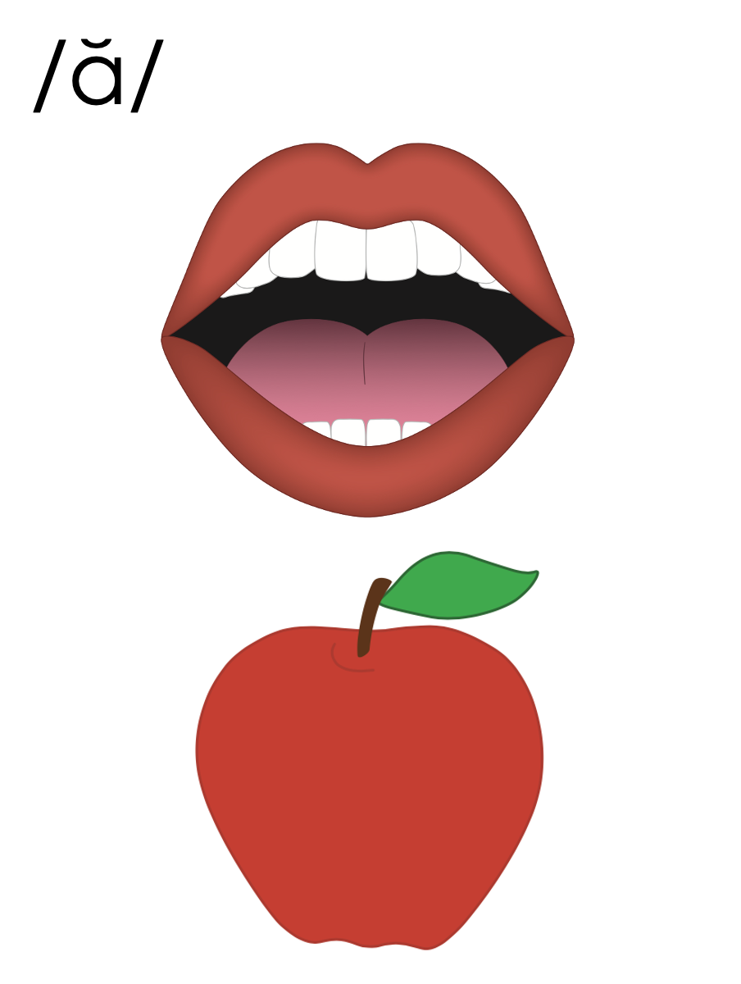
a

Slide 32
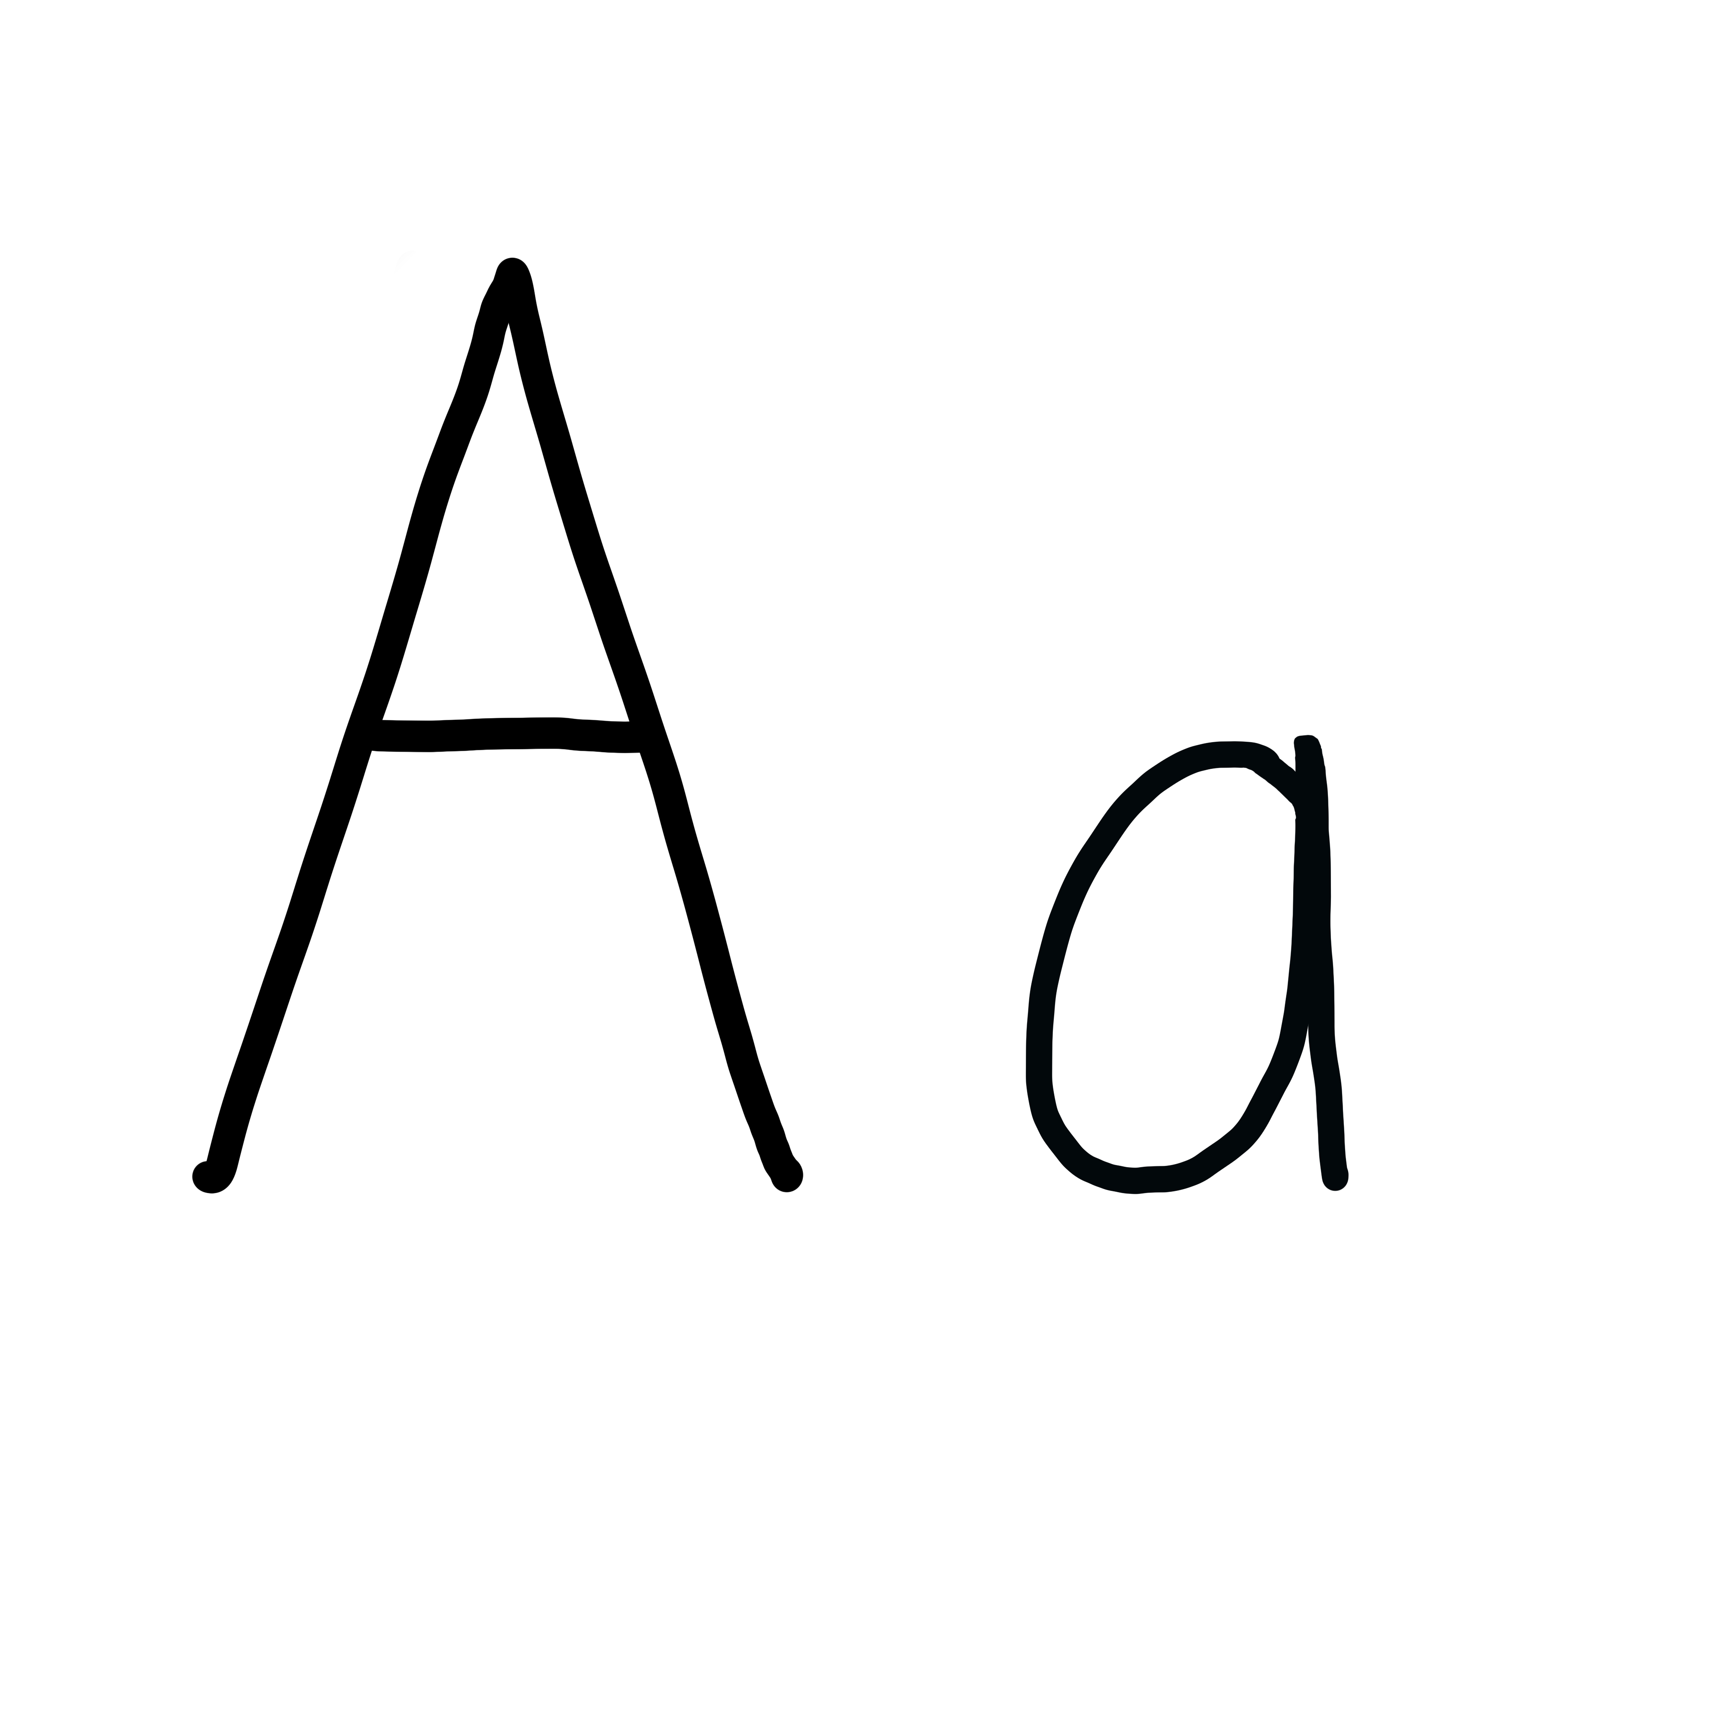

Slide 33
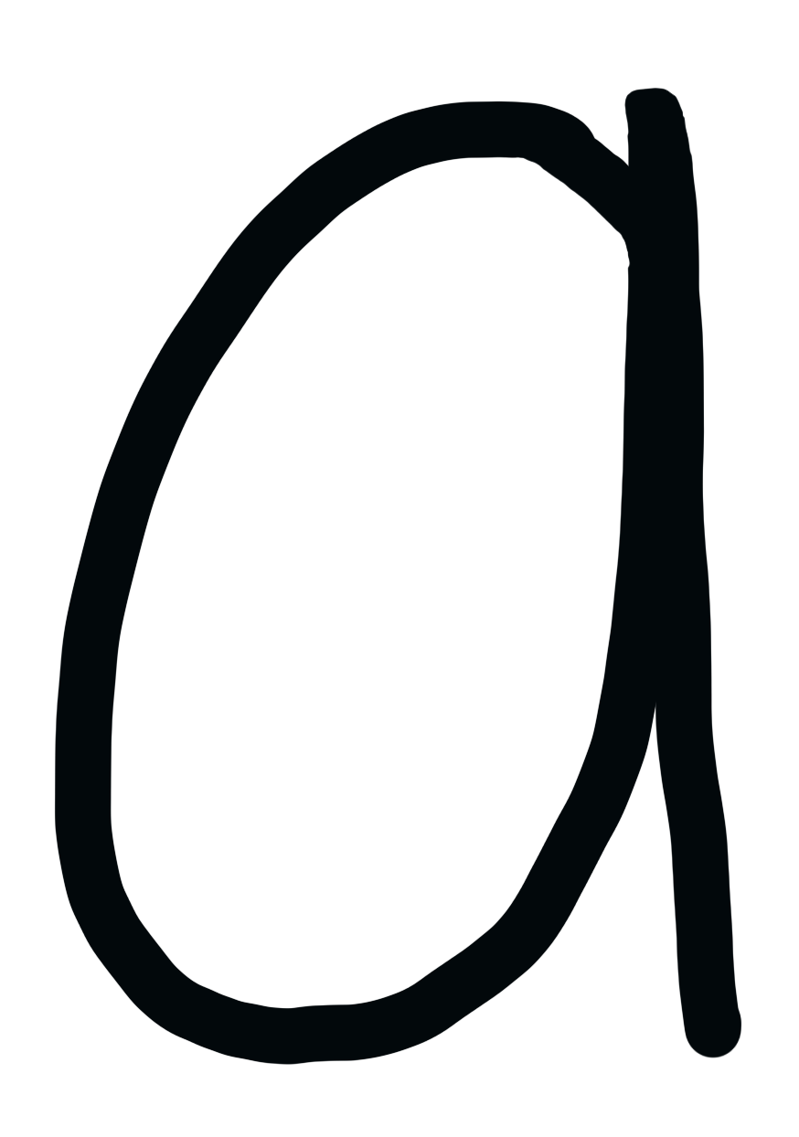

Slide 34
Notes:
Lowercase a gif

Slide 35
sat

Slide 36
at
as
mat
sad
map
had

Slide 37
has
at
bad

Slide 38
Notes:
See UFLI Foundations lesson plan Step 5 for words to spell.
Handwriting paper to model spelling.

Slide 39
Notes:
See UFLI Foundations lesson plan Step 5 for words to spell.
Handwriting paper for guided spelling practice.

Slide 41
Insert brief reinforcement activity and/or transition to next part of reading block.

Slide 42
Lesson 35a
Short A Review

Slide 44
New Concept Review
Notes:
See UFLI Foundations lesson plan Step 5 for recommended teacher language and activities to review the new concept.

Slide 45
a

Slide 46
cat
map
a

Slide 47
at
as
a

Slide 48
a

Slide 49
Notes:
Lowercase a gif

Slide 50
as
at
had
has

Slide 52
Notes:
See UFLI Foundations lesson plan Step 6 for word work activity.
Visit ufliteracy.org to access the Word Work Mat apps.

Slide 54
Notes:
See UFLI Foundations lesson plan Step 7 for irregular word activities.
The white rectangle under each word may be used in editing mode. Cover the heart and square icons then reveal them one at a time during instruction.

Slide 55
Notes:
See UFLI Foundations manual for more information about reviewing irregular words.

Slide 56
the
Notes:
Lessons 1-45
The digraph TH has not been introduced yet.
E represents the /ŭ/ or /ə/ sound depending on stress.
The white rectangle under the word may be used in editing mode. Cover the heart and square icons then reveal them one at a time during instruction.

Slide 57
I
Notes:
Lessons 3-65
*Temporarily irregular
I /ī/ has not been introduced yet.
The white rectangle under the word may be used in editing mode. Cover the heart and square icons then reveal them one at a time during instruction.

Slide 58
a
Notes:
Lesson 7+
A as a word can be pronounced /ā/ or /ŭ/.
The white rectangle under the word may be used in editing mode. Cover the heart and square icons then reveal them one at a time during instruction.

Slide 59
said
Notes:
Lesson 13+
AI represents the /ĕ/ sound.
The white rectangle under the word may be used in editing mode. Cover the heart and square icons then reveal them one at a time during instruction.

Slide 60
Notes:
Handwriting paper for irregular word spelling practice. Use as needed.
See UFLI Foundations manual for more information about reviewing irregular words.

Slide 62
Notes:
See UFLI Foundations lesson plan Step 8 for connected text activities.

Slide 63
The cat sat.

Slide 64
I had a map.

Slide 65
Dad has a bag.

Slide 66
Notes:
See UFLI Foundations lesson plan Step 8 for sentences to write.

Slide 67
Notes:
The UFLI Foundations decodable text is provided here. See UFLI Foundations decodable text guide for additional text options.

Slide 68
Bag of Hats and Caps
Jax has a big bag.
The bag has hats and caps in it.
Six hats and ten caps fit in the bag.
“Can I have a hat?” asks Gab.

Slide 69
“Yes, you can have a hat,” said Jax.
“Can I have a cap?” asks Kat.
“Yes, you can have a cap,” said Jax.
Gab and Kat are glad to have the hat and cap.

Slide 71
Insert brief reinforcement activity and/or transition to next part of reading block.

