Slide 1
Lesson 34
z /z/

Slide 2
Notes:
ufliteracy.org

Slide 4
Lesson 34
z /z/

Slide 6
Notes:
See UFLI Foundations lesson plan Step 1 for phonemic awareness activity.

Slide 8
Notes:
See UFLI Foundations lesson plan Step 2 for student phoneme responses.

Slide 9
v

Slide 10
qu

Slide 11
x

Slide 12
y

Slide 13
j

Slide 14
w

Slide 15
l

Slide 16
r

Slide 17
h

Slide 18
k

Slide 19
s

Slide 20
e

Slide 21
b

Slide 22
g

Slide 23
u

Slide 24
c

Slide 25
d

Slide 26
o

Slide 27
n

Slide 28
i

Slide 30
Notes:
See UFLI Foundations lesson plan Step 3 for auditory drill activity.

Slide 31
Notes:
No slides needed for auditory drill.

Slide 33
Notes:
See UFLI Foundations lesson plan Step 4 for blending drill word chain and grid.
Visit ufliteracy.org to access the Blending Board app.

Slide 35
Notes:
See UFLI Foundations lesson plan Step 5 for recommended teacher language and activities to introduce the new concept.

Slide 36
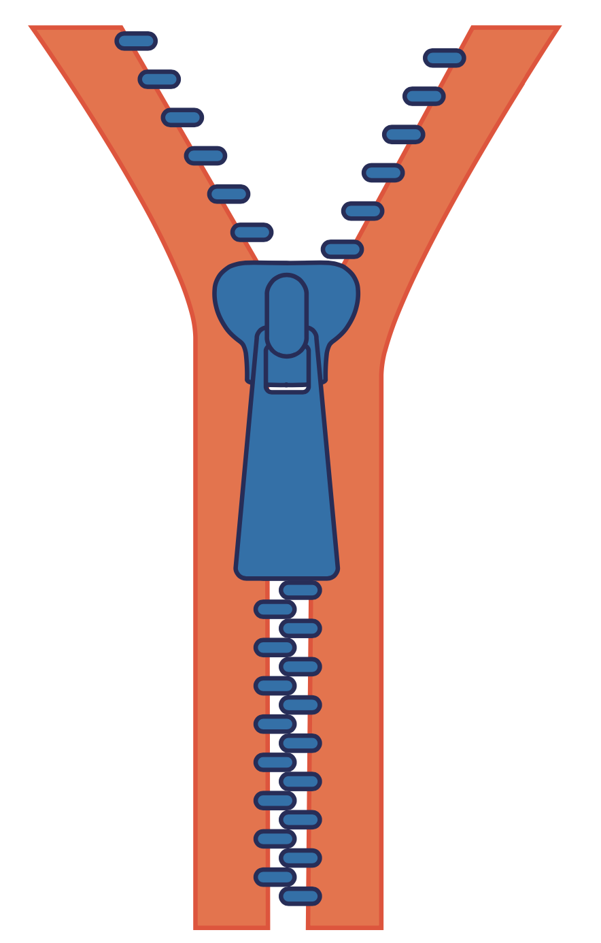
z

Slide 37
zip
zap
z

Slide 38
quiz
z

Slide 39
dogs
bugs

Slide 40
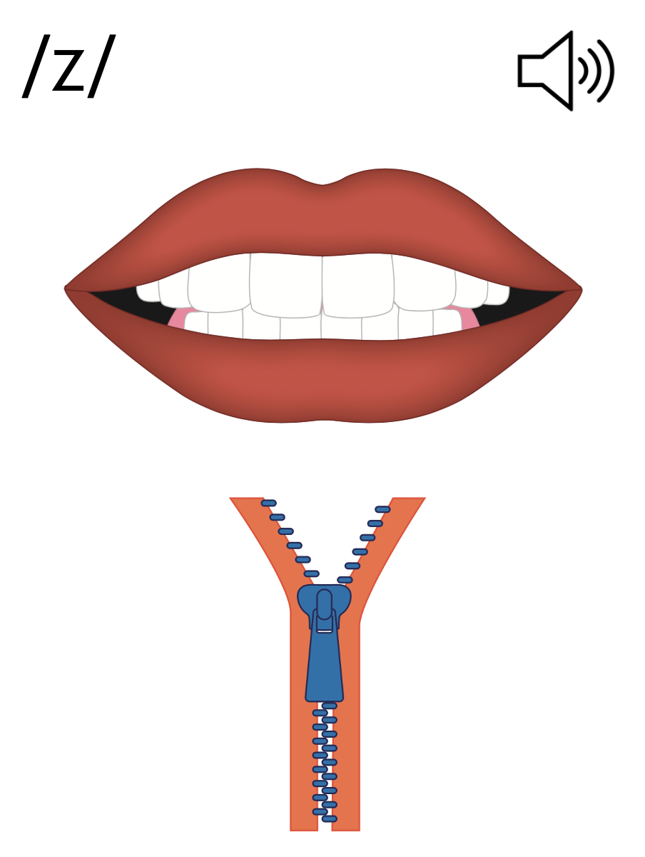
s
z

Slide 41
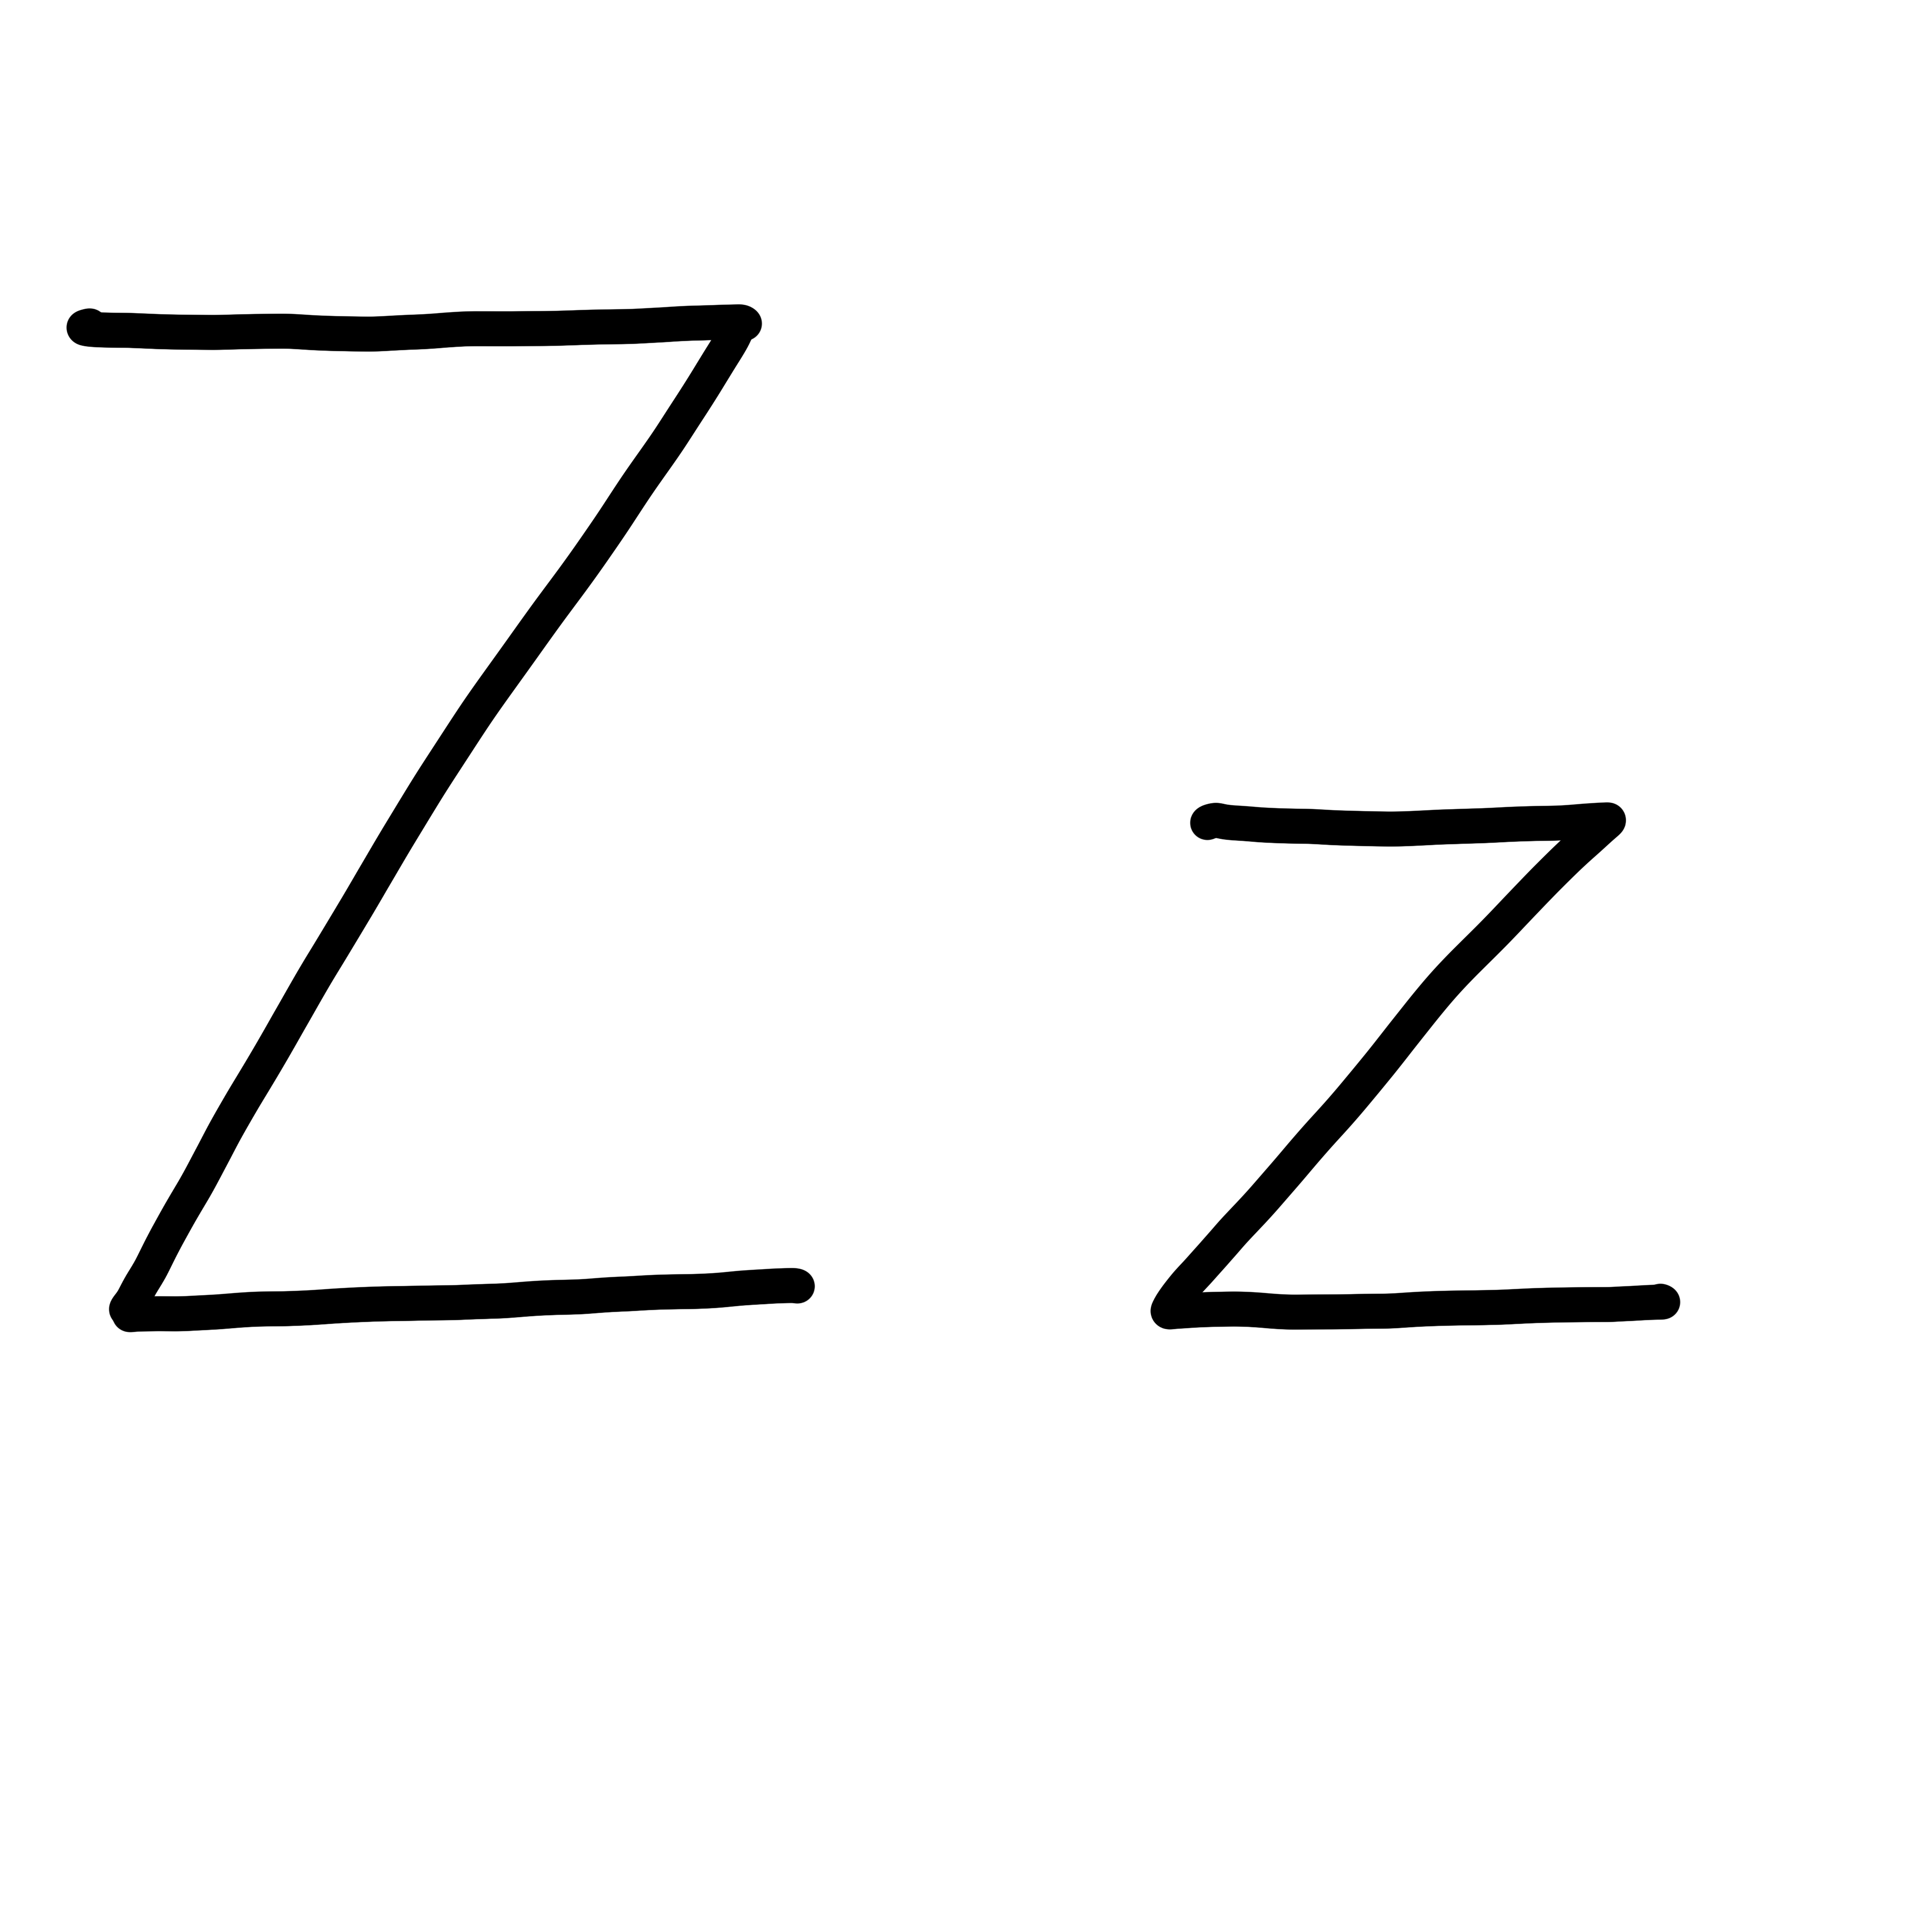

Slide 43
Notes:
Uppercase Z gif

Slide 45
Notes:
Lowercase z gif

Slide 46
zap

Slide 47
zap
zen
zit
zip
quiz
zest

Slide 48
Notes:
See UFLI Foundations lesson plan Step 5 for words to spell.
Handwriting paper to model spelling.

Slide 49
Notes:
See UFLI Foundations lesson plan Step 5 for words to spell.
Handwriting paper for guided spelling practice.

Slide 51
Insert brief reinforcement activity and/or transition to next part of reading block.

Slide 52
Lesson 34
z /z/

Slide 54
New Concept Review
Notes:
See UFLI Foundations lesson plan Step 5 for recommended teacher language and activities to review the new concept.

Slide 55
z

Slide 56
zip
zap
z

Slide 57
quiz
z

Slide 58
dogs
bugs

Slide 59
s
z

Slide 60
Notes:
Lowercase z gif

Slide 61
zip
zit
zap
quiz

Slide 63
Notes:
See UFLI Foundations lesson plan Step 6 for word work activity.
Visit ufliteracy.org to access the Word Work Mat apps.

Slide 65
Notes:
See UFLI Foundations lesson plan Step 7 for irregular word activities.
The white rectangle under each word may be used in editing mode. Cover the heart and square icons then reveal them one at a time during instruction.

Slide 66
Notes:
See UFLI Foundations manual for more information about reviewing irregular words.

Slide 67
are
Notes:
Lessons 27-76
AR /ar/ has not been introduced yet.
The final E is silent but does not follow the long vowel VCe pattern.
The white rectangle under the word may be used in editing mode. Cover the heart and square icons then reveal them one at a time during instruction.

Slide 68
was
Notes:
Lesson 29+
A represents the /ŭ/ sound.​
S /z/ has already been introduced.
The white rectangle under the word may be used in editing mode. Cover the heart and square icons then reveal them one at a time during instruction.

Slide 69
you
Notes:
Lessons 31-114
*Temporarily irregular
OU /ū/ has not been introduced yet.
The white rectangle under the word may be used in editing mode. Cover the heart and square icons then reveal them one at a time during instruction.

Slide 70
what
Notes:
Lessons 33-49
WH /w/ has not been introduced yet.
A represents the /ŭ/ sound or the /ŏ/ sound, depending on dialect.
The white rectangle under the word may be used in editing mode. Cover the heart and square icons then reveal them one at a time during instruction.

Slide 71
have
Notes:
Lessons 33-61
*Temporarily irregular
The final E is silent but does not follow the long vowel VCe pattern.
The silent E is there because English words can not end with the letter V.
The white rectangle under the word may be used in editing mode. Cover the heart and square icons then reveal them one at a time during instruction.

Slide 72
Notes:
Handwriting paper for irregular word spelling practice. Use as needed.
See UFLI Foundations manual for more information about reviewing irregular words.

Slide 74
Notes:
See UFLI Foundations lesson plan Step 8 for connected text activities.

Slide 75
Zed zips up the bag.

Slide 76
Zap the bug, Oz!

Slide 77
Did you do the quiz?

Slide 78
Notes:
See UFLI Foundations lesson plan Step 8 for sentences to write.

Slide 79
Notes:
The UFLI Foundations decodable text is provided here. See UFLI Foundations decodable text guide for additional text options.

Slide 80
Zip the Tent
Jaz and Zed went on a trip in a tent.
Jaz sets up the tent.
Zed helps.
“Look at the pond,” said Jaz.

Slide 81
“Let’s swim!”
Jaz and Zed jump in the pond to swim.
Jaz and Zed see lots of bugs.
“You have to zip up the tent,” said Jaz.

Slide 82
“If you zip it, the bugs do not get in.”
Zed runs to the tent to zip it up.
The bugs do not get in.

Slide 84
Insert brief reinforcement activity and/or transition to next part of reading block.

