Slide 1
Lesson 33
v /v/

Slide 2
Notes:
ufliteracy.org

Slide 4
Lesson 33
v /v/

Slide 6
Notes:
See UFLI Foundations lesson plan Step 1 for phonemic awareness activity.

Slide 8
Notes:
See UFLI Foundations lesson plan Step 2 for student phoneme responses.

Slide 9
qu

Slide 10
x

Slide 11
y

Slide 12
j

Slide 13
w

Slide 14
l

Slide 15
r

Slide 16
h

Slide 17
k

Slide 18
s

Slide 19
e

Slide 20
b

Slide 21
g

Slide 22
u

Slide 23
c

Slide 24
d

Slide 25
o

Slide 26
n

Slide 27
i

Slide 28
f

Slide 30
Notes:
See UFLI Foundations lesson plan Step 3 for auditory drill activity.

Slide 31
Notes:
No slides needed for auditory drill.

Slide 33
Notes:
See UFLI Foundations lesson plan Step 4 for blending drill word chain and grid.
Visit ufliteracy.org to access the Blending Board app.

Slide 35
Notes:
See UFLI Foundations lesson plan Step 5 for recommended teacher language and activities to introduce the new concept.

Slide 36
v

Slide 37
van
vet
v

Slide 38
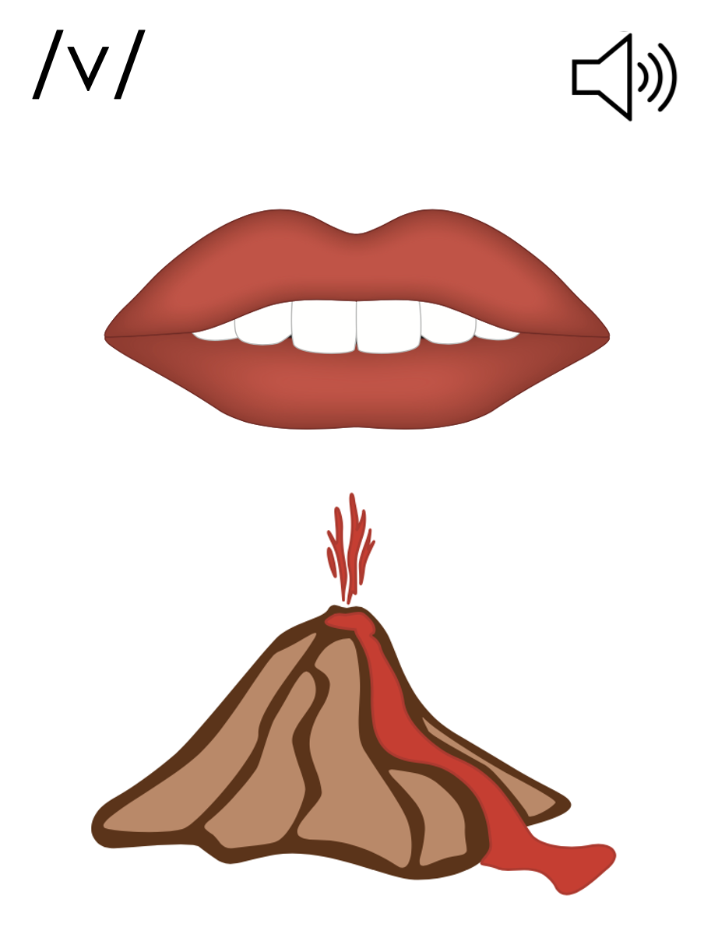
v

Slide 41
Notes:
Uppercase V gif

Slide 43
Notes:
Lowercase v gif

Slide 44
van
vest

Slide 45
vat
vet
vast
vent
vend
vest

Slide 46
Notes:
See UFLI Foundations lesson plan Step 5 for words to spell.
Handwriting paper to model spelling.

Slide 47
Notes:
See UFLI Foundations lesson plan Step 5 for words to spell.
Handwriting paper for guided spelling practice.

Slide 49
Insert brief reinforcement activity and/or transition to next part of reading block.

Slide 50
Lesson 33
v /v/

Slide 52
New Concept Review
Notes:
See UFLI Foundations lesson plan Step 5 for recommended teacher language and activities to review the new concept.

Slide 53
v

Slide 54
van
vet
v

Slide 55
v

Slide 56
Notes:
Lowercase v gif

Slide 57
vet
van
vast
vent

Slide 59
Notes:
See UFLI Foundations lesson plan Step 6 for word work activity.
Visit ufliteracy.org to access the Word Work Mat apps.

Slide 61
Notes:
See UFLI Foundations lesson plan Step 7 for irregular word activities.
The white rectangle under each word may be used in editing mode. Cover the heart and square icons then reveal them one at a time during instruction.

Slide 62
Notes:
See UFLI Foundations manual for more information about reviewing irregular words.

Slide 63
are
Notes:
Lessons 27-76
AR /ar/ has not been introduced yet.
The final E is silent but does not follow the long vowel VCe pattern.
The white rectangle under the word may be used in editing mode. Cover the heart and square icons then reveal them one at a time during instruction.

Slide 64
was
Notes:
Lesson 29+
A represents the /ŭ/ sound.​
S /z/ has already been introduced.
The white rectangle under the word may be used in editing mode. Cover the heart and square icons then reveal them one at a time during instruction.

Slide 65
you
Notes:
Lessons 31-114
*Temporarily irregular
OU /ū/ has not been introduced yet.
The white rectangle under the word may be used in editing mode. Cover the heart and square icons then reveal them one at a time during instruction.

Slide 66
Notes:
Handwriting paper for irregular word spelling practice. Use as needed.
See UFLI Foundations manual for more information about reviewing irregular words.

Slide 67
Teach
Notes:
The orange star indicates these are new irregular words that need to be introduced.
See UFLI Foundations manual for more information about teaching irregular words.

Slide 68
what
Notes:
Lessons 33-49
WH /w/ has not been introduced yet.
A represents the /ŭ/ sound or the /ŏ/ sound, depending on dialect.
The white rectangle under the word may be used in editing mode. Cover the heart and square icons then reveal them one at a time during instruction.

Slide 69
have
Notes:
Lessons 33-61
*Temporarily irregular
The final E is silent but does not follow the long vowel VCe pattern.
The silent E is there because English words can not end with the letter V.
The white rectangle under the word may be used in editing mode. Cover the heart and square icons then reveal them one at a time during instruction.

Slide 70
Notes:
Handwriting paper for irregular word spelling practice. Use as needed.
See UFLI Foundations manual for more information about teaching irregular words.

Slide 72
Notes:
See UFLI Foundations lesson plan Step 8 for connected text activities.

Slide 73
The dog was at the vet.

Slide 74
Did Vic have his vest on?

Slide 75
What did you and Vin do?

Slide 76
Notes:
See UFLI Foundations lesson plan Step 8 for sentences to write.

Slide 77
Notes:
The UFLI Foundations decodable text is provided here. See UFLI Foundations decodable text guide for additional text options.

Slide 78
What is a Vet?
What can vets do?
Vets help pets.
Can a vet help a dog?
Yes, a vet can help a dog.

Slide 79
Can a vet help a cat?
Yes, a vet can help lots of pets.
Can a vet help kids?

Slide 80
No, a vet can not help kids.
Vets just help pets.
Vets have a fun job.

Slide 82
Insert brief reinforcement activity and/or transition to next part of reading block.

