Slide 1
Lesson 24
r /r/ Part 1

Slide 2
Notes:
ufliteracy.org

Slide 4
Lesson 24
r /r/ Part 1

Slide 6
Notes:
See UFLI Foundations lesson plan Step 1 for phonemic awareness activity.

Slide 8
Notes:
See UFLI Foundations lesson plan Step 2 for student phoneme responses.

Slide 9
h

Slide 10
k

Slide 11
s

Slide 12
e

Slide 13
b

Slide 14
g

Slide 15
u

Slide 16
c

Slide 17
d

Slide 18
o

Slide 19
n

Slide 20
i

Slide 21
f

Slide 22
p

Slide 23
t

Slide 24
m

Slide 25
a

Slide 27
Notes:
See UFLI Foundations lesson plan Step 3 for auditory drill activity.

Slide 28
Notes:
No slides needed for auditory drill.

Slide 30
Notes:
See UFLI Foundations lesson plan Step 4 for blending drill word chain and grid.
Visit ufliteracy.org to access the Blending Board app.

Slide 32
Notes:
See UFLI Foundations lesson plan Step 5 for recommended teacher language and activities to introduce the new concept.

Slide 33
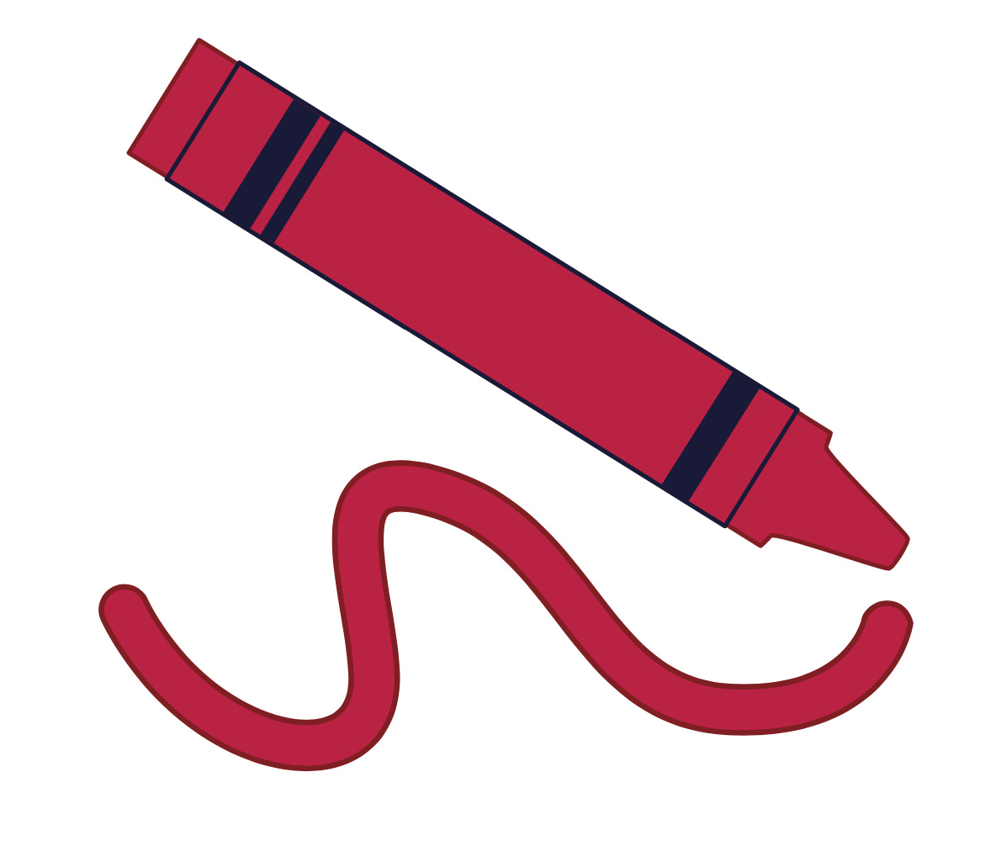
r

Slide 34
rat
run
r

Slide 35
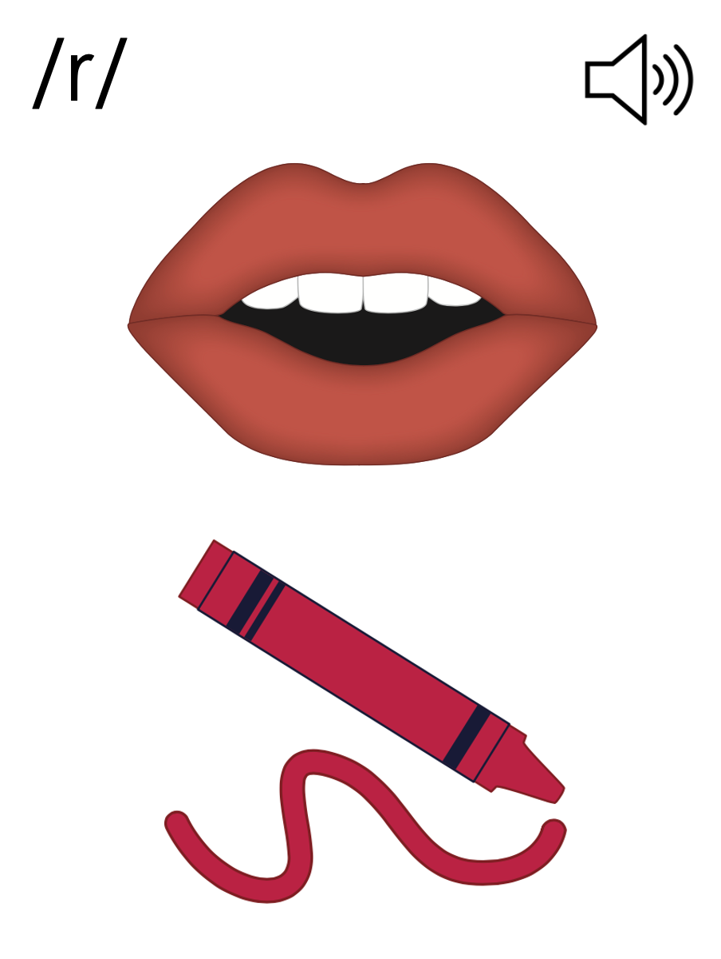
r

Slide 36
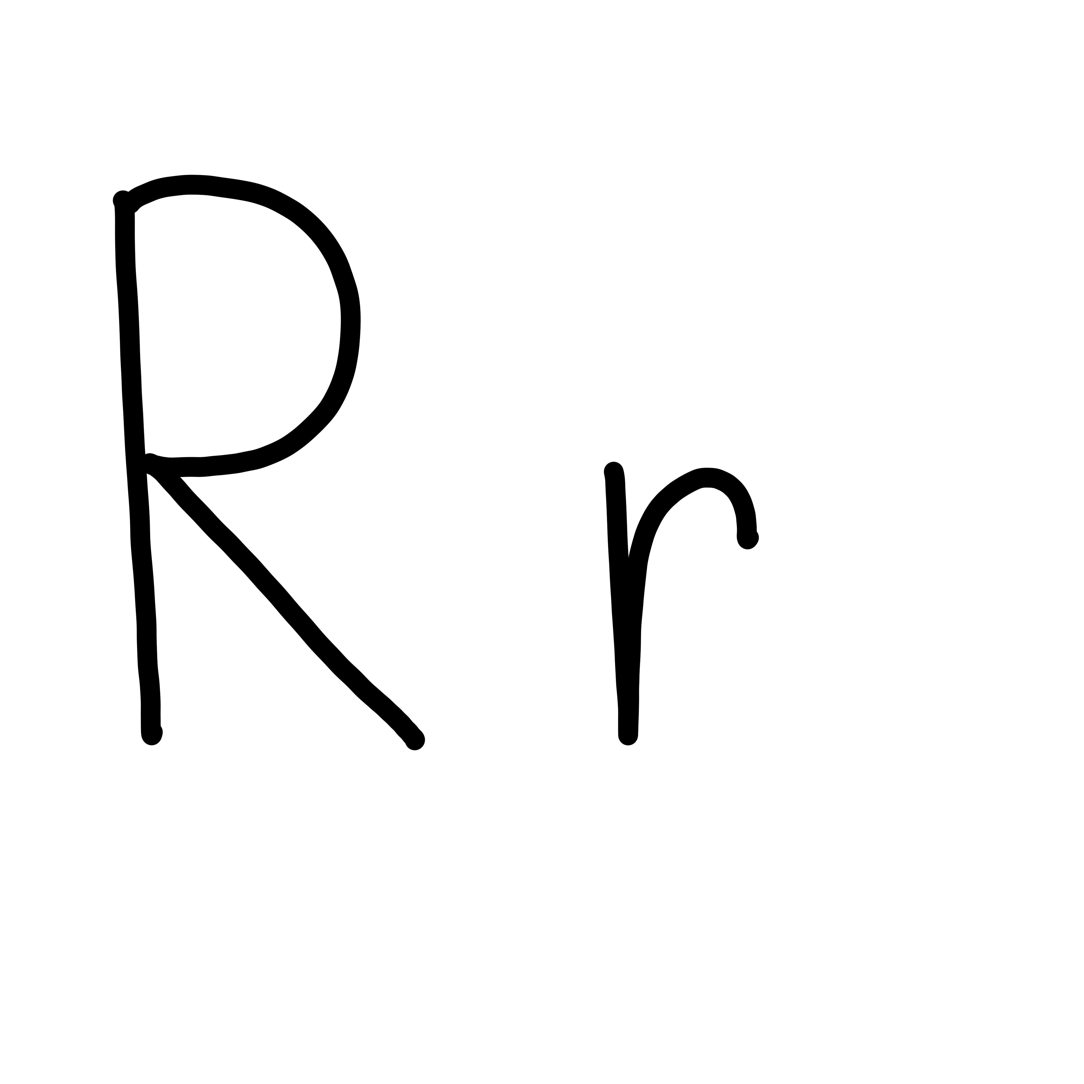

Slide 38
Notes:
Uppercase R gif

Slide 40
Notes:
Lowercase r gif

Slide 41
rim
raft

Slide 42
run
rap
rug
ran
rip
red

Slide 43
rods
rent
rust

Slide 44
Notes:
See UFLI Foundations lesson plan Step 5 for words to spell.
Handwriting paper to model spelling.

Slide 45
Notes:
See UFLI Foundations lesson plan Step 5 for words to spell.
Handwriting paper for guided spelling practice.

Slide 47
Insert brief reinforcement activity and/or transition to next part of reading block.

Slide 48
Lesson 24
r /r/ Part 1

Slide 50
New Concept Review
Notes:
See UFLI Foundations lesson plan Step 5 for recommended teacher language and activities to review the new concept.

Slide 51
r

Slide 52
rat
run
r

Slide 53
r

Slide 54
Notes:
Lowercase r gif

Slide 55
run
red
ran
rest

Slide 57
Notes:
See UFLI Foundations lesson plan Step 6 for word work activity.
Visit ufliteracy.org to access the Word Work Mat apps.

Slide 59
Notes:
See UFLI Foundations lesson plan Step 7 for irregular word activities.
The white rectangle under each word may be used in editing mode. Cover the heart and square icons then reveal them one at a time during instruction.

Slide 60
Notes:
See UFLI Foundations manual for more information about reviewing irregular words.

Slide 61
of
Notes:
Lesson 17+
O represents the /ŭ/ sound.
F represents the /v/ sound.
The white rectangle under the word may be used in editing mode. Cover the heart and square icons then reveal them one at a time during instruction.

Slide 62
see
Notes:
Lessons 19-84
*Temporarily irregular
EE /ē/ has not been introduced yet.
The white rectangle under the word may be used in editing mode. Cover the heart and square icons then reveal them one at a time during instruction.

Slide 63
he
Notes:
Lessons 23-65
*Temporarily irregular
E /ē/ has not been introduced yet.
The white rectangle under the word may be used in editing mode. Cover the heart and square icons then reveal them one at a time during instruction.

Slide 64
be
Notes:
Lessons 23-65
*Temporarily irregular
E /ē/ has not been introduced yet.
The white rectangle under the word may be used in editing mode. Cover the heart and square icons then reveal them one at a time during instruction.

Slide 65
me
Notes:
Lessons 23-65
*Temporarily irregular
E /ē/ has not been introduced yet.
The white rectangle under the word may be used in editing mode. Cover the heart and square icons then reveal them one at a time during instruction.

Slide 66
Notes:
Handwriting paper for irregular word spelling practice. Use as needed.
See UFLI Foundations manual for more information about reviewing irregular words.

Slide 68
Notes:
See UFLI Foundations lesson plan Step 8 for connected text activities.

Slide 69
Rob ran to me.

Slide 70
Did he see the rat?

Slide 71
He got rid of the rags.

Slide 72
Notes:
See UFLI Foundations lesson plan Step 8 for sentences to write.

Slide 73
Notes:
The UFLI Foundations decodable text is provided here. See UFLI Foundations decodable text guide for additional text options.

Slide 74
The Red Cat and the Rate
The red cat sees a rat.
The rat runs.
The red cat runs to get the rat.
The rat is fast.

Slide 75
The red cat is not as fast.
The rat runs to a raft.
The rat got on the raft.

Slide 76
The red cat did not fit on the raft.
The rat got rid of the red cat.

Slide 78
Insert brief reinforcement activity and/or transition to next part of reading block.

