Slide 1
3rd Grade Sample Schedule
Stay in my area.
Follow directions the first time.
☺
Have fun!

Slide 2
Visual Drill
a

Slide 3
au

Slide 4
ie

Slide 5
ew

Slide 6
oi

Slide 7
oy

Slide 8
wr

Slide 9
oo

Slide 10
kn

Slide 11
ue

Slide 12
mb

Slide 13
ou

Slide 14
aw

Slide 15
gn

Slide 16
ow

Slide 17
3rd Grade Sample Schedule
Stay in my area.
Follow directions the first time.
☺
Have fun!

Slide 18
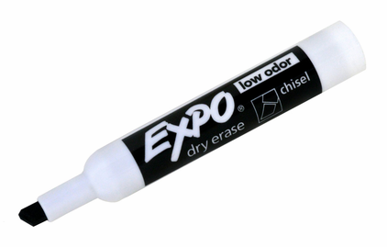
Auditory Drill
a
Notes:
Options:
Students use whiteboard.
Students use “Whiteboard” screen sharing and “Annotate” options on videoconferencing platform.
Students use paper and writing tool.

Slide 19
3rd Grade Sample Schedule
Stay in my area.
Follow directions the first time.
☺
Have fun!

Slide 20
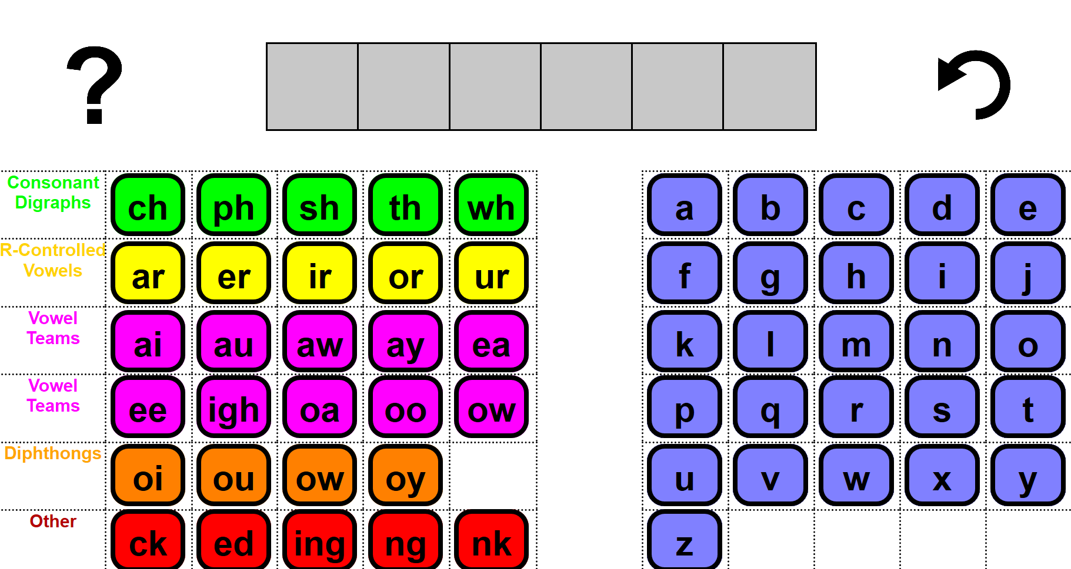
Word Work Mat
Notes:
https://research.dwi.ufl.edu/op.n/file/gc8nkxns914enc7d/embed?fbclid=IwAR1OiYiB6fERCg-3wSWOPc0QZh4cmzyZ7wdO7f__fU2c4trzyanvj1xebko

Slide 21
3rd Grade Sample Schedule
Stay in my area.
Follow directions the first time.
☺
Have fun!

Slide 22
Morphemes

Slide 23
s
ed
ing
er
ation
al
in
re
de
form
to shape
Notes:
Form is a free morpheme meaning to shape.
forms, formed, forming, former, formation, formal, inform, reform, deform, informs, informed, informing, informer, information, informal, reforms, reformed, reforming, reformer, reformation, deforms, deformed, deforming, deformer, deformation

Slide 24
3rd Grade Sample Schedule
Stay in my area.
Follow directions the first time.
☺
Have fun!

Slide 25
Irregular Words
you

Slide 26
guy

Slide 27
guess

Slide 28
guest

Slide 29
business

Slide 30
guide

Slide 31
journey

Slide 32
guard

Slide 33
machine

Slide 34
journal

Slide 35
sign

Slide 36
muscle

Slide 37
answer

Slide 38
Wednesday
Notes:
New

Slide 39
February
Notes:
New

Slide 40
3rd Grade Sample Schedule
Stay in my area.
Follow directions the first time.
☺
Have fun!

Slide 41
Connected Text

Slide 42
Notes:
One student reads aloud; other students can have a 1-minute doodle break or read with muted microphone
Use Teacher version to score

Slide 58
3rd Grade Sample Schedule
Stay in my area.
Follow directions the first time.
☺
Have fun!

Slide 59
Sentence Writing
The cat is on
the mat.

Slide 60
C
Capitalization
The dog runs.
A
Appearance
My sentence looks great!
P
Punctuation
. ? !
S
Spelling

Slide 62
3rd Grade Sample Schedule
Stay in my area.
Follow directions the first time.
☺
Have fun!

Slide 63
You did it!
Insert reinforcing activity

