Slide 1
Morpheme Trees
Activity:
Review the meanings of each prefix and suffix.
Guide students in reading the root, and discuss its meaning.
Guide student(s) in reading each word in the branches, and determine what it means based on the meanings of its roots and affixes.
Optional: Form sentences using the new words (orally or in writing).
Notes:
Some of the definitions based on the morphemes are not quite clear. It is best to use the student friendly definitions.

Slide 2
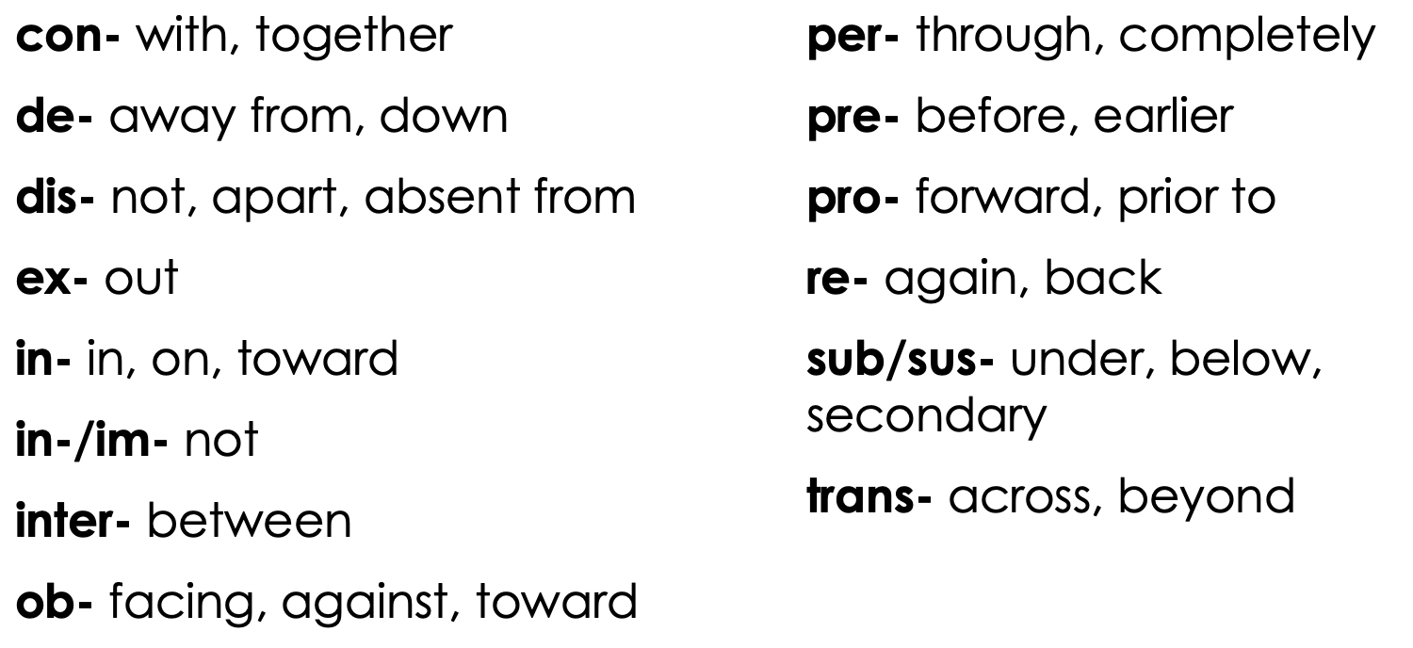
Prefix Definitions

Slide 3
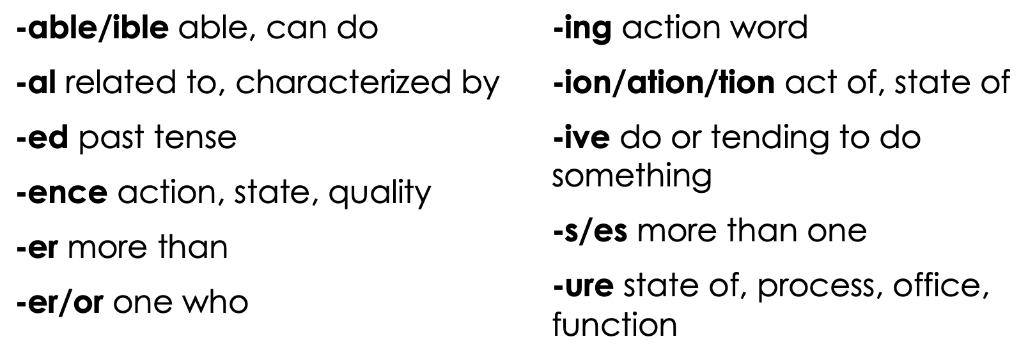
Suffix Definitions

Slide 4
deformation
reform
informed
informer
inform
reforming
deform
information
to shape
form
Notes:
Morpheme based definitions, followed by student-friendly explanations of each word:
Inform-to shape to. When you inform someone you give knowledge/information to them
Reform- to shape again. When something is reformed it is changed to a better way/shape/state
Deformation- the act of shaping away from. When something goes through deformation it is changed in a negative way.
Informer- someone who shapes to. An informer is someone who gives knowledge/info
Informed- to have already shaped to. When someone is informed, they have already been given knowledge/info

Slide 5
portable
report
deportation
reporter
portal
deported
import
deportable
to carry
port
Notes:
Morpheme based definitions, followed by student-friendly explanations of each word:
Report- to carry back. A report is something that describes another thing in detail
Deported- to have already carried away. Someone who is deported is sent away from the country forcibly/by law
Import- to carry in. Something that is an import is brought into the country
Reporter- someone who carries back. A reporter is someone who describes another thing in detail
Portable- able to carry. Something that is portable is easily carried or able to be moved
Deportation- state of carrying away. Deportation is when someone is sent away from the country by law
Portal- related to carrying. A portal is a door or gate to another place
Deportable- be able to carry away. When something is deportable, you can send it away from a place by law

Slide 6
subjected
reject
conjecture
projection
inject
dejected
projectile
objective
to throw
ject
Notes:
Morpheme based definitions, followed by student-friendly explanations of each word:
Reject- to throw back, when you reject something you do not take it or sent it away
Inject- to throw in, when you inject something, you push something in like a liquid into the body or a point into the conversation
Subjected- past tense of throwing under. When you are subjected to a certain person or situation, you are under the control of that person or situation
Projection- the act of throwing forward. A projection is when something like an image or your voice is made bigger.
Projectile- pertaining to throwing forward. A projectile is something that is thrown like a ball or a paper airplane.
Conjecture- the state of throwing with/together. A conjecture is an opinion or theory that is formed, like a guess
Dejected- to throw away past tense. When someone is feeling dejected they would be feeling sad and put down
Objective- to throw toward. An objective is a goal or purpose you are working toward

Slide 7
disruption
interrupt
eruption
disruptive
interruptible
disrupt
erupt
interrupted
To break or bust
rupt
Notes:
Morpheme based definitions, followed by student-friendly explanations of each word:
Disrupt- to break apart. When you disrupt something, you break it up or ruin it temporarily
Interrupt- to break between. When you interrupt someone, you break up something in the middle of it like when someone is talking.
Erupt- to break or burst out. When something erupts, something explodes out of it
Disruptive- tending to break apart. When someone is being disruptive, they are breaking apart or temporarily ruining what is supposed to be going on
Disruption- the state of breaking apart. When there is a disruption, what you are doing is broken up or temporarily ruined
Eruption- the state of busting out. When there is an eruption, something is busting or exploding out
Interrupted- past tense of being able to break or bust. When you are interrupted, something
Interruptible- able to break or bust between or within. When something is interruptible, it is to break it up.

Slide 8
detracted
retract
detraction
retractable
distraction
distract
subtraction
retractor
To draw or put
tract
Notes:
Morpheme based definitions, followed by student-friendly explanations of each word:
Retract- to draw back. When you retract something, you bring it back or take it back.
Distract- to draw apart. When you distract someone you try pull their attention away from what they are doing.
Detracted- past tense to draw away. When a pieced is detracted, it is taken away from the whole.
Retractable- able to draw back. When something is retractable, you are able to take it away or take it back.
Subtraction- the act of drawing under. When you are doing subtraction, you are taking away from the whole.
Detraction- the act of drawing away. A detraction would be when you are talking back about someone or taking away from their reputation
Distraction- the act of drawing apart. When you are a distraction, you are making it so others can't focus.
Retractor- someone who draws back. When someone is a retractor, they take things back

Slide 9
prescription
scripted
subscript
description
prescriber
describe
inscribe
inscription
to write
scrib or script
Notes:
Morpheme based definitions, followed by student-friendly explanations of each word:
Scripted- writing in the past tense. When something is scripted, it has already been written out.
Prescriber- someone who writes before. Someone who is a prescriber is the person who lays out the rules or the writes the plan of action.
Prescription- the act of writing before. A prescription is a written direction, normally from a doctor.
Description- the act of writing apart or to. When you are saying a description of something you are explaining it.
Inscribe- to write in, When you inscribe something. you write on it, mostly to another person
Subscript- to write below. A subscript is when there is writing below the normal line of writing (a visual example would be best)
Describe- to write down. When you describe something, you explain details about it.
Inscription- the state of writing in. An inscription is a statement written in an object (visual example would be helpful)

Slide 10
inspector
inspect
inspecting
inspection
respect
respective
suspect
respectable
to see, look, watch, or observe
spect
Notes:
Morpheme based definitions, followed by student-friendly explanations of each word:
Inspect- to observe in. When you inspect something you look at it closely
Respect- to look back at. When you respect someone, you think highly of them
Inspector- someone who watches or observes in. An inspector is someone is looks closely into something.
Inspection- the act of observing on. When an inspection occurs, someone is checking out something very closely
Suspect- to watch under. A suspect is someone that you think is guilty/ When you suspect someone you think they did it, are guilty.
inspecting- seeing in. When I am inspecting something, I am looking into it closely
Respective- tending to see again. When I talk about the respective traits of different jobs, I am talking about the traits that the individual jobs each need.
Respectable- able to watch again. Something that is respectable is something that is seen as good or okay to watch/listen/do.

Slide 11
deconstruct
construct
constructor
instructing
destructive
instruct
instructor
construction
to build
struct
Notes:
Morpheme based definitions, followed by student-friendly explanations of each word:
Construct- to build with, When you construct something you build it
Instruct- to build in, When you instruct someone, you teach them about a topic.
Deconstruct- to do the opposite of building with. When you deconstruct something, you take it apart
Instructing- the act of building in. When you are instructing someone, you are teaching them
Instructor- someone who builds in. When you are an instructor you are the one who is teaching.
Constructor- someone who builds with. When you are a constructor, you are the one building something
Destructive- tending to build apart/break down. When you are acting destructive, you are messing things up or breaking things apart.
Construction- the act of building with. When something is under construction, it is in the process of getting built.

Slide 12
deflection
inflect
inflecting
deflected
reflex
reflective
flexing
reflective
to bend or curve
flect or flex
Notes:
Morpheme based definitions, followed by student-friendly explanations of each word:
Inflect- to bend in. When you inflect your voice, you change it up and down.
Reflex- to bend again. A reflex is something you do in reaction to another event.
Deflection- the act of bending away. A deflection is when you change the direction of an object or a conversation
Deflected- past tense of bending away. When something is deflected, its direction is changed.
Flexing- the action of bending. When you are flexing, you are bending your arm or leg to show your muscle.
Inflecting- the action of bending in. When you are inflecting your words, you are changing your voice at different points, putting an emphasis on different places.
Reflective- tending to bend again. When a surface is reflective, you can see yourself in it. OR when you are being reflective, you are thinking about what you have already done.

Slide 13
predictable
diction
indicting
interdiction
predict
interdicts
indictable
predictive
to say or tell
dict
Notes:
Morpheme based definitions, followed by student-friendly explanations of each word:
Diction- the act of saying or telling. Diction is the way you speak.
Predict- to say before. When you predict something you say what is going to happen before it happens.
Predictable- able to say before. When something is predictable, it is easy to guess what is going to happen.
Interdiction- the act of saying within. An interdiction is when you try to stop something or someone, normally an enemy.
Indictable- being able to say or tell in. When you are indictable, you are able to be accused of doing something, normally against the law.
Indicting- the action of telling on. When you are indicting somone, you are accusing them of doing something illegal.
Interdicts- to say within. A leader of a group will interdict when they want to make to make sure the group doesn't do something.
Predictive- tending to say before. When something is predictive, it tends to show what might happen next (ex: predictive text)

Slide 14
referral
referred
transferring
transferrable
infer
reference
defer
preferable
to bear or yield
fer
Notes:
Morpheme based definitions, followed by student-friendly explanations of each word:
Referred- past tense of to bear back. When you are referred for something like a job, someone tells the person you can do it. Or to bring someone's attention to somewhere
Infer- to bear on. When you infer something, you make an educated guess using clues.
Referral- related to bearing back. When you get a referral, someone tells you something you would like or enjoy.
Transferrable- being able to bear across. When something is transferrable, you are able to give it to someone else.
Defer- to bear away. When you defer something, you set it aside to do another time or have someone else do it for you.
Transferring- the action of bearing across. When you are transferring something, you are moving it to another place or giving it to another person.
Reference- the action of bearing again. A reference is something you look at to help you explain something.
Preferable- able to bear before. When something is preferable, you like it better than other things.

Slide 15
transmission
remissible
submitted
remit
submission
transmit
dismiss
dismissible
to send
mit or miss
Notes:
Morpheme based definitions, followed by student-friendly explanations of each word:
Remissible- being able to send back. Something that is remissible can be sent to someone.
Transmit- to send across. You transmit something you send it or pass it to someone else.
Transmission- the act of sending across. The act of sending something to someone else.
Remit- to send back. If you remit something to someone, you send it to them.
Dismiss- to send apart. When you dismiss something, you allow them to leave
Submitted- past tense of to send under. When you have submitted something, such as an assignment, you have turned it in.
Submission- the act of sending under. When you are required to do a submission, you have to turn something in.
Dismissible- able to send apart. When something is disimissible, it is easy to forget it or send it away.

Slide 16
deducting
product
conductor
education
reduce
productive
conducts
induction
to lead
duce or duct
Notes:
Morpheme based definitions, followed by student-friendly explanations of each word:
Product- to lead forward. A product is something that you make.
Reduce- to lead again. When you reduce something, you make it smaller or less.
Deducting- action of leading down or away. When you are deducting something, you are taking a certain amount away.
Education- The act of leading out. Education involves teaching people various subjects, or leading them to learn.
Conducts- to lead with. When you conduct something, you are the one in leading the group.
Conductor- someone who leads with. A conductor is the leader of a group.
Productive- tending to lead forward. When you are being productive, you are getting a lot of stuff done.
Induction- the act of leading in. When you are attending an induction, you are seeing someone get included into a group for the first time.

Slide 17
converting
version
subversive
inverted
revert
reversed
inverse
subversion
to turn
vers or vert
Notes:
Morpheme based definitions, followed by student-friendly explanations of each word:
Version- the state of turning. A version of something is a form of it.
Revert- to turn again. When you revert something you return it to a previous form.
Converting- action of turning with. When you are converting something, you are changing it to a new form.
Inverted- past tense of turning in. When something is inverted, you turn it upside down or inside out.
Inverse- to turn in. When something is the inverse, it is the opposite of something else.
Subversive- tending to turn under. When something is subversive, it tends to undermine what is going on.
Reversed- past tense of turning back. When something is reversed, it is backwards or changed back.
Subversion- the act of turning under. A subversion is when you overthrow or undermine someone else.

Slide 18
perfect
defective
fictional
perfection
infect
defector
factor
infection
to make or do
fact, fect, fict
Notes:
Morpheme based definitions, followed by student-friendly explanations of each word:
Defective- tending to do down. If something is defective, there is something wrong with it and it does not work properly.
Infect- to do in. When you infect someone, you give them something bad, most often a sickness.
Perfect to make completely. Something that is perfect is as good as it could possibly be.
Perfection- the act of making completely. When you describe something as perfection, it does not have anything wrong with it.
Factor- one who makes. A factor is one piece of the rest of the situation or result.
Fictional- related to the act of making. When something is fictional, it is made up.
Defector- one who makes apart. When you are a defector, you leave the rest of the group.
Infection- the act of doing in/on. When you have an infection, you have a sickness.

Slide 19
contender
contend
distended
tension
intend
intensive
pretense
intention
to stretch or strain
tend, tent, tens
Notes:
Morpheme based definitions, followed by student-friendly explanations of each word:
Contend- to stretch with. If you have to contend with a problem or difficulty, you have to deal with it or overcome it.
Intend- to stretch toward. When you intend to do something, you mean to do it, or you are leaning toward doing it.
Contender- someone who stretches with. When you are a contender, you have a chance to win.
Tension- the act of straining. When there is tension, something is stretched tight.
Pretense- to stretch or strain before. A pretense is when you are pretending, or stretching the truth.
Distended- past tense to stretch apart. When something is distended, it is bigger than it should be, swollen.
Intensive- relating to stretching toward. When something is intensive it is an extreme situation.
Intention- the act of stretching toward. When you have an intention, you mean to do it, or you are leaning toward doing it.

Slide 20
deceiver
receive
deceptive
receptive
deceit
exception
perceived
interception
to take or catch
ceit, ceive, cept
Notes:
Morpheme based definitions, followed by student-friendly explanations of each word:
Receive- to take back. When you receive something, you get it after someone gives it to you or sends it to you.
Deceit- to take away from. A deceit is a lie or lead someone to the wrong idea or away from the truth.
Deceiver- someone who takes away from. A deceiver is someone who lies or tricks you to believe something incorrect.
Receptive- tending to take again. When you are receptive to a situation, you believe it or easily take it in.
Perceived- past tense to take thoroughly. Something that has been perceived is something that you are aware of or recognized.
Deceptive- tending to take away from. When you are acting deceptive, you are trying to trick someone.
Exception- state of taking out. An exception is a particular thing, person, or situation that is not included in a general statement, judgment, or rule.
Interception- the act of taking between. If you intercept someone or something that is travelling from one place to another, you stop them before they get to their destination.

Slide 21
detention
retain
contention
pertained
sustainable
contain
retainer
retention
to hold
tain, ten, tin
Notes:
Morpheme based definitions, followed by student-friendly explanations of each word:
Retain- to hold back. When you retain something, you keep it.
Contain- to hold with. When something is contained, it is held in something.
Detention- the act of holding apart. When you are in detention, you are held apart from the rest of the group, often because you are in trouble.
Pertained- past tense of to hold through. When something pertains to something else, it is related to it.
Retainer- something that holds again. A person or thing that holds other things.
Contention- the act of holding with. When you are in contention with someone, you are struggling against them.
Sustainable- able to be held under, or up from below. When something is sustainable, you can keep it going.
Retention- the act of holding back. The retention of something is when it is being held back.

Slide 22
proposition
compose
exposer
compounding
impound
expounded
impose
proposing
to put in place or set
pos or pound
Notes:
Morpheme based definitions, followed by student-friendly explanations of each word:
Compose- to put together. When you compose something, you put different things together in a good way.
Impound- to put in place. When something gets impounded, it gets taken into a closed off place.
Proposition- the act of putting in place prior to. A proposition is something that is offered to someone else to take.
Compounding- the action of putting together. When multiple things are compounding, they are getting put together.
Impose- to put in place. When you impose something on someone else, you make them take it or deal with it.
Exposer- Someone who sets out. If you are an exposer, you are showing everyone the secrets.
Expounded- past tense of putting out. When something is expounded on, it is explained in detail
Proposing- Putting in place in advance. If you propose something such as a plan or an idea, you suggest it for people to think about and decide upon.

