Slide 1
Grapheme Introduction
e

Slide 2
Grapheme Introduction
Activity:
Introduce the new grapheme and connect it with its corresponding phoneme.
Explain where it might appear in words (beginning, middle or end).
Demonstrate with sample words.
Read new words.
Select practice game and/or words from corresponding word lists or word card files to add for practice.

Slide 3
e
Notes:
This is the letter E. E is a vowel. E says /ĕ/ like in the beginning of the word edge.

Slide 4
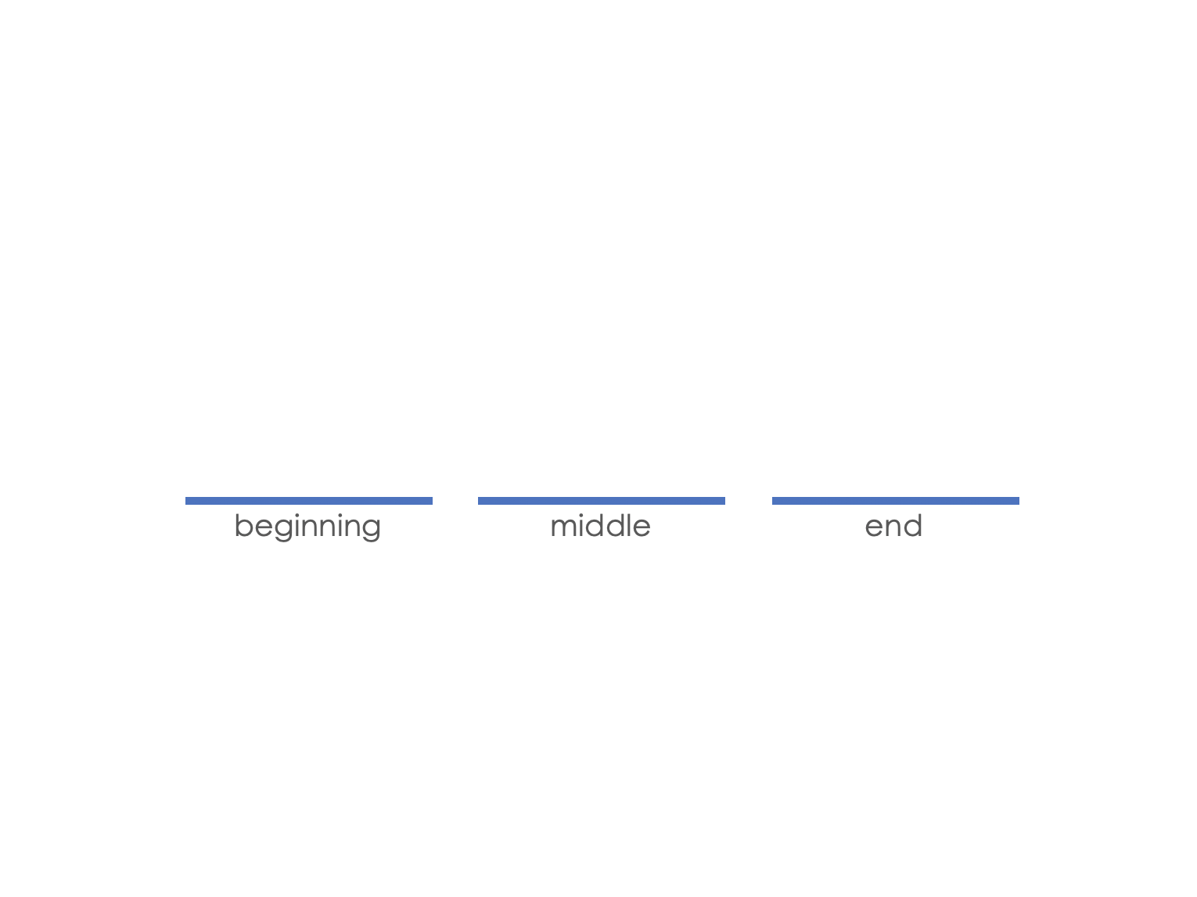
e
Notes:
The letter E can come in the middle of a word, such as the words…

Slide 5
met
e
Notes:
met…

Slide 6
met
bed
e
Notes:
and bed.

Slide 7
e
Notes:
The letter E can also come at the beginning of a word, such as the words…

Slide 8
end
e
Notes:
end…

Slide 9
end
elf
e
Notes:
and elf.

Slide 10
e
set
get
ten
bet
Notes:
Guided Practice:
E says /ĕ/… your turn (students: E says /ĕ/). Let’s practice reading some words with /ĕ/ in the middle.

Slide 11
Insert a word reading practice activity here
(see next slide for examples).

Slide 12
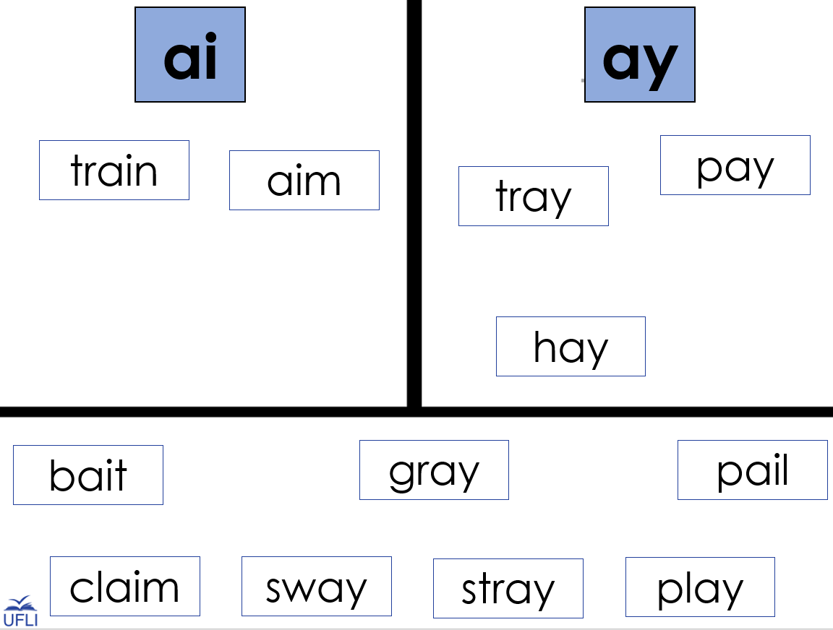
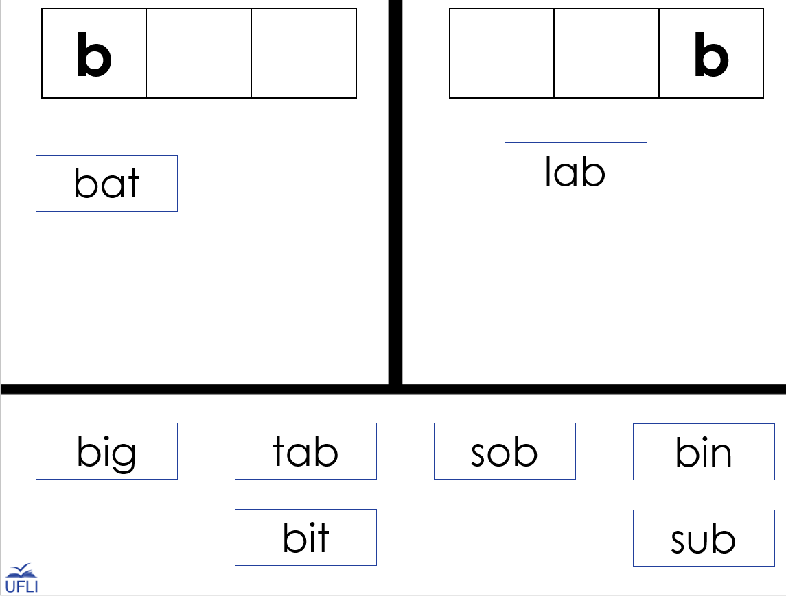
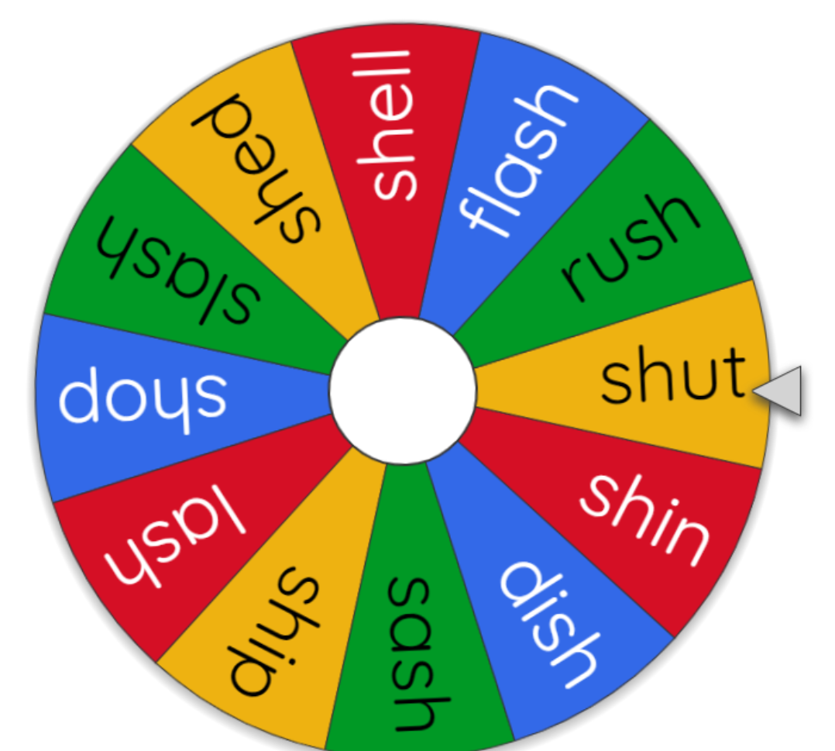
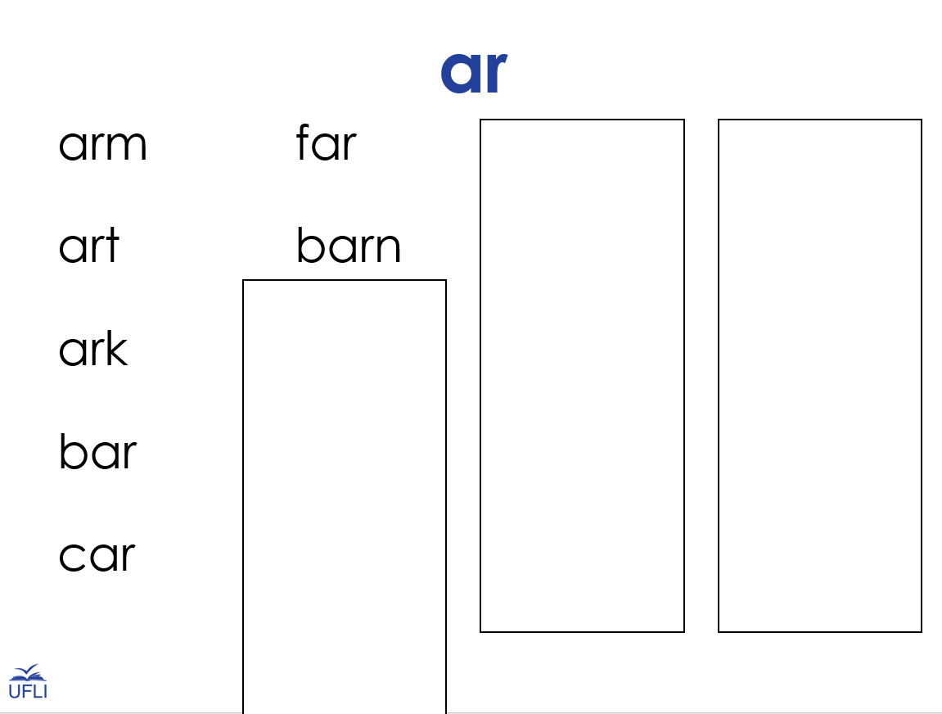
Some examples of practice activities:
Notes:
Word Sort Template: https://education.ufl.edu/ufli/virtual-teaching/main/instructional-activities/decoding-and-encoding/word-work/
Word Cards: https://education.ufl.edu/ufli/virtual-teaching/main/instructional-activities/decoding-and-encoding/word-cards/
Word Lists: https://education.ufl.edu/ufli/virtual-teaching/main/instructional-activities/decoding-and-encoding/word-lists/
Wheel Resource: https://wheelofnames.com/

