Slide 1
Elkonin Boxes
2 Phonemes

Slide 2
Elkonin Boxes
Activity:
Select items for lesson from Guide the student(s) in counting the sounds in the word pictured.
Uncover the boxes to reveal them to the student(s) and determine if they counted correctly.
Move chips into the boxes to represent the sounds in the word.
Share screen with student(s), if they are able to move items independently. Otherwise, the teacher can move the chips.

Slide 3
Notes:
key

Slide 4
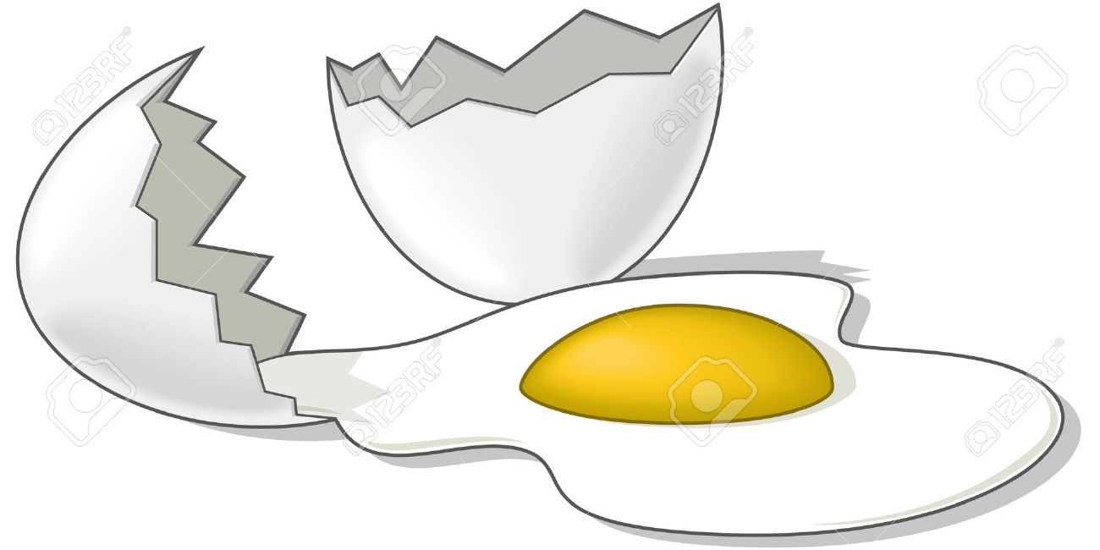
Notes:
egg

Slide 5
Notes:
two

Slide 6
Notes:
tie

Slide 7
Notes:
bee

Slide 8
Notes:
bow

Slide 9
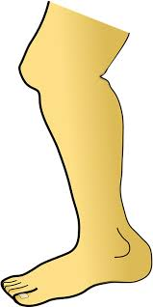
Notes:
knee

Slide 10
Notes:
eat

Slide 11
Notes:
shoe

Slide 12
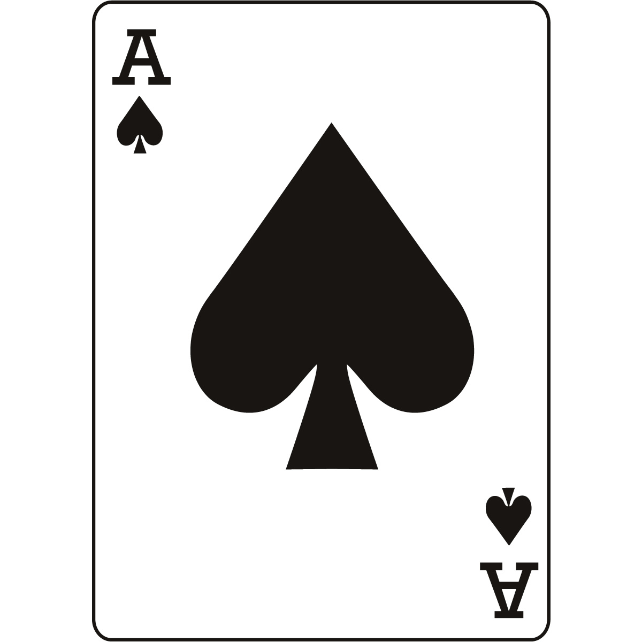
Notes:
ace

