Slide 1
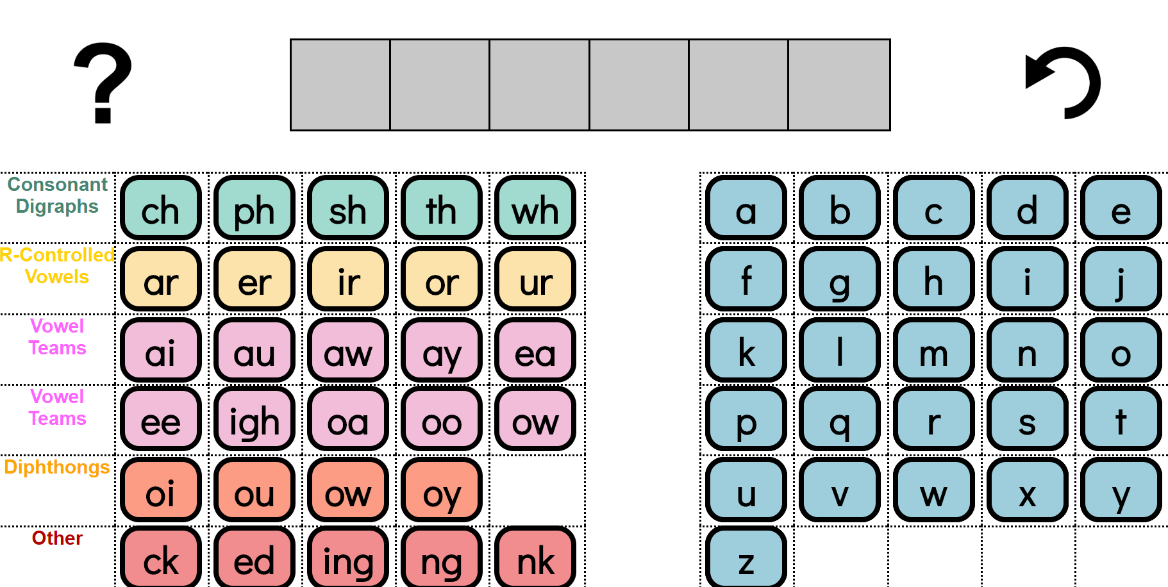
Word Work Mat

Slide 2
Word Work Mat
Activity:
Click the link or scan the QR code to reach the online Word Work Mat option of your choice (Beginner or Intermediate).
The Beginner Word Work Mat includes only the alphabet.
The Intermediate Word Work Mat includes the alphabet and other common graphemes.
Ask students to identify which tiles need to be moved to spell each word provided.
For beginning decoders, you’ll just want to move one letter/grapheme tile at a time, but for more advanced students, you may want to clear all the letters and start with an entirely new word each time.

Slide 3
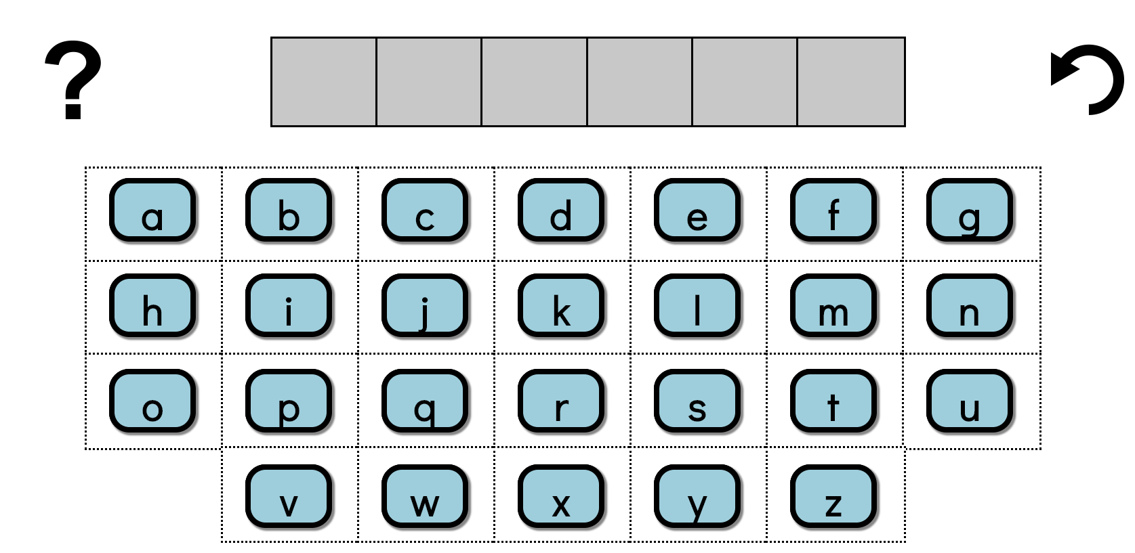
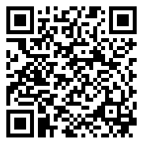
Word Work Mat – Beginner
research.dwi.ufl.edu/op.n/file/cbhd8xmn9i4ctf7i/embed
Word Work Mat – Intermediate
research.dwi.ufl.edu/op.n/file/gc8nkxns914enc7d/embed
Notes:
Beginner Word Work Mat - https://research.dwi.ufl.edu/op.n/file/cbhd8xmn9i4ctf7i/embed
Intermediate Word Work Mat - https://research.dwi.ufl.edu/op.n/file/gc8nkxns914enc7d/embed

Slide 4
Instructions for Tablet Use
Word Work Mat – Beginner
research.dwi.ufl.edu/op.n/file/cbhd8xmn9i4ctf7i/embed
iOS
Open this link from Safari and add it to home screen
by and then
Android
Open this link from Chrome and add it to home screen
from the settings

Slide 5
Instructions for Tablet Use
Word Work Mat – Intermediate
research.dwi.ufl.edu/op.n/file/gc8nkxns914enc7d/embed
iOS
Open this link from Safari and add it to home screen
by and then
Android
Open this link from Chrome and add it to home screen
from the settings

